Slide 1
A message for Parents: "Once a new technology rolls over you, if you're not part of the steamroller, you're part of the road" - Stewart Brand

Slide 2
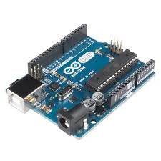
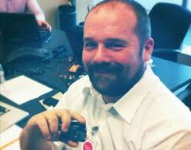
Who invented Arduino
Massimo Banzi made Arduino as a way to teach electronics to artists.

Slide 3
What are we going to learn?
Making circuits with Arduino.
Drawing circuit diagrams using Fritzing.
Uploading sketches using Arduino IDE.

Slide 4
You must have…..
Arduino Budget Pack or equivalent
Laptop
Software (Arduino IDE and Fritzing)

Slide 5
Arduino Budget Pack
Parts are very delicate handle with care
Arduino circuit board
Breadboard
Jumper cables
Resistors, LEDs and sensor packet
USB Cable
LED Packet

Slide 6
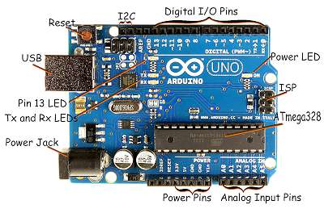
Arduino Circuit Board

Slide 7
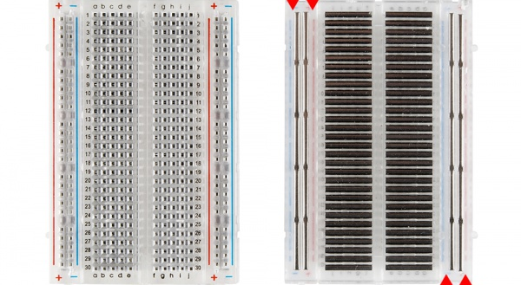
Breadboard Power rails

Slide 8
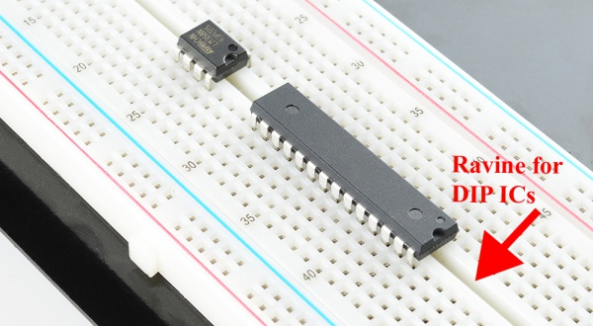
Breadboard Rows, Columns, IC ravine

Slide 9
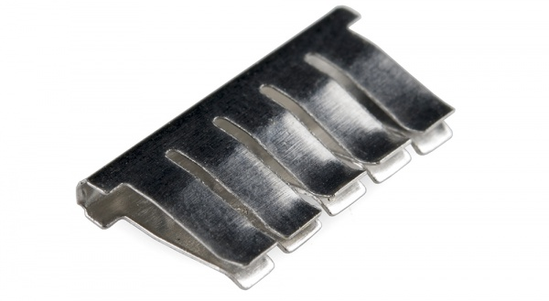
Breadboard clips

Slide 10
Practice 1 (2 minutes)
Take 1 Jumper wire and practice inserting and removing into/from one slot.
Take 1 Resistor and practice inserting and removing into/from one slot.

Slide 11
Resistor
A Resistor resists the flow of electrical current.
Resistance is measured in Ohms.
Analogy: Water flowing through a thin pipe vs large pipe

Slide 12
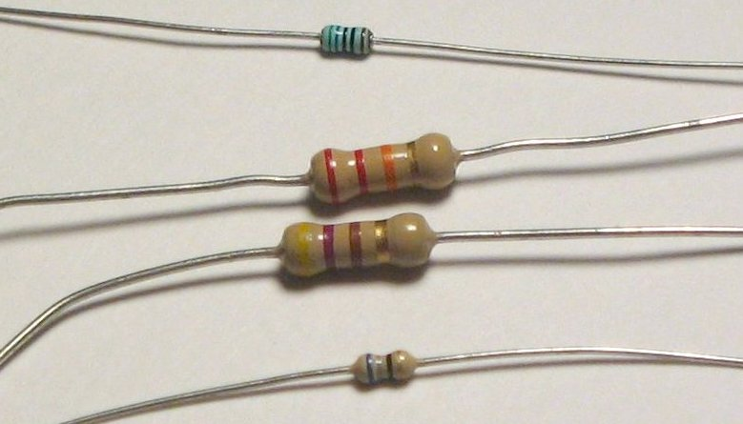
Resistor

Slide 13
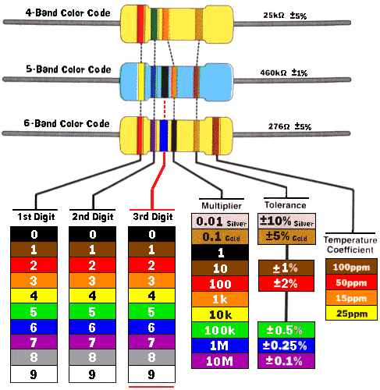
Resistor Color coding

Slide 14
Diode
Allows the flow of electrical current in one direction only.
Anode is +ve the Long leg.
Cathode is –ve the short leg.

Slide 15
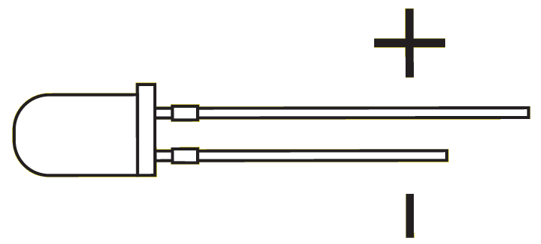
Light Emitting Diode (LED)

Slide 16
Precautions
Disconnect USB cable when making changes to circuit. One wrong connection, you could make the component burn out.
Highly recommended to wear safety goggles.
LEDs could burn out and emit gases.

Slide 17
Project 1 – Check list
Start your laptop
Check to make sure Arduino IDE is installed.
Arduino, Breadboard, 100 Ohms resistor, 1 Red LED, Jumper wires, USB cable.

Slide 18
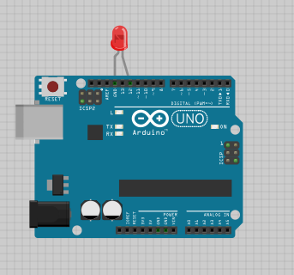
Project 1A Circuit

Slide 19
Project 1 Sketch
int led = 12;
void setup() {
pinMode(led, OUTPUT);
}
void loop() {
digitalWrite(led, HIGH);
delay(1000);
digitalWrite(led, LOW);
delay(1000);
}

Slide 20
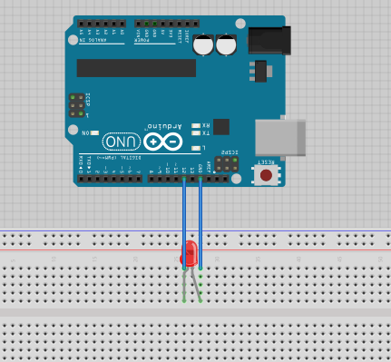
Project 1B Circuit

Slide 21
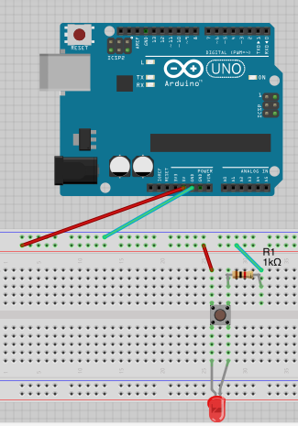
Project 2

Slide 22
Fritzing
Demo Fritzing for Project 2

Slide 23
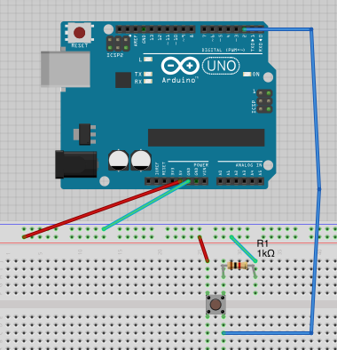
Project 3

Slide 24
Project 3 Sketch
Github link

Slide 25
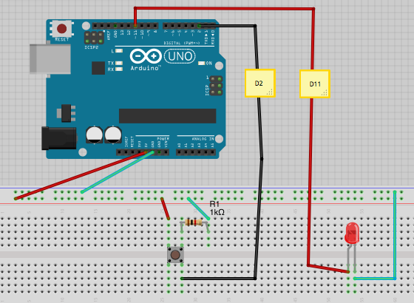
Project 4

Slide 26
Project 4 Sketch
Github link

Slide 27
Project 5
TODO PhotoResistor
http://arduino.cc/en/Tutorial/AnalogInput

Slide 28
Project 6
TODO Potentiometer
http://www.arduinoclassroom.com/index.php/arduino-101/chapter-7

Slide 29
Homework

Slide 30
Resources

