Slide 1



FOOD RECIPE
DAPP
LIKITH ANDAVARAPU
S20210010018
Github Link :
https://github.com/andavarapulikith/FOOD-RECIPE-DAPP
Deployment Link:
https://food-recipe-dapp-qbki.vercel.app/

Slide 2
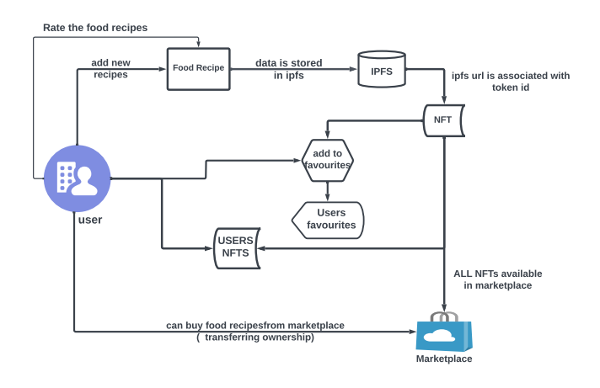





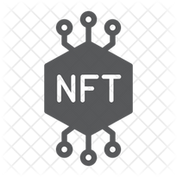


Architecture
Tech stack used

Slide 3
Implemented Features
Features | Implementation | Use case
IPFS | Yes | utilized IPFS through Pinata to store food recipe data, obtain a URL, and associate it with a unique token ID for the NFT.
NFTs | Yes | Submitted food recipes are transformed into NFTs, granting ownership and blockchain-based traceability.
Marketplace | Yes | established a marketplace where users can access and purchase food recipes, facilitating the transfer of NFT ownership upon each transaction.
Rating | Yes | integrated a user rating system for recipes, allowing users to provide feedback and ratings on the culinary creations within the NFT marketplace.
Favourites | Yes | introduced a 'Favorites' feature, enabling users to curate and save their preferred recipes within the NFT platform.

Slide 4

Uniqueness
1. IPFS Integration
Storing recipe data on IPFS for decentralized, secure, and efficient data storage.
2. NFTs for Recipes
Converting recipes into NFTs, ensuring provenance and uniqueness.
3. Marketplace
Providing a platform for users to buy and sell recipe NFTs.
4. User Interaction:
Allowing users to rate, add to favorites, and view their own recipes.
5.Metamask Integration:
Enabling secure and user-friendly transactions through the Metamask wallet

Slide 5
THANK YOU

