Slide 1
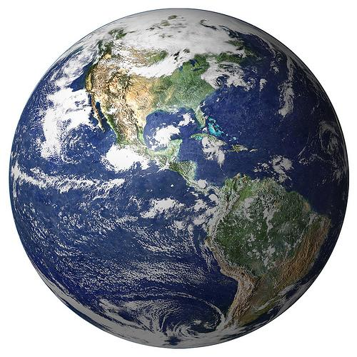
Social Geography:
A study in TDA
Andrew Banman

Slide 2
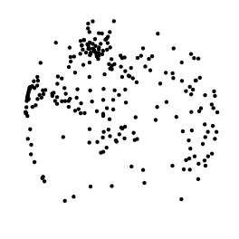

TDA: topological data analysis
Collect data
Build structure
Calculate homology
Interpret results

Slide 3
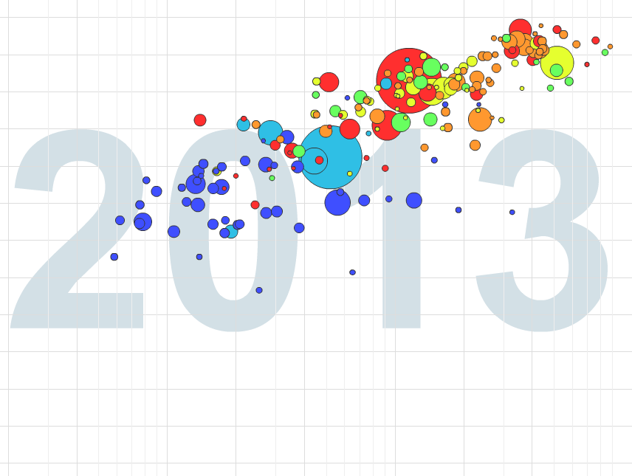
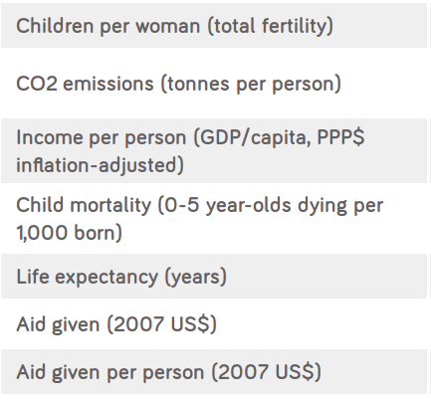
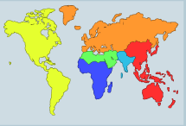
Mind the gap

Slide 4
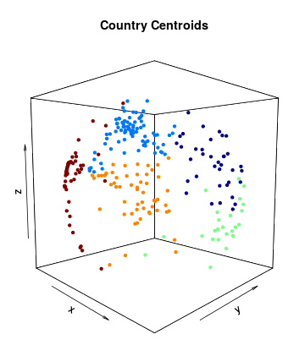
Geography
Point cloud of data
How do we impose structure?

Slide 5
Connecting the dots
Euclidean distance:
as the crow flies
as the mole burrows
allow higher dimensions
proximity parameter ε
ε / 2

Slide 6
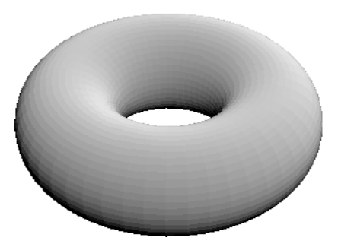
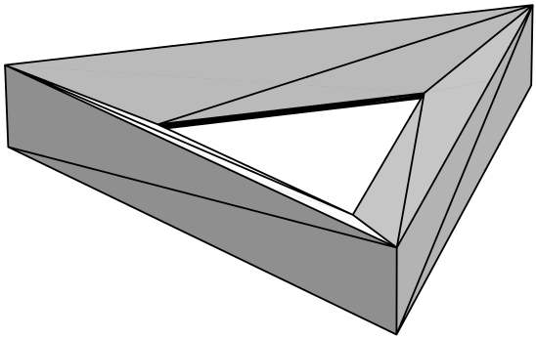
Simplicial Complexes
Oxymoron?
simplices
  k=0 k=1 k=2 k=3 ...
simplicial complex:
if σ < Σ, and τ < σ, then τ < Σ
=

Slide 7
Persistent Homology
What is the right choice for ε ?
Barcodes

Slide 8
Torus example

Slide 10
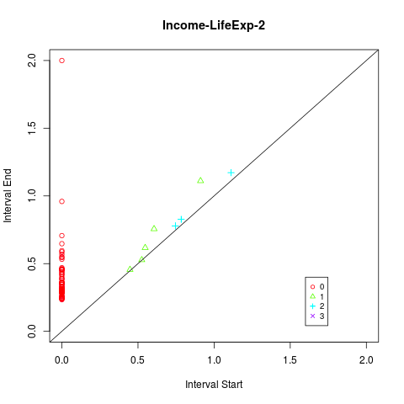
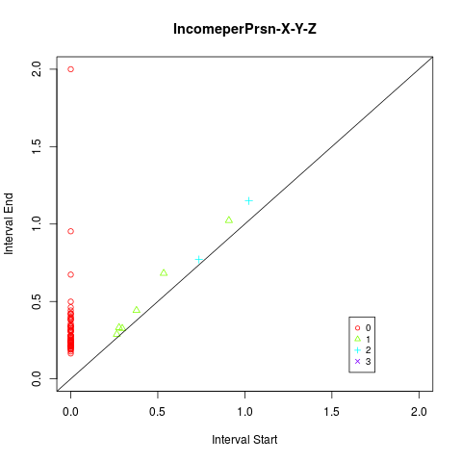
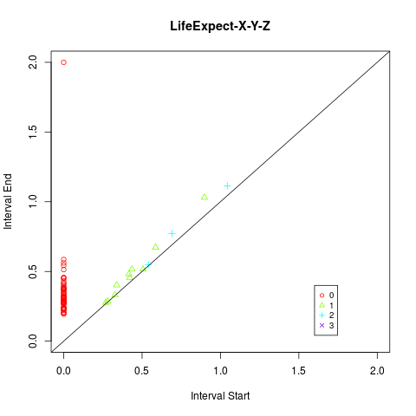
Adding social dimensions
Income per person “pulls” the countries into two distinct
geographic groups. Life expectancy is not strong enough to pull them back together.

Slide 11
What is topology?
“...a topologist is someone who cannot tell the
difference between a tea cup and a doughnut.” -Crossley
Notions of equivalence
  ex) x = y , = , =
Study of continuous functions.
  ex) continuous integer-valued function on the real line must be constant. What matters is the topology of R and Z.

Slide 12
Outline
Gapminder does geography matter? Looks like it.
Want to impose structure on data → analyze that structure instead (look for holes)
Start w country centroids. To impose structure we are tempted to start connecting the dots, but how? By proximity
Enter the simplicial complex → build up our math structure out of simple parts (simplicies)
How do we analyze? We look for holes (of n-dimension), these holes tell us different things about the data → connected components, cycles, etc. (hard part)
Calculate homology of simplicial complex. But which simplicial complex? Enter persistent homology.
Look for holes that persist over a “significant” parameter range.

Slide 13
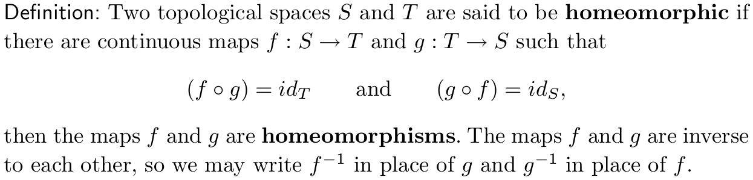
Homeomorphisms
TODO: Add coffee donut animation!!!

Slide 14
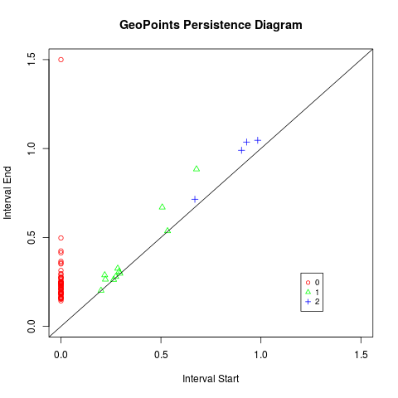
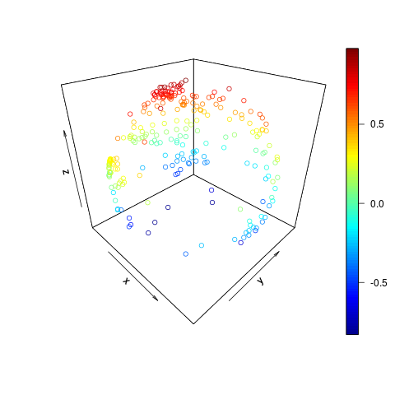
Geography
Country
Centroids
TODO: make graph of geopoints colored by continent
scatter3D() {plot3D}
pHom() {phom}

Slide 15
Limitations
Coordinate space not theoretically justified
Statistical significance (examine difference in means)
Slow as Canadian molasses
Ask a sociologist

Slide 16
Acknowledgment & References
Gapminder
http://www.statmethods.net/advstats/cluster.html (clustering)
http://earthobservatory.nasa.gov/IOTD/view.php?id=885 (Earth Image)
Wikipedia
WolframMathWorld
Ghrist
Carlson
Topology textbook (Crossley)
Thank you...
Lori Zeigelmeir & topology class
MSCS
y'all

Slide 17
Homotopy
Two functions (loops or paths) are homotopic if there is a continuous deformation from one to the other.
The homotopy is the function that ''does the deforming.''
Group functions into homotopy equivalence classes → can count the number of “holes.”

Slide 18
Understanding B₀ with clustering
(cluster slides to be replaced w/ improved bettir 0 anlysis)
Can we use persistent homology as a clustering algorithm?
Slow
Sensitive to outliers
Bridges collapse clusters
Preprocessing algorithms required
In the meantime we’ll use k-mean.

Slide 19
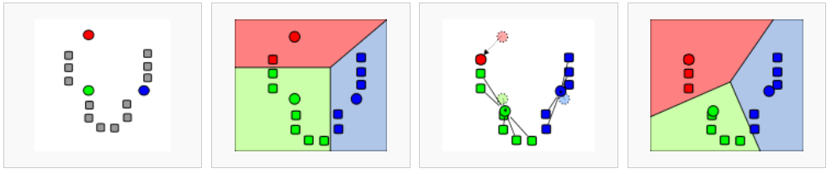
A k-means to an end
Initialize cluster centers.
Generate Voronoi Diagram for each center.
Let the centroid of each region be the new center.
Requires choice of k
Fast
Global solution NP-hard
Heuristic Algorithm
Voronoi Diagram The partitioning of a plane with points into convex polygons such that each polygon contains exactly one generating point and every point in a given polygon is closer to its generating point than to any other -WolframMathWolrd

Slide 20
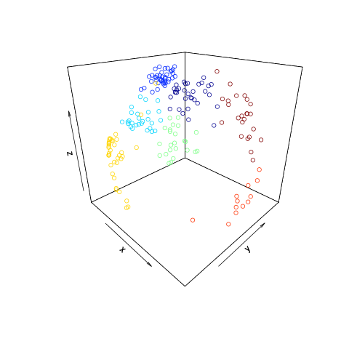
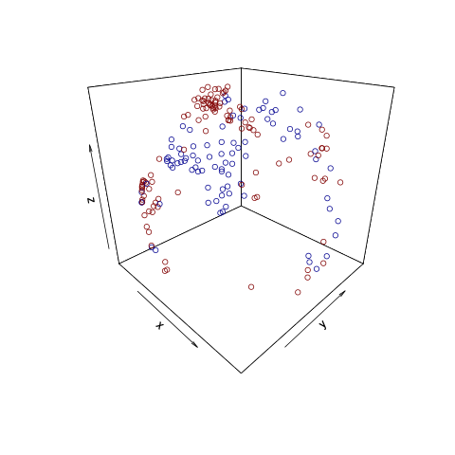
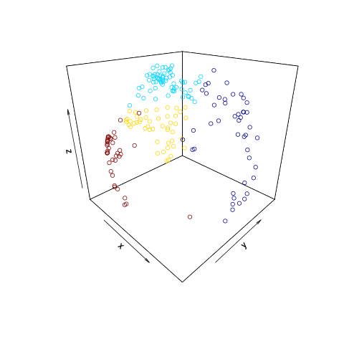
Geographic and social clusters
+
=
k = 7
Clusters based on geographic
data only.
k = 2
Clusters based on Income per person and Life Expectancy
k = 4
Combined Geographic,
Life expectancy, Income
0.45, -0.74 Europe/Eurasia
0.60. -0.58 Asia/South Pacific
-0.38, -0.94 Africa
0.53, -0.78 Americas
pamk() {fpc package}

