Slide 1
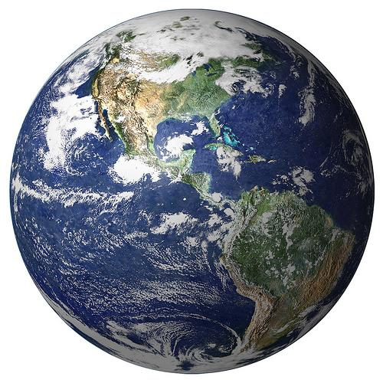
Working Title
Andrew Banman

Slide 2
Outline

Slide 3
What is topology?
“...a topologist is someone who cannot tell the
difference between a tea cup and a doughnut.” -Crossley
Notions of equivalence
ex) x = y , = , =
Study of continuous functions.
ex) continuous integer-valued function on the real line must be constant. What matters is the topology of R and Z.

Slide 4
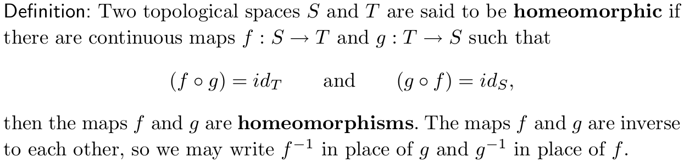
Homeomorphisms
TODO: Add coffee donut animation!!!

Slide 5
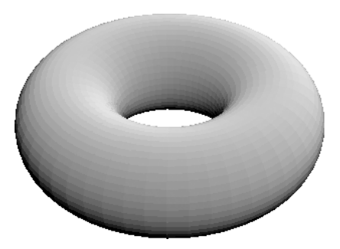
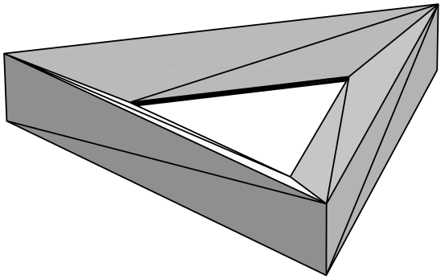
Simplicial Complexes
Simplex
k=0 k=1 k=2 k=3
Simplicial complex
Formal def: if sigma < Sigma, and tau < sigma, then tau < Sigma

Slide 6
Point Clouds: enter the data
Persistent homology
Sample the torus
Show the barcodes / persistence diagram

Slide 7
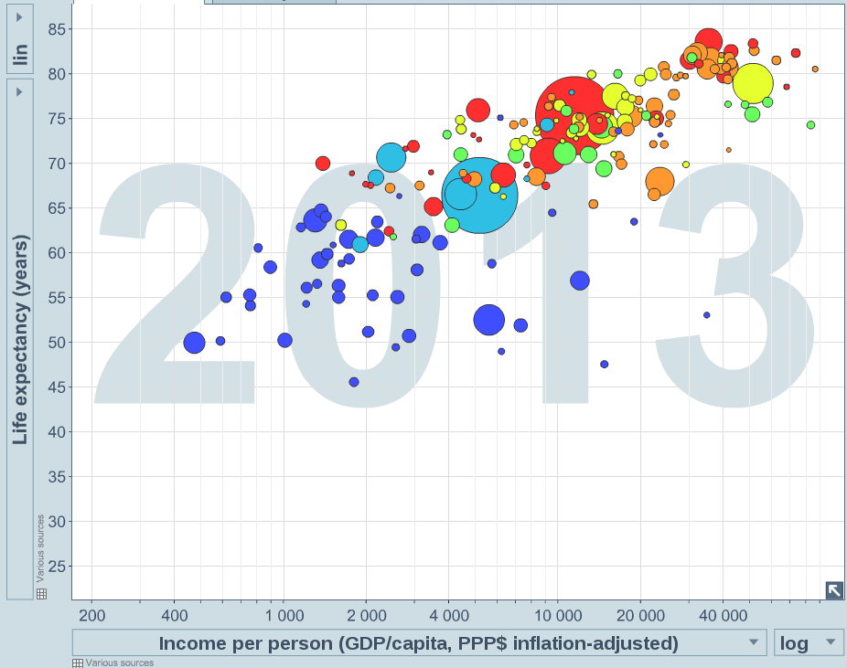
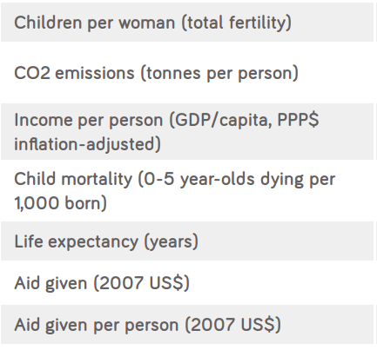
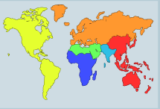
Mind the gap
Indicators

Slide 8
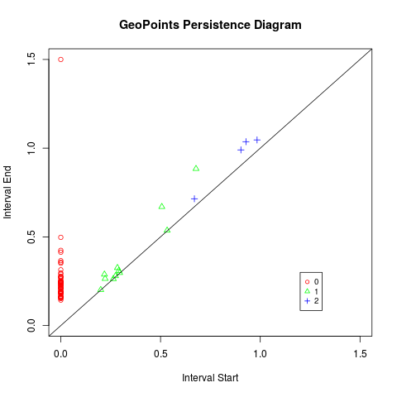
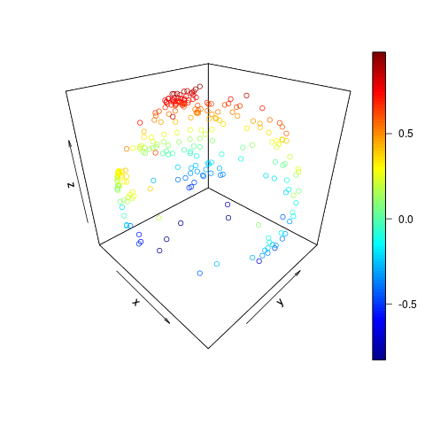
Geography
Country
Centroids
TODO: make graph of geopoints colored by continent
scatter3D() {plot3D}
pHom() {phom}

Slide 9
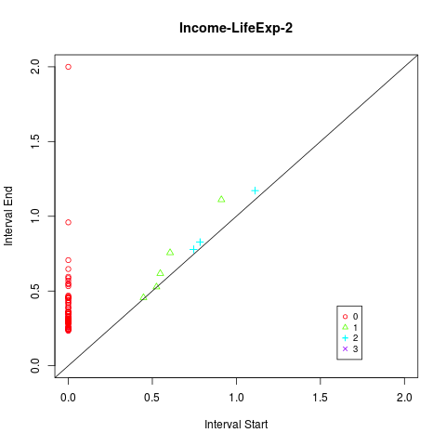
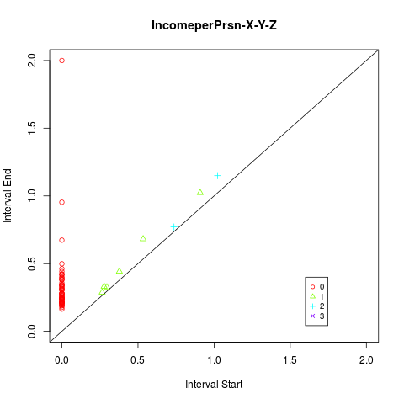
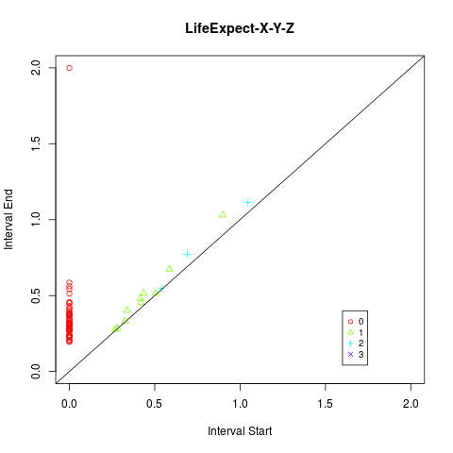
Adding social dimensions
Income per person “pulls” the countries into two distinct
geographic groups. Life expectancy is not strong enough to pull them back together.

Slide 10
Limitations
Coordinate space not theoretically justified
Statistical significance (examine difference in means)
Slow as Canadian molasses
Ask a sociologist

Slide 11
Acknowledgment & References
Gapminder
http://www.statmethods.net/advstats/cluster.html (clustering)
http://earthobservatory.nasa.gov/IOTD/view.php?id=885 (Earth Image)
Wikipedia
WolframMathWorld
Ghrist
Carlson
Topology textbook (Crossley)
Thank you...
Lori Zeigelmeir & topology class
MSCS
y'all

Slide 12
Homotopy
Two functions (loops or paths) are homotopic if there is a continuous deformation from one to the other.
The homotopy is the function that ''does the deforming.''
Group functions into homotopy equivalence classes → can count the number of “holes.”

Slide 13
Understanding B₀ with clustering (cluster slides to be replaced w/ improved bettir 0 anlysis)
Can we use persistent homology as a clustering algorithm?
Slow
Sensitive to outliers
Bridges collapse clusters
Preprocessing algorithms required
In the meantime we’ll use k-mean.

Slide 14
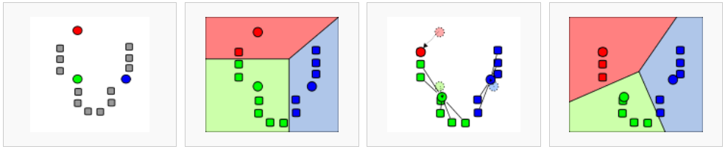
A k-means to an end
Initialize cluster centers.
Generate Voronoi Diagram for each center.
Let the centroid of each region be the new center.
Requires choice of k
Fast
Global solution NP-hard
Heuristic Algorithm
Voronoi Diagram The partitioning of a plane with points into convex polygons such that each polygon contains exactly one generating point and every point in a given polygon is closer to its generating point than to any other -WolframMathWolrd

Slide 15
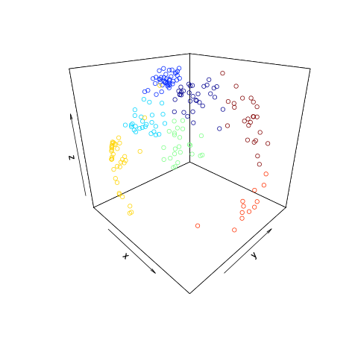
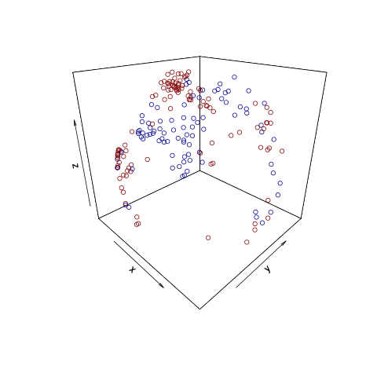
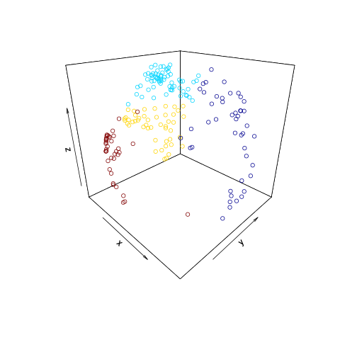
Geographic and social clusters
+
=
k = 7
Clusters based on geographic
data only.
k = 2
Clusters based on Income per person and Life Expectancy
k = 4
Combined Geographic,
Life expectancy, Income
0.45, -0.74 Europe/Eurasia
0.60. -0.58 Asia/South Pacific
-0.38, -0.94 Africa
0.53, -0.78 Americas
pamk() {fpc package}

