Slide 1

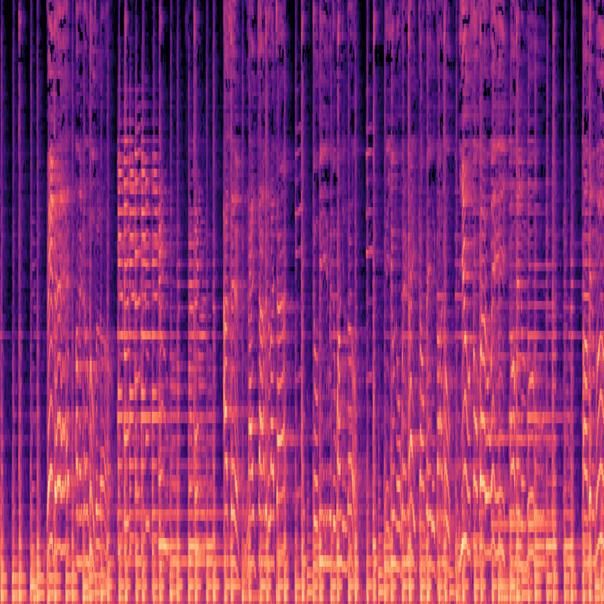

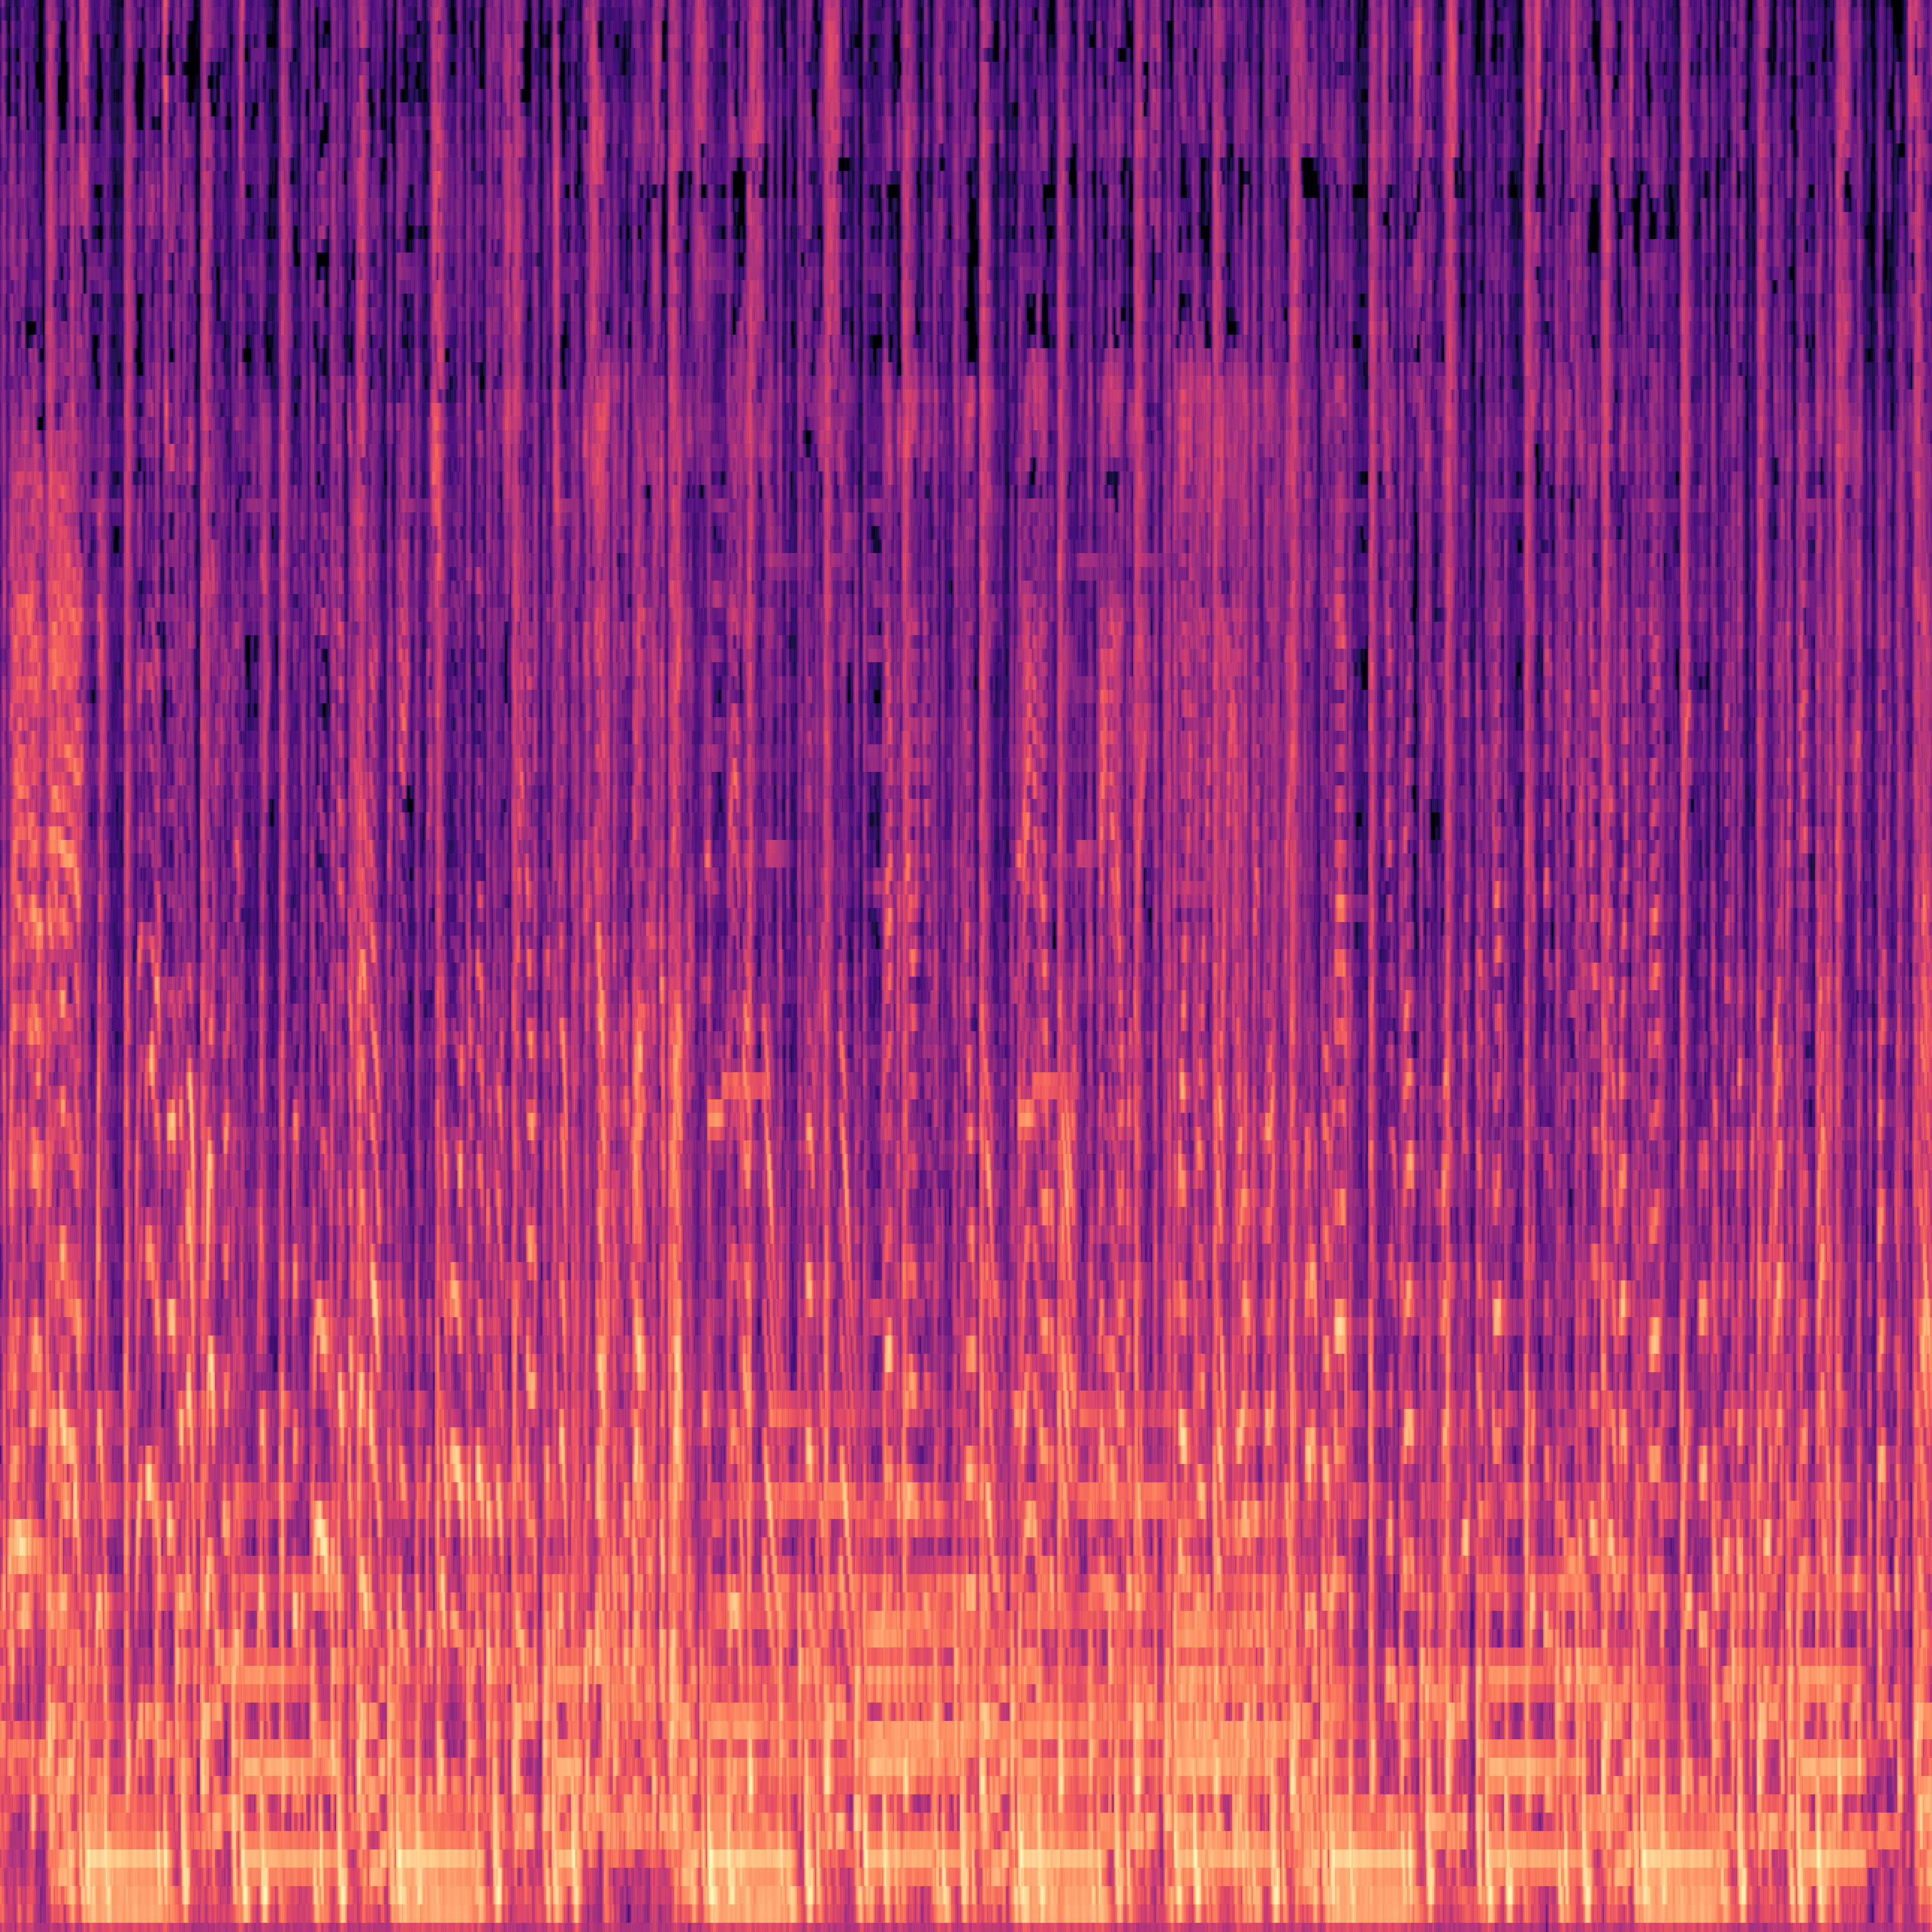

1000 MP3 Files
1000 PNG Files
10 music genres
100 tracks by genre
30 sec audio by track
1000 images
4000 x 4000 pixels e each
blues01.mp3
rock12.mp3
Spectrogram Extraction
blues01.png
hiphop02.mp3
rock13.mp3
hiphop02.png
rock15.mp3
blues01.mp3

Slide 2


1000 MP3 Files
Single .CSV Dataset
10 music genres
100 tracks by genre
30 sec audio by track
Zero crossing rate
Spectral centroid
Spectral bandwidth
Spectral rolloff
1000 rows
28 columns
Music Genre as label
blues01.mp3
rock12.mp3
Feature Extraction
hiphop02.mp3
rock13.mp3
Mel-Frequency Cepstral Coefficients
Chroma frequencies
RMSE (Root Mean Square Energy)
Etc…
rock15.mp3
blues01.mp3

Slide 3
1000 MP3 Files
Single .CSV Dataset
10 music genres
100 tracks by genre
30 sec audio by track
Zero crossing rate
Spectral centroid
Spectral bandwidth
Spectral rolloff
1000 rows
64 columns
Music Genre as label
blues01.mp3
rock12.mp3
Feature Extraction
hiphop02.mp3
rock13.mp3
Mel-Frequency Cepstral Coefficients
Chroma frequencies
RMSE (Root Mean Square Energy)
Etc…
rock15.mp3
blues01.mp3

Slide 4
Output
Input
metal
jazz
disco
Feature Extraction
Machine Learning Classifier
reggae
pop
classical
Top predicted class
blues
“ Lacrimosa by Mozart “
hiphop
rock
blues

