Slide 1

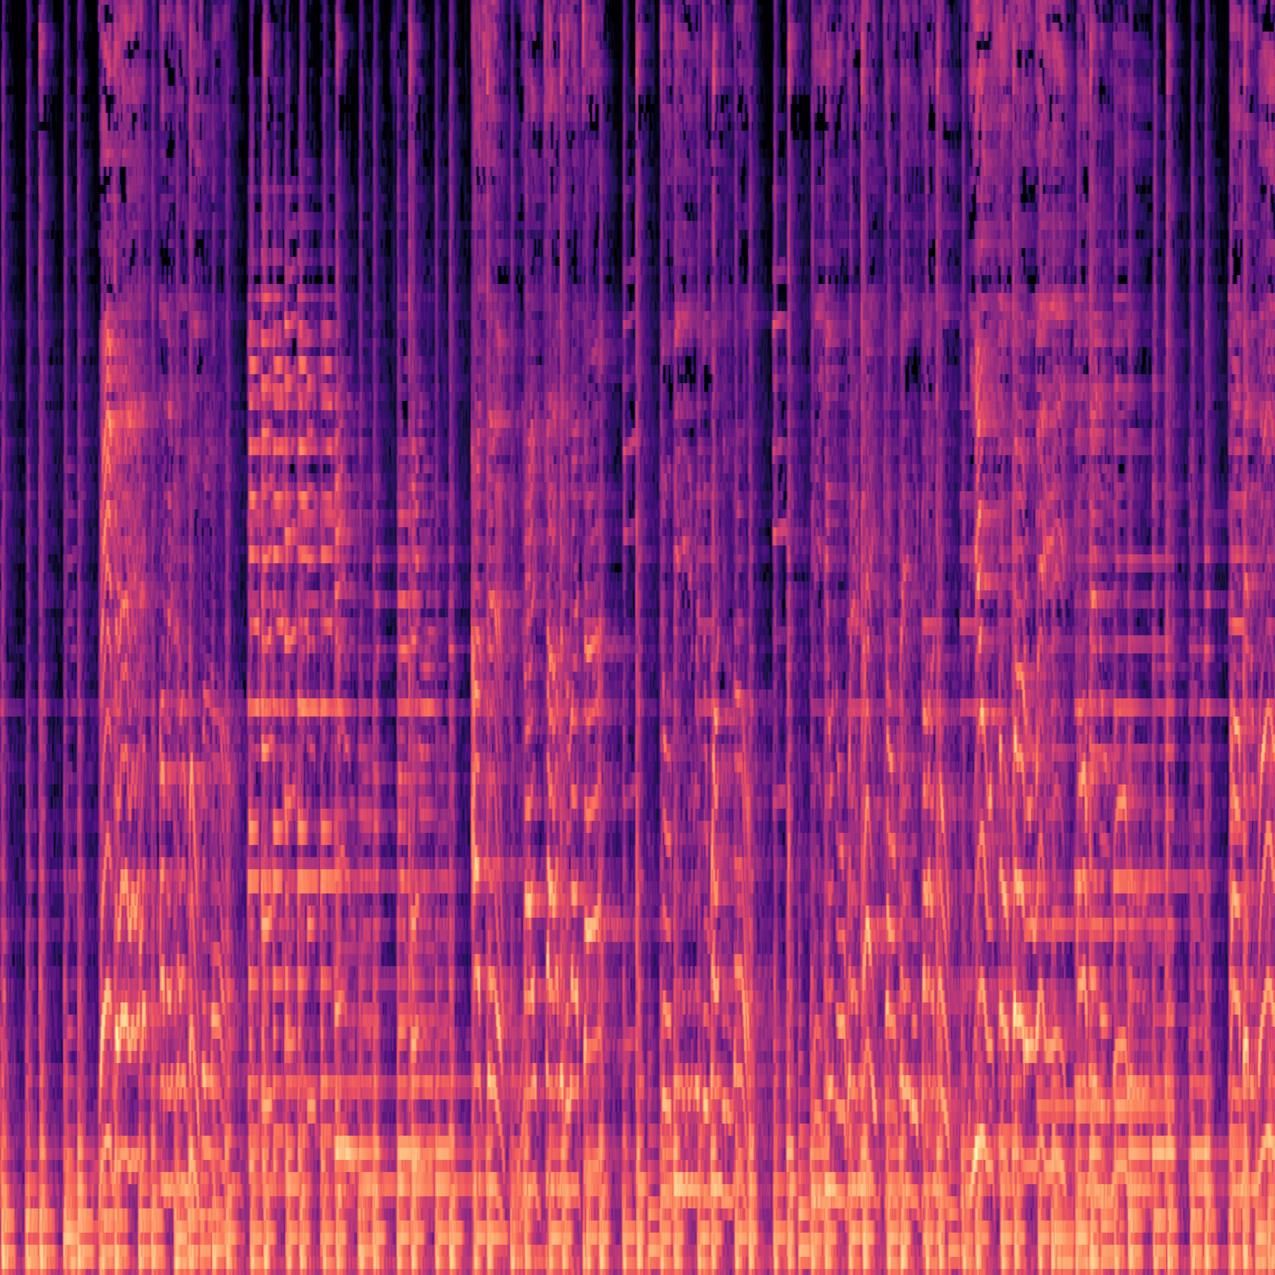

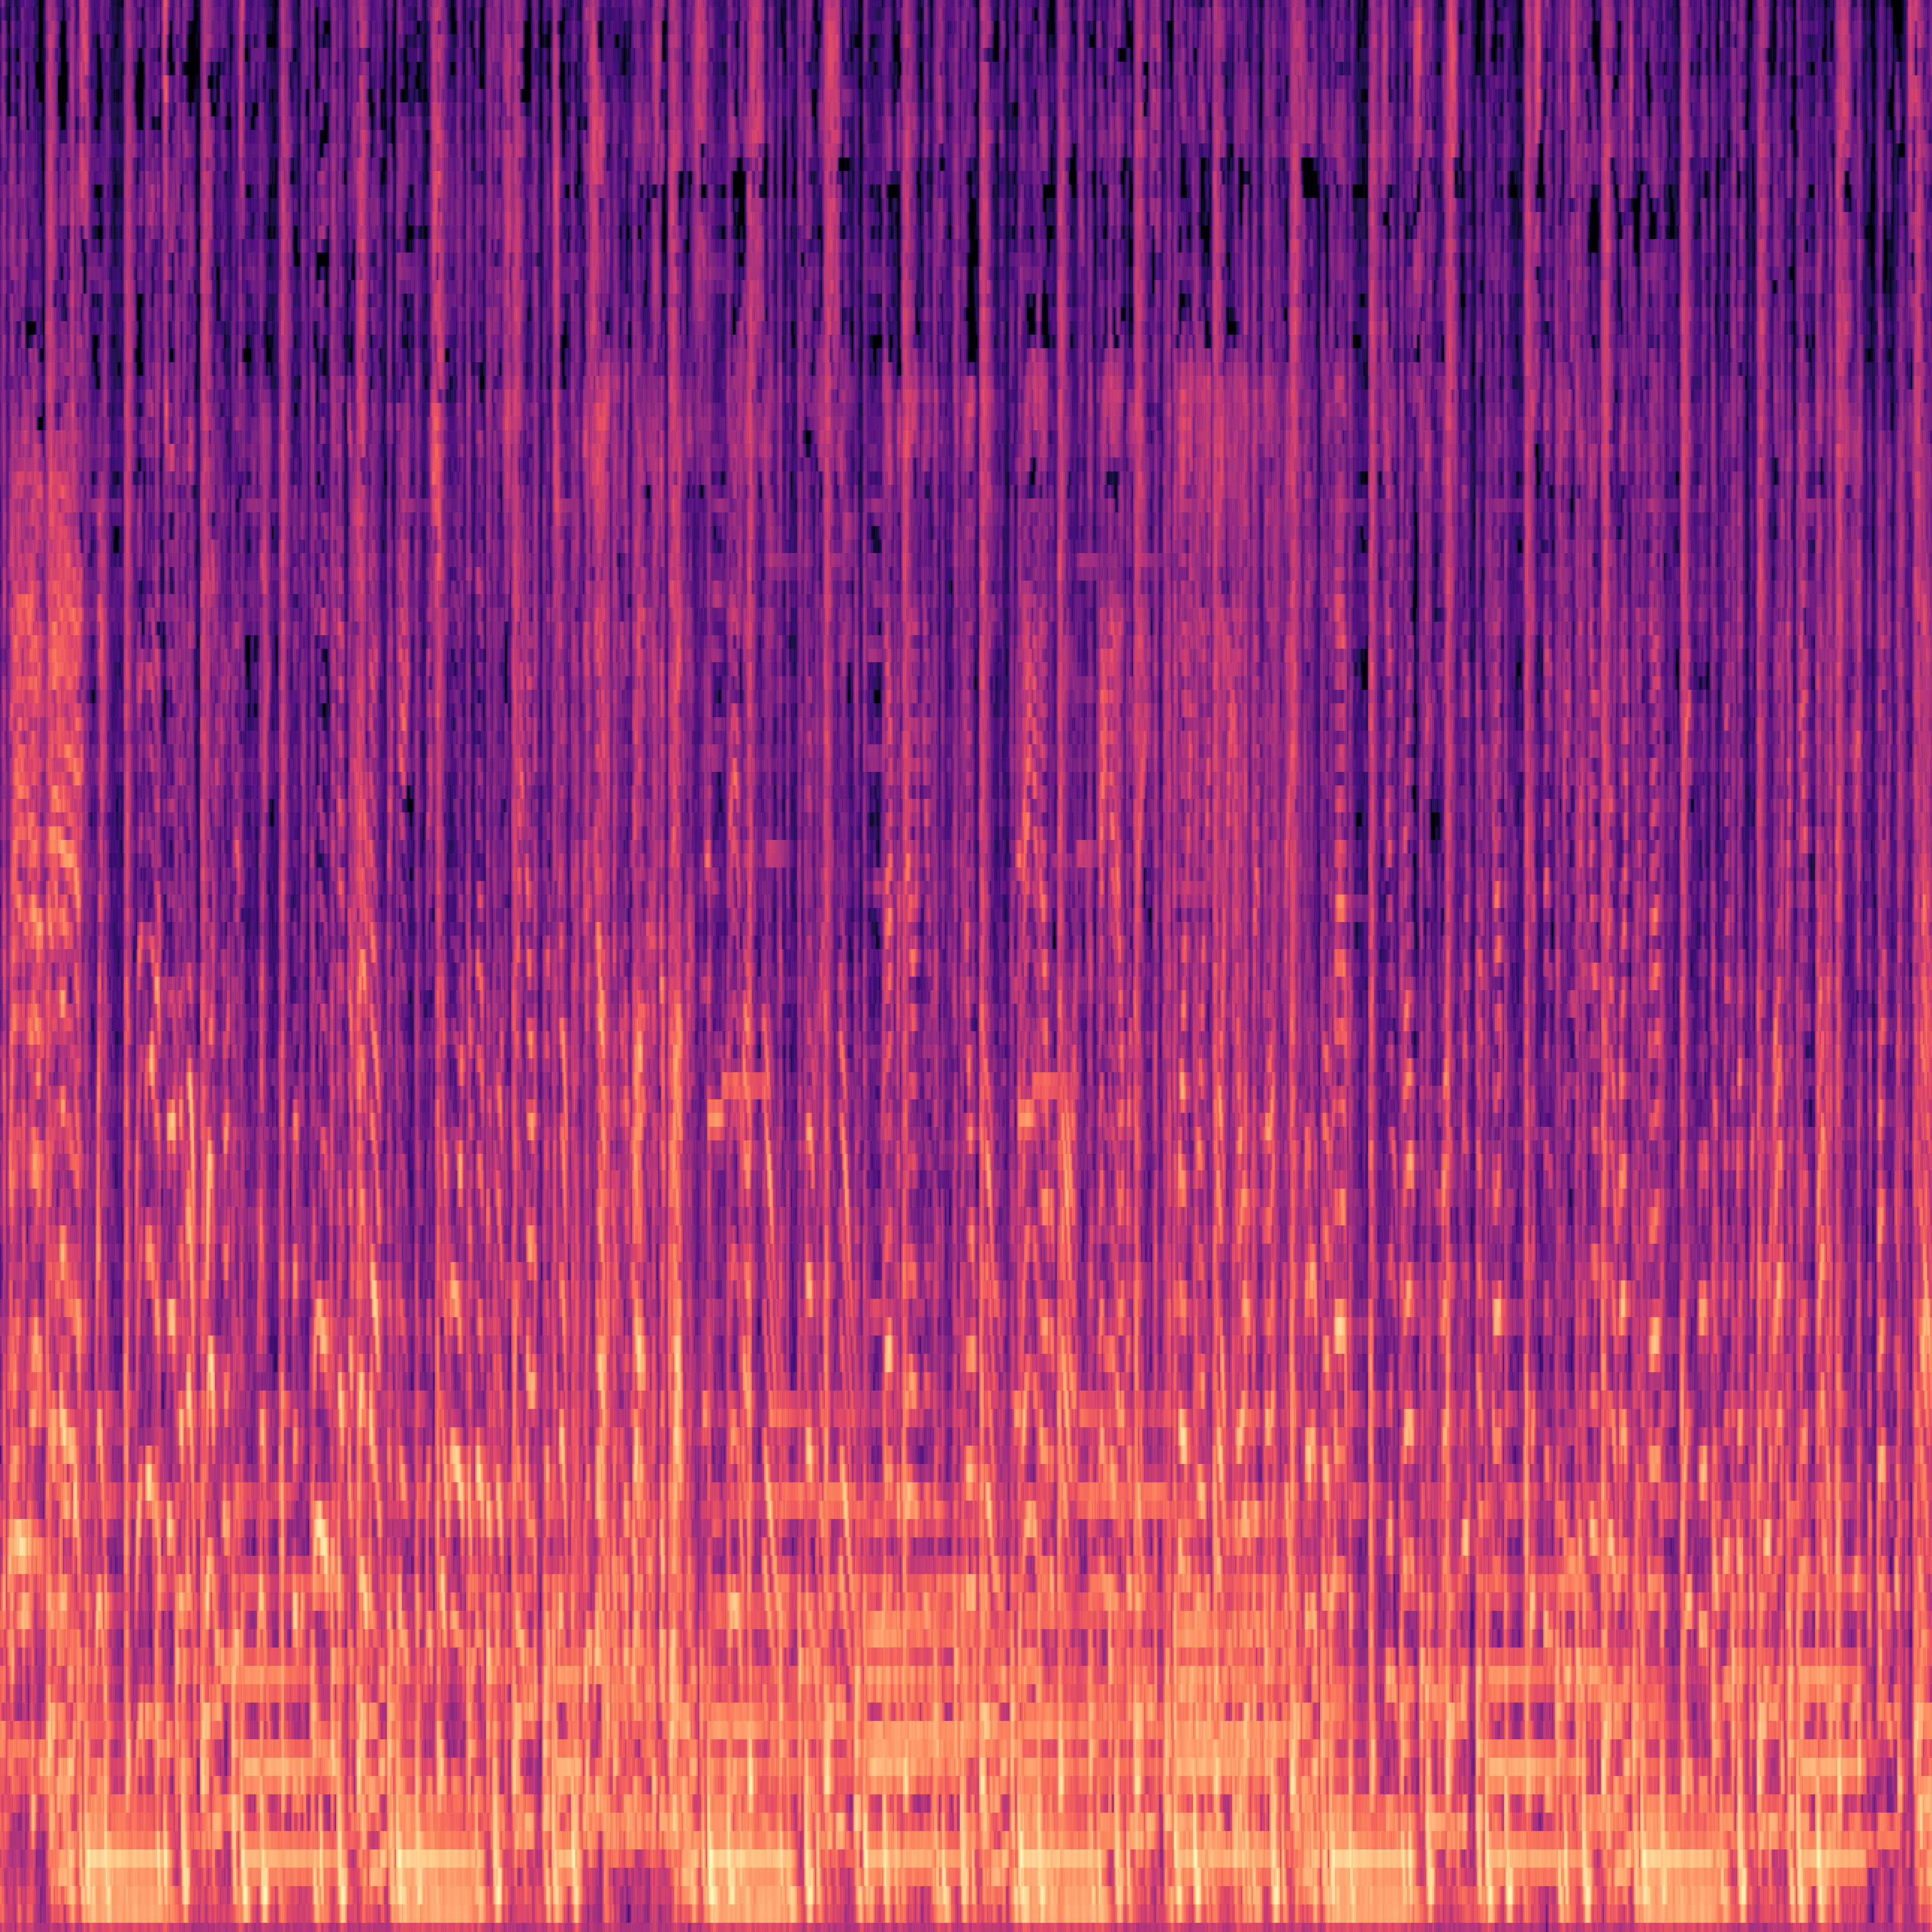

1000 MP3 Files
1000 PNG Files
10 music genres
100 tracks by genre
30 sec audio by track
1000 images
4000 x 4000 pixels e each
blues01.mp3
rock12.mp3
Spectrogram Extraction
blues01.png
hiphop02.mp3
rock13.mp3
hiphop02.png
rock15.mp3
blues01.mp3

