Slide 1
Regulatory Options & Efficiency
What are the implications of alternative regulatory options?

Slide 2
Problem
EPA has regulations to control biological oxygen demand (BOD). EPA would like your advice on how to improve water quality (lower BOD) without increasing costs.
What is your advice?

Slide 3
Today’s talk
Notion of efficiency
What it is and why do we want it?

Slide 4
Why regulate?
Does free market efficiently provide goods and services?
Market failure (externalities, public goods, etc.)
Market power (monopolies inefficiently restrict production to raise prices)
Information problems (damages uncertain, food safety, env quality)

Slide 5
Types of questions in regulation
What is the “optimal” amount of pollution?
To reduce by X%, who should reduce and by how much?
What regulatory instrument(s) should be used to achieve that level?

Slide 6
Back to the question from the EPA BOD Removal Costs, US Regulations
Industry | Subcategory | Marginal Cost
Poultry | Duck-small plants | $3.15
Meat Packing | Simple Slaughterhouse | $2.19
Cane Sugar | Crystalline Refining | $1.40
Leather tanning | Hair previously removed | $1.40
Paper | Unbleached Kraft | $0.86
Poultry | Chicken – small plants | $0.25
Raw Sugar Processing | Louisiana | $0.21
Paper | NSSC – Sodium Process | $0.12
Poultry | Chicken—large plants | $0.10
Source: Magat et al (1986); units: dollars per kilogram BOD removed

Slide 7
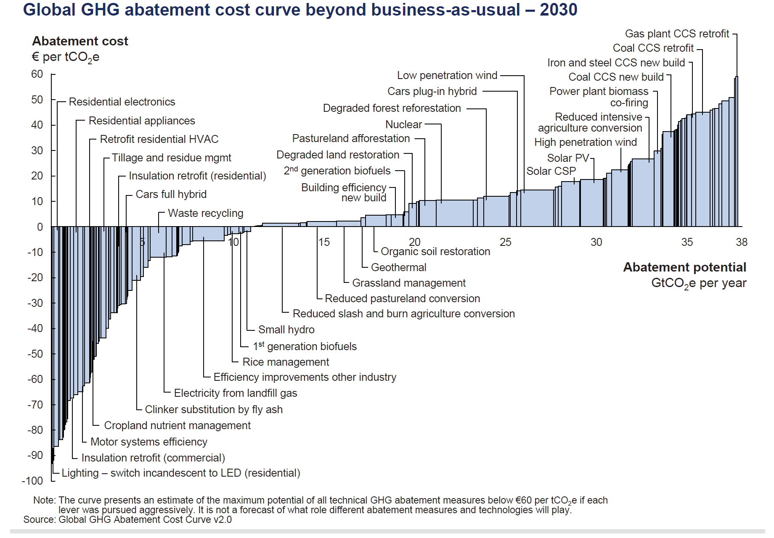
MC of carbon abatement

Slide 8
Principle of efficiency
Most common approach: uniform burden (eg, everyone cuts pollution by x%)
Two possible results
Too much pollution for the total amount of pollution control costs
Too much cost for a fixed level of pollution reduction
Burden of pollution control should fall most heavily on firms with low costs of pollution control

Slide 9
More Generally: The “efficient” amount of pollution
Marginal
Control
Cost
$/unit
Marginal
Damage
Cost
Total
Damage
Cost
Total Control
Cost
Q*
Units of pollution

Slide 10
Modified Example from first week
60 firms, each pollute 10 tons
30 low abatement cost
30 high abatement cost
Total pollution: 600 tons
Need to cut pollution levels in half
Options
1. Cut each firm by 50%
2. Something more efficient?

Slide 11
With mixed high and low cost firms abating, we could
Either:
Reduce more pollution for the same amount of money…or
Reduce the same amount of pollution for less money.
So we always want low-cost firm to shoulder abatement.

Slide 12
If costs aren’t constant: two firms (eg, NOx emissions)
Abatement
Cost
($/unit)
Who should abate
the 1st unit of NOx?
MC_{A}
MC_{B}
NOx Reduction

Slide 13
How much abatement from each (60 total)?
$ (A)
MC_{A}
First draw Marginal Cost for A
A:
0
60

Slide 14
How much abatement from each (60 total)?
Next, add MC for B,
flipping it from total of 60
$ (A)
MC_{A}
$ (B)
MC_{B}
A:
0
20
30
60
B:
60
40
30
0

Slide 15
How much abatement from each (60 total)?
$ (A)
Any point involves a
total of 60 tons reduced
MC_{A}
$ (B)
MC_{B}
A:
0
20
30
60
B:
60
40
30
0

Slide 16
How much abatement from each (60 total)?
$ (A)
Loss from equal
reduction
MC_{A}
$ (B)
MC_{B}
A:
0
20
30
60
B:
60
40
30
0

Slide 17
How did he do that?
Determine how much total abatement you want (e.g. 60)
Draw axis from 0 to 60 (A), 60 to 0 (B)
Sum of abatements always equals 60.
Draw MC_{A} as usual, flip MC_{B}
Lines cross at equilibrium
Price is MC for A and for B.

Slide 18
Generalize to N “firms”
Sum horizontally
Obtain aggregate marginal cost
Total abatement on x-axis
For any amount of total abatement, what is cheapest way to achieve it?
Which firms will abate?

Slide 19
The “equimarginal principle”
Not an accident that the marginal abatement costs are equal at the most efficient point.
Equimarginal Principle: Efficiency for a homogeneous pollutant requires equating the marginal costs of control across all sources.
Technical exceptions:
sources that are so costly that they cannot control at all
Sources that are so cheap they emit nothing

Slide 20
Control costs
Should include all other costs of control
monitoring & enforcement
administrative
Equipment
Regulatory uncertainty increases costs.
If you are a polluter, what would be your response to uncertainty in what you have to do?
Does this increase your costs?
Would like to design regulations that provide an incentive to innovate

Slide 21
Weitzman on carbon taxes
“One can only wish that US political leaders might have the insight to understand and the courage to act upon the breathtakingly-simple market-friendly idea that the right carbon tax could do way more to unleash the power of decentralized American inventive genius on the problem of developing economically-feasible non-carbon-intensive alternative technologies than all of the command-and-control schemes and patchwork subsidies making the rounds in Washington these days.”
Why do we continue to see inefficient regulations?

Slide 22
Common Instruments for regulation
Command and Control/Prescriptive Regulations: Centralized determination of which firms reduce by how much.
Taxes: charge $X per unit emitted. This increases the cost of production. Forces firms to internalize externality.
Quotas/standards: uniform standard (all firms can emit Y) or non-uniform.
Tradable permits: All firms get Y permits to pollute, can buy & sell on market. Other initial dist’n mechanisms.

Slide 23
A creative quota: bubble policy
Multiple emissions sources in different locations.
Contained in an imaginary “bubble”.
Regulation only governs amount that leaves the bubble.
May apply to emissions points within same plant or emissions points in plants owned by other firms.

Slide 24
Relationship between a tax and a marketable permit
We know:
Marginal damage from pollution
Marginal cost of pollution control
Thus we can calculate
Optimal level of pollution is Q*
Marginal Social Cost at the optimum is P*

Slide 25
Basic Setup
$/unit
MD
P*
-MC_{Control}
Q*
Pollution

Slide 26
What if we issue Q* Marketable Permits?
$/unit
MD
P*
-MC_{Control}
Q*
Pollution

Slide 27
What if we issue make everyone pay P*?
$/unit
MD
P*
-MC_{Control}
Q*
Pollution

Slide 28
What is the difference between permits and prices?
$/unit
MD
P*
-MC_{Control}
Q*
Pollution

