Slide 1
New Directions Seminar- I

Slide 2
Backprojection
Requesting BHZ data from IRIS for German Regional Seismic Network (GR)
Epicentral Distance: 60° – 90°
Azimuth Range: -15° - 35°

Slide 3
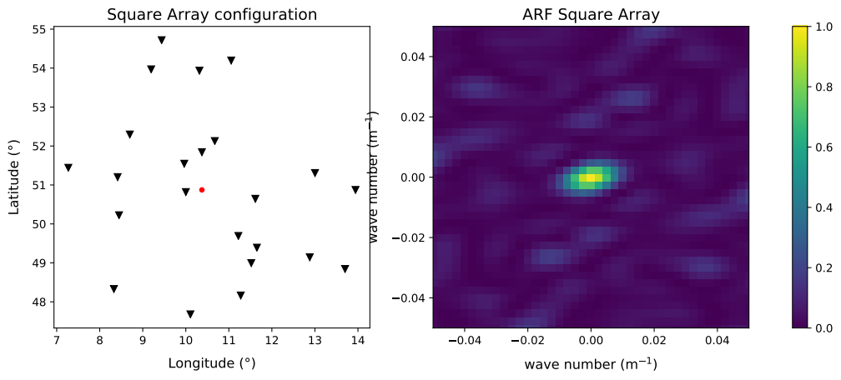
Array and Response

Slide 4
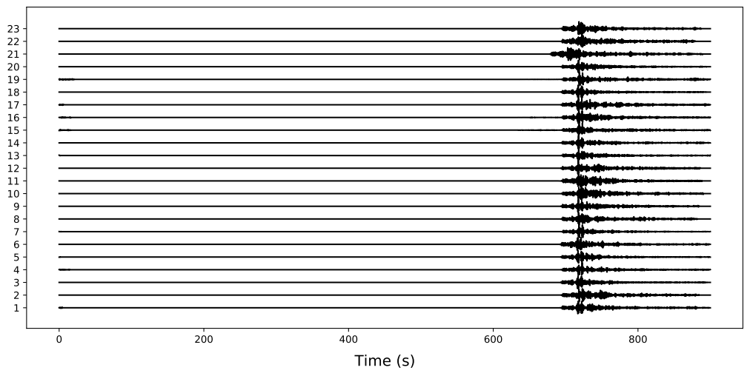
Traces (23) [0.5 – 5.0 Hz]

Slide 5
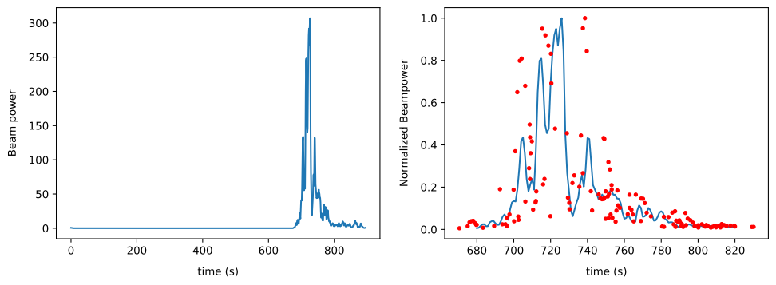
Beam Power

Slide 6
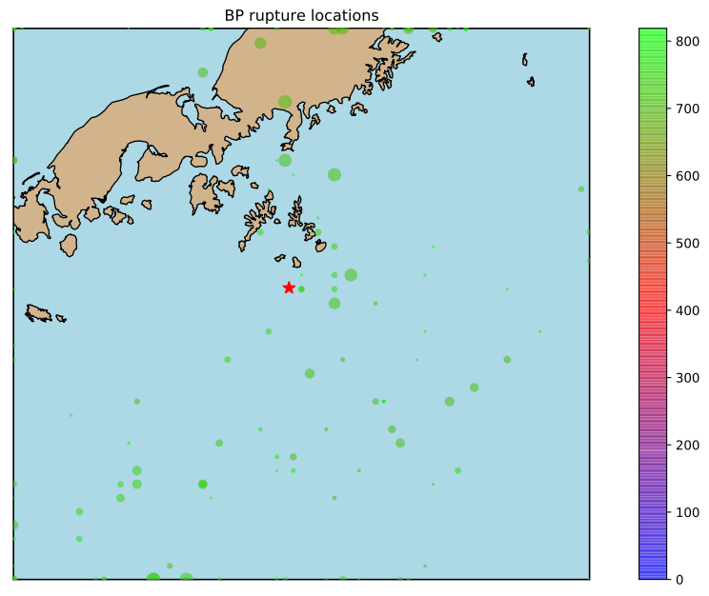
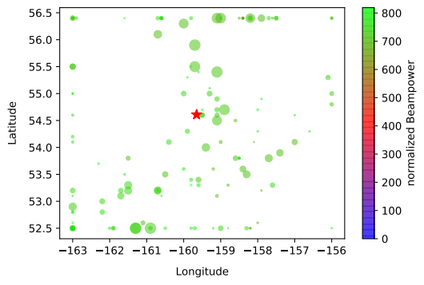
Rupture Locations

Slide 7
Backprojection
Requesting BHZ data from IRIS for European Stations
Epicentral Distance: 60° – 90°
Azimuth Range: -15° - 35°

Slide 8
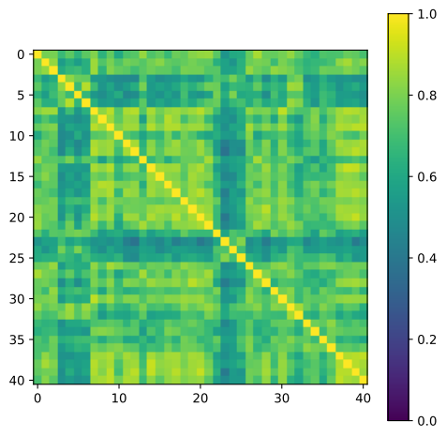
CrossCorrelation
41 stations

