Slide 1
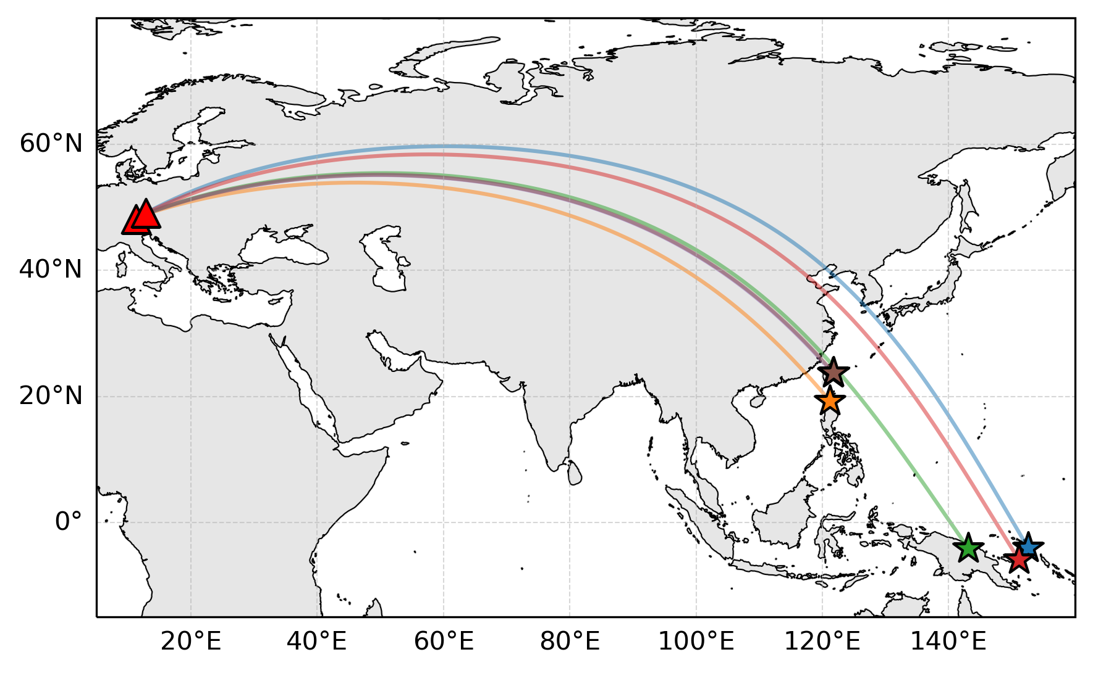
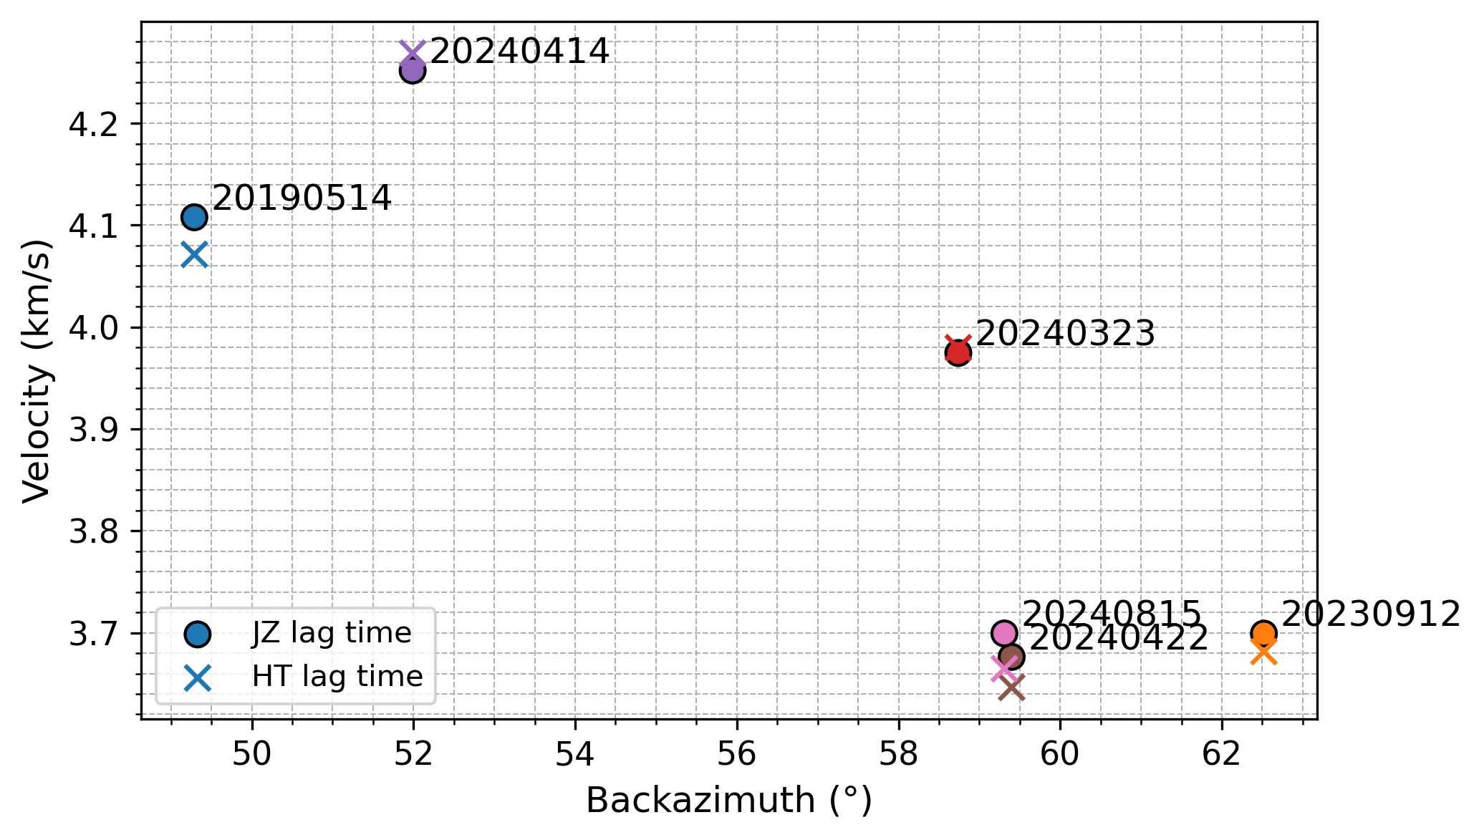
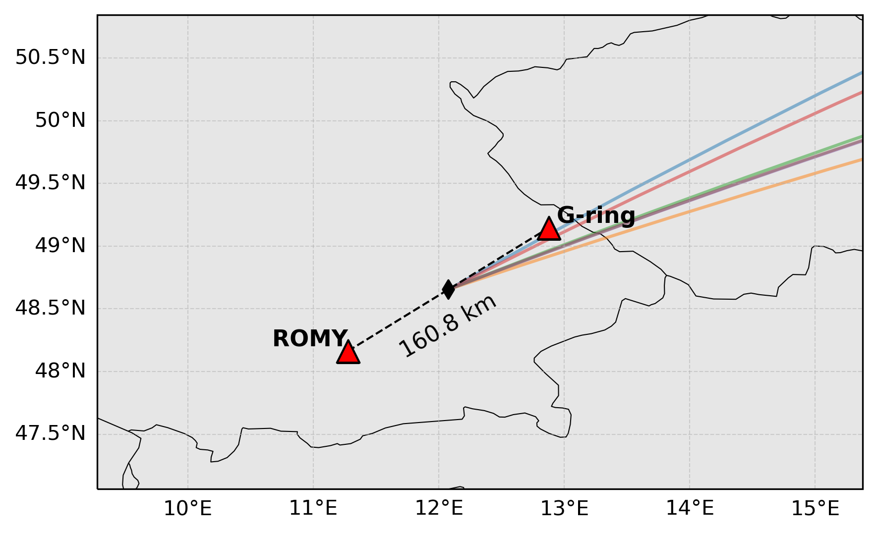

(a)
(c)
$$c = \frac{D \cos{φ}}{∆T}$$
G-ring
R
T
D
k
N
φ
ROMY
(d)
(b)

Slide 2
$$c = \frac{D \cos{φ}}{∆T}$$
G-ring
R
T
D
k
N
φ
ROMY

