Slide 1
MapsAgo
An enterprise level application to manage the content for a map-based RIA and provide a Web API
http://mapsago2.azurewebsites.net/
https://github.com/andburn/maps-ent

Slide 2
Functionality Details
Provides ability to manage content for RIA
Provide a Web API for RIA to access data
Ability to populate data from third party services

Slide 3
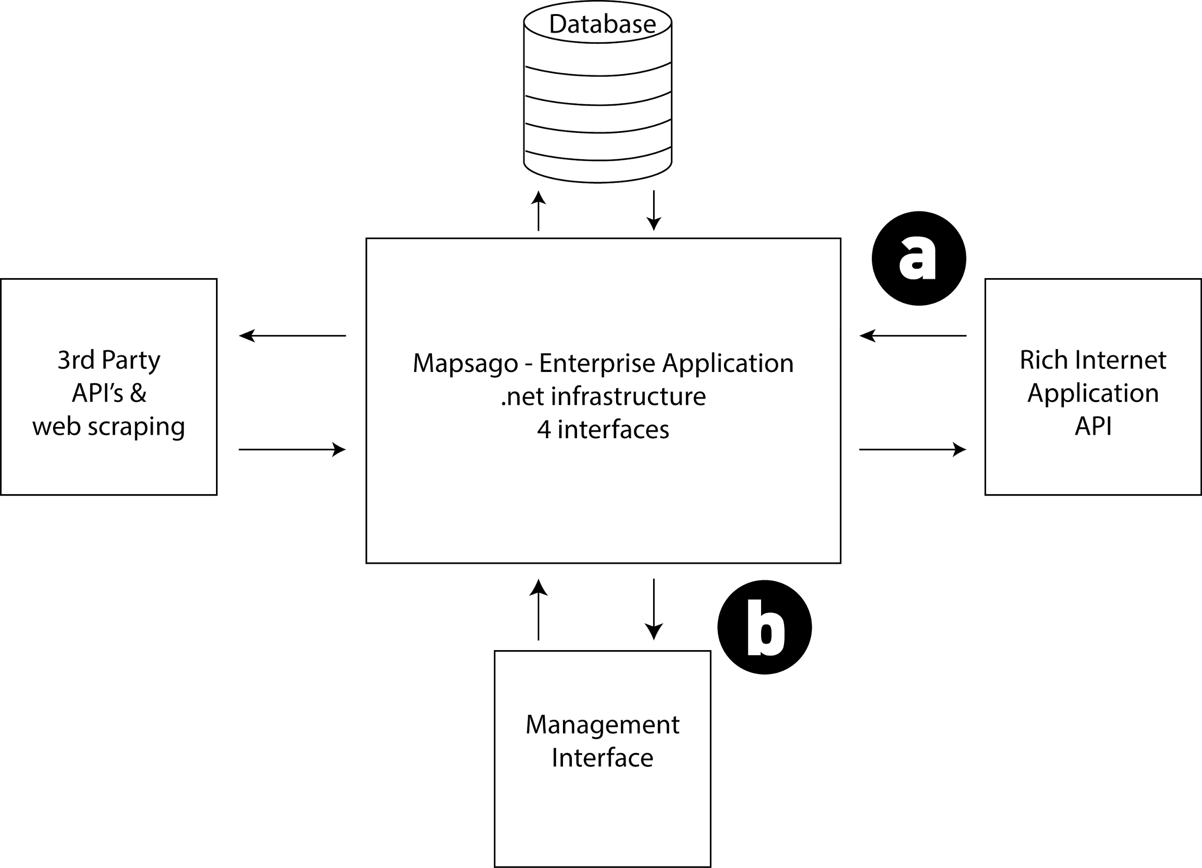
Design Overview
Central hub for serving and gathering information
Management – API - Retrieval

Slide 4
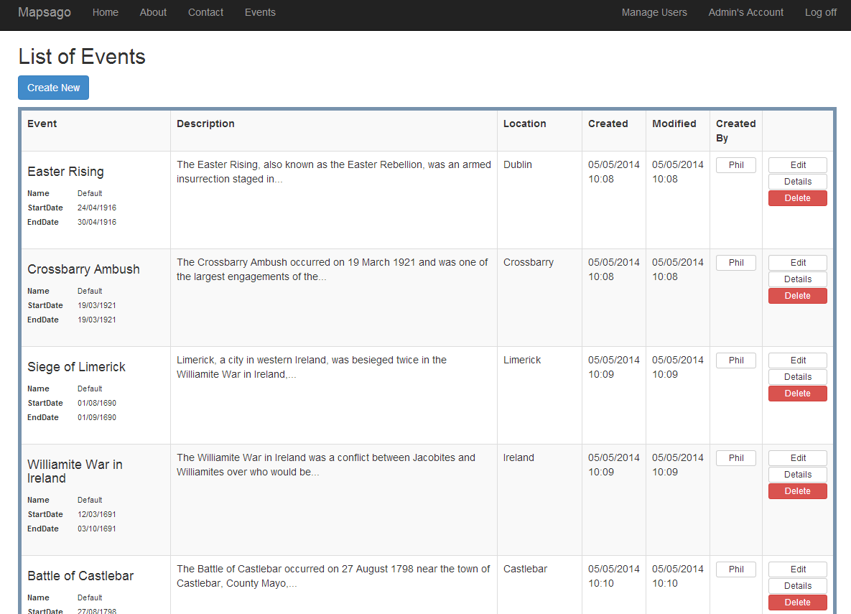
Demo….Listing Events

Slide 5
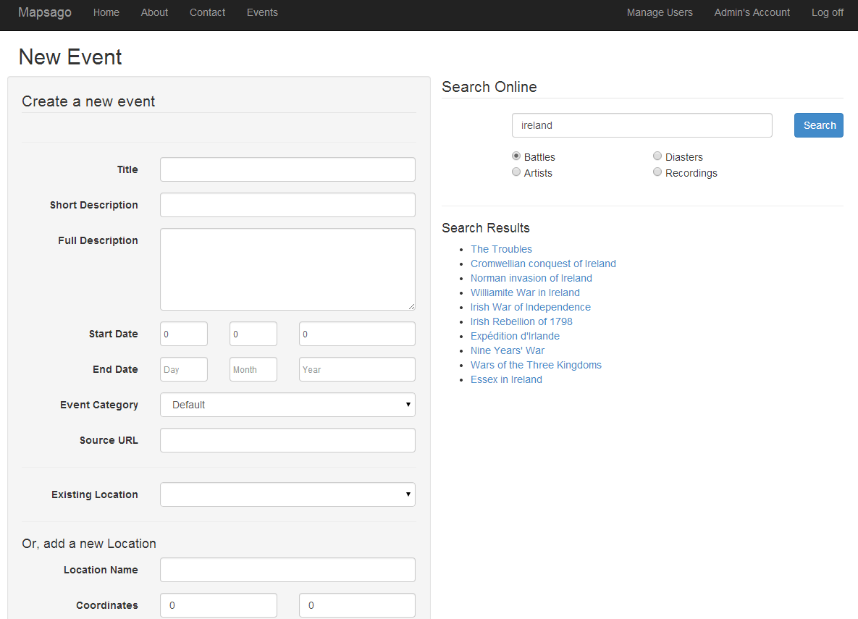
Demo….Adding New Event

Slide 6
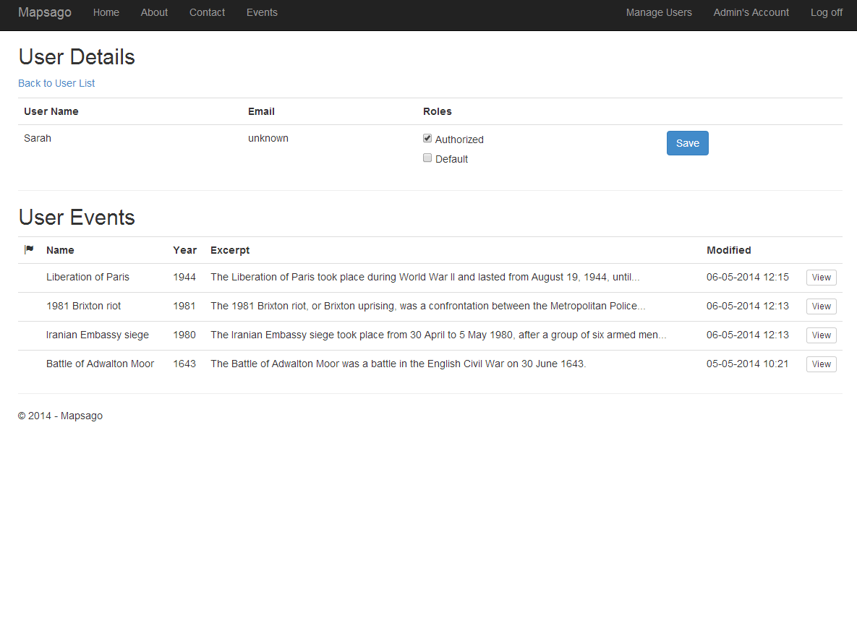
Demo….User Management

Slide 7
User Management
MVC 5 – Identity Framework
Provides full user management and authorization
Hook own models up with Identity schema
User management
Role assignment
Control access to certain pages
Admin – role assignment, event deletion
Authorized User - add and edit records
Created ViewModels to cater for interaction with rest of application
High level of difficulty integrating into MVC application

Slide 8
Code First Models
Event
Need to use Datetime2 type for larger date range
Location
Use of SQL Server Geography type
EventType
Enum based value type
Resources
All using extensive annotations and attributes, to enforce validation

Slide 9
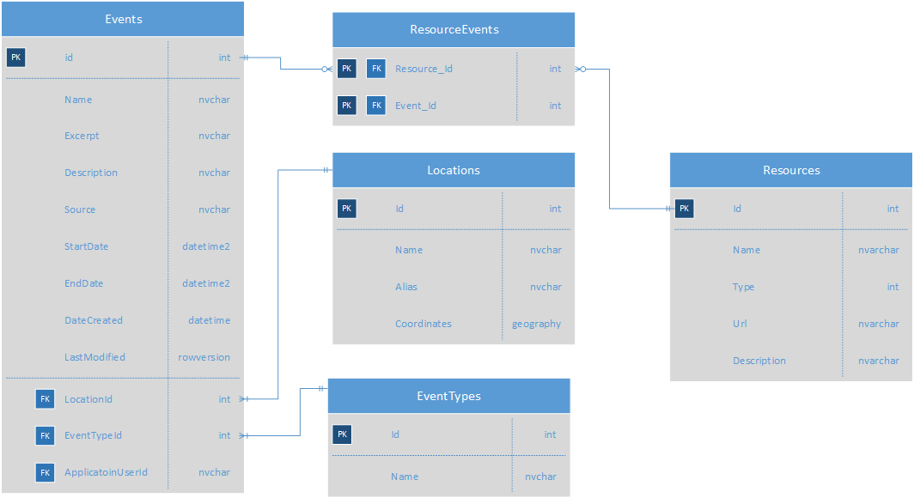
Database Schema

Slide 10
Custom-shaped ViewModel classes
The MVC pattern makes it possible to efficiently manage common functionality centred around creating, deleting, updating and deleting content within a structured application; perfect for a management system.
However,
Exposes underlying data structures
Non-direct mapping of input/output to data storage
Custom shaped view model solves this for UI and for data view (API request/response etc)

Slide 11
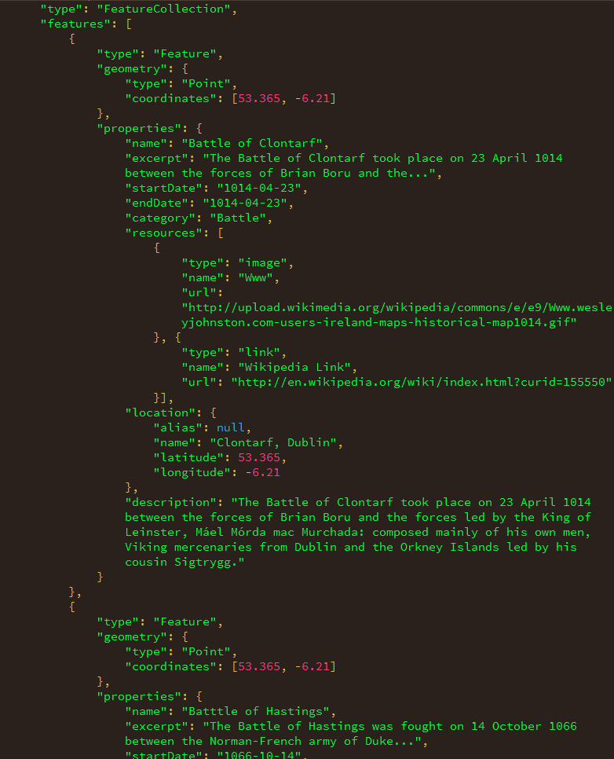
GeoJson
​http://localhost:9190/api/5/5/5?startdate=01-01-1560&enddate=01-01-1950&categories=war|love&keywords=hello|world​

Slide 12
Query logic
Search by proximity to a given location
Search by key words
Search by category, categories or not
Search within date ranges
Or all of the above?

Slide 13
ORM
Entity Framework
Abstraction layer data business logic
Multiple ways to create DB schema
Code First
Database First
Model First

Slide 14
Info Gatherer
Code to acquire data from third party sources
Needed to be able to get data from different sources
Keeping the same interface to communicate with rest of application
Strategy pattern to load in behaviour
Good use for IoC

Slide 15
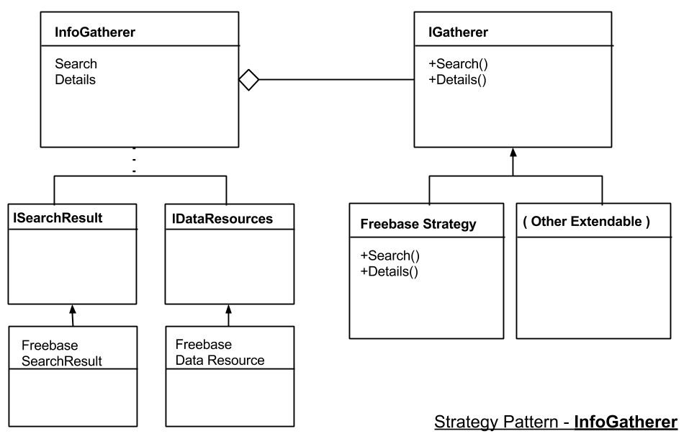
Strategy Pattern

Slide 16
Testing
Unit testing for
Controllers
Model validation via use of Moq library for fake controllers
InfoGatherer and associated strategies
Manual integration and system testing
Visually inspect a number of outcomes

Slide 17
Additional Info
Creation of custom AuthorizeAttribute
to allow use of enum types for role authorization
Default functionality requires explicit strings
Extensive use of partial views and custom editor and display helpers
Cutting down on repetition, making more maintainable views
Use of paging library to cater for large event data sets
Successful deployment to Microsoft Azure Platform

