Slide 1
MapsAgo
An enterprise level application to manage the content for a map-based RIA and provide a Web API

Slide 2
The key characteristics of the project in terms of functionality

Slide 3
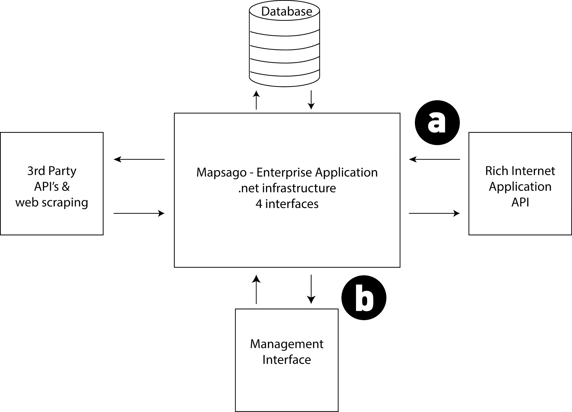
API - Development
Defining the interface between the two applications (Service provider, service user) required negotiation and consideration of the differing needs of each.

Slide 4
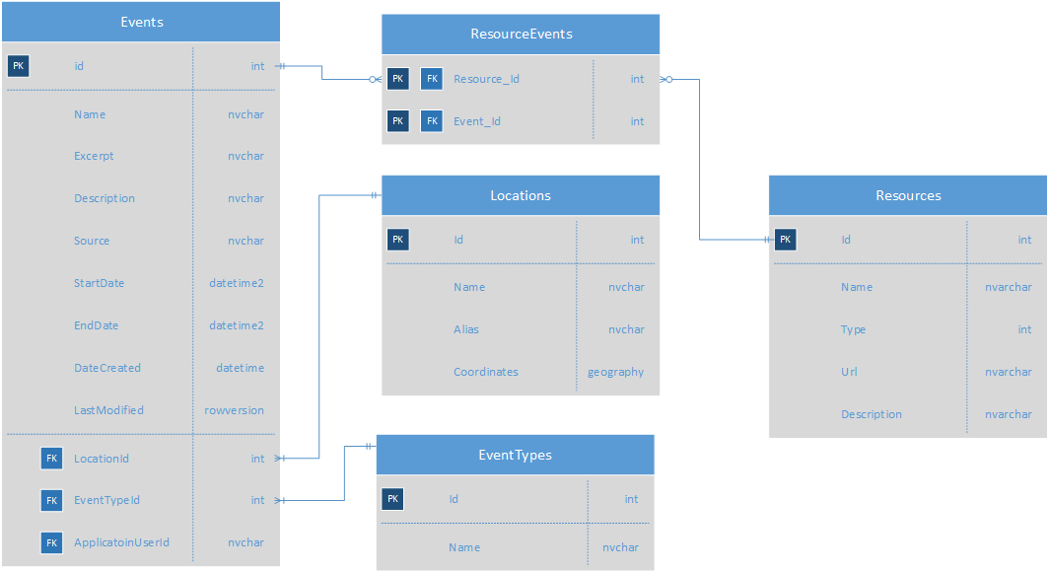

Slide 5
Custom-shaped ViewModel classes
The MVC pattern makes it possible to efficiently manage common functionality centered around creating, deleting, updating and deleting content within a structured application; perfect for a management system.

Slide 6
Design Patterns

Slide 7
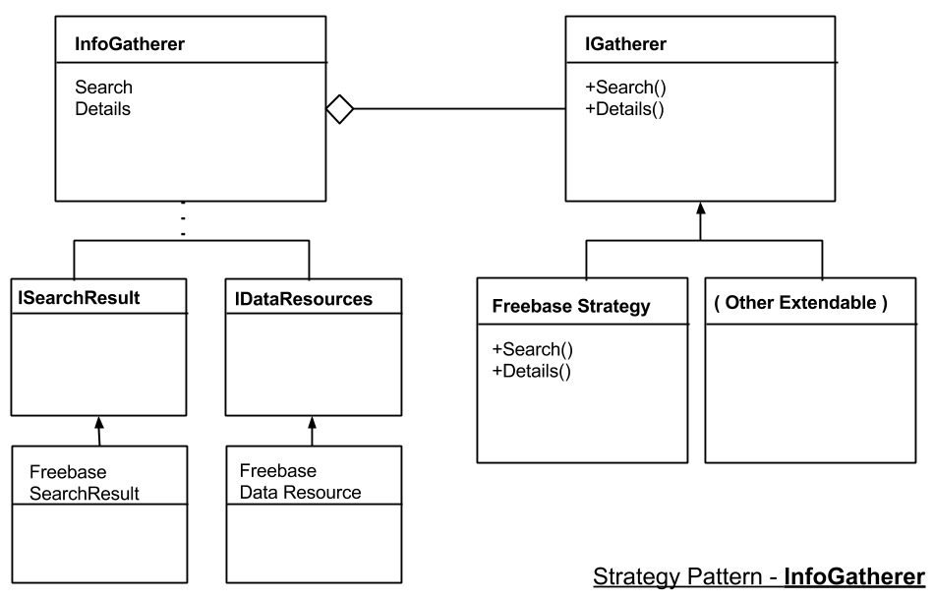
Use of the Strategy Pattern

