Slide 1
MapsAgo
An enterprise level application to manage the content for a map-based RIA and provide a Web API

Slide 2
Functionality Details
Provides ability to manage content for RIA
Provide a Web API for RIA to access data
Ability to populate data from third party services

Slide 3
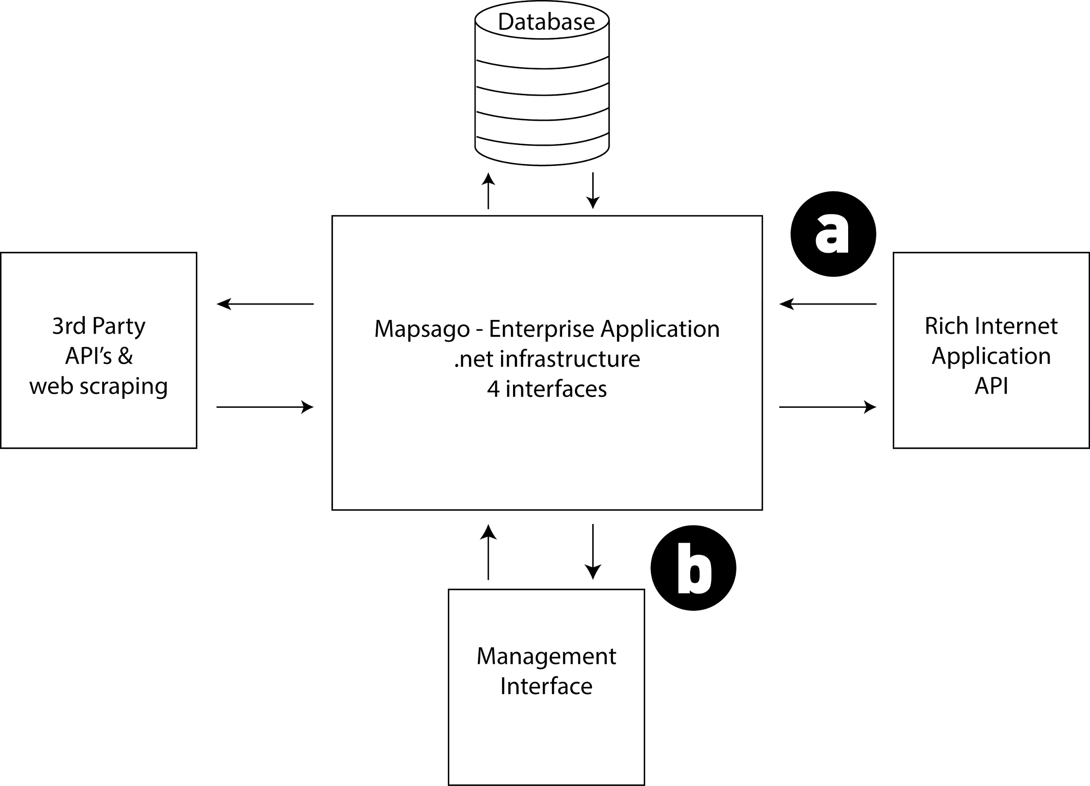
Design Overview
Central hub for serving and gathering information
Management – API - Retrieval

Slide 4
Demo….

Slide 5
User Management
MVC 5 – Identity Framework
Provides full user management and authorization
Hook own models up with Identity schema
User management
Role assignment
Control access to certain pages
Admin – role assignment, event deletion
Authorized User - add and edit records

Slide 6
Code First Models
Event
Location
EventType
Resources

Slide 7
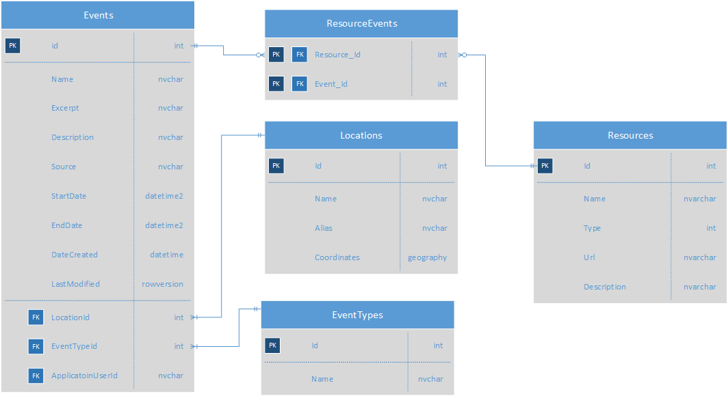
Database Schema

Slide 8
Custom-shaped ViewModel classes
The MVC pattern makes it possible to efficiently manage common functionality centred around creating, deleting, updating and deleting content within a structured application; perfect for a management system.
However,
Exposes underlying data structures
Non-direct mapping of input/output to data storage
Custom shaped view model solves this for UI and for data view (API request/response etc)

Slide 9
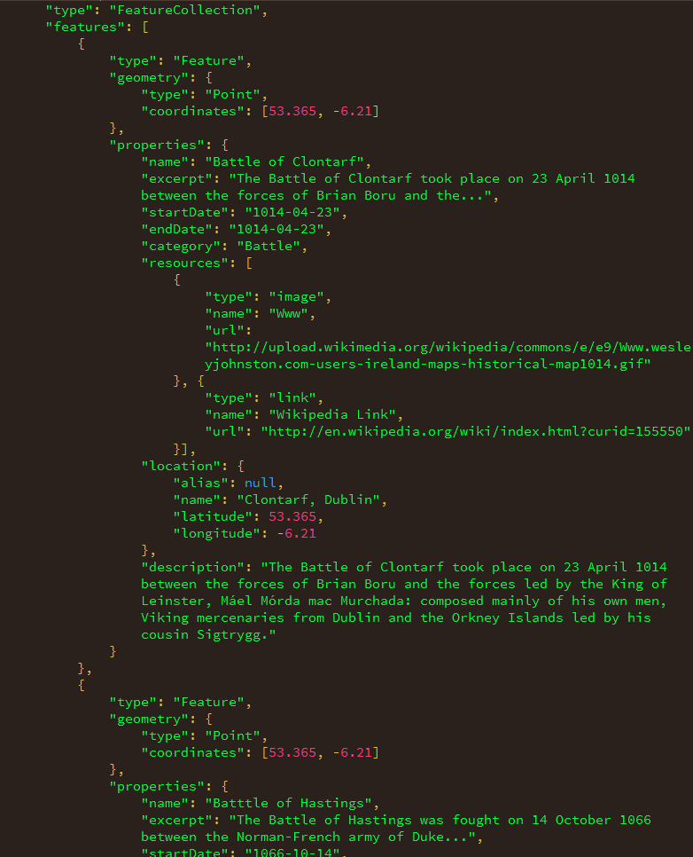
GeoJson
​http://localhost:9190/api/5/5/5?startdate=01-01-1560&enddate=01-01-1950&categories=war|love&keywords=hello|world​

Slide 10
Query logic
Search by proximity to a given location
Search by key words
Search by category, categories or not
Search within date ranges
Or all of the above?

Slide 11
ORM
Entity Framework
Abstraction layer data business logic
Multiple ways to create DB schema
Code First
Database First
Model First

Slide 12
Info Gatherer
Code to acquire data from third party sources
Needed to be able to get data from different sources
Keeping the same interface to communicate with rest of application
Strategy pattern to load in behaviour
Good use for IoC

Slide 13
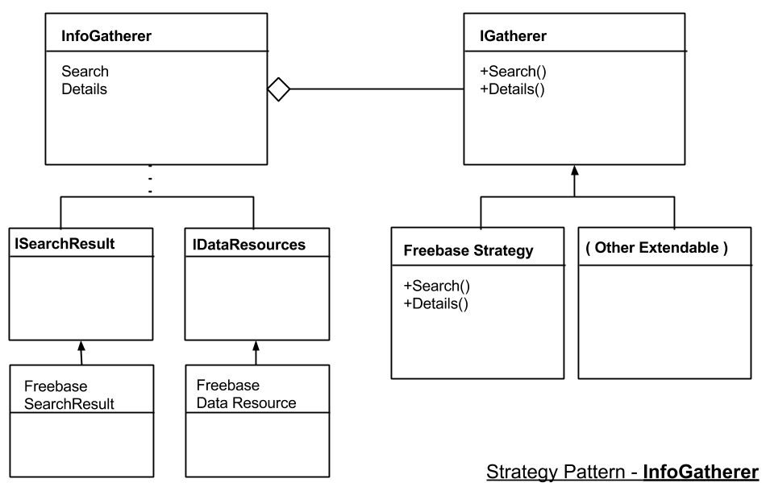
Strategy Pattern

