Slide 1
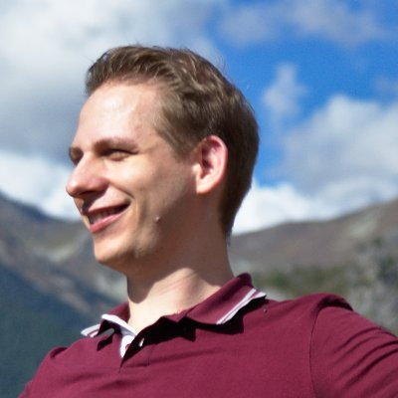




About Me
Résumé
Experience
Education
2020 – 2023
Co-Founder, CodeShield GmbH
AWS Cloud-Security Solution for detecting privilege escalations
2016 – Now
(ext.) PhD Student, Paderbn University
Secure OSS Usage
2016-2019
PhD Candidate, Paderborn University
Static Code Analysis, Vulnerabilities in OSS
2013-2016
M.Sc. Computer Science, Paderborn University
Andreas Dann
Security Researcher
2018
Research, SAP Security Research Labs, France
Research on Eclipse Steady
Projects
/anddann

