Slide 1
Web Apps w/ Django
ANDREW AND SKYLAR
Notes:
Named after a musician.
Django is a framework.

Slide 2
What are web apps
Software accessible by any web browser that has internet connection
All websites are web apps!
Django is a python framework
Module vs Framework
Modules provide you functions that you call
You provide functions for the framework to call

Slide 3
Model View Controller Framework
View
Templates/html
Client
Model
Models.py
Controller
views.py
urls.py
Notes:
templates is a folder containing HTML
templates: what you see
url maps the page you’re looking at to what the backend should do (ex.
actions creates forms and does other stuff (any action that the thing can do)

Slide 4
Creating a Django project
Installation: type in your command prompt:
pip install django==3.0.2
Create project directory (don’t forget the dot at the end!)
django-admin startproject webapps .
Create the app
python manage.py startapp appName
Notes:
make migrations

Slide 5
Creating a Django project (p2)
Create the database
python manage.py migrate
Go into webapps/settings.py
scroll to the list INSTALLED_APP and add ‘appName’
Run the app:
python manage.py runserver
Type in chrome:
localhost:8000

Slide 6
Structure
projectFolder |-- README.md
|-- webapps/ |-- settings.py |-- urls.py
|-- projectName/ |-- static/
|-- templates/
|-- forms.py |-- models.py |-- views.py
|-- manage.py
CSS files + JS files
ProjectName/
HTML files
not given
Notes:
It’s convention to put html files inside the ‘projectName’ folder, because you may have multiple apps. They must all exist inside templates folder, because that is where Django will look for them. Remember, this is provided for you.

Slide 7
HTML and CSS
HTML - HyperText Markup Language
Structure of the website
Buttons, Searchbars, any website element
CSS - Cascading Style Sheets
Style of the website
decoration for different HTML elements
Bootstrap - framework for website design
gives you HTML and CSS so you don’t have to build it yourself

Slide 8
Controller
All the controller functions exist inside “views.py” (bad name!)
request -> data the client gives you (the server)
context -> the data that you (server) want to give the client
context and request can be treated as python dictionaries
# Example:
def login(request):
context = {‘data’: ‘hello’}
return render(request, “appName/login.HTML”, context)
Notes:
Should be call actions.py (has no relation to ‘view’ in MVC)

Slide 9
HTTP
HTTP - Hypertext Transfer Protocol - enables communication between server and client
POST request
Send information to the server (when you login or register)
GET request
Request data from server, but doesn’t modify server data
More information here:
https://www.w3schools.com/tags/ref_httpmethods.asp
Notes:
There are other HTTP methods that we don’t care about (no one does). Post requests can modify the server, get requests don’t. For get requests, the data is inside the URL string (don’t use for sensitive data)

Slide 10
Django Templating Language
When you pass information to the client, how do you use it in HTML of the page dynamically?
For variables use 2 curly braces {{ variable_name }}
For tags, use {% tag %}
{% If condition %}
Some HTML
{% endif %}
{% for item in list %}
Some HTML, possibly involving {{item}}
{% endfor %}

Slide 11
Forms
HTML element that sends information to the server
Specify the method type (post or get)
HTML element <button> will send information
<button name = "button" value = "0" > 0 </button>
Hidden fields - information you want to send to the client but not show
<input type="hidden" name="storedInt" value="{{storedInt}}">
Notes:
name attribute = key, value attribute = value

Slide 12
Cross Site Request Forgery
What are CSRF attacks?
Django will check to make sure that the CSRF token is valid
You must pass in a CSRF token in your form (otherwise you’ll get an error)
Only prevents against POST request. (why not GET requests?)
{% csrf_token %}
Notes:
Imagine you are zuckerberg and own facebook, and one feature of facebook is to delete your own account. A user must click on the ‘delete account’ button to delete their own account. If the user is already logged in, how do you prevent another site from linking to the URL ‘facebook.com/deleteAccount’. GET requests don’t impact the server data.

Slide 13
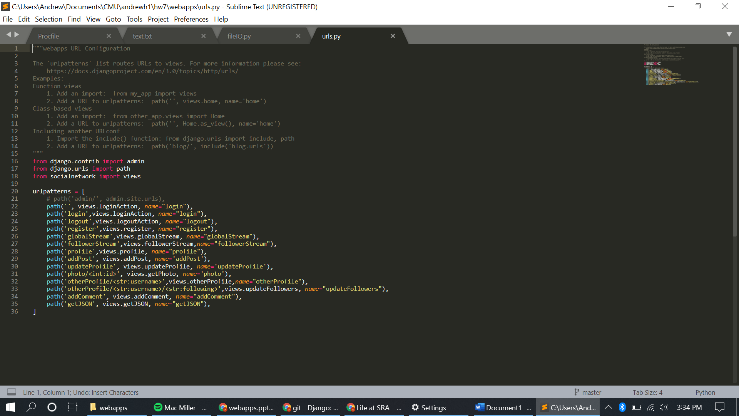
URL Routes
urls.py file keeps track of all the pages in your app (list of mappings)
When URL has nothing in it (localhost:8000) it will go to views.loginAction (line 22)
Notes:
Notice how I import views at the top. Remember that ‘views’ has all the functions that I want to call, and these particular ‘views’ functions return a ‘render()’ function, which runs the HTML page. When URL has ‘localhost:8000/login’, it will go to views.register
the name parameter???

Slide 14
Calculator App
https://github.com/anddhong/DjangoCalculator

Slide 15
Conclusion
If you’re interested in Web Apps, consider taking
17-437: Web Application Development
Attendance

