Slide 1
Event Planner
SEIS 635 – Semester Project
May 18, 2013
Ross Anderson / Ben Passe - (Group 1)
Notes:
Ben

Slide 2
Project Description
Desktop application to manage social events
Events include:
Vendors
Wish list with items
Invitees
Location information
Developed in C# using Visual Studio
Ideally could be ported to web application / mobile application
Notes:
Ben

Slide 3
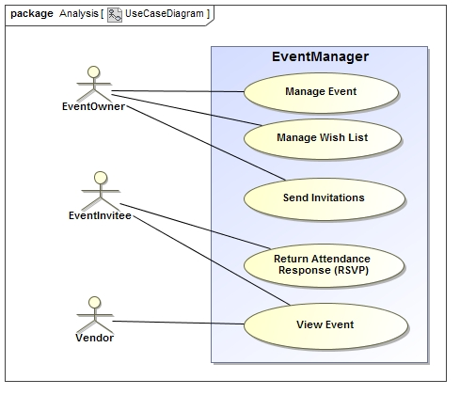
Requirements – Use Case Diagram
Notes:
Ross

Slide 4
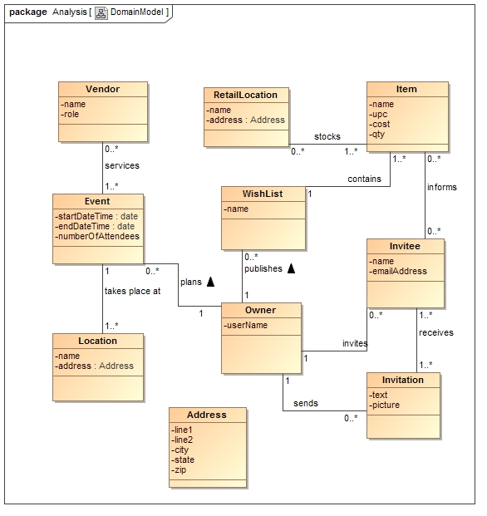
Analysis – Domain Model
Notes:
Ben

Slide 5
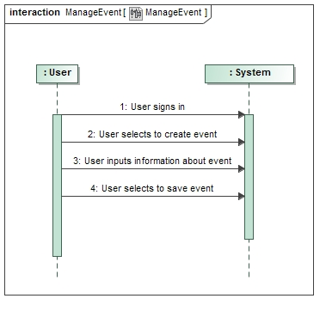
Analysis – System Sequence Diagram
Notes:
Ross

Slide 6
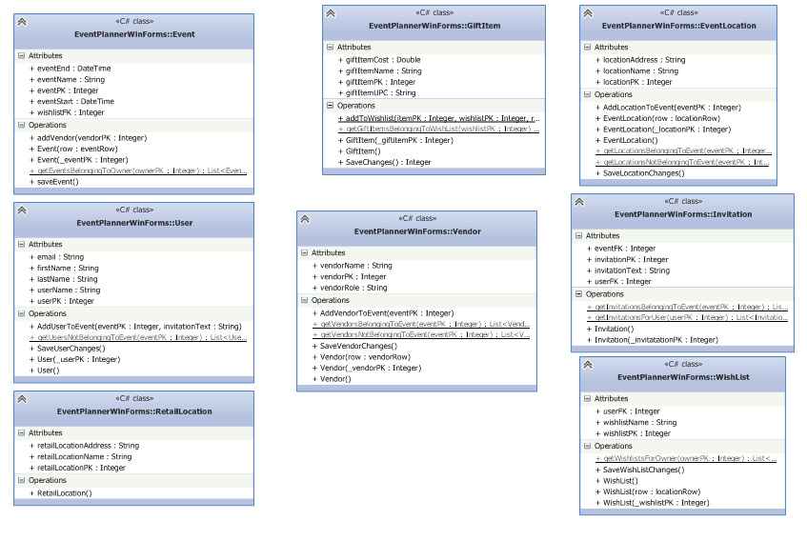
Design – Class Diagram
Notes:
Ben

Slide 7
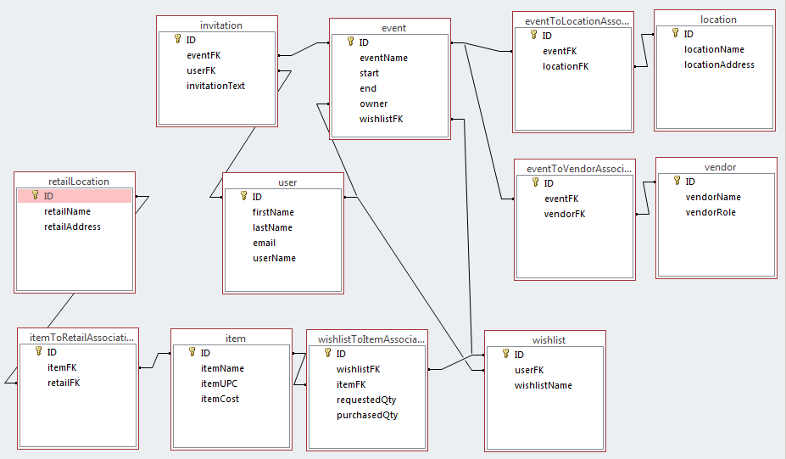
Database Diagram
Notes:
Ross

Slide 8
Organization Strategy
Source and artifact control – GitHub
https://github.com/ande8331/SEIS635Project
Communication: Gmail and in-class
Assigned lead on each phase
Reduce dependency on each other
Reduce overhead for decision making
Divided up tasks to reduce duplication of effort
Notes:
Ben

Slide 9
Demo
Notes:
Ross

Slide 10
Differently the Next Time
Choose application subject sooner
Choose technology sooner
Create web or mobile application
Notes:
Ben

Slide 11
If we continued development…
Convert to a web application
Dynamically resize for mobile apps
Email notifications
New events, wish list updates, RSVP’s, etc.
Live links for ordering items from wish lists
Notes:
Ben

Slide 12

Questions

