Slide 1
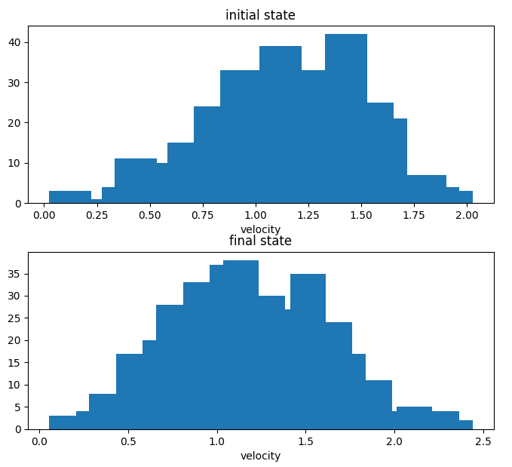
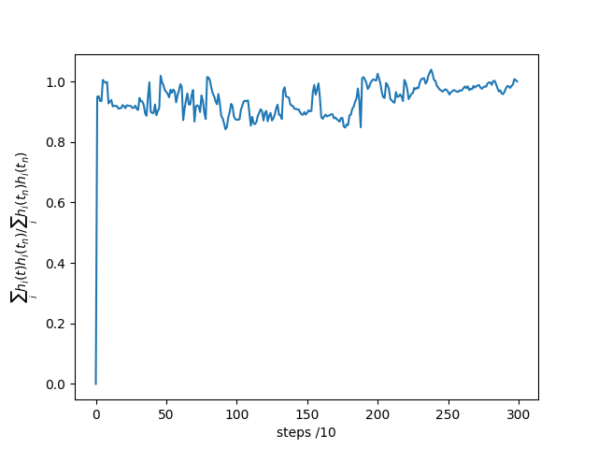
Project 1, a
Initial velocity 0.5

Slide 2
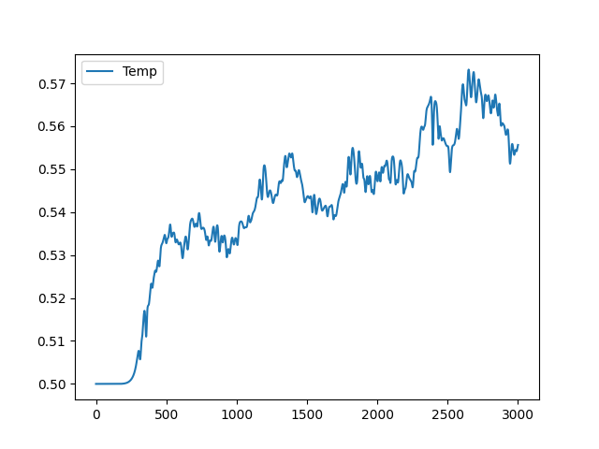
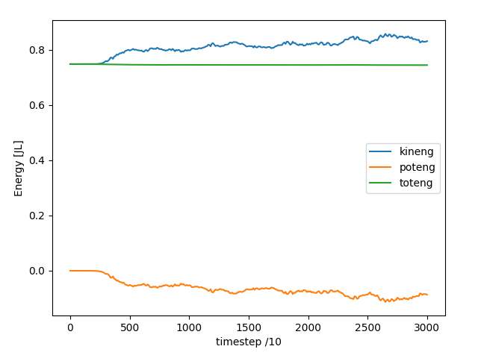
Project 1, b,c
Initial Velocity 0.5 [L/J]

Slide 3
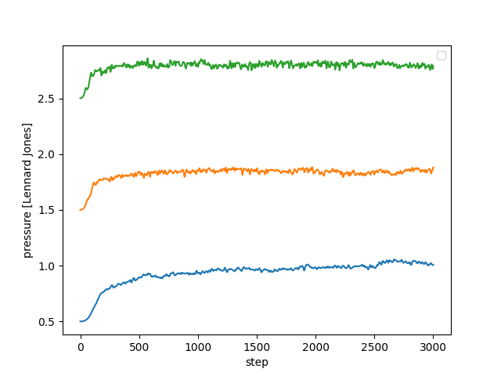
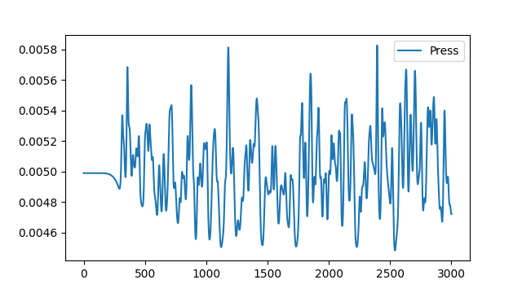
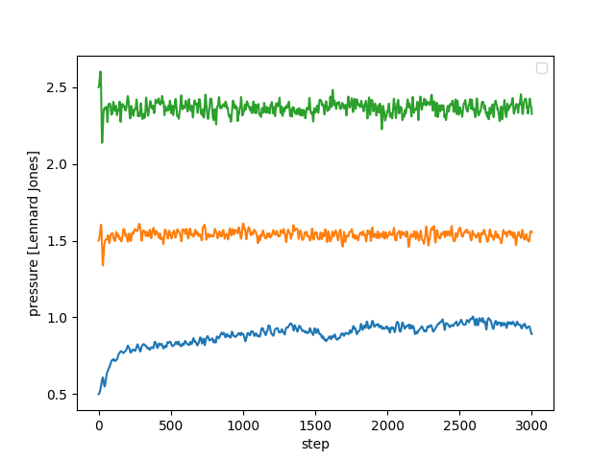
Project 1, d,e
Lattice fcc 0.1 and 0.5
Initial velocity 0.5 [L/J]

Slide 4
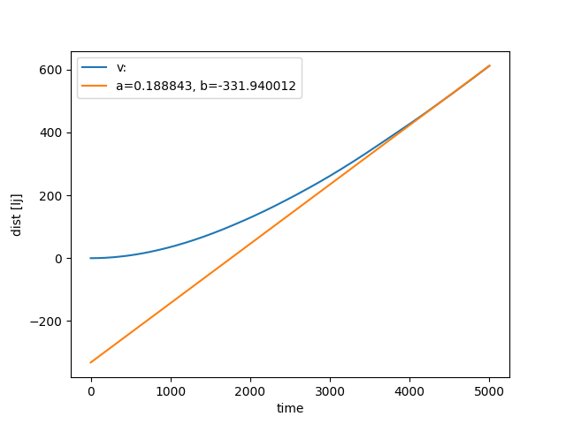
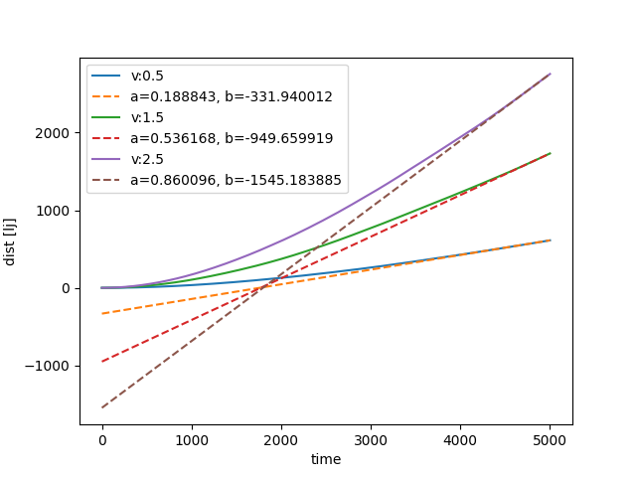
Project 1 f
Initial V = 0.5 [L/J]
Initial velocities: 0.5, 1.5, 2.5
Wikipedia: argon gas D = 2E-5

Slide 5
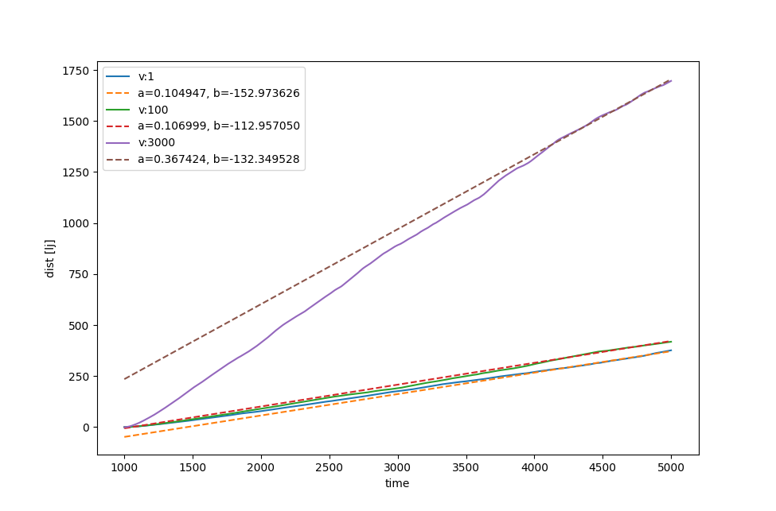
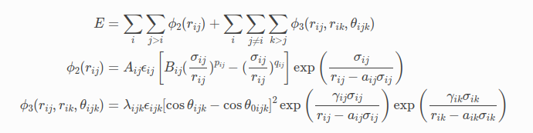
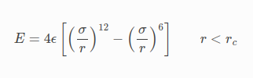
Project 1, l
Stillinger weber potential
Lennard jones

Slide 6
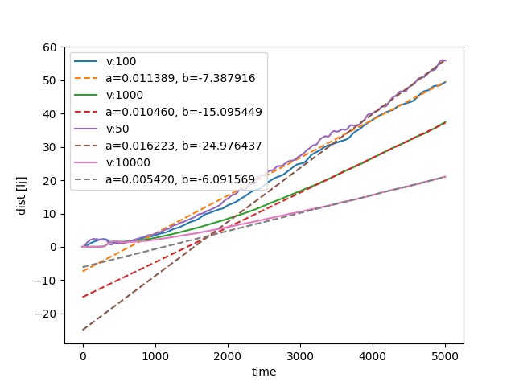
Project 1, m

Slide 7
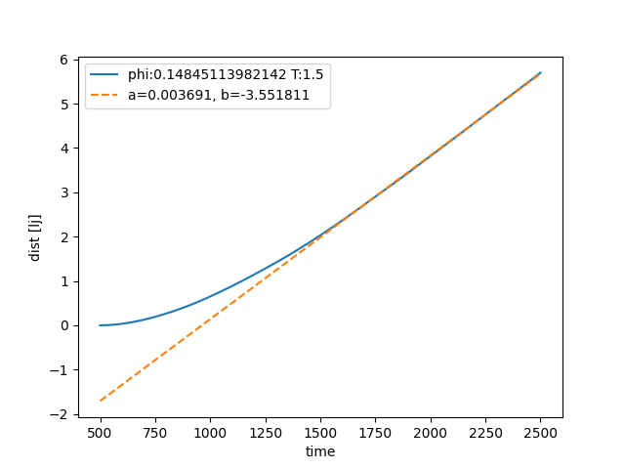
Project 2, f

