Slide 1
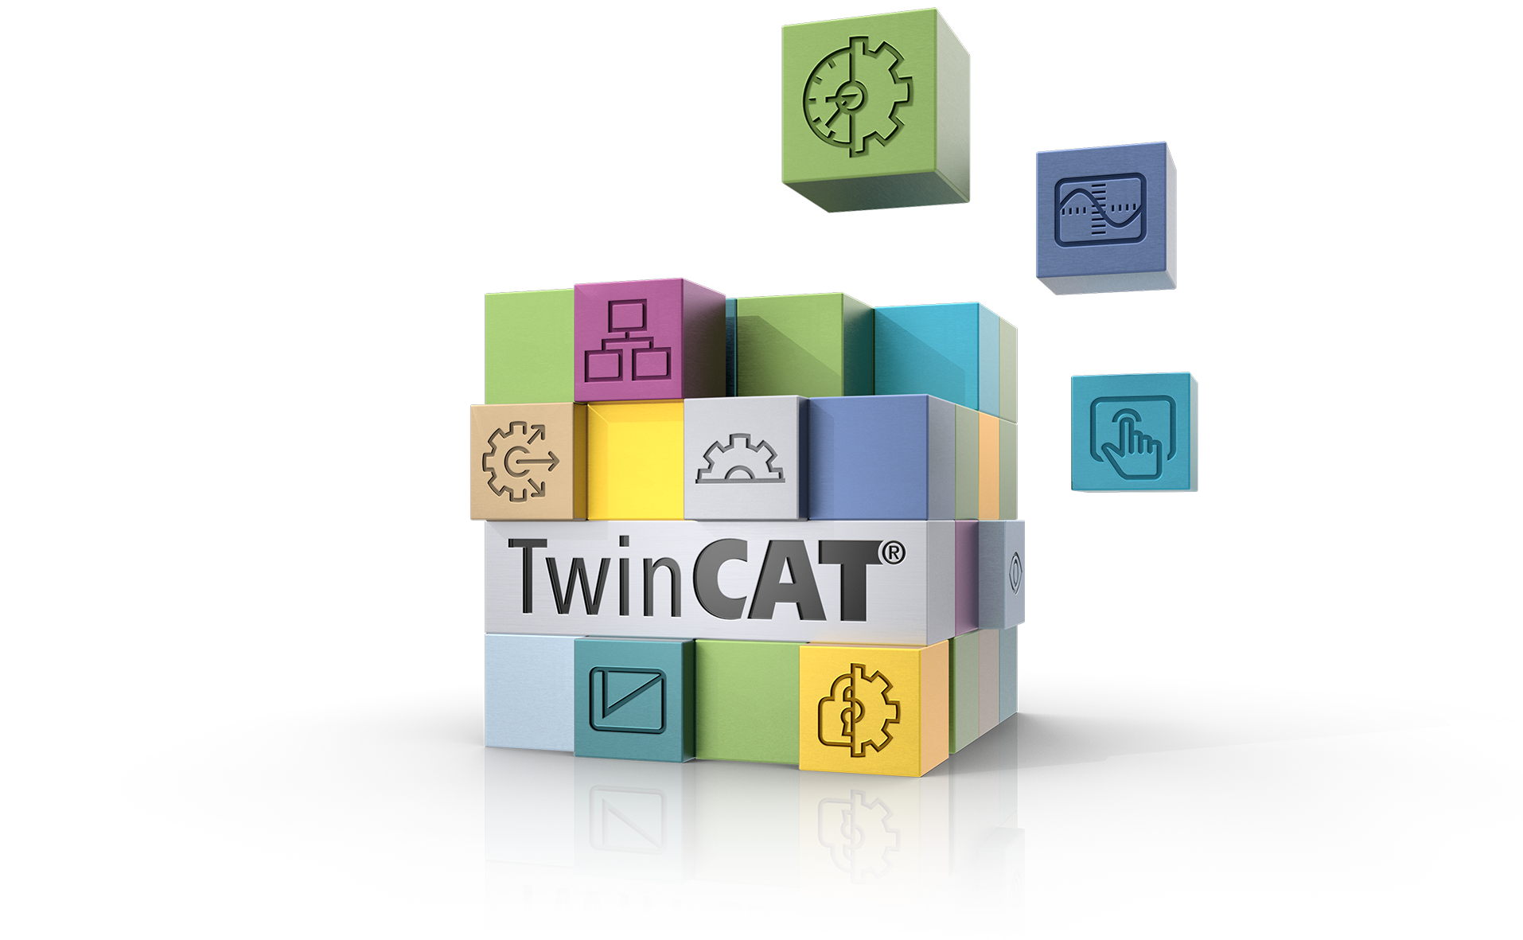
Automation Communication Protocols
Alyssa Dedolph
Advanced Applications Group

Slide 2




















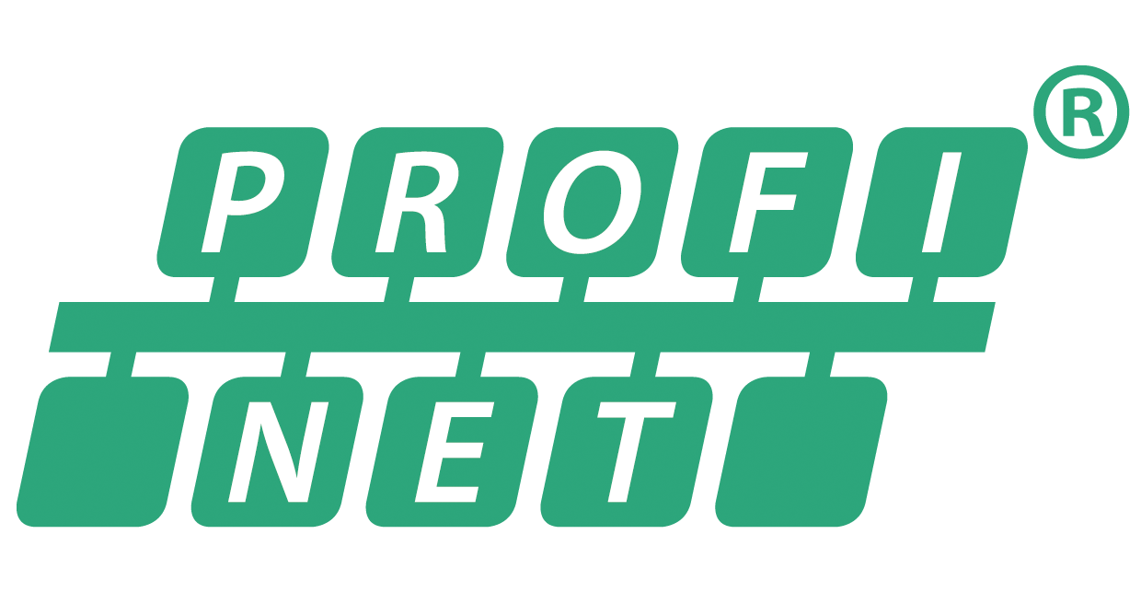






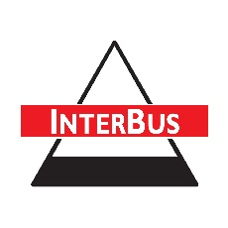




TwinCAT Connectivity Big Picture
DB
ERP
Cloud Connectivity + Analytics
153/42/108
153/42/108
153/42/108
153/42/108
153/42/108
M2M
MES / WES
HMI
MATLAB®
LabView®
194/212/229
PC Hardware
153/42/108
153/42/108
153/42/108
153/42/108
153/42/108
153/42/108
153/42/108
IoT Communication
HTTPs
MQTT
Database Connection
TCP/IP
ADS
EtherCAT Automation Protocol
PROFINET, EtherNet/IP,
Modbus
TwinCAT 3
153/42/108
153/42/108
153/42/108
153/42/108
153/42/108
153/42/108
153/42/108
153/42/108
153/42/108
153/42/108
153/42/108
Connectivity
PLC
PLC
Safety
Motion
CNC
Robotics Motion
CCAT
Modules
Simulink®
Module
Measurement
and Analytics
Vision Runtime
HMI
RS232
RS485

Slide 3


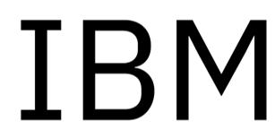
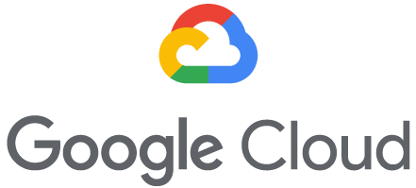



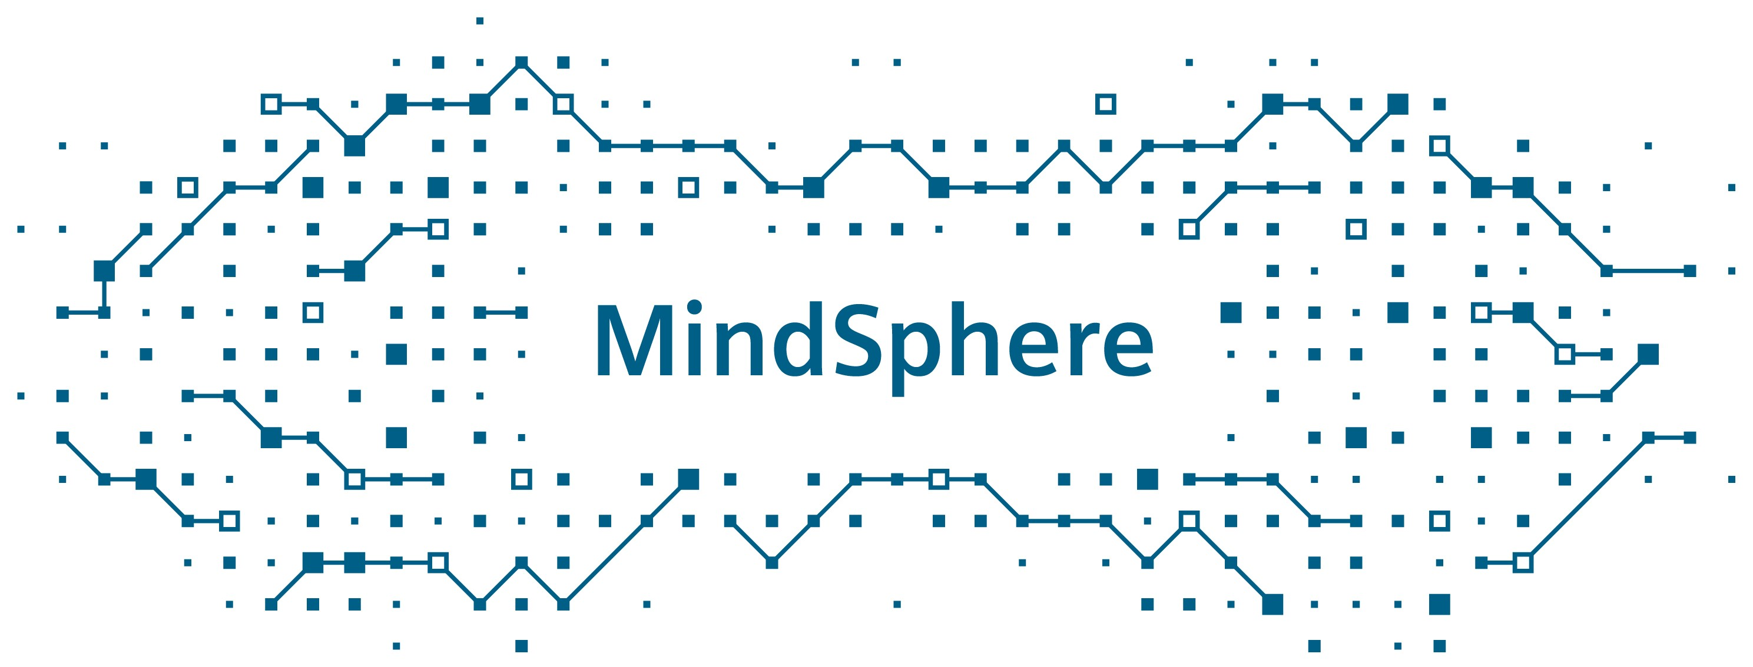


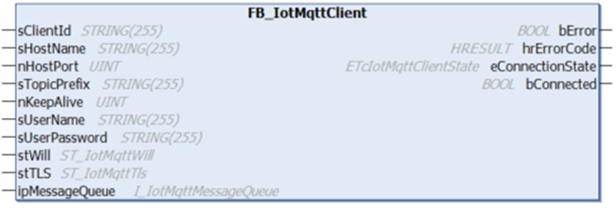
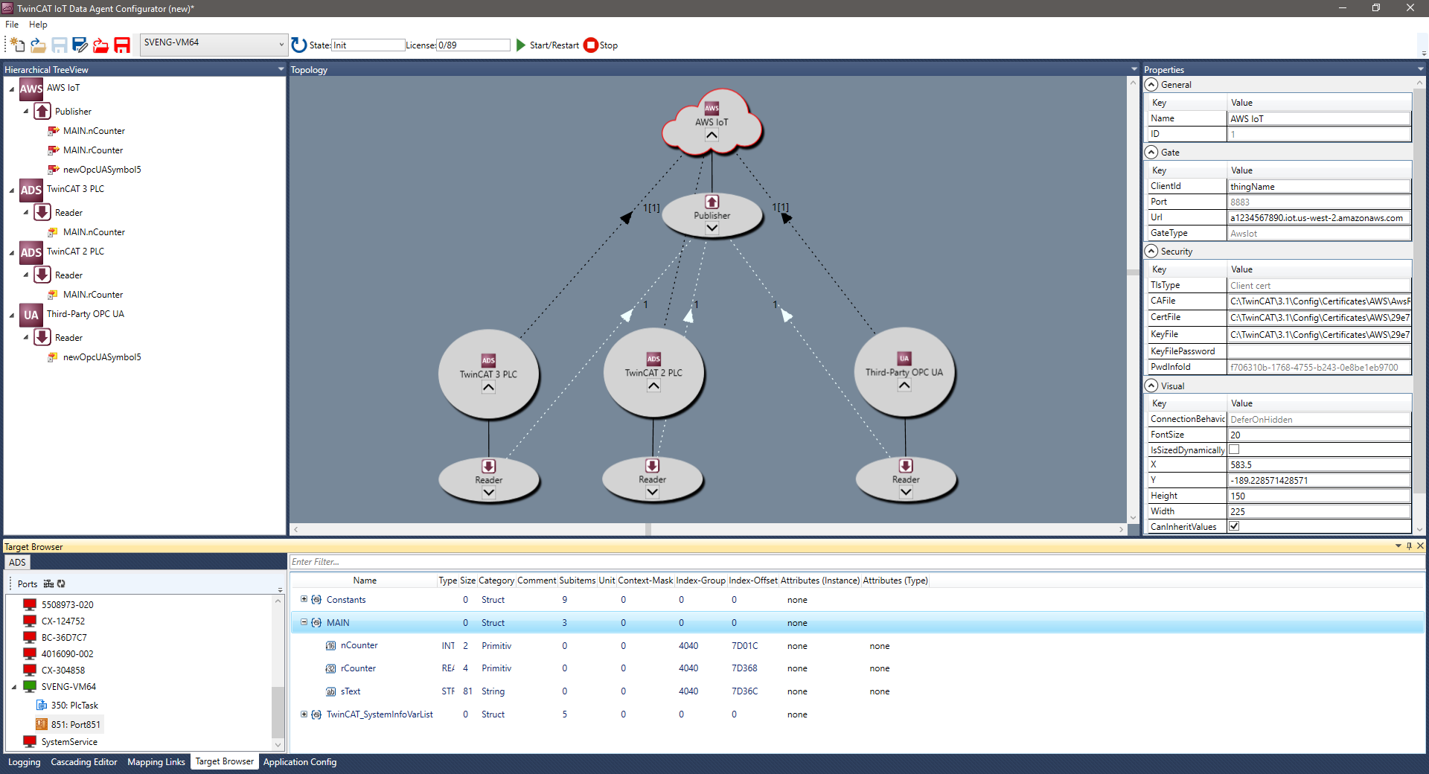
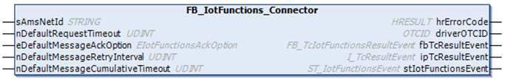




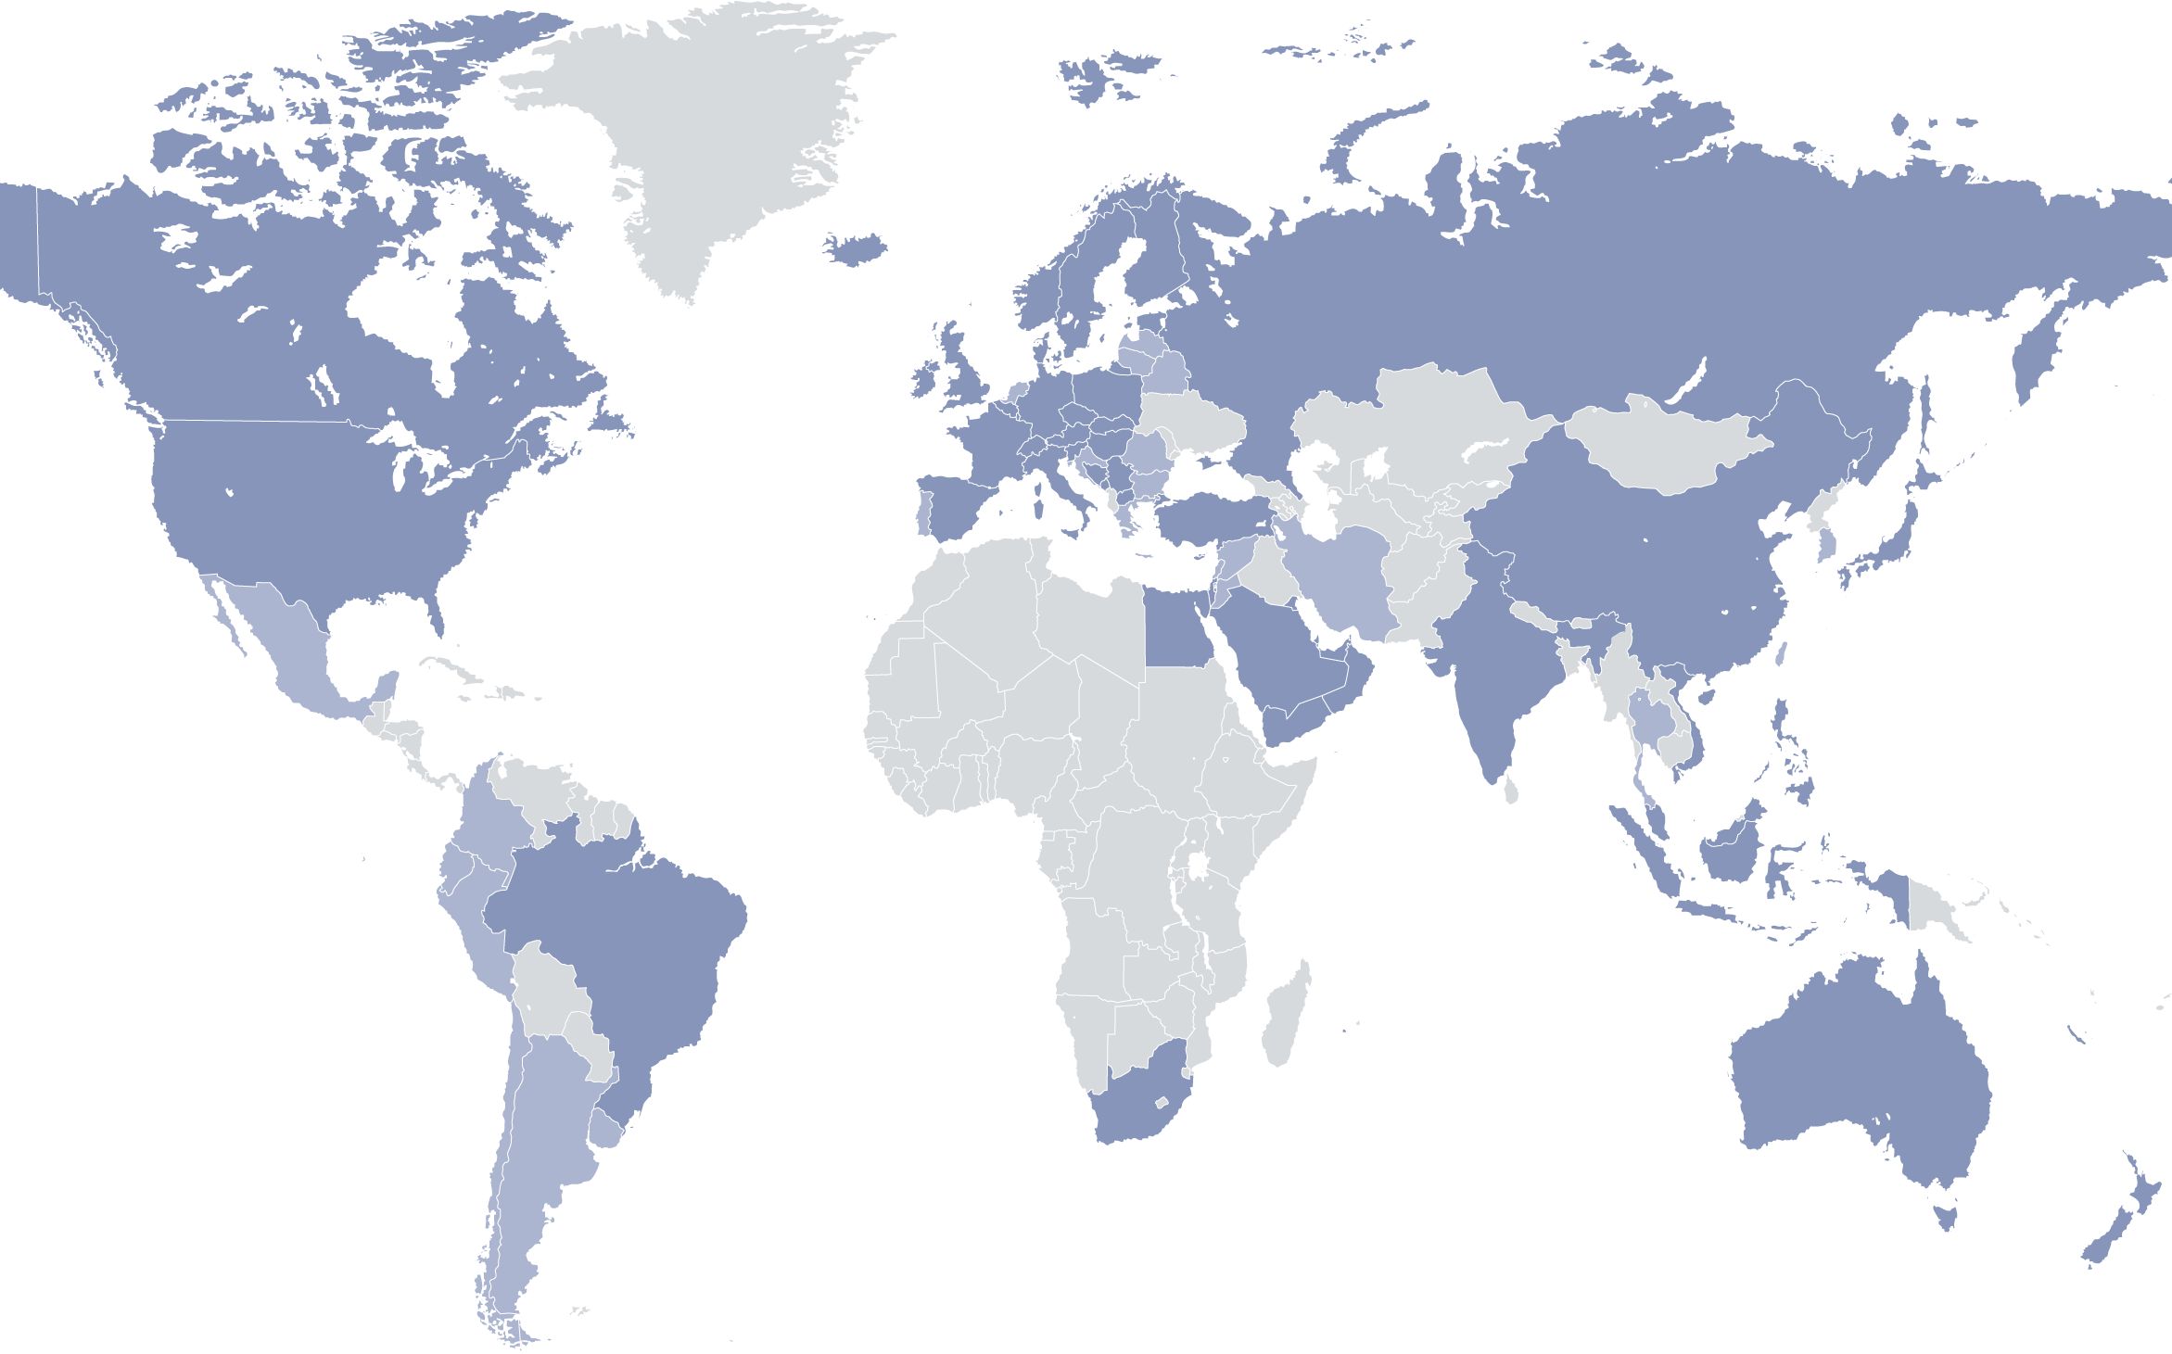

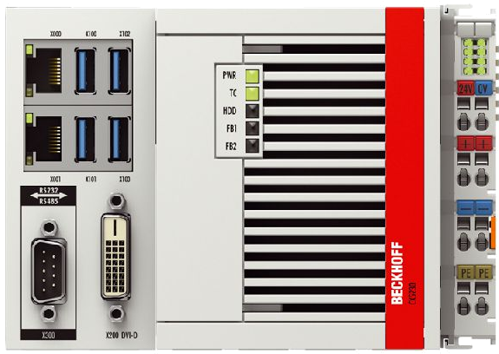
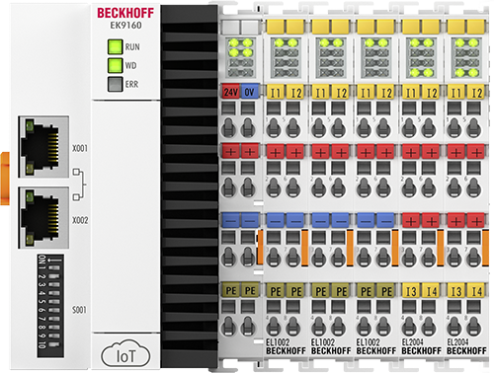
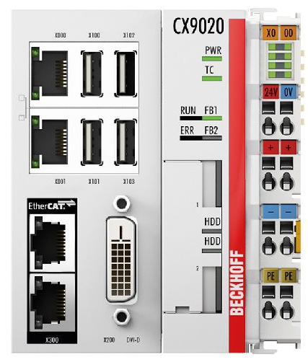
TwinCAT IoT product overview
Easy integration of IoT communication protocols
Multiple protocols available: MQTT, HTTPS, OPC UA Pub/Sub, WebSockets, OCPP
Smartphone App available for Android and iOS
Microsoft Azure
TF6701 IoT Communication
MQTT client connectivity
Real-time driver for the PLC
TF6720 IoT Data Agent
IoT gateway application
Standalone tool
TF6710 IoT Functions
Data Agent access
Real-time driver for the PLC
TF6730 IoT Communicator
Smartphone App
Thingspeak
TwinCAT Cloud Engineering
MQTT, WSS,
HTTPS, OCPP,
OPC UA
MQTT, WSS,
HTTPS, OCPP,
OPC UA
MQTT, WSS,
HTTPS, OCPP,
OPC UA
TF6760 IoT HTTP/REST
HTTP(S) client connectivity
Real-time driver for the PLC
TF6770 IoT WebSockets
WebSockets client/server
Real-time driver for the PLC
TF6771 IoT OCPP
OCPP client connectivity
OCPP server connectivity
Real-time driver for the PLC
TF6020 JSON Data Interface
Req/Res MQTT connectivity
ADS interface for PLC
TF6105 OPC UA Pub/Sub
OPC UA Pub/Sub connectivity
MQTT, UDP

Slide 4
TwinCAT Connectivity MQTT
“A lightweight, publish-subscribe, machine to machine network protocol.”
Originally designed for remote sites with low-bandwidth or unreliable networks.
Why is MQTT ideal for IoT?
Simple
Pub/sub simplifies device communications and routing
Supports multiple data formats
Secure
Supports TLS (certificate-based encryption)
Performant

Slide 5
TwinCAT Connectivity Traditional MES Communication Model
To transact with each OT device, we need:
Networking
Security, firewall
Address routing, NAT
Application protocol driver
Port numbers
Device/node addressing
Vendor software
Data address and type information
Type systems
Byte packing, endianness
OT System
Transaction
IP Address: 10.10.1.10
Protocol: ModbusTCP
Data Address: 432770
Data Format: 2x 16-bit words
Networking
OT System
IT System
Transaction
IP Address: 10.10.2.10
Protocol: Beckhoff ADS
Data Address: ‘PLC1.MAIN.eStatus’
Address Table
---------------
Machine1: 10.10.1.10
Machine2: 10.10.2.10
Machine#: 10.10.x.x
…
Data Format: 1x 32-bit DINT
OT System
Transaction
IP Address: …
Protocol: …
Data Address: …
Data Format: …

Slide 6
TwinCAT Connectivity Broker Pub/Sub Model
To transact with each OT device, we need:
Broker address
Topic
Payloads can be binary or JSON (human-readable)
New components can simply connect to the broker and can begin publishing/subscribing
Topics created as needed, with user-defined names and “paths”:
OT System
OT System
Publish
Publish
Broker: 10.10.0.1
Broker: 10.10.0.1
Topic: Machine/1/Status
Broker
Data: { ‘status’: ‘running’ }
Topic: Machine/2/Status
Data: { ‘status’: ‘idle’ }
IT System
Topic Subscription Messages Received
------------------- ---------------------------------
Machine/# All messages from all machines
Machine/1/# All messages from machine 1
Machine/1/Status Machine 1 status messages
Machine/+/Status Status messages from all machines
OT System
Publish
Broker: 10.10.0.1
Topic: Machine/3/Status
Subscribe
---------------
Broker: 10.10.0.1
Topic: Machine/#
Data: { ‘status’: ‘running’ }

Slide 7
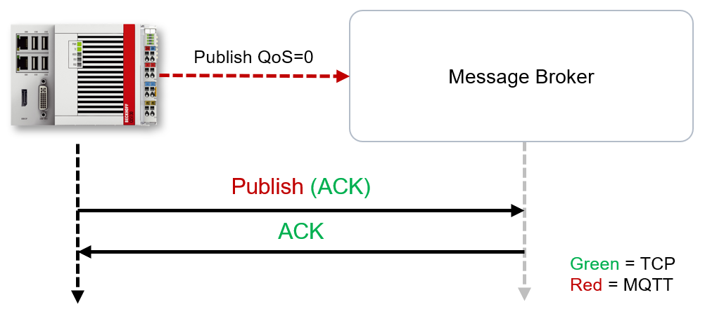
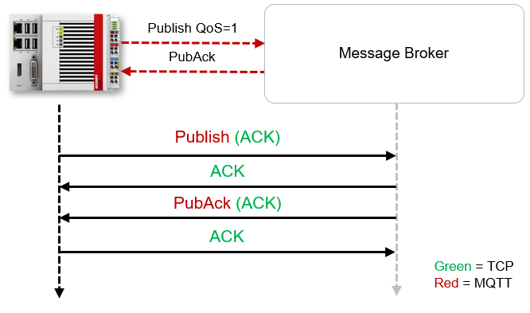
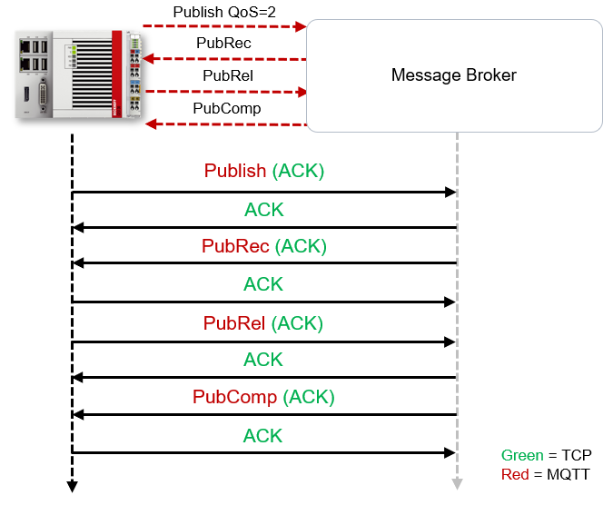
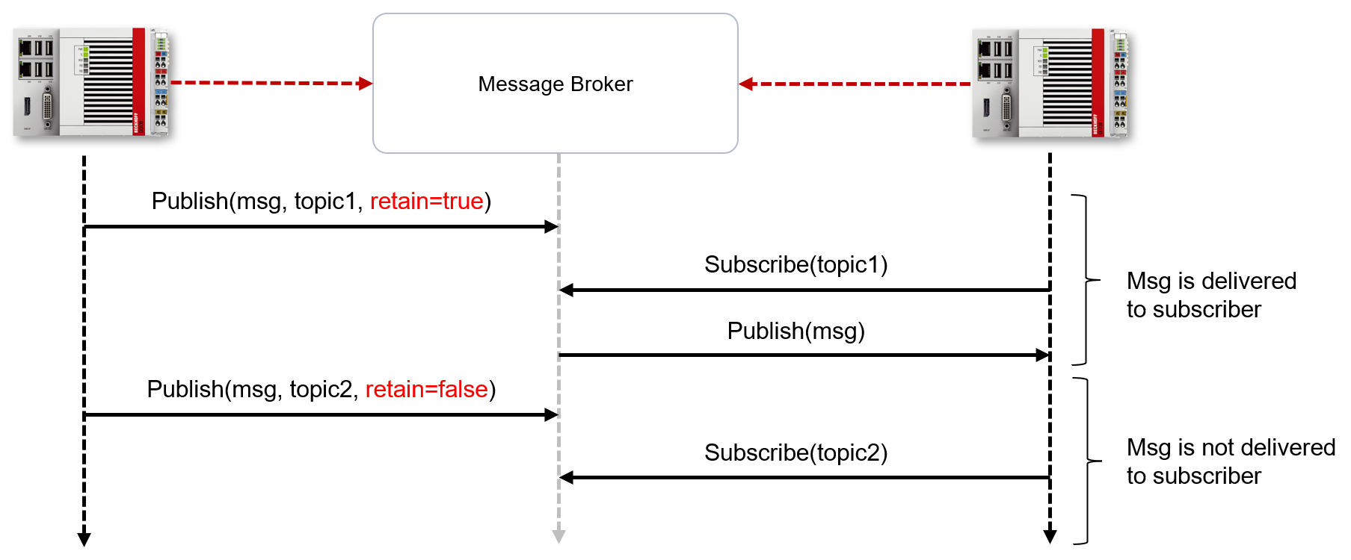
TwinCAT Connectivity QoS and Retain
QoS (Quality of Service) – Means of guaranteeing message transfer to the broker, specified by the client
Level 0: At most once
Level 1: At least once
Level 2: Exactly once
Retain – Mechanism for ensuring a subscriber received the message.
A flag to inform the broker to hold onto the most recent “retain” message for a topic
Any client subscribing to the topic, before or after the publish, will receive this message
Notes:
QoS level 0
At this QoS level the receiver does not acknowledge receipt. The message is not sent a second time.
QoS level 1
At this QoS level the system guarantees that the message arrives at the receiver at least once, although the message may arrive more than once. The sender stores the message internally until it has received an acknowledgment from the receiver in the form of a PUBACK message. If the PUBACK message fails to arrive within a certain time, the message is resent.
QoS level 2
At this QoS level the system guarantees that the message arrives at the receiver no more than once. On the MQTT side this is realized through a handshake mechanism. QoS level 2 is the most secure level (from a message transfer perspective), but also the slowest. When a receiver receives a message with QoS level 2, it acknowledges the message with a PUBREC. The sender of the message remembers it internally until it has received a PUBCOMP. This additional handshake (compared with QoS 1) is important for avoiding duplicate transfer of the message. Once the sender of the message receives a PUBREC, it can discard the initial publish information, since it knows that the message was received once by the receiver. In other words, it remembers the PUBREC internally and sends a PUBREL. Once the receiver has received a PUBREL, it can discard the previously remembered states and respond with a PUBCOMP, and vice versa. Whenever a packet is lost, the respective communication device is responsible for resending the last message after a certain time.

Slide 8
TwinCAT Connectivity Broker Scalability
Broker-to-broker communications and cloud hosted brokers facilitate distributed, scalable connectivity
Formalize topic naming and hierarchy (“namespaces”) to organize site, machine and component level data
Web service can be introduced for external access
cloud.broker.com
Broker
Site 2
Site 1
1
Broker
Broker
2
3
Subscribe
Broker: cloud.broker.com
Topic: Site/1/Machine/2/Status
Site 3
Web server
Data:
{
‘status’: ‘running’,
‘ppm’: 12.32,
‘uptime: ‘3:54:21’
…
}
Broker
https://web.portal.com/site/1/machine/2/status

Slide 9
TwinCAT Connectivity Lab 1 – MQTT
Open MQTT Client of choice
Connect to iot.beckhoff.us:1883 (User: BausUser PW: TwinCAT)
Depending on client, you may need to subscribe to ‘#’ to see all incoming messages (there will be tons)
Unsubscribe from ‘#’ and subscribe to ‘nem_2026/#’
Reference and follow lab guide: https://github.com/andedolph/NEM_2026_Connectivity

Slide 10
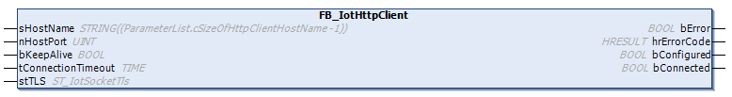

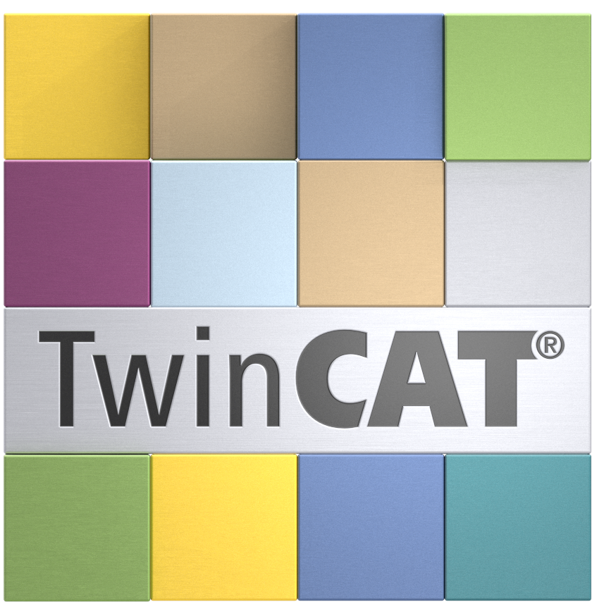






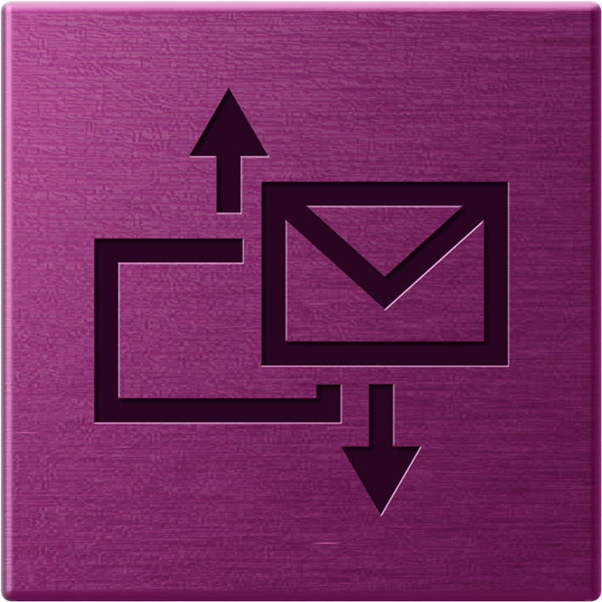




TwinCAT Connectivity TF6760
TF6760 TC3 IoT HTTPS/REST
HTTPS client connectivity for TwinCAT 3 PLC
Allows to send HTTPS requests (GET, POST, PUT, ...)
Perfectly suited for web services that offer a REST API
Security via SSL/TLS
Web service with
REST API
HTTPS
TF6760 IoT HTTPS/REST

Slide 11
TwinCAT Connectivity HTTP/REST
Hyper Text Transfer Protocol (HTTP) is the ubiquitous language for web sites and services
Representational State Transfer (REST) is a set of architectural guidelines for web-based applications
Describes how web clients and servers should interact at a high level
“RESTful” APIs commonly use HTTP
Tons of technology relies on HTTP, not just websites:
Native apps, mobile apps
Package Managers
Commercial systems; ERP, CMS, POS, etc.
SaaS, PaaS systems
Very mature and comprehensive ecosystem of tooling
Development tools, libraries
Security, access control, encryption
Notes:
Enterprise Resource Planning, content management system, point of sale

Slide 12
TwinCAT Connectivity HTTP/REST
Hyper Text Transfer Protocol (HTTP) is the ubiquitous language for web sites and services
The most common HTTP methods are GET, POST, and PUT
GET – Requests a resource from the server
POST – Transfers data to the server
PUT – Replaces or creates a resource on the server with the request payload
Notes:
The POST method is used to request that the origin server accept the entity enclosed in the request as a new subordinate of the resource identified by the Request-URI in the Request-Line.
The PUT method requests that the enclosed entity be stored under the supplied Request-URI. If the Request-URI refers to an already existing resource, the enclosed entity SHOULD be considered as a modified version of the one residing on the origin server. If the Request-URI does not point to an existing resource, and that URI is capable of being defined as a new resource by the requesting user agent, the origin server can create the resource with that URI.

Slide 13
TwinCAT Connectivity HTTP/REST Query Parameters
Query parameters are used to specify resources from a server in a way which sorts/filters the resources.
https://www.beckhoff-weather.com/forecast?city=verl
https://www.beckhoff-weather.com - Domain
/forecast - Path
?city=verl - Query parameter, where ‘?’ indicates the start of the query string

Slide 14
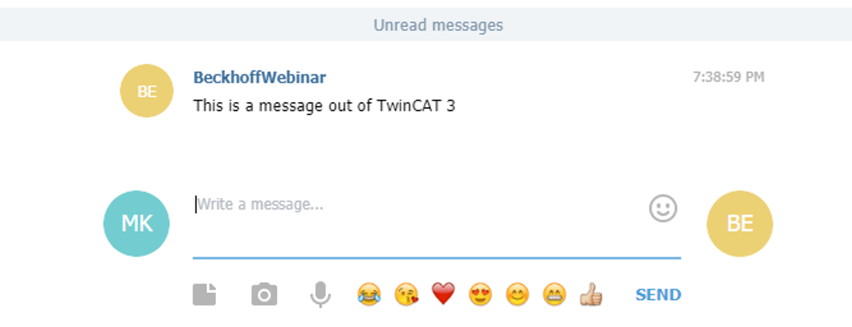
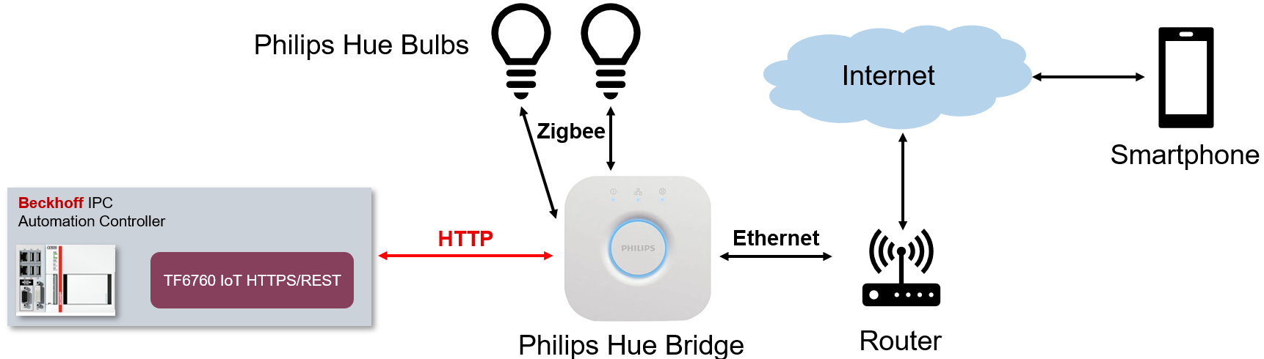
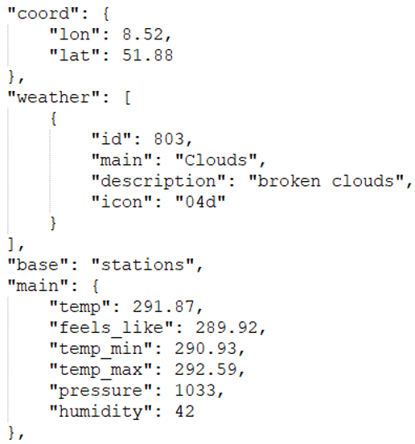
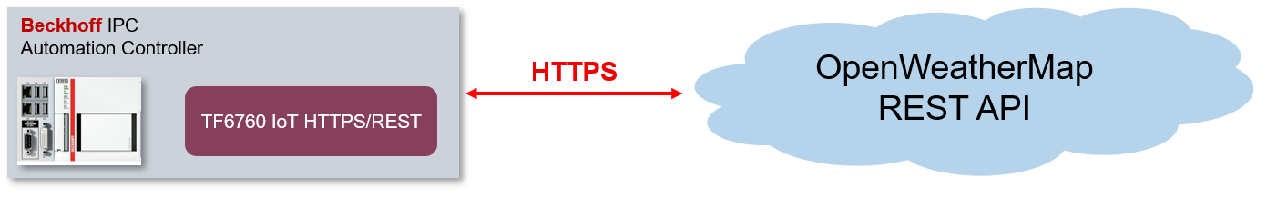
TwinCAT Connectivity TF6760 Application Examples
Telegram: Messaging application with REST API
„Telegram-Bot“ is used for communication
Philips Hue: Smart home system
Philips Hue bridge is the central unit
Bridge offers REST API to control devices
OpenWeatherMap: REST API for weather data
Different weather data formats
Location-based requests

Slide 15
TwinCAT Connectivity HTTP/REST – Exercises
Exercise 1: Web Browser
Open your browser of choice
Open developer tools (usually Ctrl + Shift + i)
Open the ‘Network’ tab
Load a web page – observe requests
Markup, binary data (e.g. images), JavaScript, JSON – all retrieved via HTTP requests
Exercise 2: cURL, wget, Invoke-WebRequest
Open a PowerShell terminal
Use any one of the above commands
Type in an endpoint, e.g. ‘httpbin.org/get’
Samples: https://github.com/Beckhoff/TF6760_Samples
Postman
OpenWeatherMap

Slide 16

TF6105 | TC3 OPC UA Pub/Sub
Implements OPC UA Pub/Sub (OPC10000-14)
Supported transport protocols:
UDP: use case “Device-to-Device”
MQTT: use case “Device-to-Cloud”
Supported operating system platforms:
Windows 10/11 (32-bit/64-bit)
TwinCAT/BSD
TwinCAT/Linux (32-bit/64-bit)
3rd-party application
Pub/Sub MQTT
Message Broker
Pub/Sub MQTT
TF6105 OPC UA Pub/Sub
3rd-Party application
Pub/Sub UDP

Slide 17
Client/Server vs. Pub/Sub
OPC UA has had a client/server architecture since its beginning in 2006
This has been perfectly suited for direct communication between devices, e.g. an HMI that directly connects to the PLC to read data
However there are challenges:
Firewalls that need to be configured in order to allow access
Poor scalability to hundreds or even thousands of devices
Poor performance because of the underlying TCP channel that is used for client/server
3rd Party OPC UA Client/Server
3rd Party OPC UA Client/Server
TF6100 OPC UA Client/Server

Slide 18
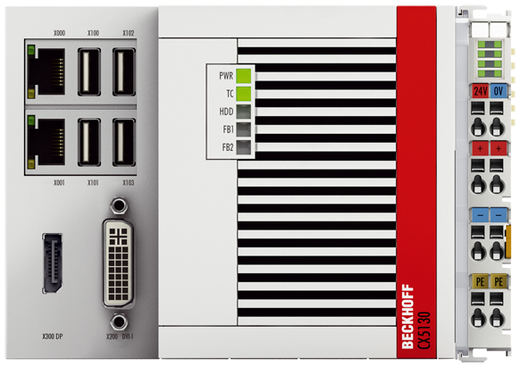
Should I use OPC UA Pub/Sub or MQTT?
Inhomogeneous environments with different vendors make interoperability a challenge
Remember: MQTT only standardizes transport, the data format is up to the application
Therefore OPC UA Pub/Sub and MQTT complement each other very well:
MQTT provides standardized transport
OPC UA provides standardized data format
Application
Message Broker
MQTT payload:
MQTT payload:
MQTT payload:
{
Timestamp : x,
Values : {
Var1 : 42
}
}
{
DayTime : x,
Var1 : 42.0
}
OPC UA object
(Binary, JSON)
3rd Party

Slide 19








TwinCAT Cloud Engineering
TwinCAT Cloud Engineering is a cloud service that provides virtual-machines with pre-installed TwinCAT + Functions
Platform-independent, secure access to the virtual machine via regular web browser
Secure access to physical controller via ADS-over-MQTT - perfectly suited for remote maintenance
TwinCAT Cloud Engineering
TwinCAT
Engineering
TwinCAT
PLC
TwinCAT
HMI
TwinCAT
ML Runtime
Message Broker
TwinCAT
Analytics
TwinCAT
Connectivity
ADS-over-MQTT
HTTPS
Connected machine
User

