Slide 1
Initial Page Load
Render Controls
Default Dataset Selected
Initial Layout Calculated (igraph)
GML to JSON
Render Table
User Selects Dataset
Render Graph (as SVG element)
Calculate Within and Outside Edges
User Uploads Dataset
User Selects Points
User Groups Nodes
Client Side
Server Side
User Activity

Slide 2
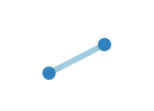
Node 2
Node 1

