Slide 1

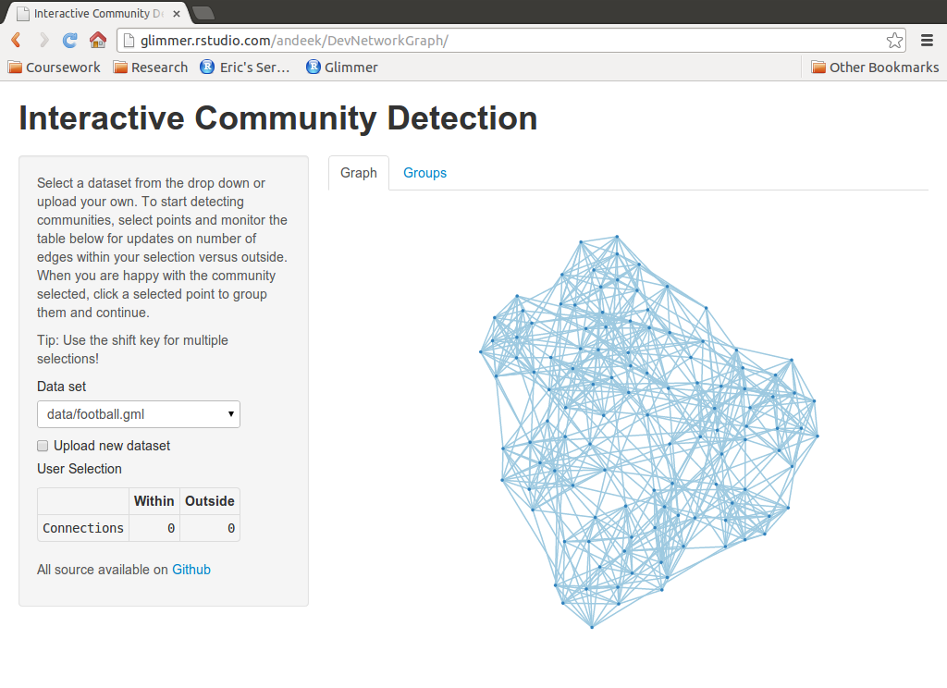
Server Side
Client Side
Interactive Graph
User Controls
D3
javascript
(general)
Shiny
Binding
Binding
Shiny
igraph
rjson
Data formatting
Client Side
Server Side
User interactions, updated data
Controls, formatted data, summary info
Shiny
igraph
rjson
D3

