Slide 1
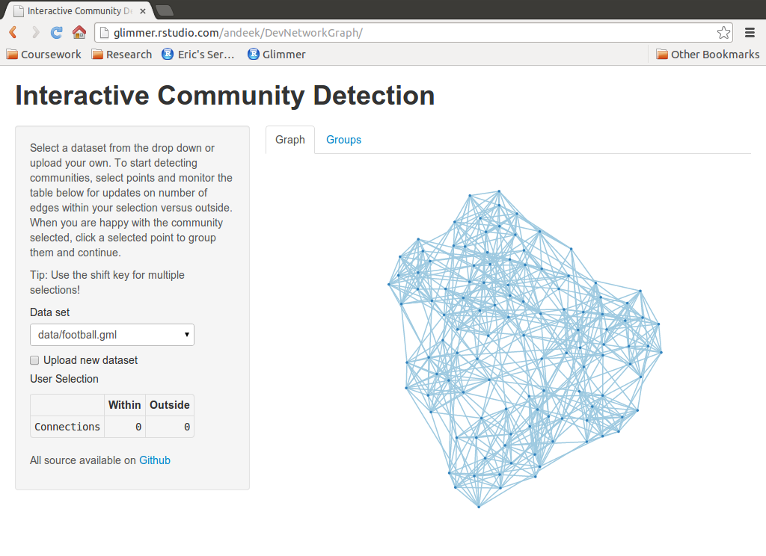

Client Side
Server Side
User interactions, updated data
Controls, formatted data, summary info
Shiny
igraph
rjson
D3

