Slide 1
List D
Linked data
List 2
List 1
Record linkage
Downstream task

Slide 2
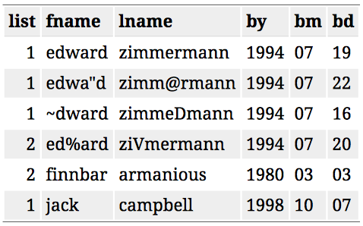
List 2
Yes No
1
??
Yes No
List 1
1
1

