Slide 1

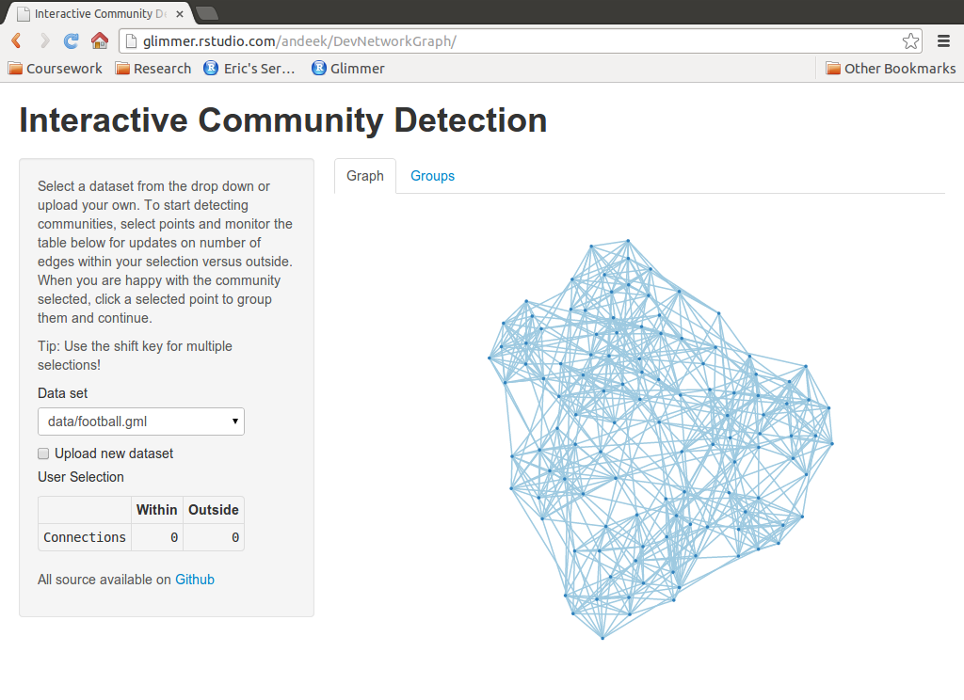
Server Side
Client Side
Interactive Graph
User Controls
D3
JavaScript
(general)
Shiny
Binding
Binding
Shiny
igraph
rjson
Data formatting
Client Side
Server Side
User interactions, updated data
Controls, formatted data, summary info
Shiny
igraph
rjson
D3

Slide 2
Initial Page Load
Render Controls
Default Dataset Selected
Initial Layout Calculated (igraph)
GML to JSON
Render Table
User Selects Dataset
Render Graph (as SVG element)
Calculate Within and Outside Edges
User Uploads Dataset
User Selects Points
User Groups Nodes
Client Side
Server Side
User Activity

Slide 3

Node 2
Node 1

Slide 4
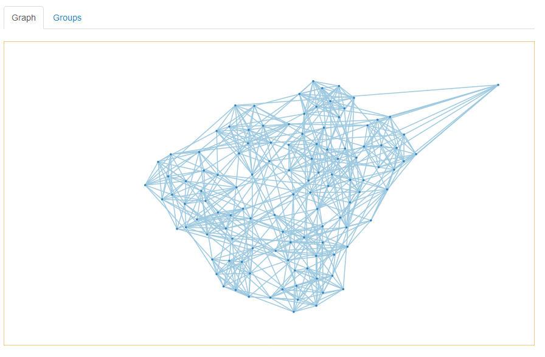


Slide 5
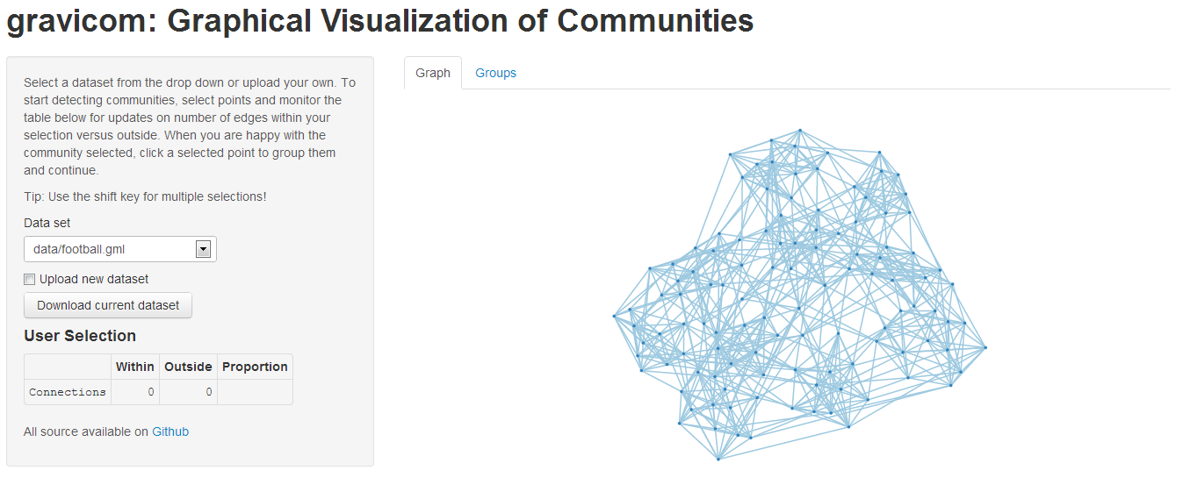
1
5
4
2
3

Slide 6
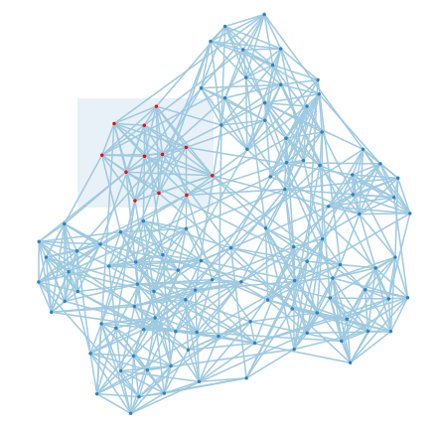
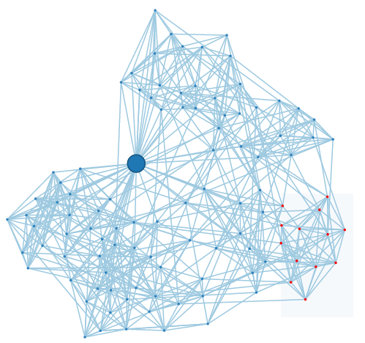
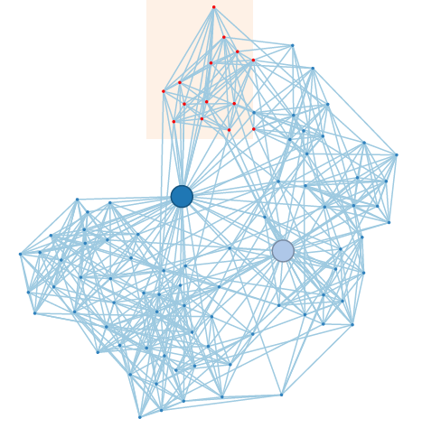
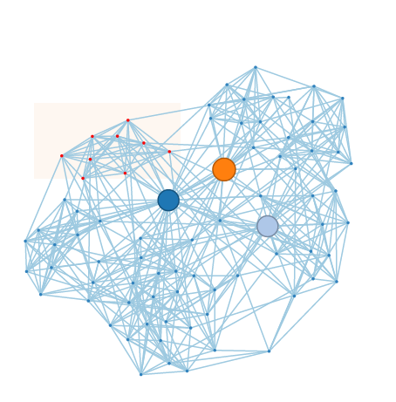
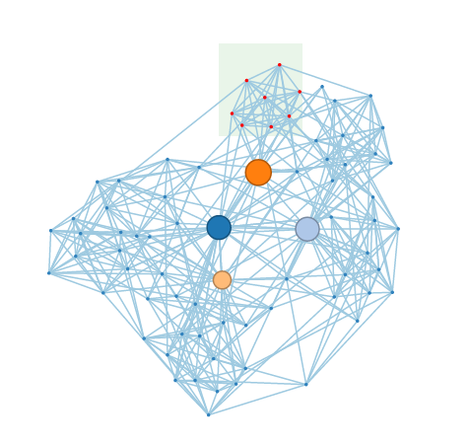
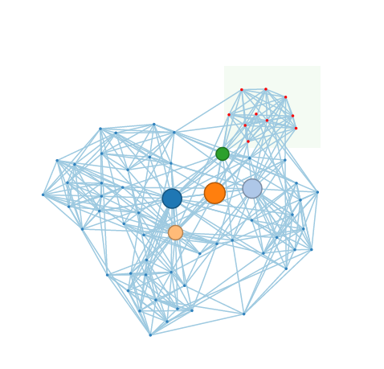
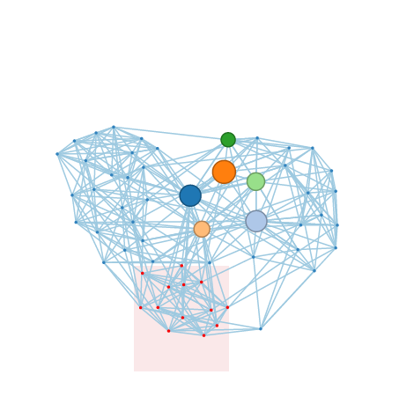
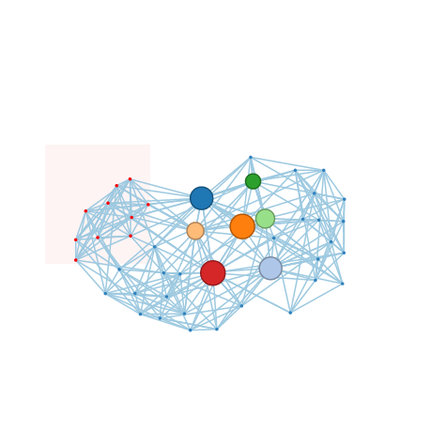
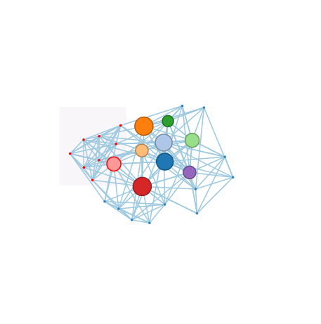
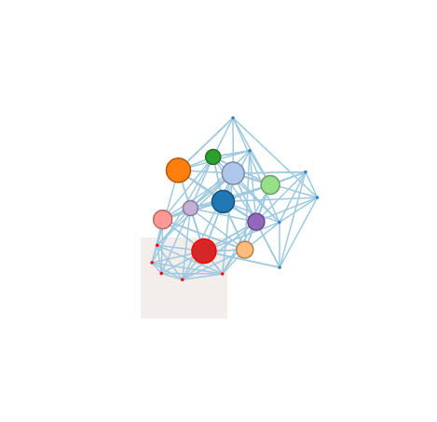
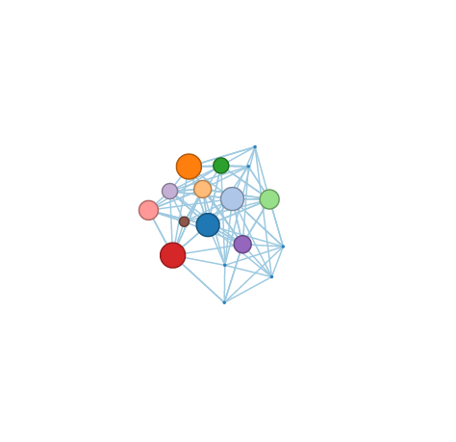
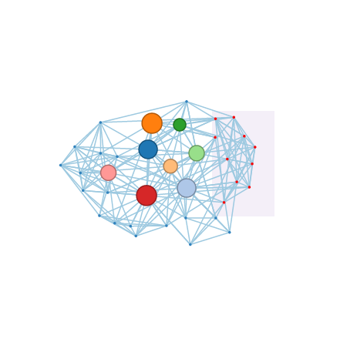
1
2
3
4
Big 10
MAC
SEC
5
6
7
8
WAC
Big East
Pac-10
Big 12
9
10
11
Mountain West
12
C-USA
ACC
Big West

Slide 7
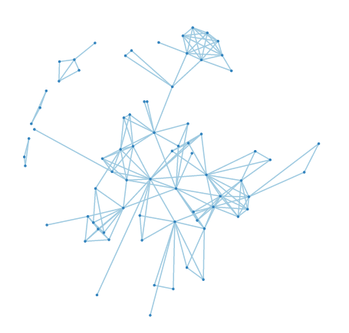
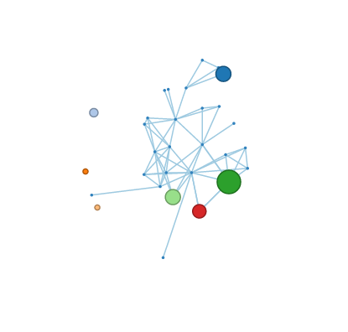
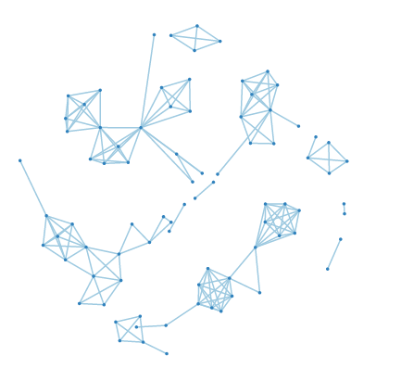
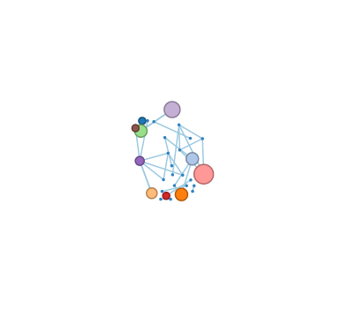
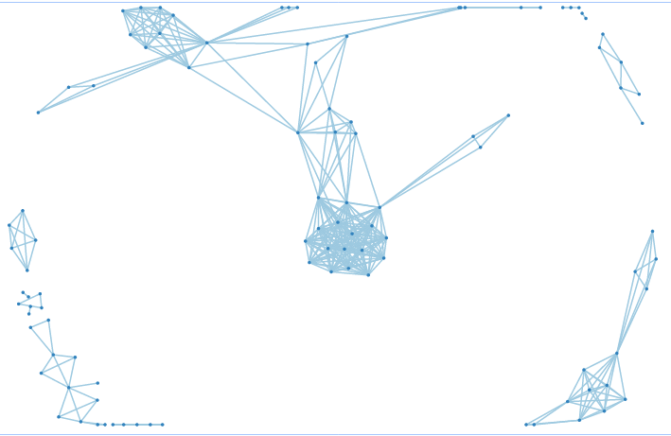
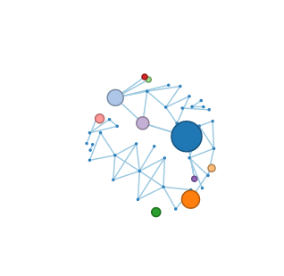
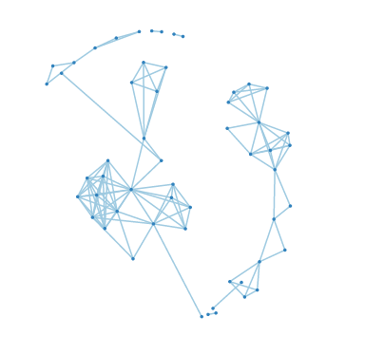
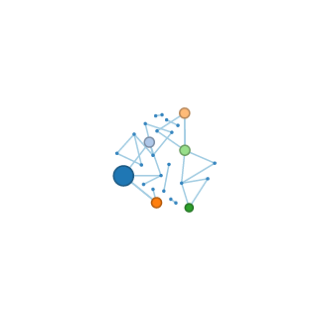
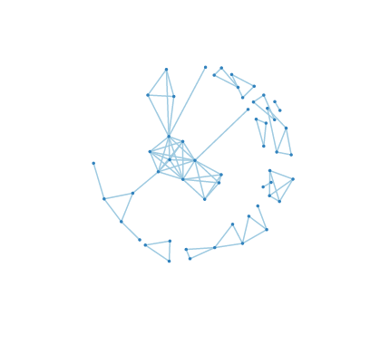
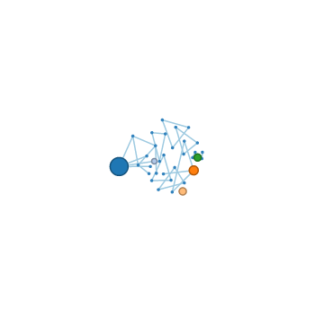
Book 1:
A Game of Thrones
Book 2:
A Clash of Kings
Book 3:
A Storm of Swords
Book 4:
A Feast for Crows
Book 5:
A Dance with Dragons

