Slide 1
List D
Linked data
List 2
List 1
Record linkage
Downstream task

Slide 2
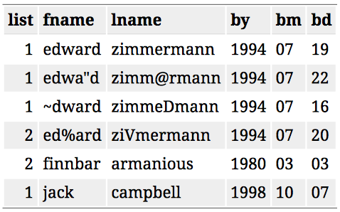
Record linkage
Λ = {1, 1, 1, 1, 5, 6}
List 2
CRC
Yes No
1
??
Yes No
List 1
1
1

Slide 3
Record linkage
List 2
CRC
Yes No
Λ = {1, 1, 1, 1, 5, 6}
1
??
Yes No
List 1
1
1

Slide 4
Population
List 2
Yes No
5
6
Yes No
List 1
Capture 2
3
6
Capture 1

Slide 5
List 1
List 2
List 3
Michael Jordan
Danny Glover
Alan Gelfand
Lebron James
?
Chadwick Boseman
Ed George
Kevin Durant
Michael Jordan
?
Mike Jordan
Stephen Curry
Donald Glover
Phillip Dawid

Slide 6
List 1
List 2
List 3
Michael Jordan
Danny Glover
Alan Gelfand
Lebron James
Chadwick Boseman
Ed George
Kevin Durant
?
Michael Jordan
Mike Jordan
Stephen Curry
?
Donald Glover
Phillip Dawid
?
MJ

Slide 7
Basketball Players
Actors
Statisticians
Michael Jordan
Danny Glover
Alan Gelfand
Lebron James
Chadwick Boseman
Ed George
?
?
Kevin Durant
Michael Jordan
Mike Jordan
Stephen Curry
?
Donald Glover
Phillip Dawid
?
?
MJ
DG

Slide 8
Google
Yahoo
Bing
Michael Jordan
Danny Glover
Alan Gelfand
Lebron James
Chadwick Boseman
Ed George
Kevin Durant
Michael Jordan
Mike Jordan
Stephen Curry
Donald Glover
Phillip Dawid
MJ
DG

Slide 9
Dataset 1
Linkage Variables
Explanatory Variables
Response Variables
Dataset 2
Linkage Variables
Explanatory Variables
Response Variables

Slide 10
Dataset 1
Linkage Variables
Explanatory Variables
Dataset 2
Linkage Variables
Explanatory Variables
Response Variables

