Slide 1

SYSTEM
monitoring
Notes:
I HAVE A CONFESSION TO MAKE:
I HAVE NEVER OWNED A PAGER
NEVER BEEN ON CALL
AND NEVER BEEN IN OPERATIOS
SO WITH THAT, LET ME TELL YOU ALL ABOUT MONITORING ☺
BUT I HAVE SPENT 4 YEARS OF MY LIFE BUILTING DISTRIBUTED NETWORK MONITORING SYSTEMS – A PROPRIOTERAY ONE.

Slide 2
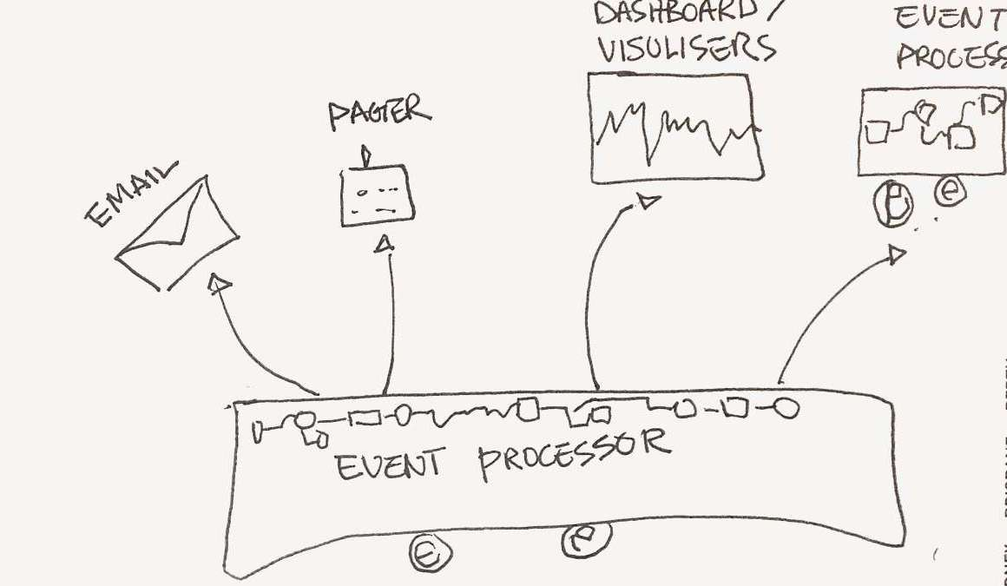

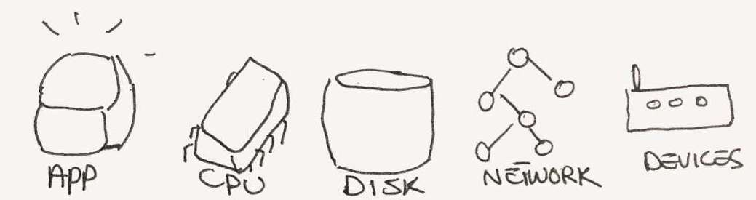
DECONSTUCTING
MONITORING
Event Processors
Aggregating
Filtering
Processing
Alerting ...
Collectors
Producing
events
from the source
Source
Things to monitor
Notes:
I HAVE A CONFESSION TO MAKE:
I HAVE NEVER OWNED A PAGER
NEVER BEEN ON CALL
AND NEVER BEEN IN OPERATIOS
SO WITH THAT, LET ME TELL YOU ALL ABOUT MONITORING ☺
BUT I HAVE SPENT 4 YEARS OF MY LIFE BUILTING DISTRIBUTED NETWORK MONITORING SYSTEMS – A PROPRIOTERAY ONE.

Slide 3
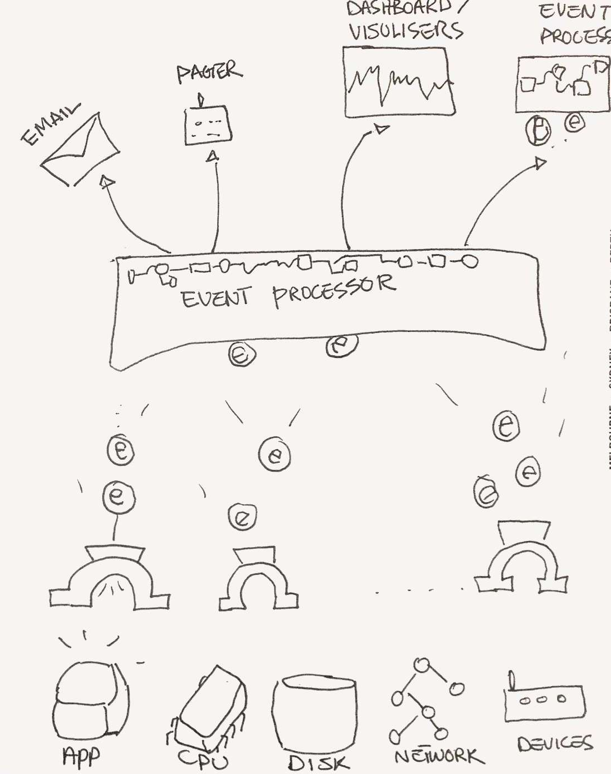
OPENSOURCE
Menu of the day
Riemann-dash
Dashboard
Riemann
clojure stream
processing
collectd
+ plugins
CPU
System load
Processes
Connectivity

Slide 4

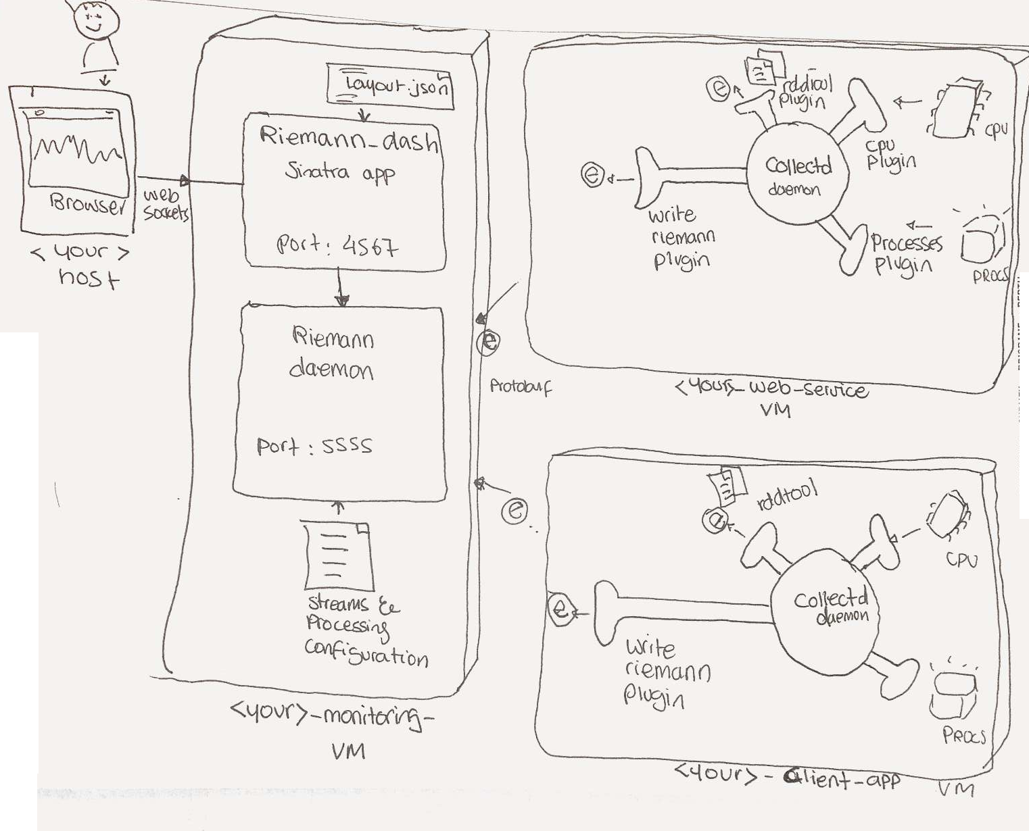
THE SYSTEMS TO MONITOR

Slide 5
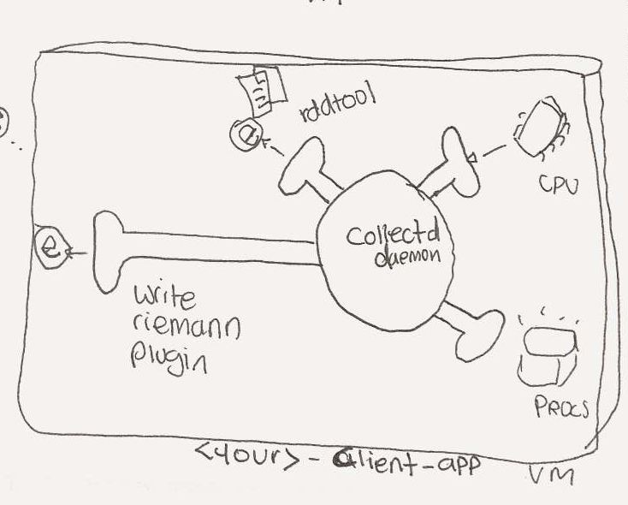
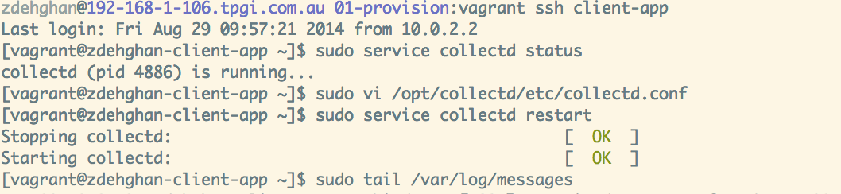
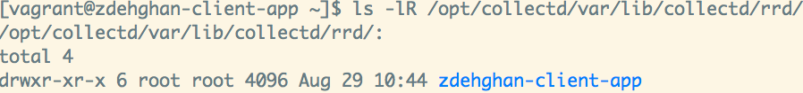
ALLONS-Y!
Step 1. Enable collectd cpu, load and process
plugins on source vms and write events into local files
Step 2. Check out collected rrd files and make yourself a graph
Step 3. Repeat on web-service vm

Slide 6
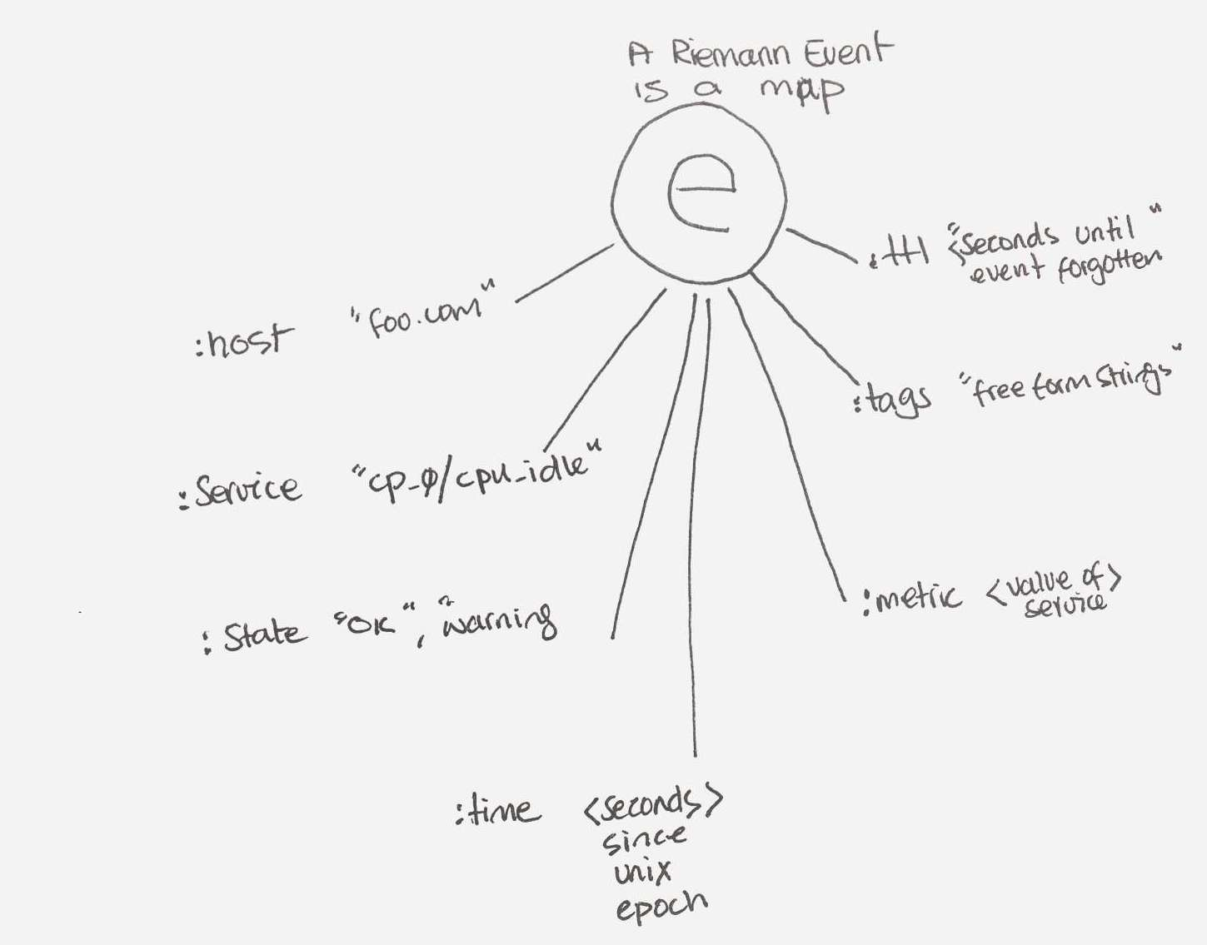
Riemann – it is a beautiful thing
Events temporarily
kept in an index
Keyed by [:host :service]
to be queried by dashboard

Slide 7
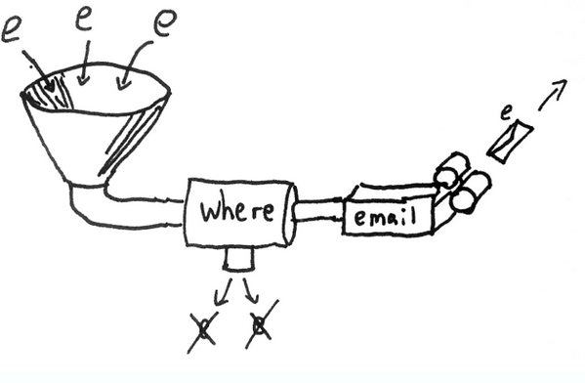
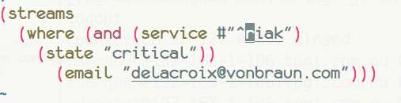
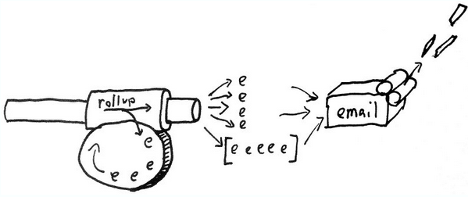
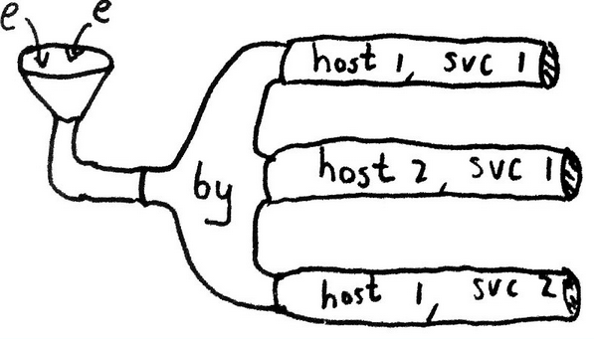
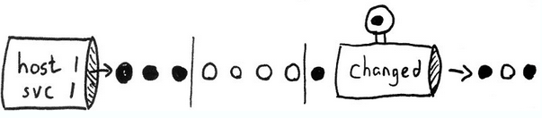
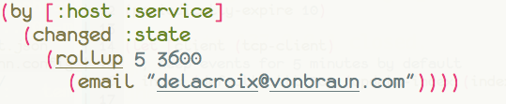
Riemann – The magic of streams
2 Streams: FILTER and ALERT
3x2 Streams: SPLIT, DETECT STATE CHANGE and ALERT BUT NO SPAM
Notes:
Streams are s-functions that get defined in clojure, live in riemann config file and perform all sorts of wonderful and powerful processing, filtering, aggregation, and forwarding to other streams external to riemann such as graphite.

Slide 8
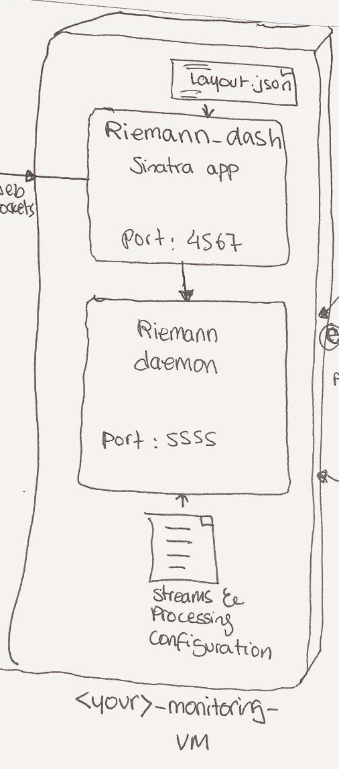
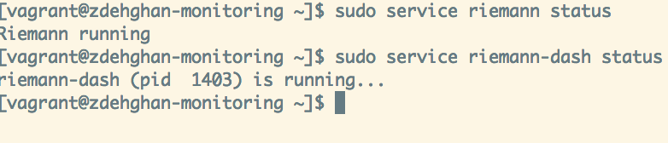
LETS GET THOSE EVENTS TO RIEMANN
Step 1. Enable Riemann and its dashboard on monitoring vm
Step 2. Enable riemann_write plugin on client-app and web-service vms
and restart collectd
Step 3. Repeat step 2 on web-service vm
Notes:
Now that I have made you excited enough, lets get those events to riemann

Slide 9
A GLANCE AT THE RIEMANN CONFIG & LOG
Step 1. Basic logging stream – enable logging & watch events
Step 2. Enable riemann_write plugin on client-app and web-service vms
and restart collectd
Step 3. Repeat step 2 on web-service vm
Notes:
Now that I have made you excited enough, lets get those events to riemann

Slide 10
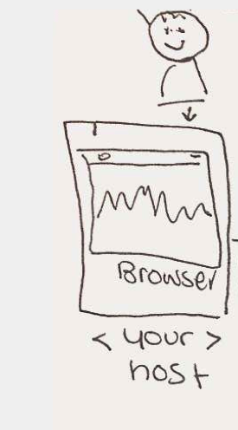
Lets setup the dashboard
Step 1. Basic logging stream – enable logging & watch events
Step 2. Connect the browser to the riemann-dash
http://zdehghan-monitoring.local:4567/#Riemann
Step 3. Calculate the number of hosts and the cpu utilization – you may need to stress your machine
Notes:
Now that I have made you excited enough, lets get those events to riemann

Slide 11
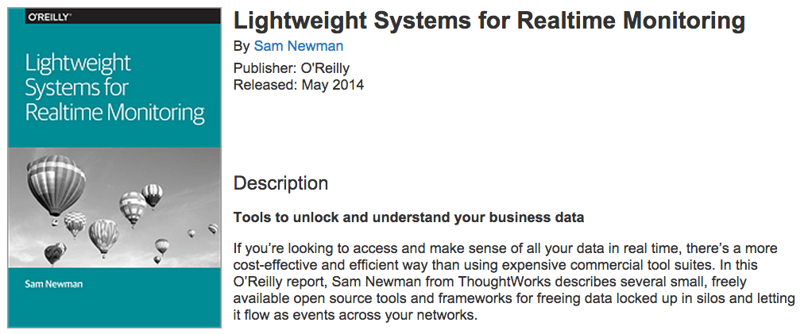
WHAT you could do NEXT
Explore other collectd plugins
Extend riemann to send email, sms
Extend riemann to capture application info
Use application riemann clients
Check out Sam’s book
Notes:
Now that I have made you excited enough, lets get those events to riemann

