Slide 1

MHC-PMS / klinischer Apotheker
CS1 Task 8:
Architecture and Package Diagram

Slide 2

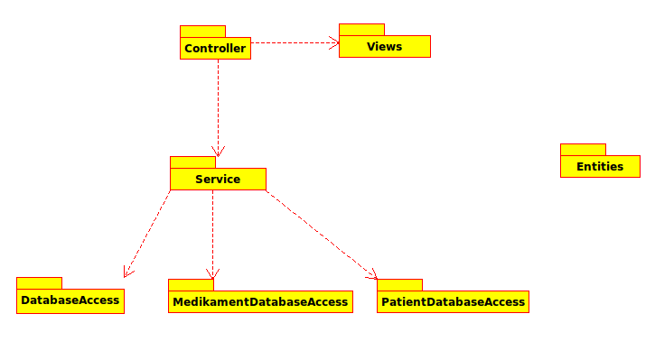
Client/Server
Browser
Client (Browser)
Server

Slide 3
Domain Model
Presentation Layer (MVC)
Service Layer
Data Access Layer

Slide 4

Fragen & Diskussion

