Slide 2
Cypress Workshop
Why Cypress?
Cypress vs Selenium
Install and create first test.
Excersice 1.
Why Typescript?
Install Typescript for Cypress.
Notes:
Hi
The purpose of this workshop is to get you started with Cypress as a gui testing tool
As you in the slide we are going to mix walkthru’s and excersices

Slide 3
Why Cypress?
Like modern frontend frameworks, it’s based on JavaScript
No wait’s
Time travel
Based on well known NodeJS libraries like Chai, Sinon.
It’s a complete test tool.
Notes:
Based on JavaScript, possible to use TypeScript to get better/clearer code
Cypress automatically waits for calls to finish. No need for explicit waits
In Cypress you can go back and see haw a test played out, step by step.
And it’s in the NodeJS eco-system, so you can add other libraries.
No need of separate test runner, it’s a complete tool. And it’s simple to get up and running

Slide 4
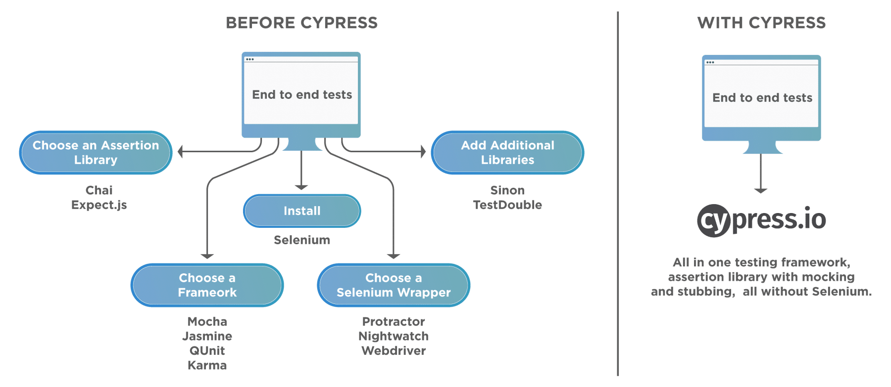
Why Cypress?
Notes:
This picture is how Cypress like to explain why it’s simpler to get started with.

Slide 5
Cypress vs Selenium
Tool | Advantages | Limitations
Cypress | Time travel No wait’s Automatic scrolling Command execution in real time Good documentation | Only one browser at the time No support for multi-tabs JavaScript (Typescript) only No Safari support Limited support for iFrames
Selenium | Compatible with multiple OS Many programming languages Supports all major browsers Provides Concise APIs Multiple tests possible | No built-in cmd for autogen. of test results Handling of Page/Element load is difficult Limited support for testing images Creating test cases is time-consuming Difficult to set up test environment as compared to Cypress
Notes:
I’ve googled some of the pros and cons of Cypress and Selenium and came up with this table.

Slide 6
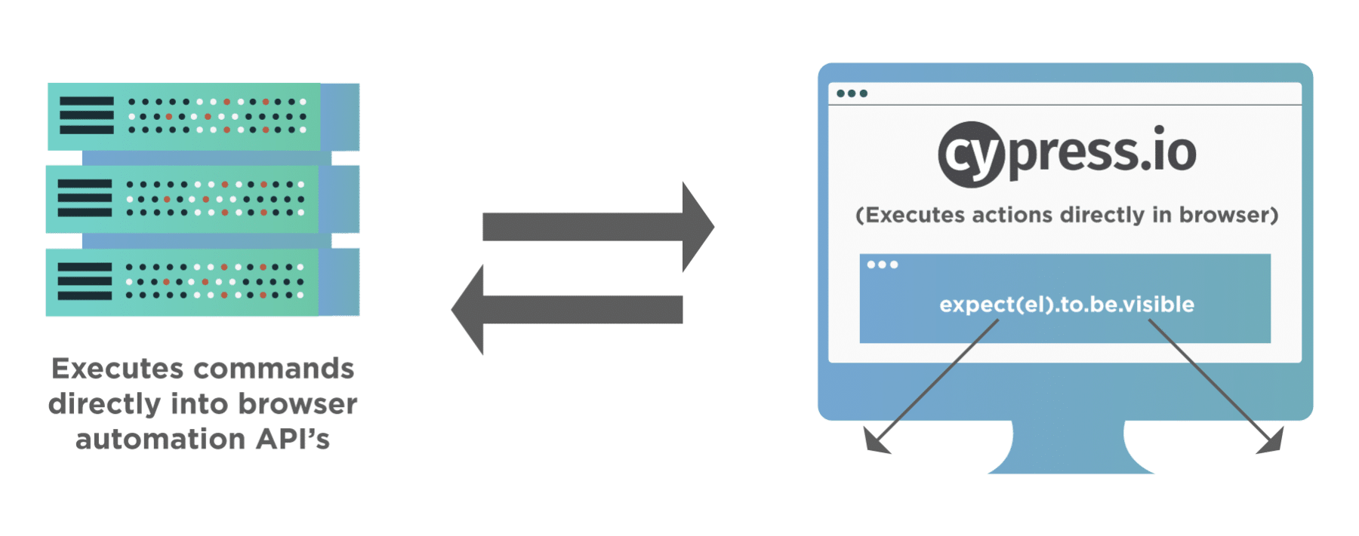
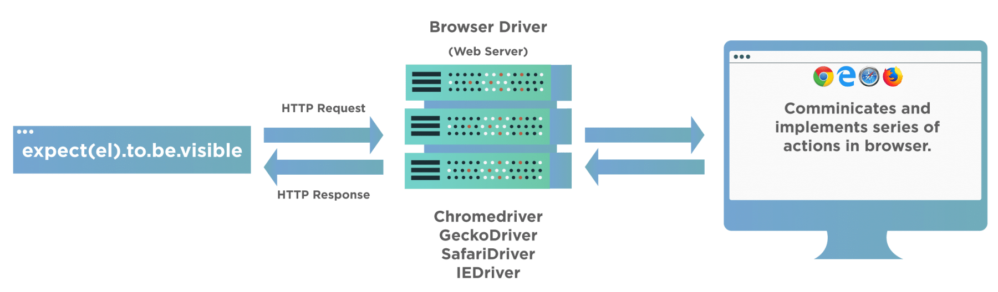
Cypress vs Selenium
Cypress | Selenium
Executes inside browser - WebSocket between tool and browser | Executes outside browser - WebDriver controls browser
Notes:
In my opinion the biggest difference is how the test code is executed.
As shown on this slide Cypress test code is executed directly in the browser

Slide 7
First test
Cypress come with a bundle of example tests
By default, all tests are located in /cypress/integration
Mocha test structure
Key functions | Meaning/Use
describe() | Test suite, organize a set of test for one subject.
context() | Same functionality as ‘describe’. Often used when a subject is in a specific state. Enhances readability.
it() | Test case. This is where the actual test code goes.
beforeEach() | Code that will run before each test case.
before() | Code that will run once before any test case is run.
afterEach() | Code that will run after each test case.
after() | Code that will run once after all test cases have finished.
Notes:
Show where example tests are located, open todo.js and show the structure of the test-spec
Go thru the key-words
Show the example testcase again and walk thru it
Mention nested calls.

Slide 8
First test
Cypress can be started from git-bash with any of:
./node_modules/.bin/cypress open
npx cypress open
npm run cyo
Notes:
Explain the 3 cmd’s
Start cypress and run the example

