Slide 2
Cypress Workshop
Why Cypress?
Cypress vs Selenium
First Test
Excersice 1.
Why Typescript?
Install Typescript for Cypress.
Notes:
Hi
The purpose of this workshop is to get you started with Cypress as a gui testing tool
As you in the slide we are going to mix walkthru’s and excersices

Slide 3
Why Cypress?
Like modern frontend frameworks, it’s based on JavaScript.
No wait’s.
Time travel.
Based on well known NodeJS libraries like Mocha and Chai.
It’s a complete test tool.
Notes:
Based on JavaScript, possible to use TypeScript to get better/clearer code
Cypress automatically waits for calls to finish. No need for explicit waits
In Cypress you can go back and see how a test played out, step by step.
And it’s in the NodeJS eco-system, so you can add other libraries.
No need of separate test runner, it’s a complete tool. And it’s simple to get up and running

Slide 4
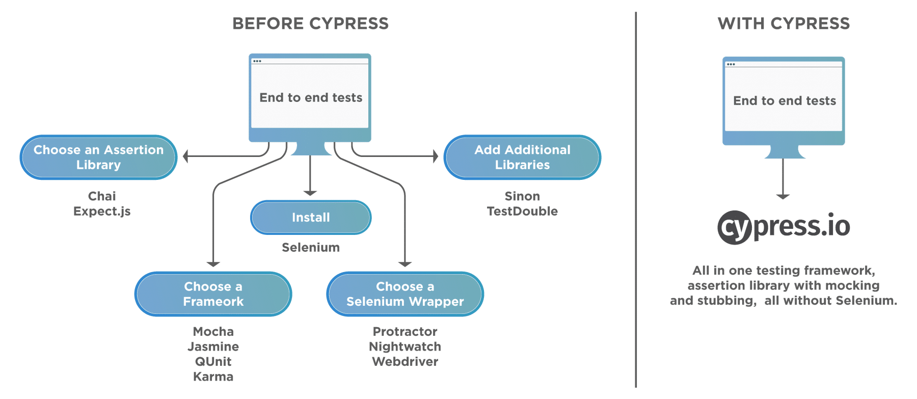
Why Cypress?
Notes:
This picture is how Cypress like to explain why it’s simpler to get started with.

Slide 5
Cypress vs Selenium
Tool | Advantages | Limitations
Cypress | Time travel No wait’s Automatic scrolling Command execution in real time Good documentation | Only one browser at the time No support for multi-tabs JavaScript (Typescript) only No Safari support Limited support for iFrames
Selenium | Compatible with multiple OS Many programming languages Supports all major browsers Provides Concise APIs Multiple tests possible | No built-in cmd for autogen. of test results Handling of Page/Element load is difficult Limited support for testing images Creating test cases is time-consuming Difficult to set up test environment as compared to Cypress
Notes:
I’ve googled some of the pros and cons of Cypress and Selenium and came up with this table.

Slide 6
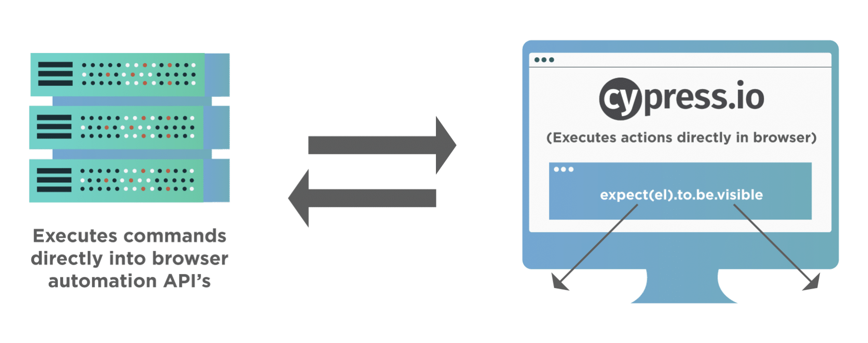
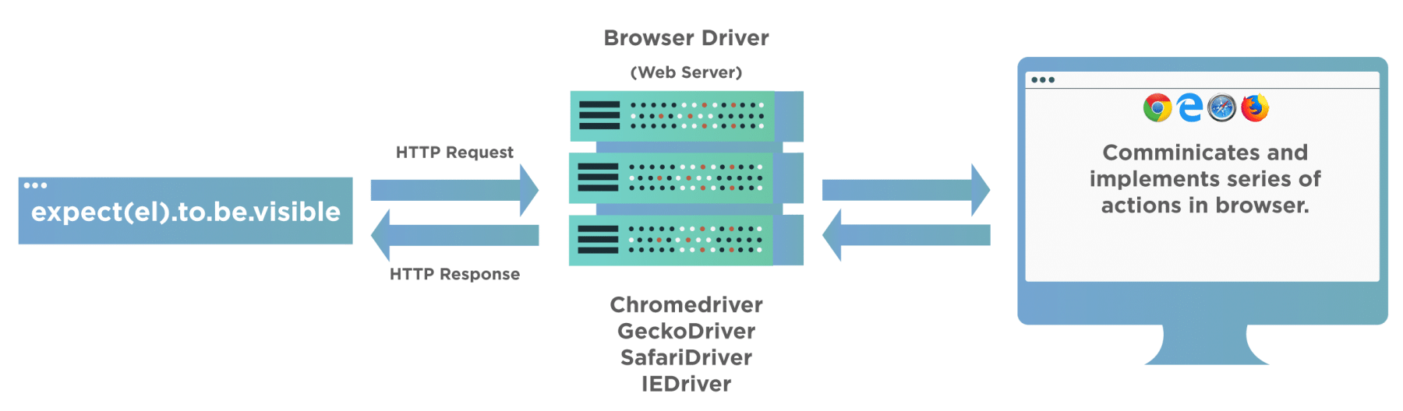
Cypress vs Selenium
Cypress | Selenium
Executes inside browser - WebSocket between tool and browser | Executes outside browser - WebDriver controls browser
Notes:
In my opinion the biggest difference is how the test code is executed.
As shown on this slide Cypress test code is executed directly in the browser

Slide 7
First test
Cypress come with a bundle of example tests
By default, all tests are located in /cypress/integration
Mocha test structure
Key functions | Meaning/Use
describe() | Test suite, organize a set of test for one subject.
context() | Same functionality as ‘describe’. Often used when a subject is in a specific state. Enhances readability.
it() | Test case. This is where the actual test code goes.
beforeEach() | Code that will run before each test case.
before() | Code that will run once before any test case is run.
afterEach() | Code that will run after each test case.
after() | Code that will run once after all test cases have finished.
Notes:
Show where example tests are located, open todo.js and show the structure of the test-spec
Go thru the key-words
Show the example testcase again and walk thru it
Mention nested calls.

Slide 8
First test
Cypress can be started from git-bash with any of:
./node_modules/.bin/cypress open
npx cypress open
npm run cyo
Goto https://docs.cypress.io/guides/getting-started/writing-your-first-test
Remember to open two git-bash, cypress app will lock one git-bash
Stop when you get to headline “Next Steps”
Notes:
Explain the 3 cmd’s
1. Here we run the Cypress application directly by giving the relative path to it (from our ws folder)
2. In later versions of npm we can use npx, npx will automatically find our application
3. We can also define our own commands in the package.json file – show package.json
I will now start cypress and run the 1:st example:: I will now just show what it looks like when you run a test in Cypress testrunner
Show how to expand the finished test in the testrunner
I will make it simple for me and use Cypress own tutorial for writing your first test
Now everybody can start Cypress, if you haven’t already. If it’s the first time you started cypress you will get a link to the first test tutorial
Has everybody got Cypress started?
Then go a head and run thru the tutorial for writing your first test, this will take about 30 min
Ask as soon as anything seems unclear.

Slide 9
WS Exercise 1
Create folder ‘Exercises’ in /cypress/integration/
In that folder create test specification ex1_spec.js
The test should check that David Caro is the contact person for test automation at CAG
Cag is found at url: https://www.cag.se/
One way of finding David is: Homepage -> Systemutveckling -> Mer om Test
NB! It’s tricky to check Davids name. I will show you how, if you get stuck. Clue: Resolve promise first.
Notes:
Explain the 3 cmd’s
1. Here we run the Cypress application directly by giving the relative path to it (from our ws folder)
2. In later versions of npm we can use npx, npx will automatically find our application
3. We can also define our own commands in the package.json file – show package.json
I will now start cypress and run the 1:st example:: I will now just show what it looks like when you run a test in Cypress testrunner
Show how to expand the finished test in the testrunner
I will make it simple for me and use Cypress own tutorial for writing your first test
Now everybody can start Cypress, if you haven’t already. If it’s the first time you started cypress you will get a link to the first test tutorial
Has everybody got Cypress started?
Then go a head and run thru the tutorial for writing your first test, this will take about 30 min
Ask as soon as anything seems unclear.

Slide 10
WS Solution Exercise 1
Walk thru of suggested solution
Notes:
Show good practice with simple assertions that we are on desired page
Show how we can wait for promise to finnish and how we use expect in that callback for assertion

Slide 11
What is TypeScript?
Wikipedia:
TypeScript is a programming language developed and maintained by Microsoft. It is a strict syntactical superset of JavaScript and adds optional static typing to the language. TypeScript is designed for the development of large applications and transcompiles to JavaScript.^{[5]} As TypeScript is a superset of JavaScript, existing JavaScript programs are also valid TypeScript programs.
Notes:
Read the text
Created at Microsoft by Anders Hejlsberg (designer of C#)

Slide 12
Why TypeScript?
Static typing (optional)
Every .js-file is a valid TypeScript file
More reliable, easier to refactor.
Better for larger/complex projects
Better to start with TypeScript direct.
Large JavaScript projects can be hard to refactor to TypeScript
Notes:
I’m neither a JavaScript or Typescript developer so I will not dive down into the more technical aspects of either
Static typing, no need to use JS linter. Can be turned of if you need to (during refactoring from JavaScript for example)
Static typing means that you have to declare your variable by type, like number or string, before you can use them
Java is a static typed language
Python is dynamically typed
This since Typescript is a superset of JavaScript
Using Typescript makes it easier to structure and maintain your code
It is possible to refactor, but needs JavaScript and Typescript expertise

