Slide 1

What is a Ruby Gem?
A Ruby Gem is essentially a ruby plugin. It’s history dates back to where ruby plugins are used. These plugins however require the full code hierarchy to be included directly into the project and updating the plugins is a manual process where the updated code would be downloaded and extracted into the project at top the previous version but ruby gems came to make our lives easier. All needed is reference and optionally the version. the only aspect managed is a special file called Gemfile.

Slide 2
Why do we need Ruby Gems?
One of the most obvious reasons relates to code reuse. if you find yourself implementing the same feature over & over again across projects, there’s a good chance that you’ve found the need for a gem.
Also, releasing a gem as open-source provides others the opportunity to contribute by adding features, addressing issues that you might have overlooked.
Lastly, you might also consider building a gem to show case your talent as a developer (for learning & improvement sake). Companies or individuals might reach out to you based on your coding contributions.

Slide 3

Let’s dive into building a Gem!!!

Slide 4
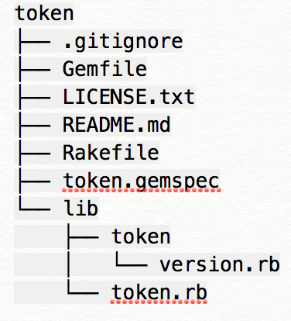
From path directory on terminal:
gem search -ar <gem name>
bundle gem <your gem name>
The command generates the tree below:

Slide 5
Releasing your Gem!!!
Create an account on https://rubygems.org/sign_up
gem build <gem name>.gemspec
gem push <gem name>-0.0.1.gem

Slide 6
Yayyy!!! And we have a Gem
A big thanks to everyone for listening.
#gRACIAS
#mERCI

