Slide 1
Building Rails Application (A Dummy Guide)
Yusuf daniju
software developer
andela

Slide 2
What is Rails?
A ruby web framework
Quick website
Opinionated
Convention over configuration

Slide 3
Let’s Build a bucketlist app
Initialize the App
Update Gemfile with dependencies
Run bundle (install)
Generate models
Write validations
Run ‘rake db:migrate’
Set up routes
Controllers
Views
Blah blah blah!

Slide 4
1.
Initializing the app
THE DEFAULT OR NOT?

Slide 5
Initializing
rails new ‘app_name’ --skip-test-unit

Slide 6
Initializing
Add ‘rspec-rails’ and ‘pry’ to gemfile and run ‘bundle’
run ‘rails generate rspec:install’
Voila!

Slide 7
2.
Models
The Home of business Logic

Slide 8
Two Models
User
Name:
at most 30 chars
required
Password:
at least 8 chars
required
Jotter
title
body
user_id

Slide 9
User Model
rails g model User name password_digest
rails generate model User name:string password_digest:string

Slide 10
User models...
context 'when initialized' do
it 'is valid with correct parameters' do
expect(user).to be_valid
end
end

Slide 11

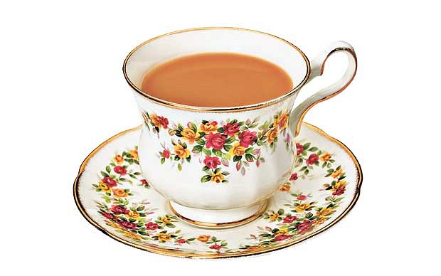

Slide 12
Users COntroller
rails g controller Users

Slide 13
Just three actions
new
create
show

Slide 14
USER sessions
rails g controller Sessions
new, create and destroy
Update routes ie
resources :sessions, only: [:new, :create, :destroy]

Slide 15
More on sessions
HTTP(S) is stateless
Session is used to store state
Session expires at the close of a browser session

Slide 16
Session Contd.
<%=
form_for :session,
url: sessions_path do |f|
%>
Another one, eh?

Slide 17
SEssion CONTd.
Creating a session is just storing user info in sessions
You can retrieve to know who is being dealt with
For security, look ahead...

Slide 18


Slide 19
Jotter
Model
Controller
View

Slide 20
Jotter Model
rails . . . model . . .
Let’s model it together
Oh! We forgot a column?

Slide 21
Jotter model
Instead of
rails g model Jotter title body:text
we did
rails g model Jotter title

Slide 22
Jotter Model contd.
We need to generate and run migration to include column
Hope you know schema already?

Slide 23
Add new column
rails g migration
add_body_column_to_jotters
body:text

Slide 24
Jotters controller
rails g controller … … …
index
new
create
edit
update
destroy

Slide 25
The new http verb
We know
get
post
put or patch
delete
...

Slide 26
Small talk
Quit Small talk, do the job

Slide 27
Gems to look at
annotate
faker
capybara
factory_girls
selenium_webdriver
etc

Slide 28
referEnces
RailsGuides
http://api.rubyonrails.org/
https://www.relishapp.com/
Lastly, you can look at this app
https://github.com/andela-ydaniju/jotters

