Slide 1
Changes needed in BeanGo
01/23/2026

Slide 2
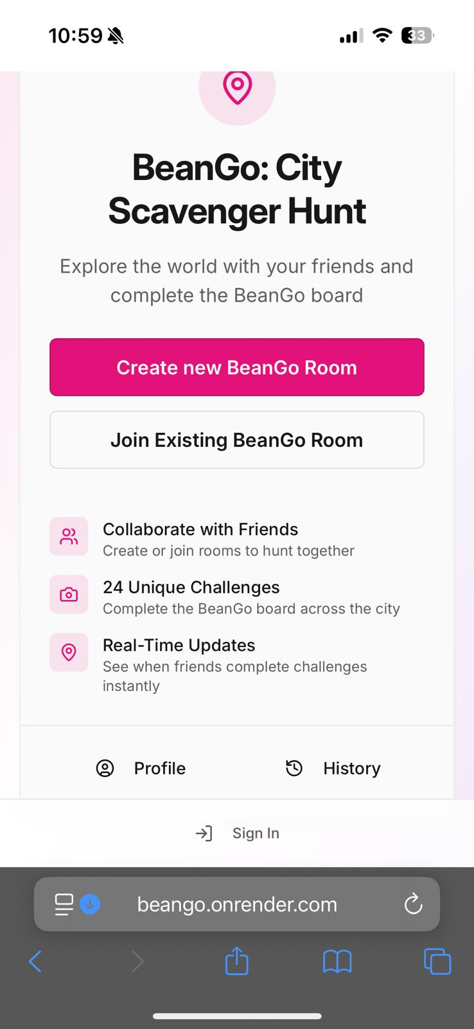
Step 1
Room creator lands in main menu

Slide 3
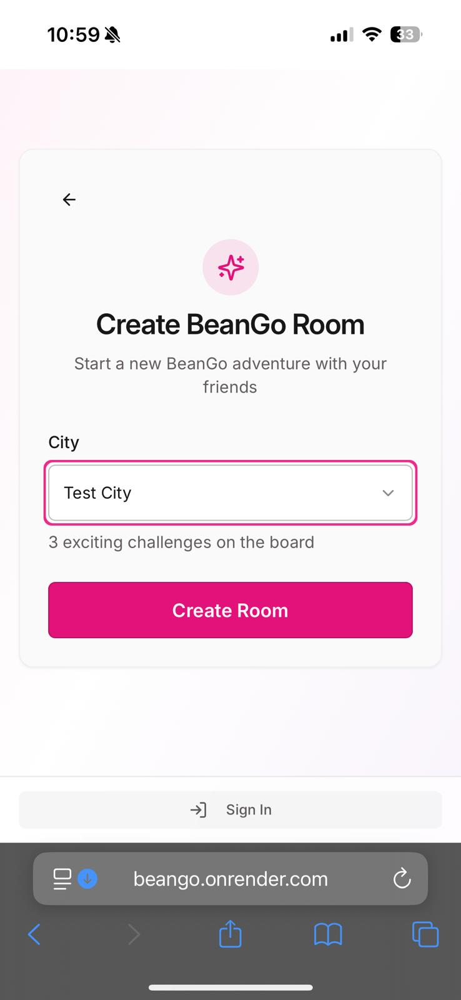
Step 2
Room creator Selects city and taps on “Create Room”

Slide 4
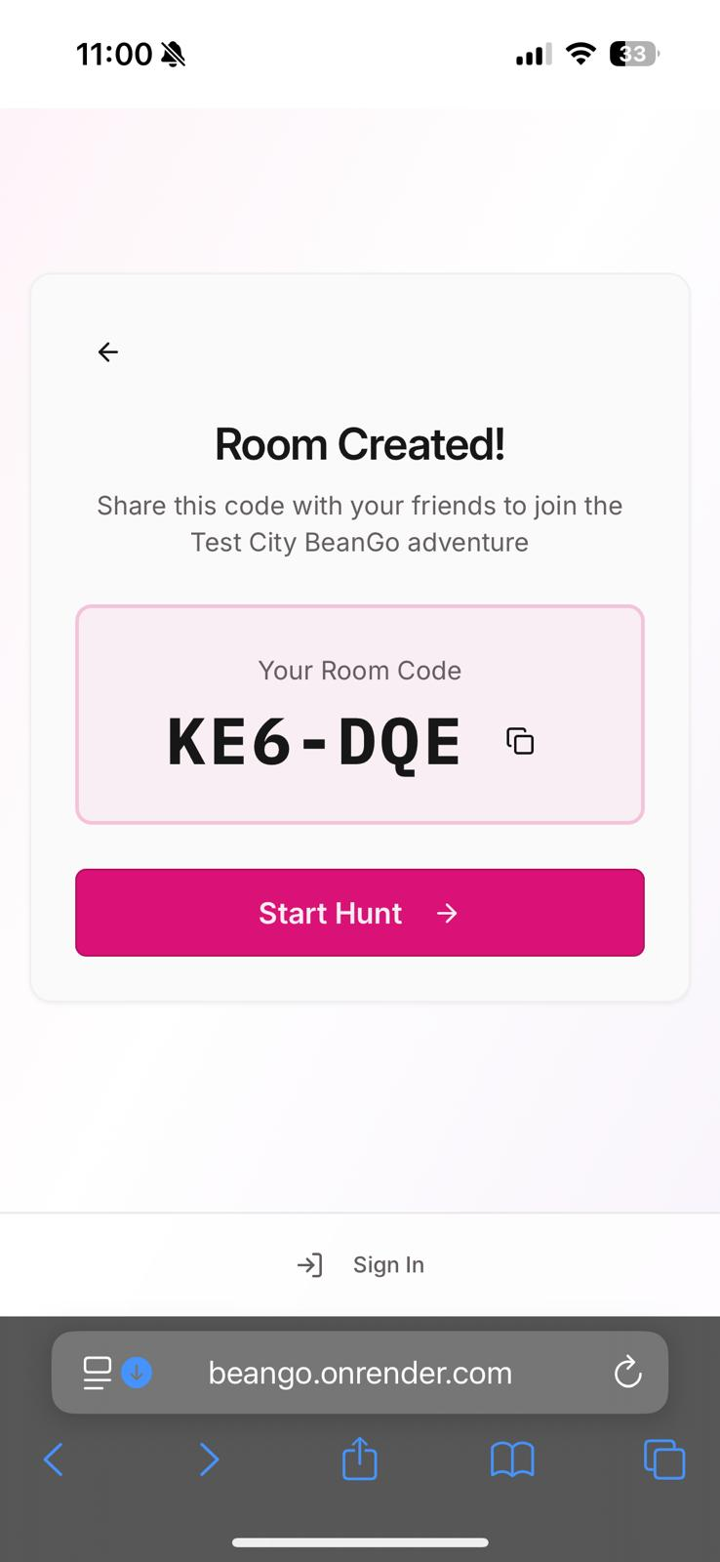
Step 3
This is the lobby.
We display the room code.
Only the room creator sees the button which reads “Start Hunt”.
This screen should be modified so that all participants are displayed.

Slide 5
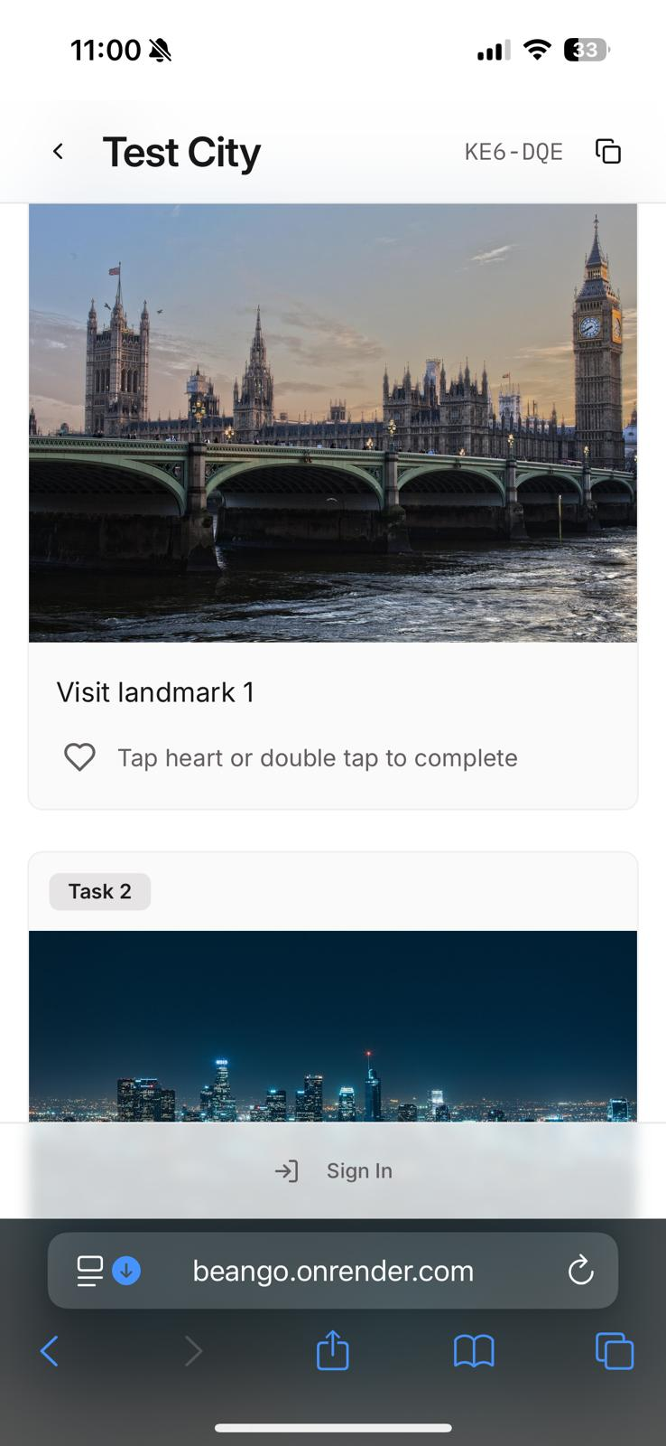
Step 4
The board is created.
It should reflect the interests of everyone who joined the room before the board was created.

