Slide 1

Software Engineering
Project: SMART COMMUTE WEB APP
Antonio Michele Del Negro -862516
Pável Pascacio De Los Santos-852255
Prof. Matteo Rossi
March 2019

Slide 2
Outline
1. Smart Commute Overview
2. Idea
3. Objective
4. Requirements
4.1 Use Case Diagram
4.2 Requirements
4.3 System Architecture
5. Design
5.1 High Level Class Diagram
5.2 Front-end Class Diagram
5.3 Back-end Class Diagram
5.4 Sequence Diagrams
5.4.A Log in and Load data to the App Environment
5.4.B Create an Event
5.4.C Modify and Delete an Event
5.4.D Select an Event on the Map
6. Implementation
6.1 Graphical User Interfaces
6.2 Used Tools and Code description
7. Testing
8. Conclusion and Future Works
Professori
Outline

Slide 3
Smart Commute Overview
Nowadays, work routines are getting progressively more hectic over time. People in several industries must quickly to adapt to new routines and appointments, go from one place to the other trying to do not be late, accomplishing that demands the individual to spend handful minutes on the smartphone using apps and calculates its day routine.
Most of the functionalities of a mapping application depend on the versatility and portability of a Smartphone, which encourages to the main developers to the development of mobile apps. However, attempts have been made to turn smartphones more “browser-native” and web-oriented as the Firefox OS that was used like a base for some startup as JiPhone on the development of a successful iOS called KaiOS, which was installed in very low-end feature phones given excellent results.
The previous statements encourages us to consider the development of a mapping web app exploited the main advantages of web app as compatibility and versatility between devices, free installing and updating, multidevice…
In addition, the correct delimitation of the web app’s users allows us to design an ad hoc app, which placing our app web in advantageous position with respect to commercial apps that cover a wide range of users.
Professori
Smart Commute Overview

Slide 4
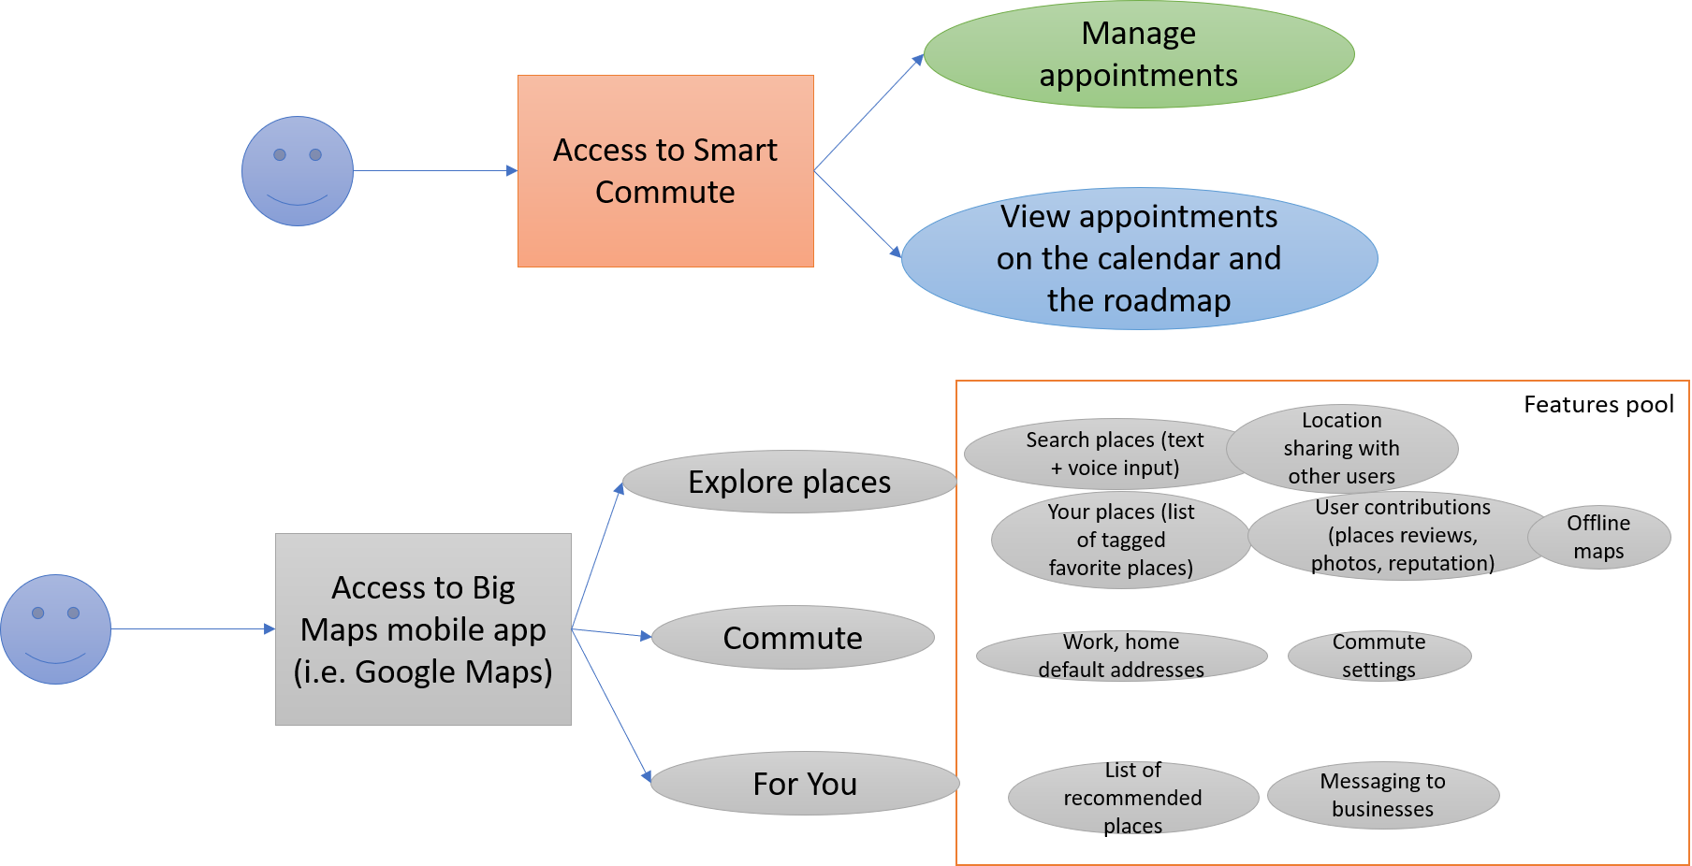
Idea
Smart Commute intends to construct a simple but very useful application ad hoc dedicated to who need to schedule their events considering also the geographical location of each event, but, reducing the additional functionality provided by commercial applications, which generically satisfies more needs than our users need, making the user experience more complicated and less optimized.
Professori
Idea

Slide 5
Idea
Professori
Idea

Slide 6
Objective
Provide a scheduler web-app with a calendar interface that computes and accounts for travel time between appointments to make sure you are never late for an appointment.
Professori
Objective

Slide 7
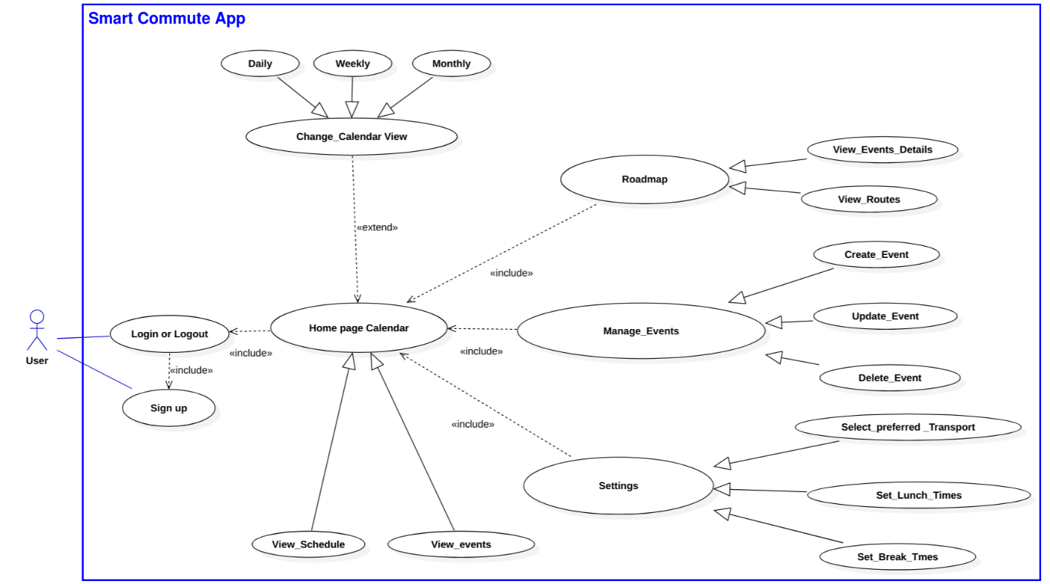
User Case Diagram
Requirements

Slide 8
Requirements
User authentication
Calendar
Roadmap
User settings
Smart Commute
Professori
Requirements

Slide 9
User Authentication REQ.1.1
The App will allow the user to access Smart Commute through the use of an account
The App permits to register new users using email and password
The App Authenticates user’s credentials
The App permits the user to login and Logout
The App helps the user to retrieve lost credentials
Professori
Requirements

Slide 10
User Authentication REQ.1.2
The App will permit Multiuser access
The App provides to each user its own environment
The App allows to log in different users simultaneously
The App permits the users to access the platform from different browsers
Professori
Requirements

Slide 11
User Authentication REQ.1.3
The App must communicate with the database to interact with each user’s data
The App must be able to store each user credentials in the Database
The App must load each user’s data from the Database for later use
Professori
Requirements

Slide 12
Calendar REQ.2.1
The App must provide a Calendar interface that shows the user's events and permits the user to interact with them
The Calendar will allow the user to pick a previously created event and prompt the edit event popup for event edition
The App allows the user to change the calendar views to: Monthly, Weekly and Daily
The Calendar will allow the user to pick a day or several days from the calendar and prompt the create event popup for event creation
Professori
Requirements

Slide 13
Calendar REQ.2.2
The Calendar must provide a graphic representation of all user events
The user's events must be represented on the calendar views with a tag indicating the start time and title
The user's events on the calendar must show details including the full title and start and end times whenever the user hovers on the event
Professori
Requirements

Slide 14
Calendar REQ.2.3
The Calendar must provide a Form popup to Manage the events
The popup must allow the user to delete/create/update events and to cancel any of the operations
The popup must avoid the creation of any event with an empty Title
The popup must allow the user to input the following data: title, start and end times, location and description
Professori
Requirements

Slide 15
Calendar REQ.2.4
The Calendar must store and update the user's events in the Database
The Calendar must retrieve each event data from the Database and render it onto the calendar interface every time the user creates/modifies an event
The Calendar must retrieve each event data from the Database and render it onto the calendar interface for every user login
The Calendar must save/update to the Database the event data created or modified by the user
Professori
Requirements

Slide 16
Roadmap REQ.3.1
The Road Map will have a map and a daily calendar of the current events
The Roadmap must retrieve all the events from the database to calculate the routes, and render both the events as markers and the routes as polylines
The Daily Calendar will display the user’s day events, its details upon hovering, and show its details on the map marker on clicking
The Map must have the following utilities: zoom in, zoom out, map layers, display routes and show route checkpoints
Professori
Requirements

Slide 17
Settings REQ.4.1
The app will provide a settings menu that allows the user to modify the preferences
The Settings menu must preload the default settings onto the interface, or the saved user settings from the Database (if any)
The Settings menu must allow the user to specify and toggle on/off break and lunch times
The settings menu will allow the user to save & exit, submitting the settings data and saving it in the Database
The settings menu must permit the user to select the available and favorite transportation means (bus, car, bike…)
Professori
Requirements

Slide 18
Smart Commute REQ.5.1
The Smart Commute must compute and validate the time of the events
The Smart Commute must avoid that the event’s start and end conflict with the lunch or break times for weekdays
The Smart Commute must check that the event time of the event to be created/updated does not overlap with the existing events’ start and end times
The Smart Commute must check that the event start time is not greater than the end time and forbids its creation/update if this requirement is not fulfilled.
Professori
Requirements

Slide 19
Smart Commute REQ.5.2
The Smart Commute must account for travel times for event validation
The Smart Commute must check if the travel times are smaller than the time available between events to allow event creation/update
The smart Commute must update the travel times every time that the user modifies the location and times of the events and settings
The Smart Commute must calculate the route times for each event pair and user’s current location, considering the user transport preferences
Professori
Requirements

Slide 20
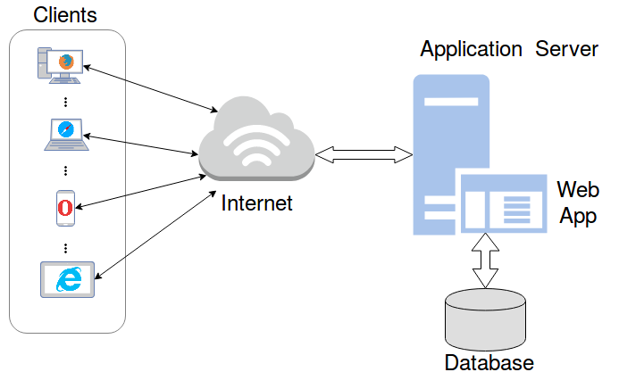
System architecture
Professori
Requirements

Slide 21
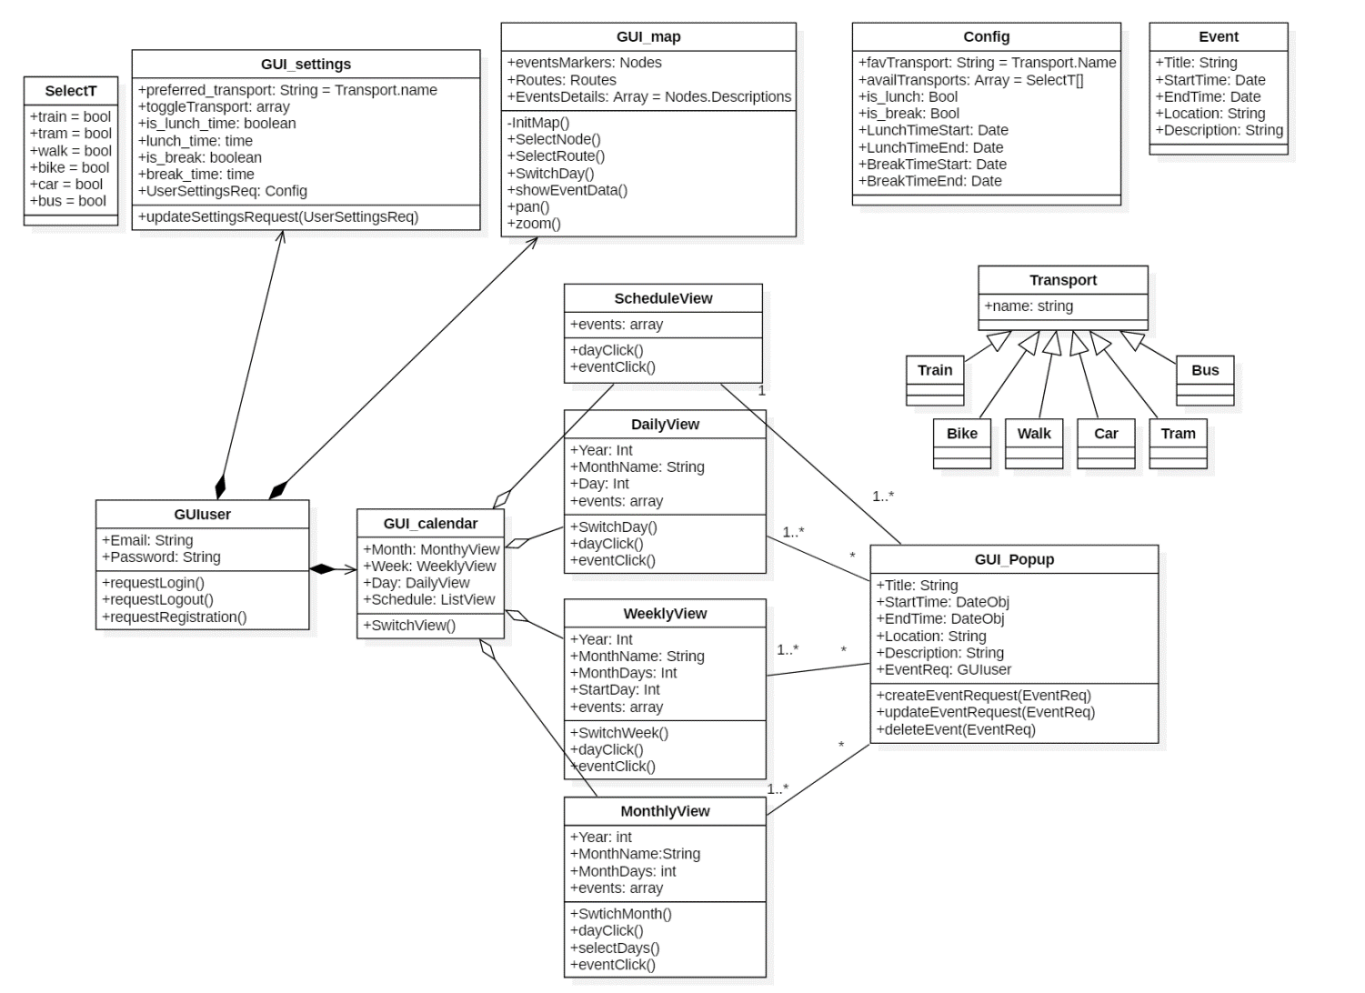
Front End Class Diagram
Professori
Design

Slide 22
Front End Class Diagram
The GUI user class is the initial interface the user interacts with upon access to Smart Commute
Design

Slide 23
Front End Class Diagram
Design

Slide 24
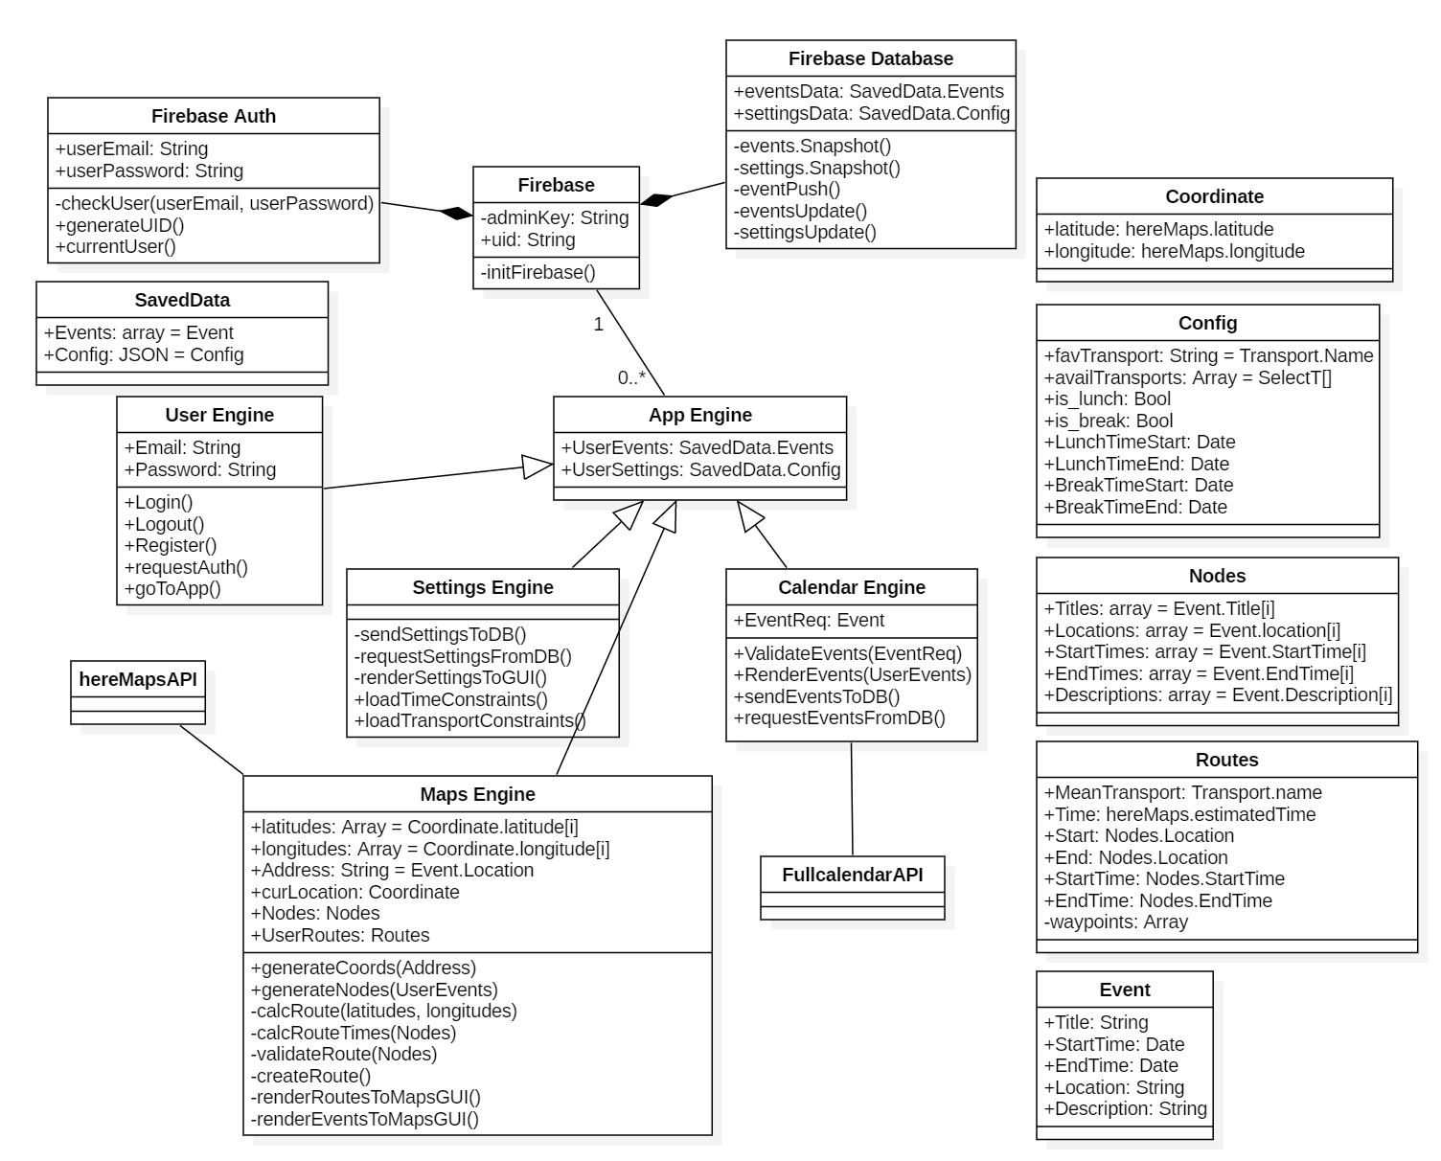
Back End Class Diagram
Professori
Design

Slide 25
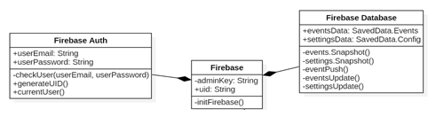
Back End Class Diagram
Design

Slide 26
Back End Class Diagram
Design

Slide 27
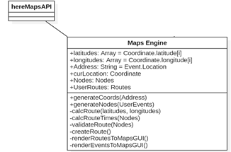
Back End Class Diagram
Design

Slide 28
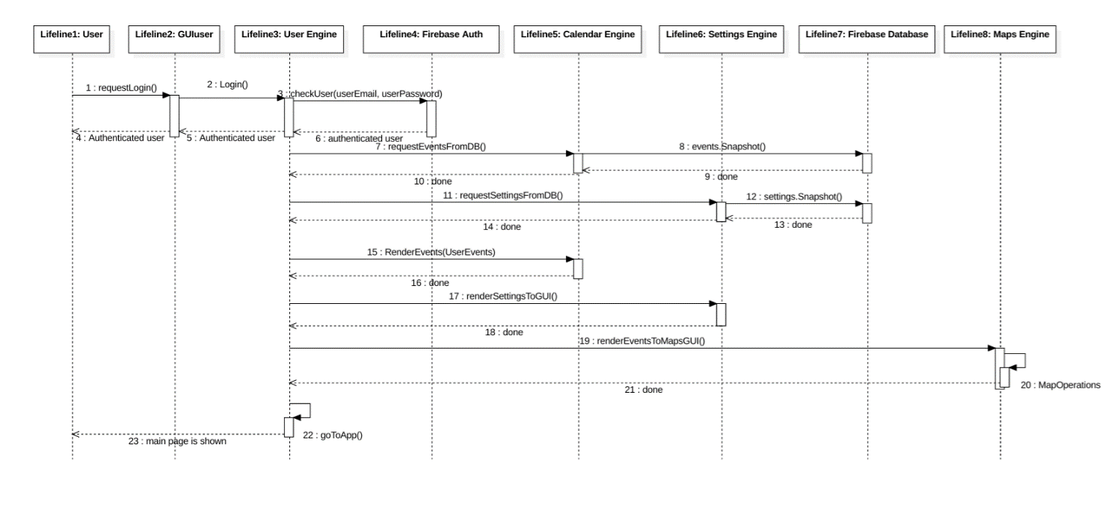
Sequence Diagram: Log in to Web App and load user data to the environment
Professori
Design

Slide 29
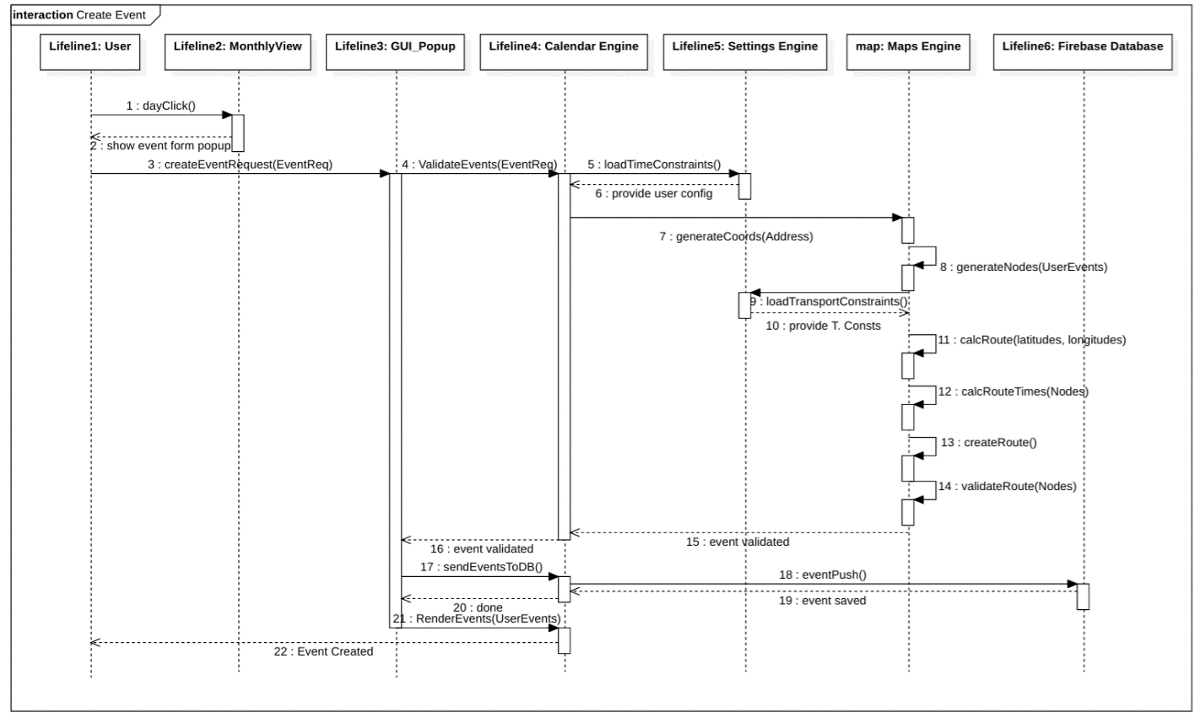
Sequence Diagram: Create an Event
Professori
Design

Slide 30
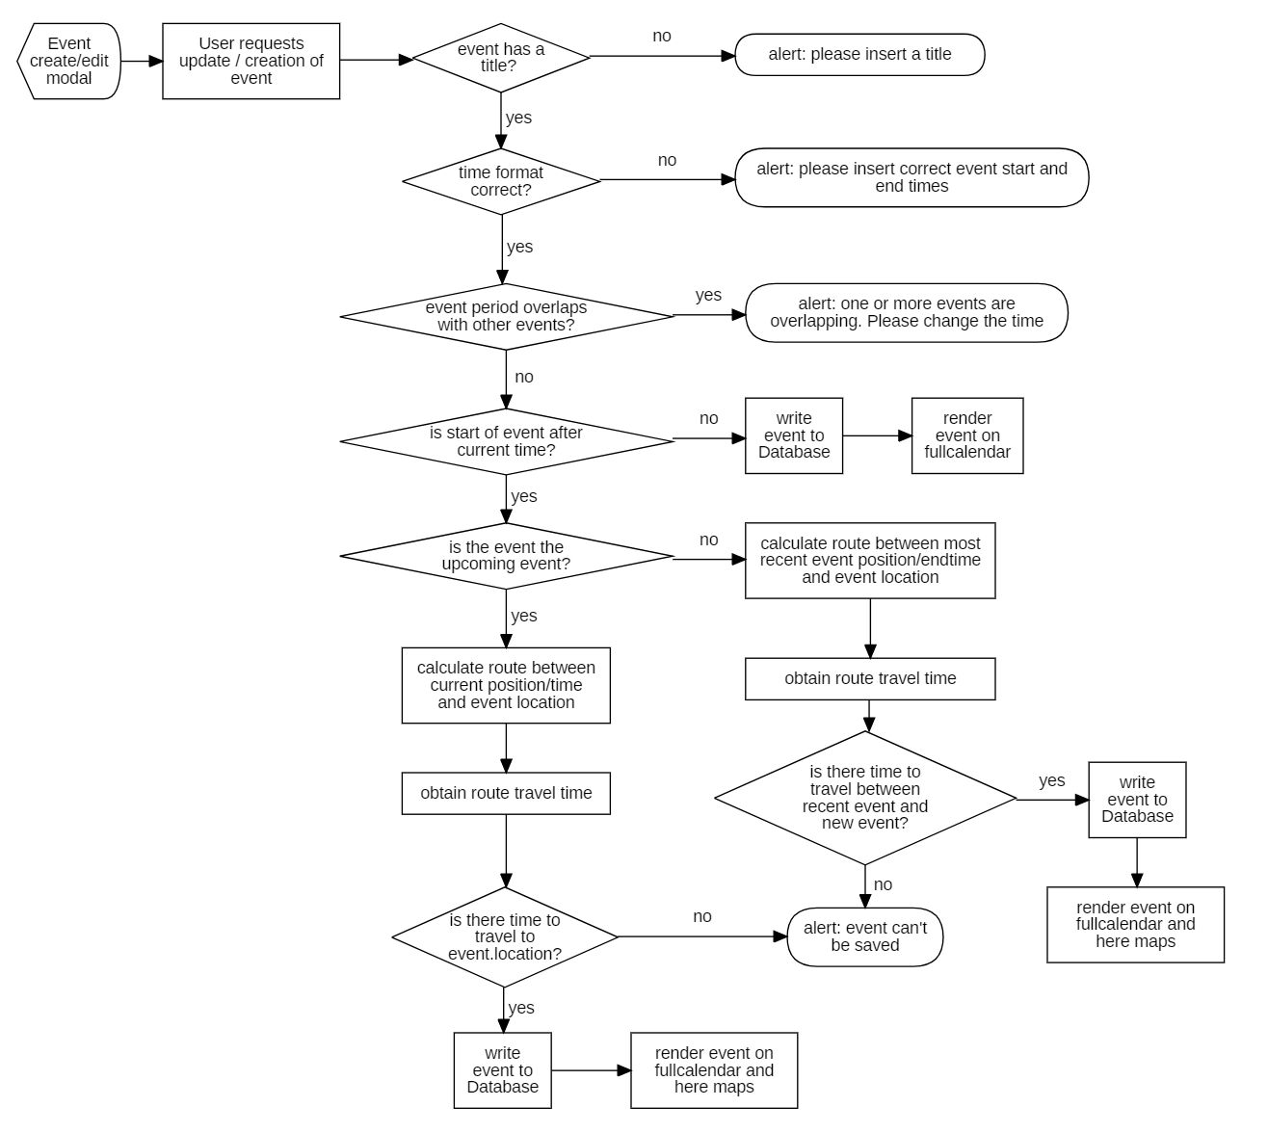
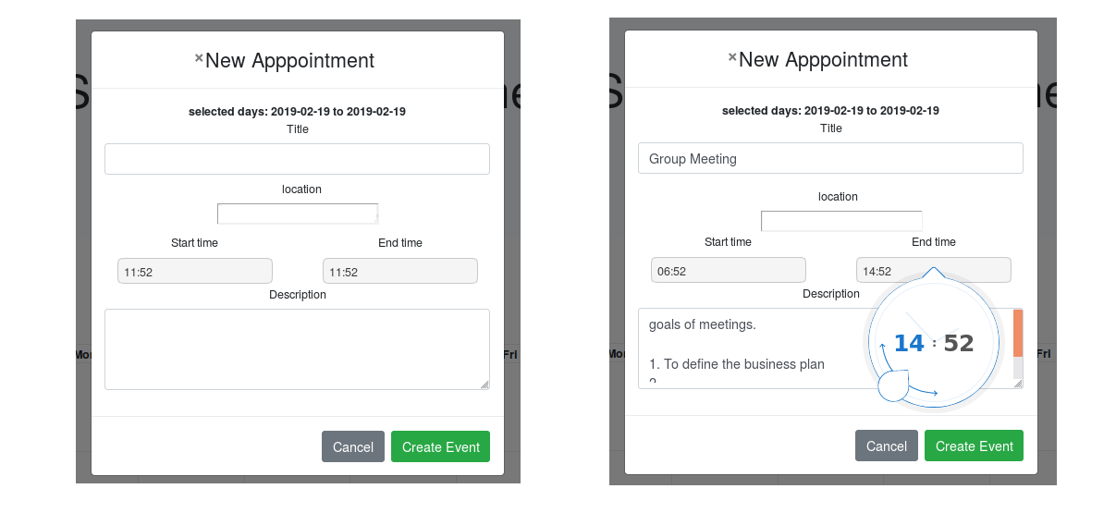
Flow Chart Diagram:
Professori
Design

Slide 31
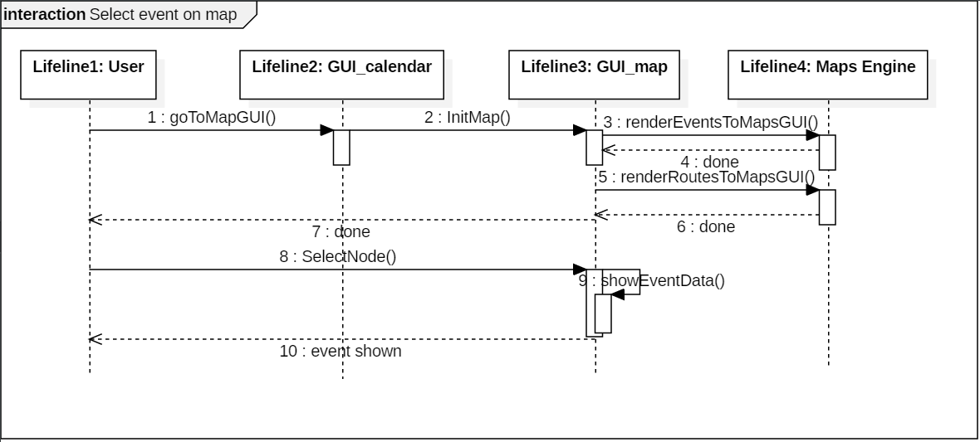
Sequence Diagram: Select an Event on Map
Professori
Design

Slide 32
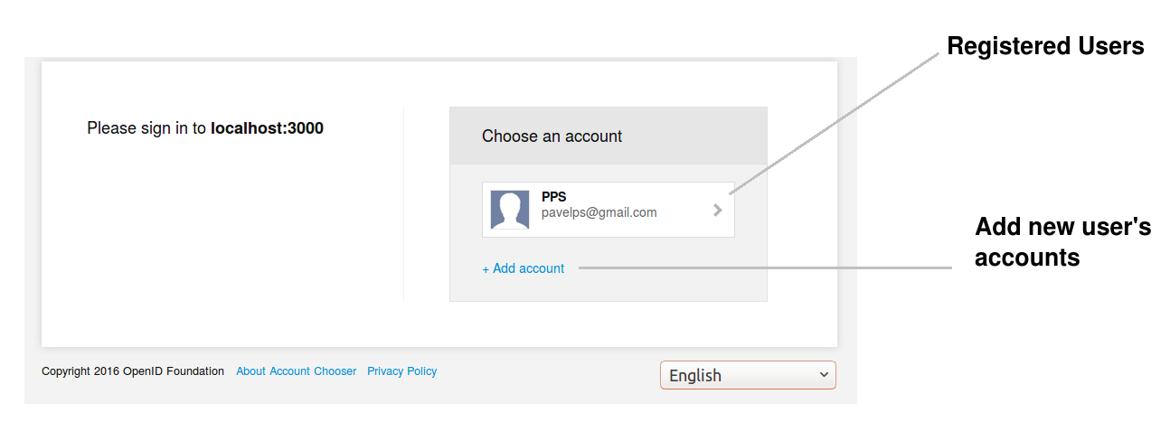
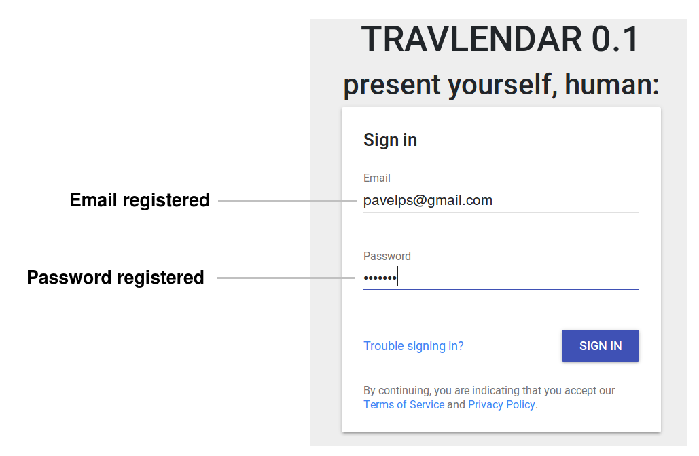
GUI User (Authentication interface)
Professori
Implementation

Slide 33
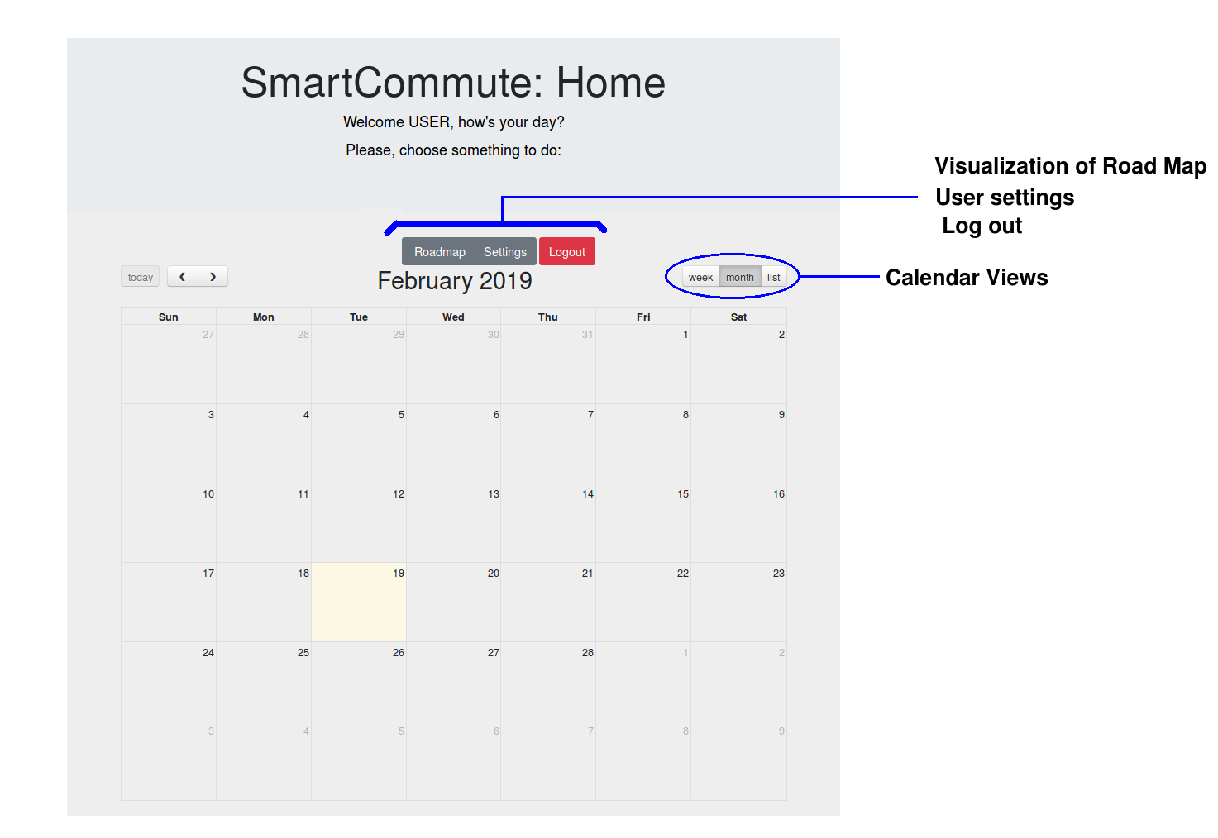
GUI Calendar (Main Page)
Professori
Implementation

Slide 34
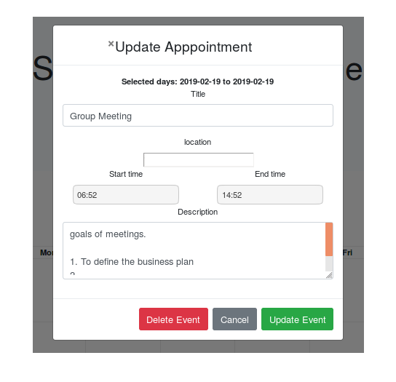
GUI Event Dialog Form (Popup)
Implementation

Slide 35
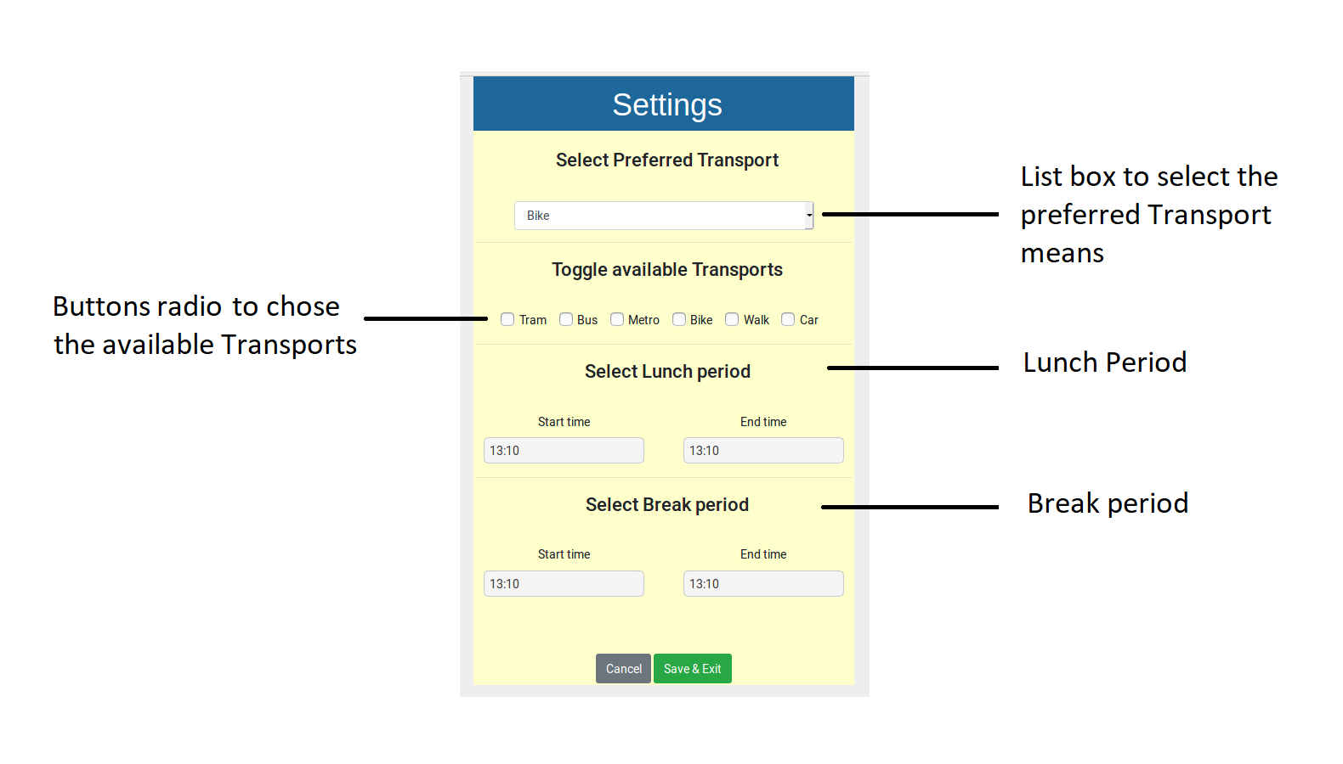
GUI Setting
Professori
Implementation

Slide 36
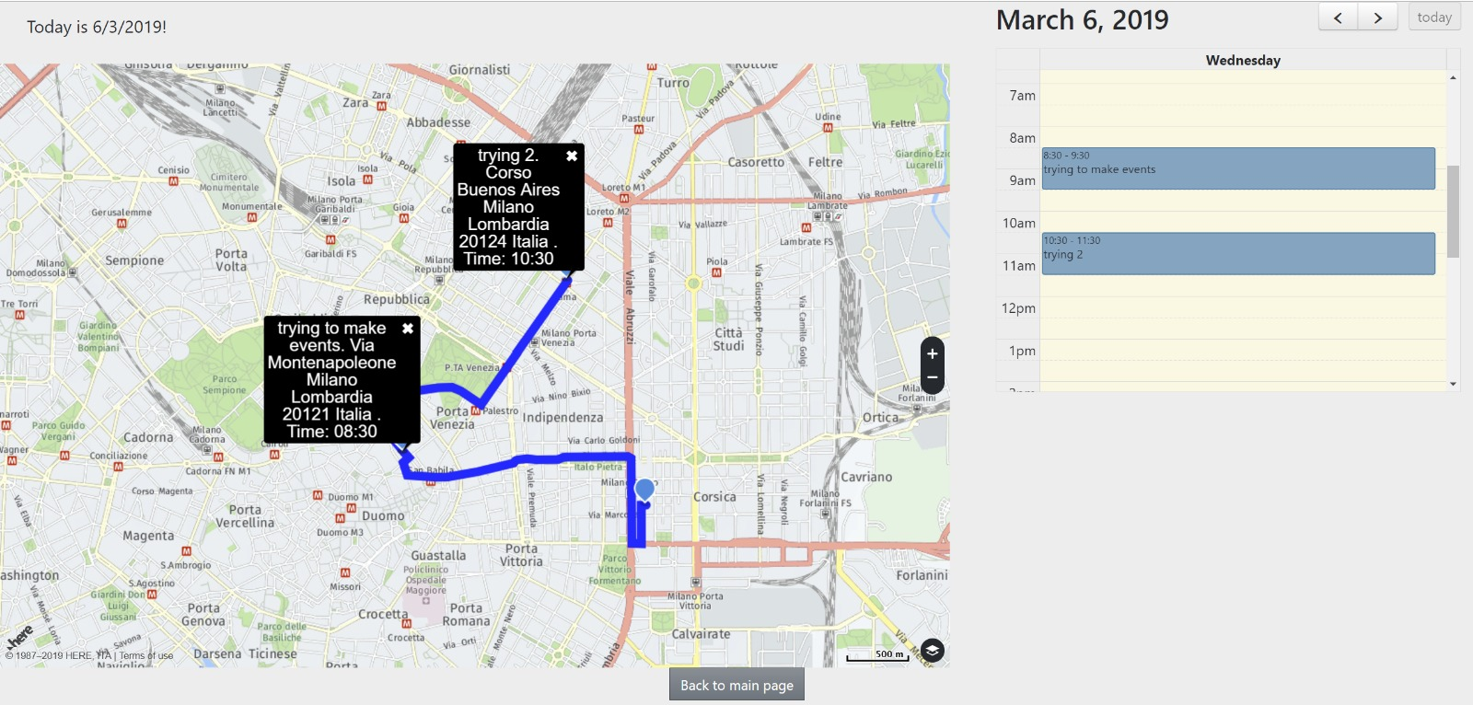
GUI Road Map
Professori
Implementation

Slide 37
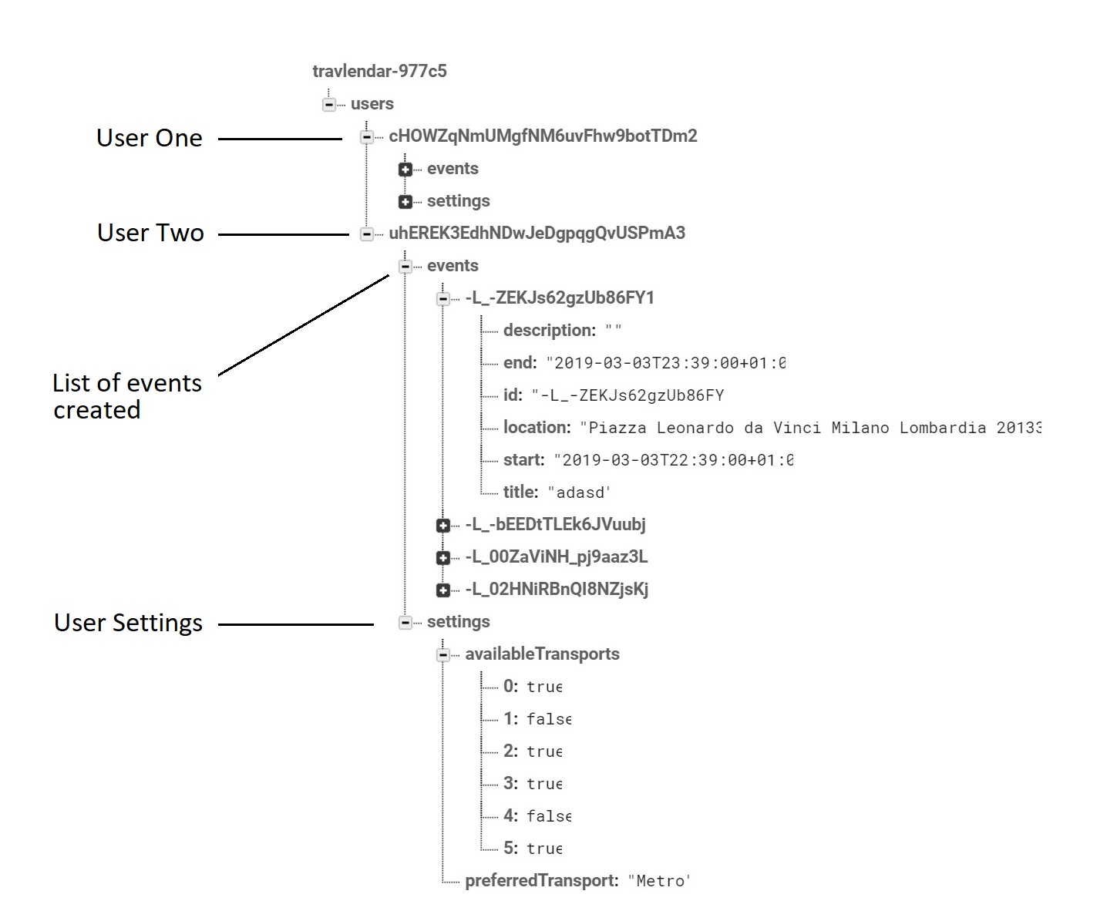
Data Base (FireBase)
Professori
Implementation

Slide 38
Structure of Web App code
Professori
Implementation

Slide 39
Structure of Web App code
Edit tex
Professori
Implementation

Slide 40






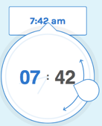

Used Tools
Implementation

Slide 41
Test Report
Professori
Testing

Slide 42
Conclusion and Future work
Professori
Conclusion and Future

