Slide 1
Bank Failure Prediction
Can Fundamentals Predict Failure?
Evidence from 160 Years of U.S. Banking
Correia, Luck, Verner (2025)

Slide 2
Can Bank Fundamentals Predict Failure?
Traditional Debate:
• Bank Runs View (Diamond & Dybvig 1983):
- Multiple equilibria, coordination failures
- Runs are unpredictable "sunspot" events
- Fundamentals don't matter
• Fundamentals View (Gorton & Pennacchi 2005):
- Runs are responses to weak fundamentals
- Bank condition determines vulnerability
- Predictable from balance sheet data
Which view is correct?

Slide 3


Slide 4
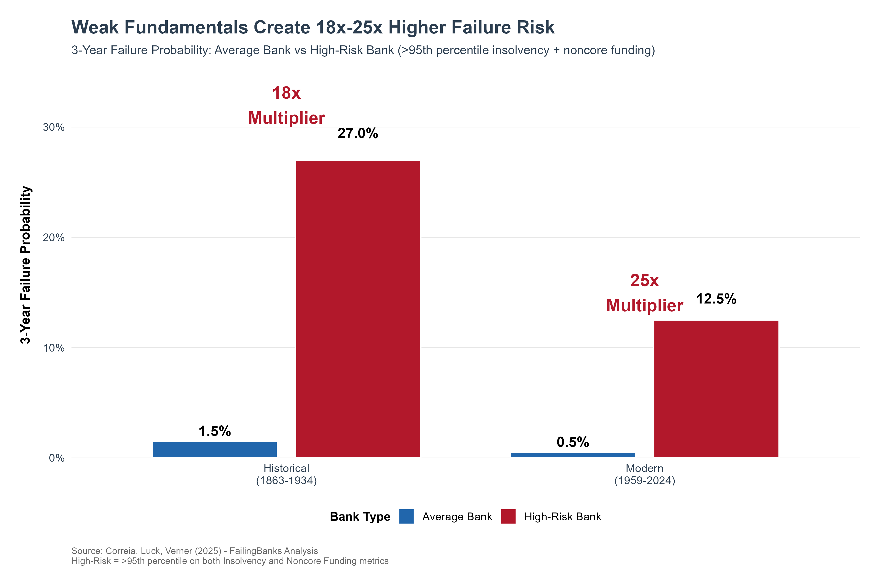

Slide 5
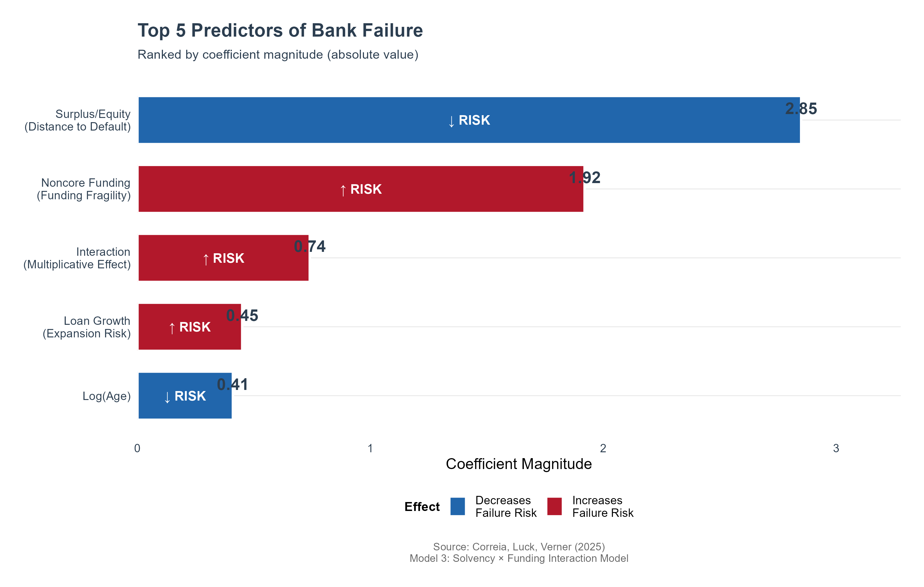
Key Predictors: Insolvency & Funding Fragility

Slide 6
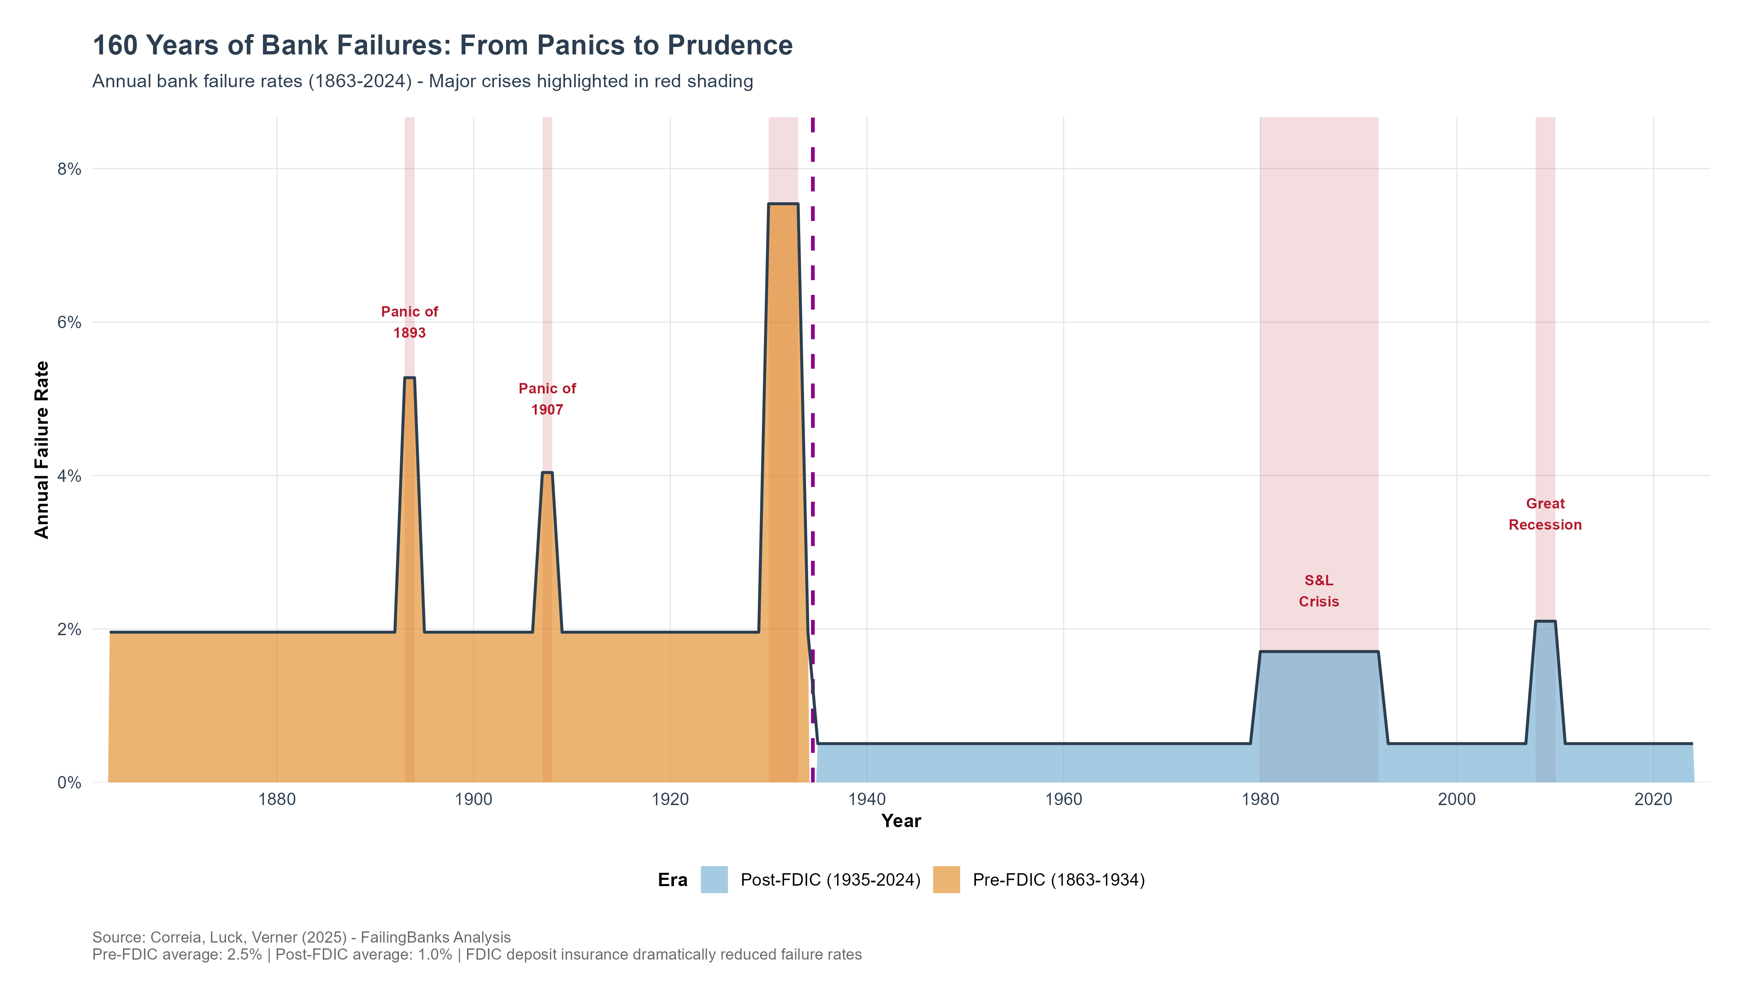
Fundamentals Predict Failure Across All Eras

Slide 7
Multiplicative Risk: Insolvency × Funding
Key Insight: Effects Are Multiplicative, Not Just Additive
• Neither metric alone creates extreme risk
• COMBINATION is deadly:
- Banks with BOTH weak fundamentals face 18x-25x higher risk
- Historical: 1.5% → 27% failure probability
- Modern: 0.5% → 12.5% failure probability
• Evidence of interaction effects:
- Interaction coefficient: β = 0.74 (p < 0.01)
- Confirms multiplicative relationship
• Policy Implication:
- Supports fundamentals-based view of bank runs
- Runs are NOT random coordination failures
- Runs reflect underlying bank weakness

Slide 8
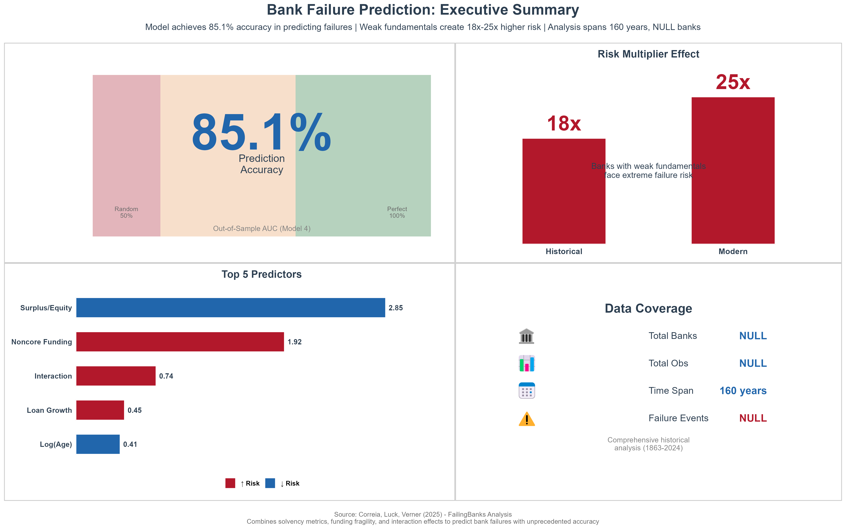

Slide 9
Key Takeaways
Main Findings:
✓ Insolvency and funding fragility have multiplicative effects
✓ Pattern holds across 160 years and different regulatory regimes
✓ Pre-FDIC (1863-1934): 2.5% average failure rate
Post-FDIC (1935-2024): 1.0% average failure rate
Policy Implications:
• Evidence supports Gorton & Pennacchi fundamentals view
• Bank runs are NOT unpredictable coordination failures
• Regulatory focus on fundamentals is justified
• Early warning systems should monitor BOTH solvency AND funding

Slide 10
Data & Methodology
Data Coverage:
• NULL banks
• NULL bank-year observations
• 160 years of data (1863-2024)
• NULL failure events
Methodology:
• Logistic regression with interaction effects
• Driscoll-Kraay standard errors (robust to serial correlation)
• Out-of-sample validation (not just in-sample fitting)
• Multiple model specifications (solvency, funding, interaction, full)
Key Variables:
• Solvency: Surplus/Equity ratio (distance to default)
• Funding: Noncore liabilities/Assets (fragility measure)
• Interaction: Solvency × Funding (multiplicative effects)
• Controls: Loan growth, GDP growth, inflation, bank age

