Slide 1
LA 558 Final Project
Chicago Public Libraries, Bailey Anderson

Slide 2
Initial Goals
Create a Leaflet map of Chicago utilizing public data to sort and filter by communities while incorporating a walk score and the following development technology:
Bootstrap
Leaflet
GeoJSON
jQuery
Awesome markers
Mapbox Studio Styles

Slide 3
Challenges
Initial data was inaccurate and incomplete
Had to find new data for Chicago libraries
New data did not have as many properties available, but still had relevant information
Walk Score API
My skill-set is beginner level in PHP
Walk Score took longer than a week to provide my API key (less time for testing)
Worked with Professor Seeger to get PHP up and running
Overall jQuery
Had challenges using a marker to both click and generate a pop-up as well as click and provide a Walk Score - doing one replaced the other
Contextual information of pop-up was more important

Slide 4
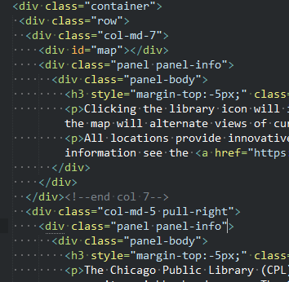
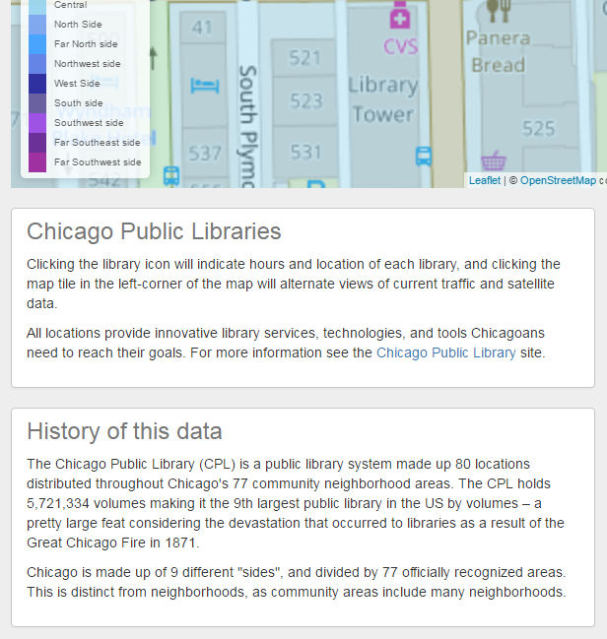
Implementation - Bootstrap
Site is responsive utilizing the grid system
Code View
Mobile View

Slide 5
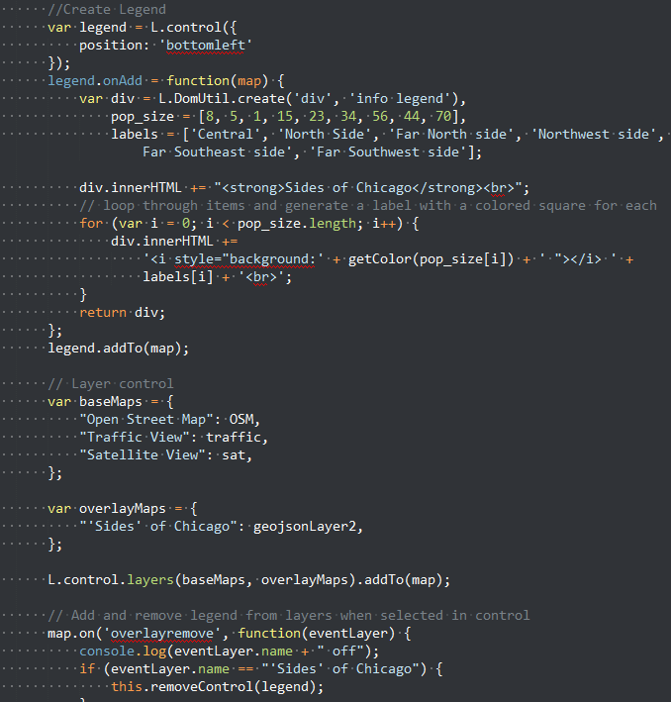
Implementation - Leaflet
Site utilizes Leaflet including pieces like
Legend
Overlays
Included a layer to hide/show legend and layers of the communities
User has ability toggle the community data for better view-ability as the shape fill includes various colors that may not be desired as the user zooms in

Slide 6
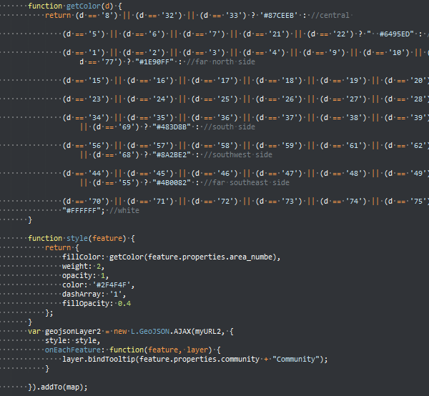
Implementation - GeoJSON
GeoJSON Data
Pulled community outline data to help residents of Chicago to view libraries in their locations based on where they live
Created a function to filter by “sides” of Chicago which included making an “OR” statement and pulling the properties of the community from the file to determine the side each belonged to

Slide 7
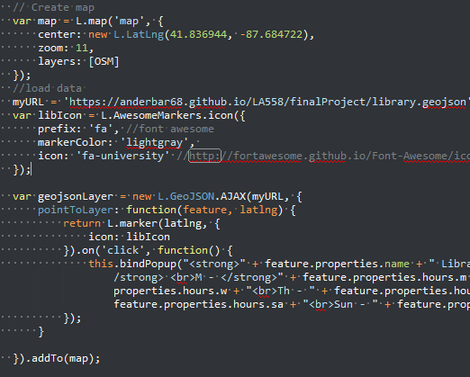
Implementation – Awesome Markers + GeoJSON
Awesome Markers
Customized markers that used the bootstrap font awesome library icon to add simple visual aesthetic to the map for each library location
Library GeoJSON was used to map each library
Properties like address, name, and hours were used to display on pop-up

Slide 8
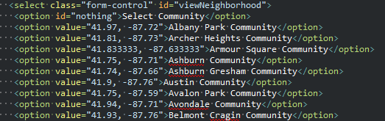
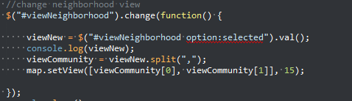
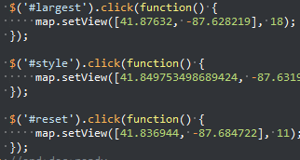
Implementation – jQuery
jQuery
Tried out different functionality to zoom to the neighborhood view by using the split feature which took the lat / long from my HTML and changed the view
Used another variation of setting the zoom by placing the lat / long directly in the jQuery

Slide 9
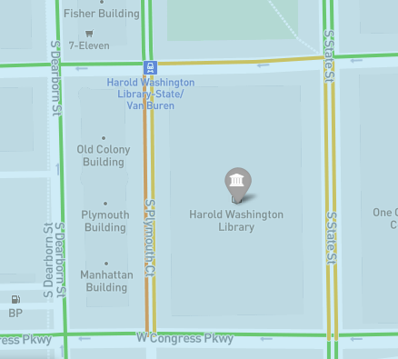
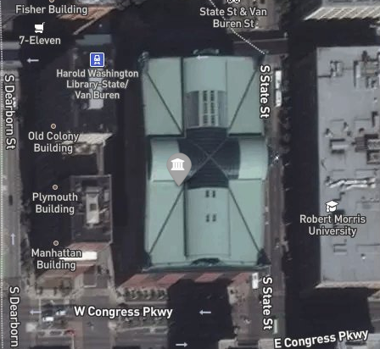
Implementation - Mapbox
Traffic View
Mapbox
Customized satellite and traffic maps including colors and custom zooming to add to the theme of the overall map
Included both as overlays
Traffic is relevant in getting to a library destination
Satellite view shows a better image of what the library actually looks like
Satellite View

Slide 10
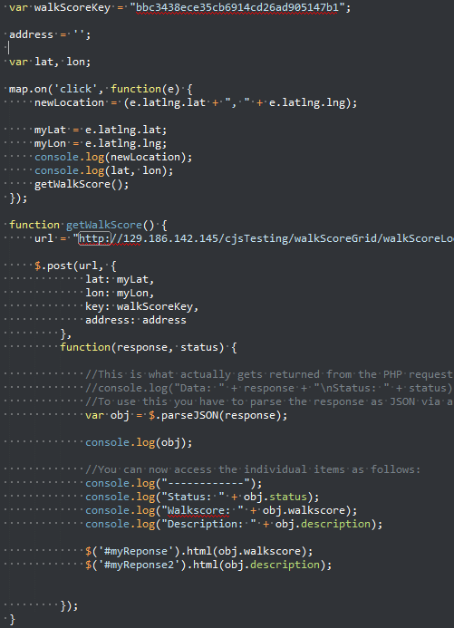
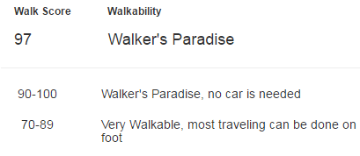
Implementation – Walk Score
Walk Score API
Worked with Professor Seeger to get server and PHP working
Utilized map click function to get latitude and longitude to return the walk score of the clicked portion of the map
Included helpful descriptions of what the scores mean for the end user

Slide 11
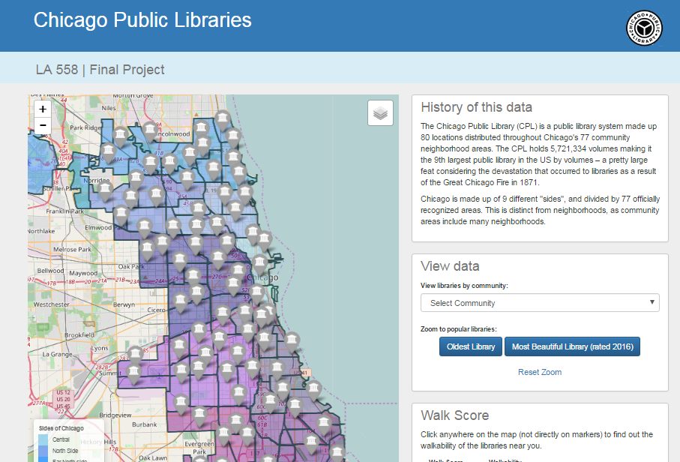
Conclusion
Overall Project
Output is a map that the user can interact with to find libraries in their communities within Chicago
Overall Class
Gained exposure and improved skills I previously did not have in jQuery and Web Mapping
Future Project Goals
Take project and continue to advance skills to enhance map
Improve Walk Score function
Pull in other city landmarks and filter data to show libraries vs landmarks

