Slide 1
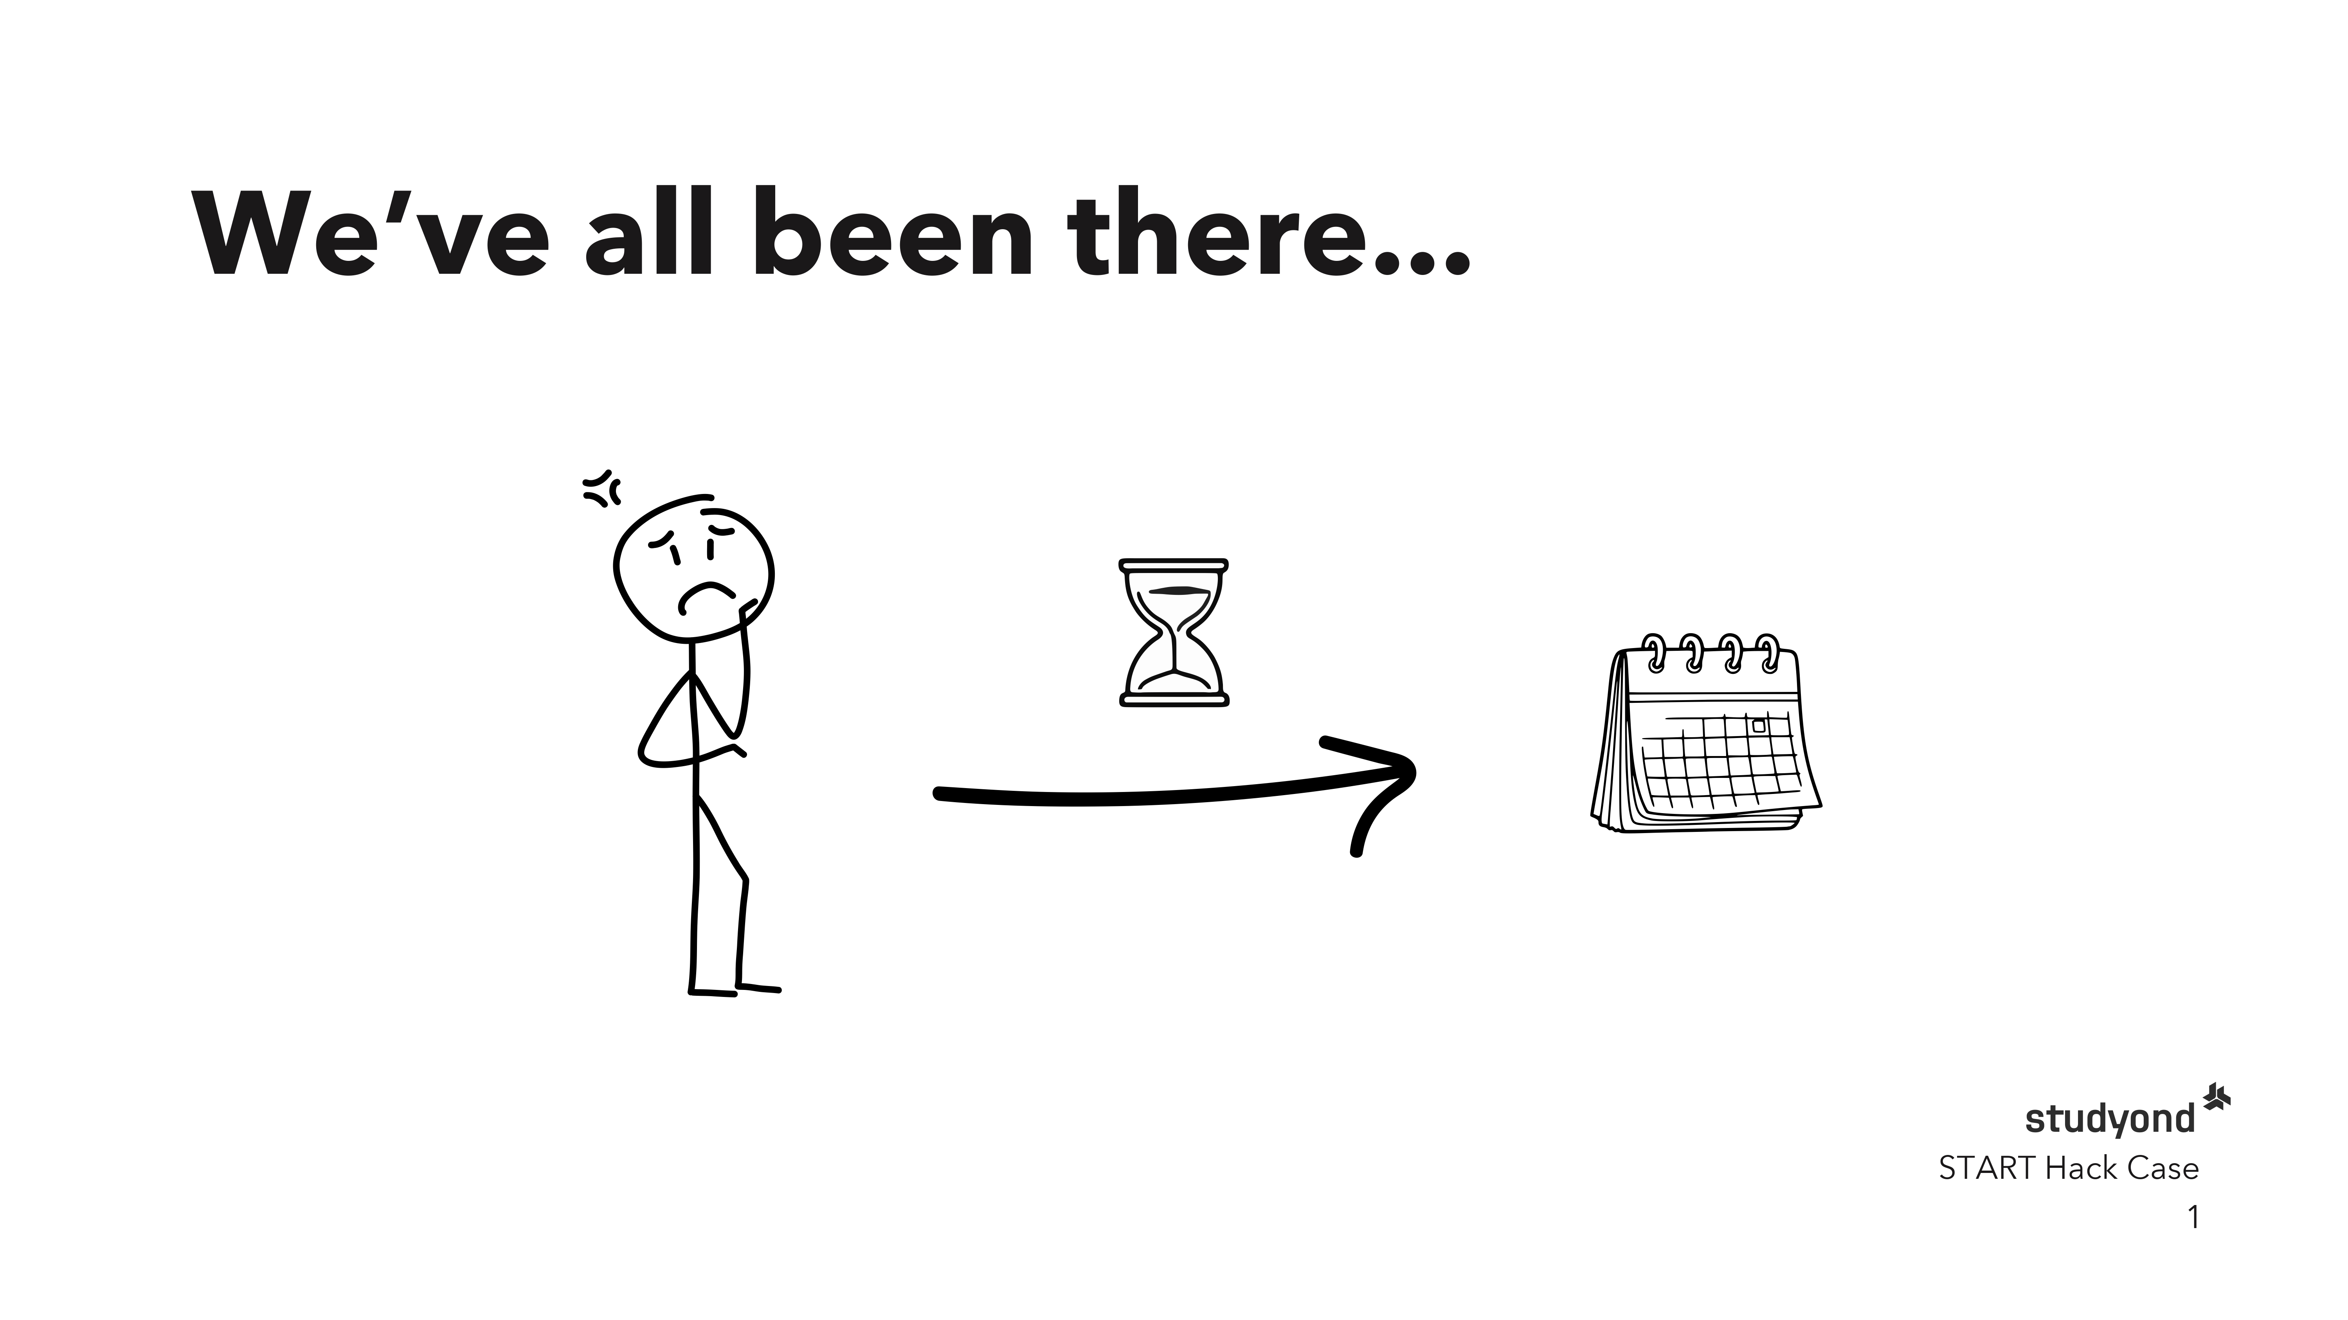
Notes:
- We've all been there or at least can relate
- Thesis (or other assignment) is due
- You don't know what to write about
- You might not have a network yet
- time is ticking so you need a solution fast

Slide 2
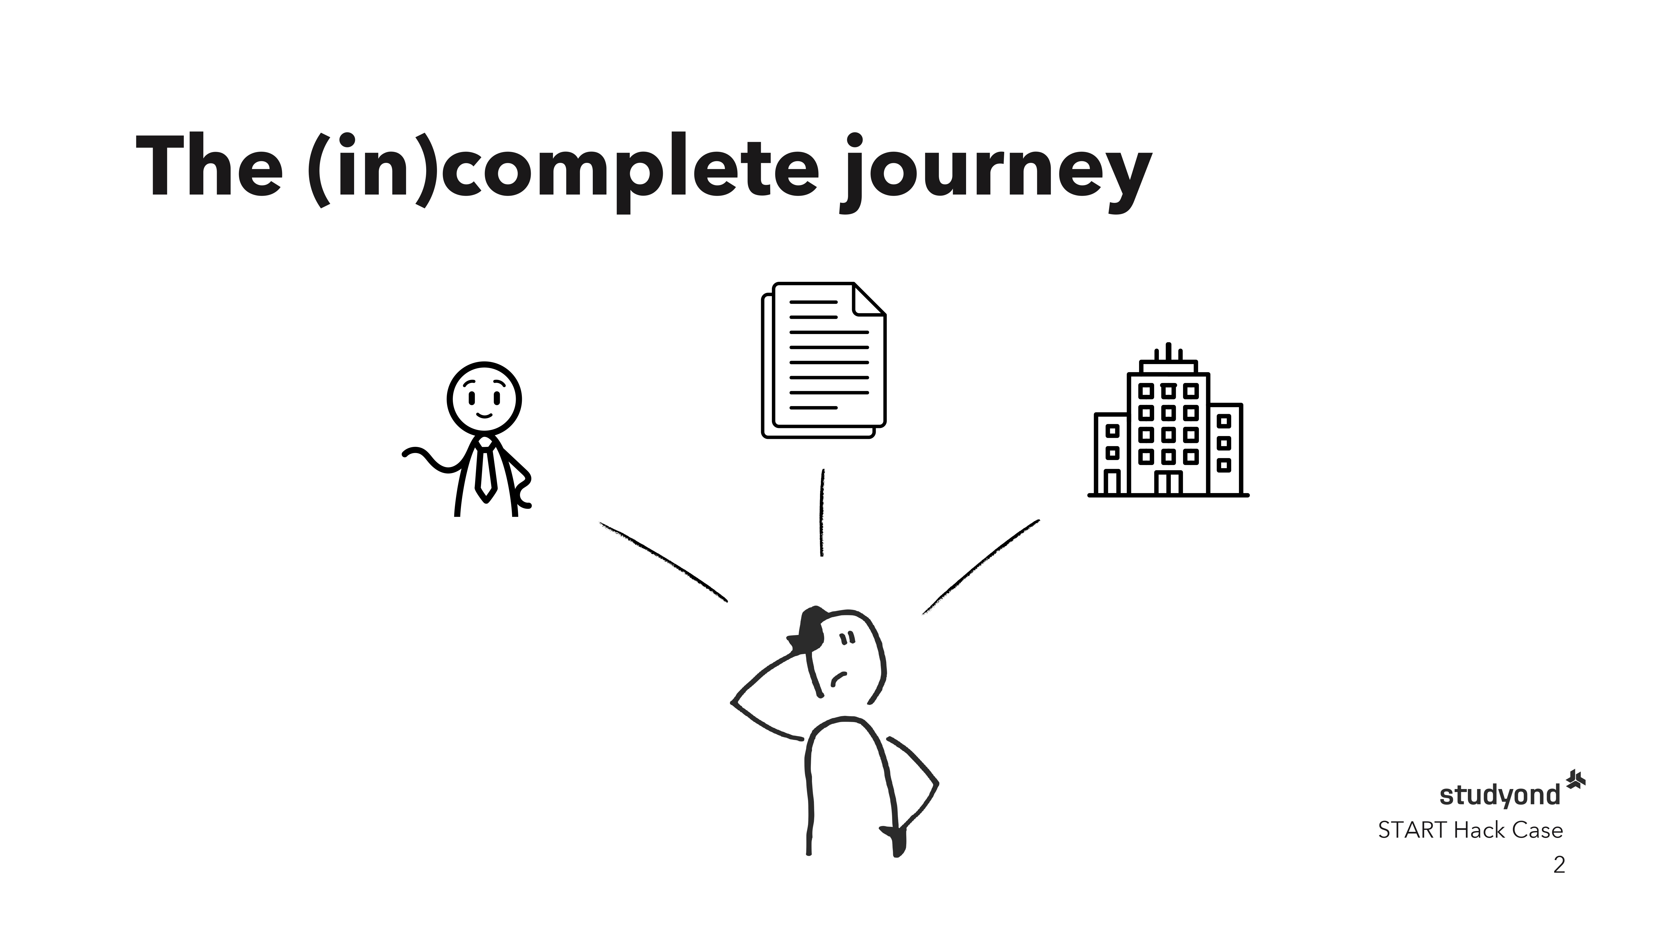
Notes:
- Core components to solve this problem are there (on studyond)
- We have a huge network of topics, experts and companies
- However, as a student who is just starting out this is overwelming
- There is no streamlined process that brings these components together
-> ending up in procrastinating and not finding a topic that you're passionate about or even miss out on a possible employment

Slide 3
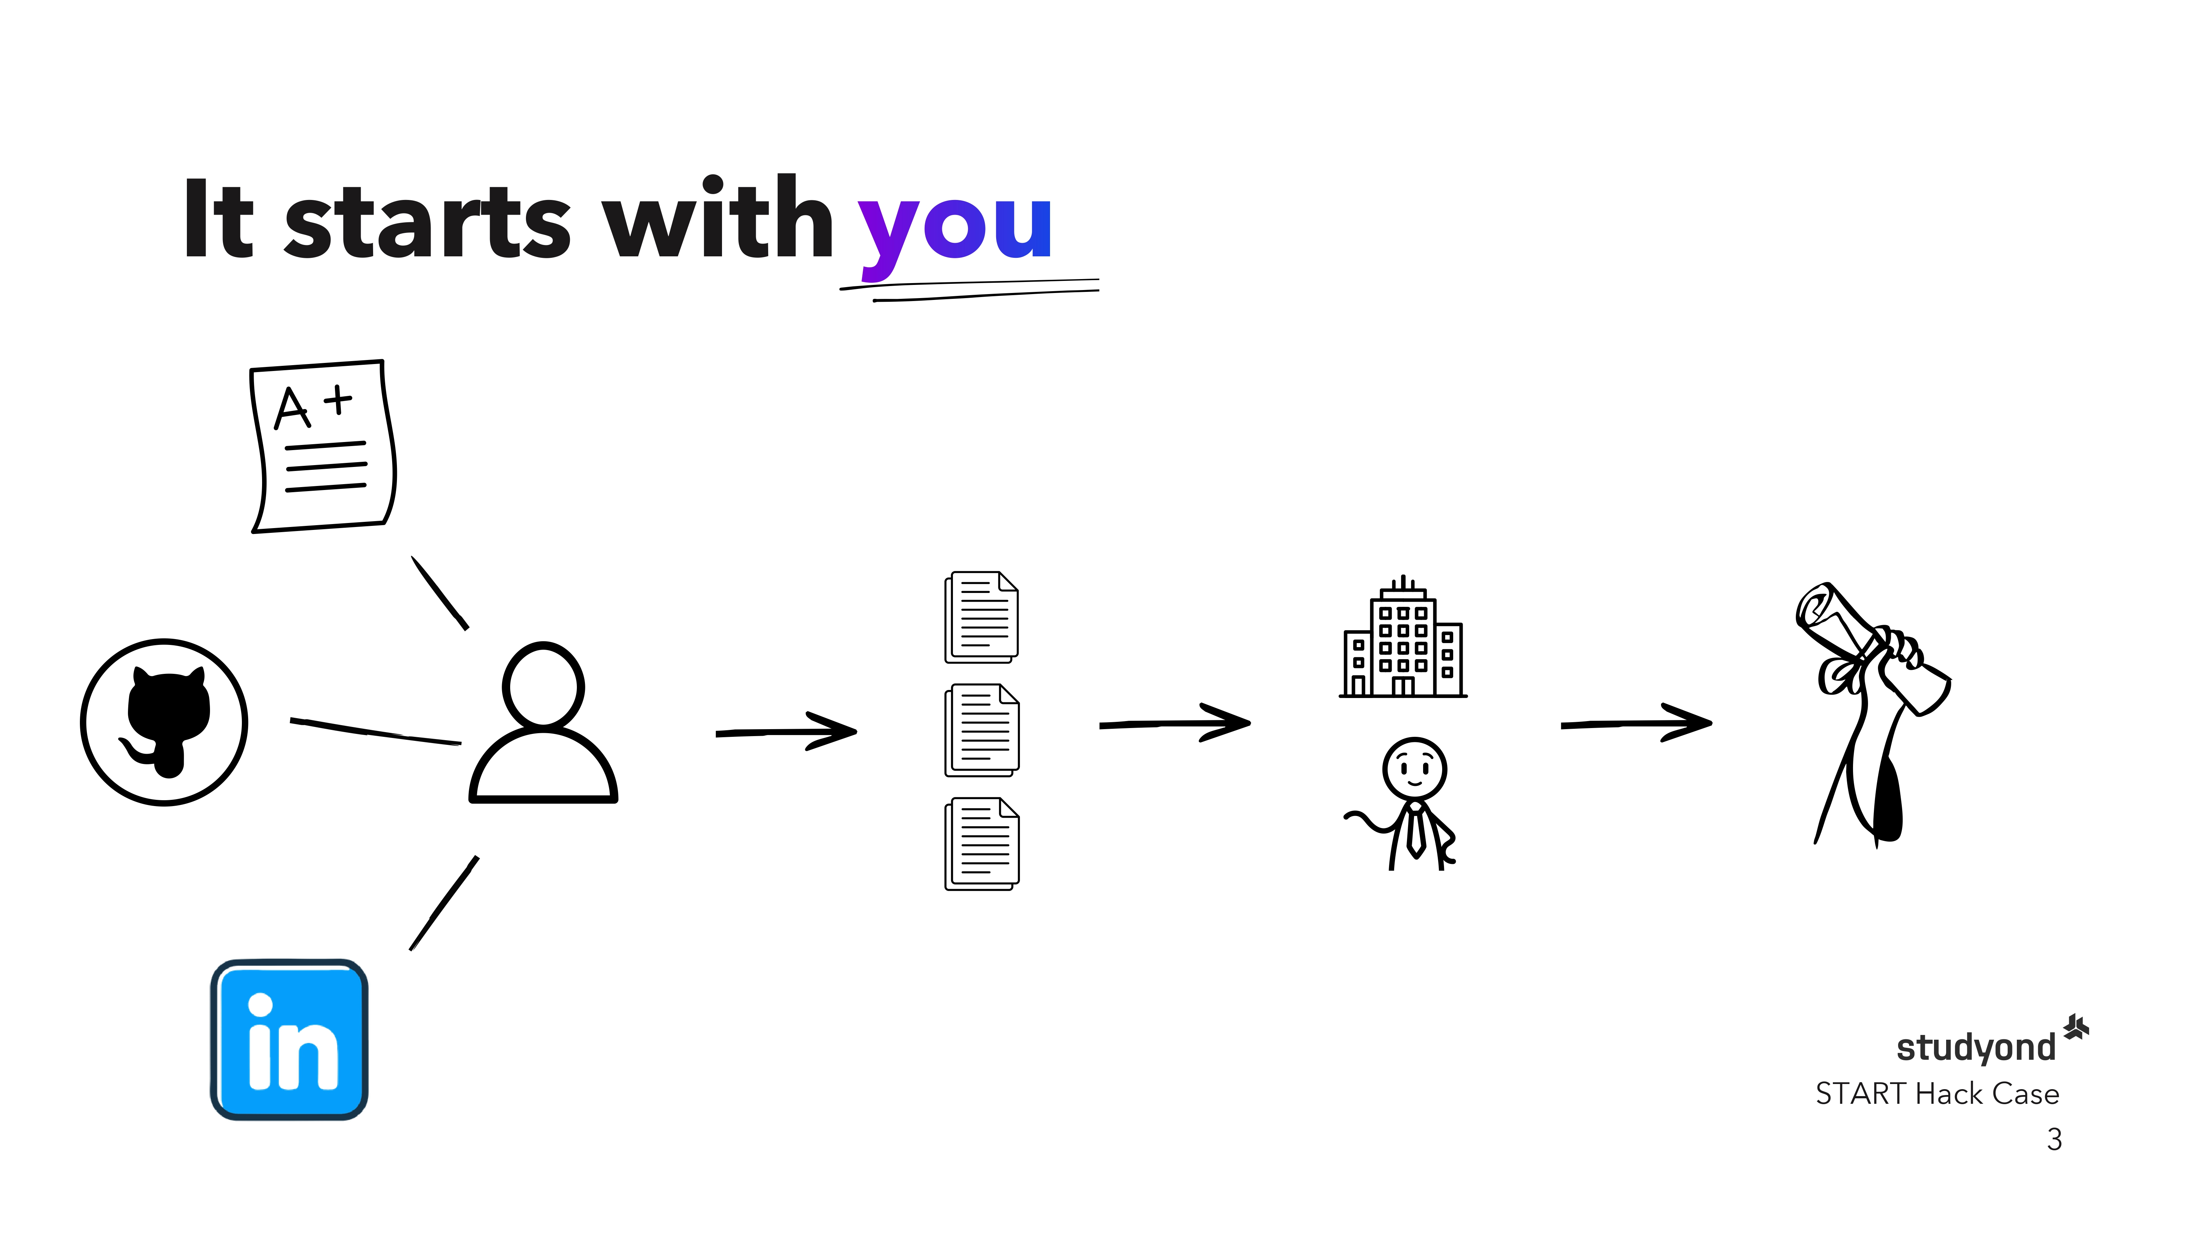
Notes:
- That's why build an AI mentor on top of the existing studyond components that streamlines this process
- It all starts with YOU - you are the most important part of your thesis
- Your SKILLS matter, your experience and your interests
- Our Mentor considers these by accepting TOR (explain), stuff like github or linkedin to extract topics you're good at, passionate about and gets to know you better
An essential part of a close thesis partner
- Our mentor accompanies you throughout the thesis process,
whether it is choosing your topic, company, experts
- Our mentor ALWAYS leads you to success

Slide 4
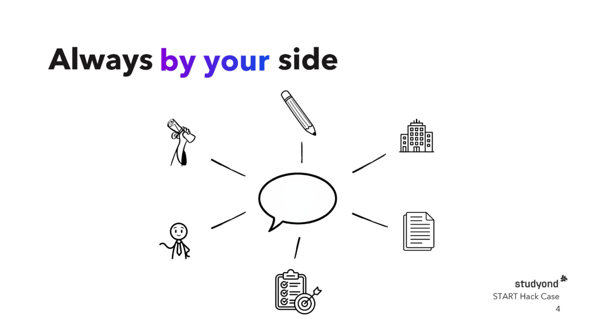

Notes:
- Using our progress tracking framework you always stay on track with your thesis... let it be topic decision, company selection, planing, writing and submitting
- Our AI mentor is always by your side, knows in which stage you are, can discuss topics, decisions or answer any questions you may have
AND that's not all!

Slide 5
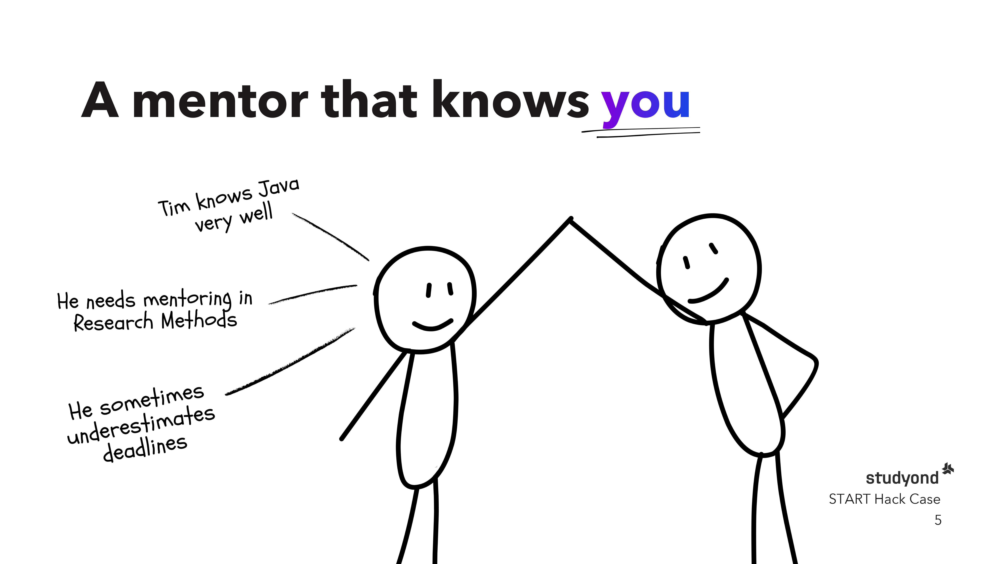
Notes:
- Our AI mentor gets to know you better with each interaction
- Using a Persistent memory layer - the AI accumulates context across sessions and across progress phases
- This ensures our agent always knows your exact needs and whats right for your topic

Slide 6
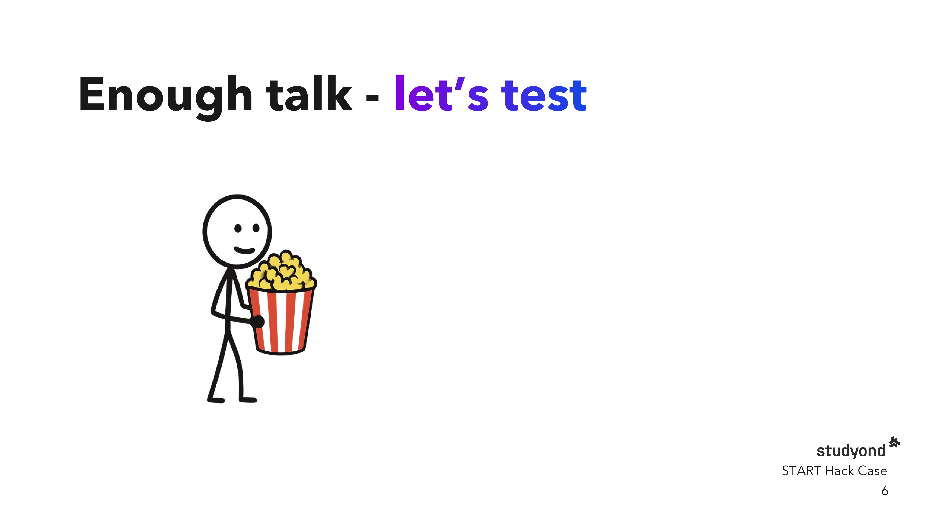
Notes:
- That's it for now, enough talk, let's see it in action!

Slide 7
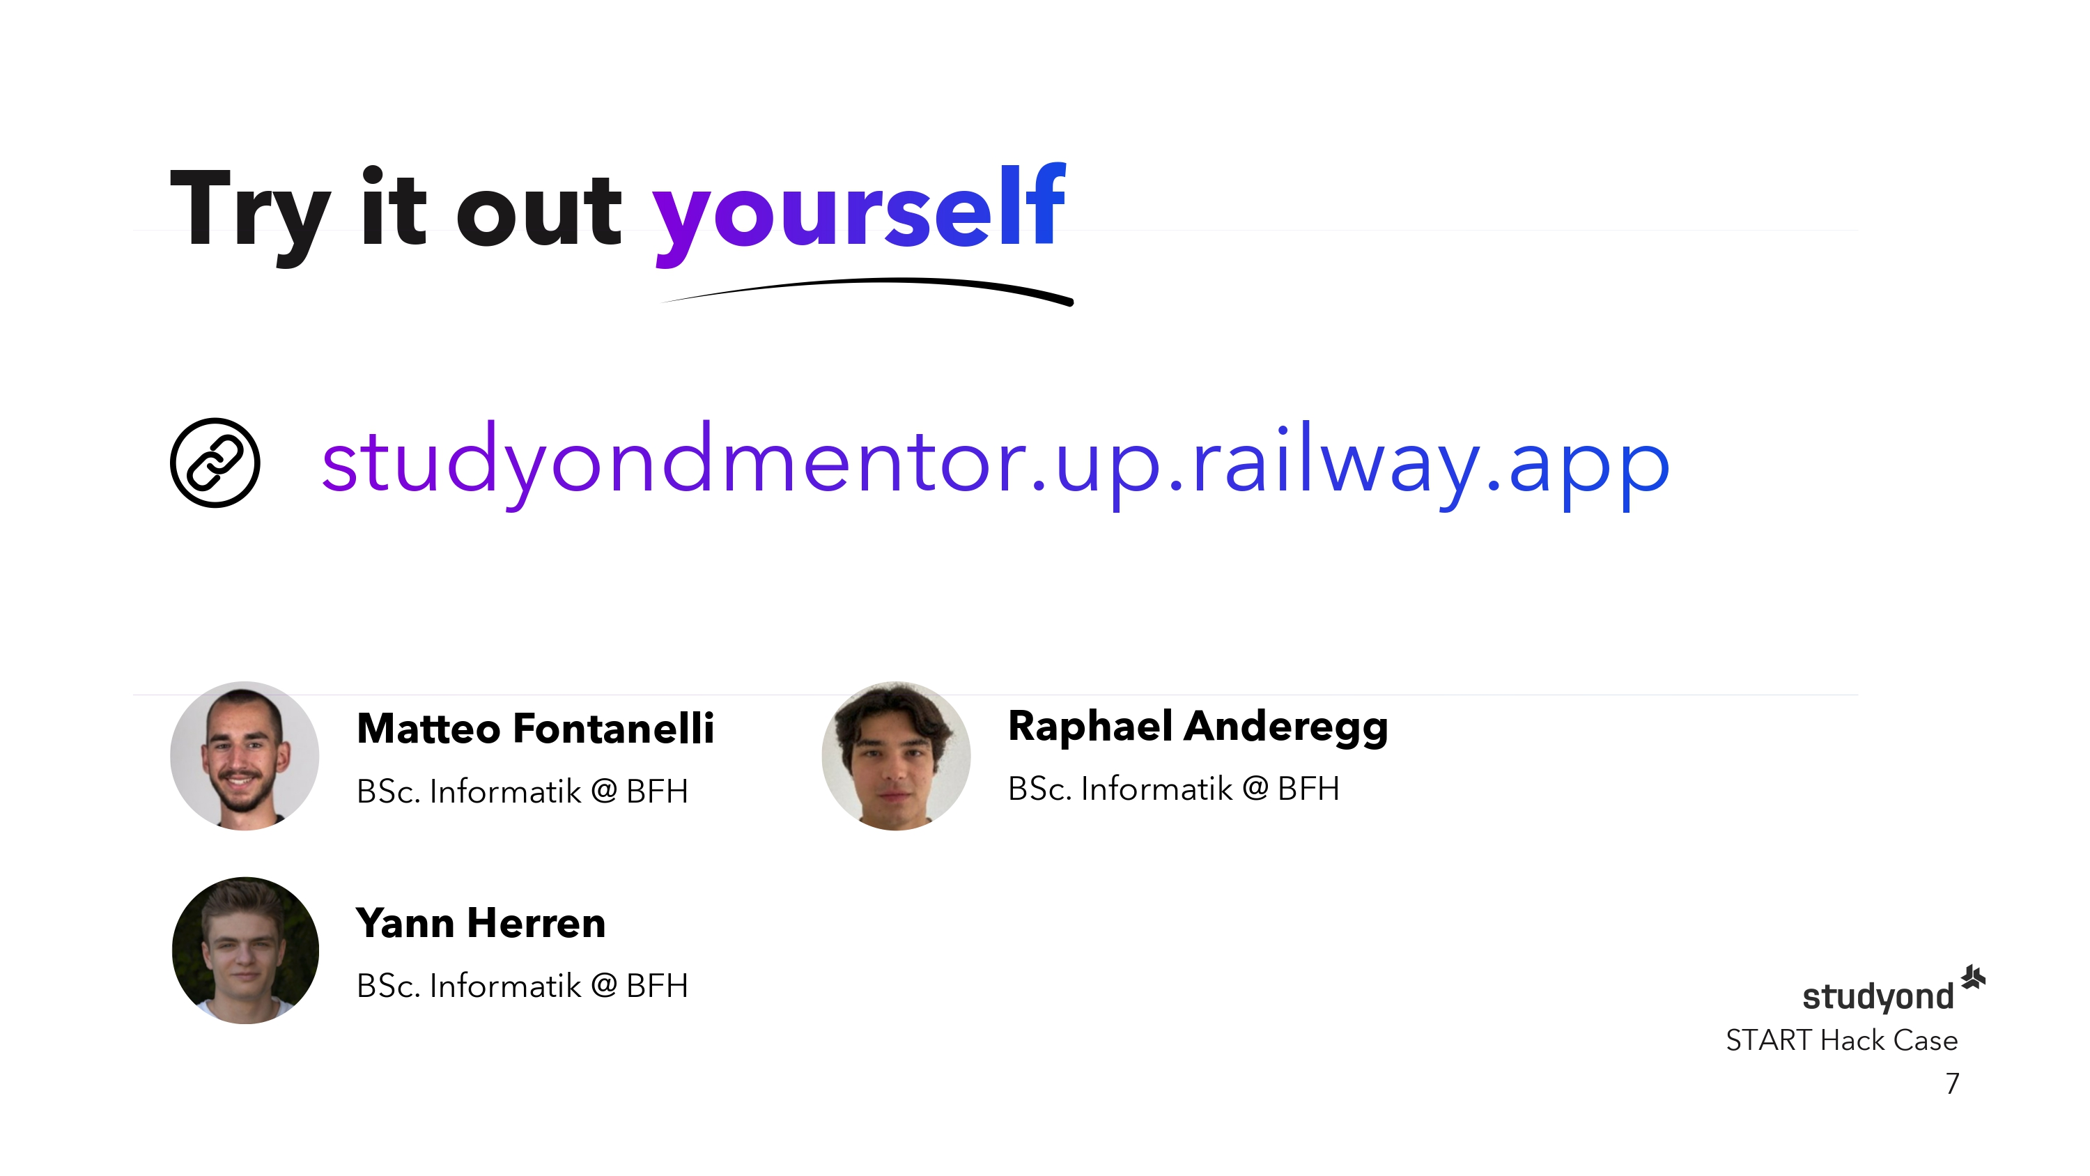
Notes:
- Thank you for your attention and we encourage you to try our prototype yourself

