Slide 1

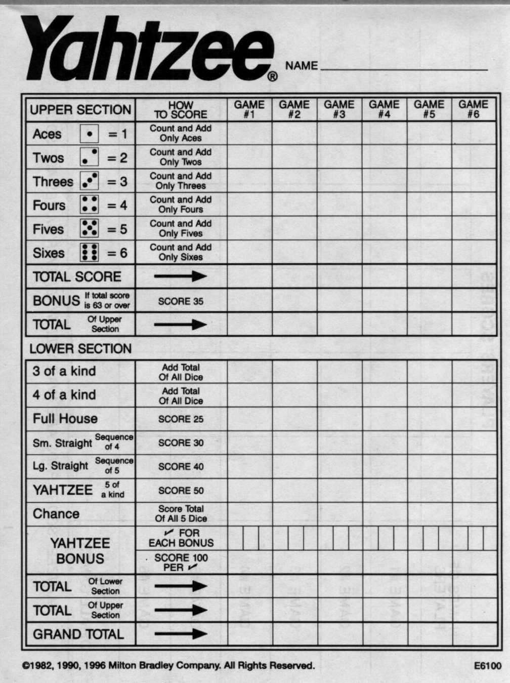
Our Problem
- Yahtzee!
- 3 rolls of 5 dice per round
- Choose a category at the end
of each round
- Game ends when all 13
categories are used
- Score range: 5-375

Slide 2
Problem Analysis
- Stochastic
- Large state space
- Number of rolls left in round
- Categories left to choose from
- Current dice roll
- (3)(2^13)(C(10,5)) ~ Millions!
- Actions, two different types.
- Choosing dice to keep: up to 2^5 = 32
- Choosing a category: up to 13

Slide 3
Approach
- A combination of hard-coding and Monte-
Carlo Planning
- Sparse sampling for choosing dice to
keep
- Hard coded strategies for category
decision

Slide 4
Results
 | Avg | Min | Max | StD
Random | 40.15 | 21 | 68 | 13.1
Greedy | 122.4 | 56 | 168 | 33.9
Strategic | 126.2 | 71 | 184 | 30.8
Human | 213.45 | 173 | 274 | 26.3
Optimal | 245.0 | 12 | 375 | 59.6
PGreedy | 199.0 | 164 | 257 | 25.1
PStrategic | 193.85 | 147 | 222 | 17.2

