Slide 1

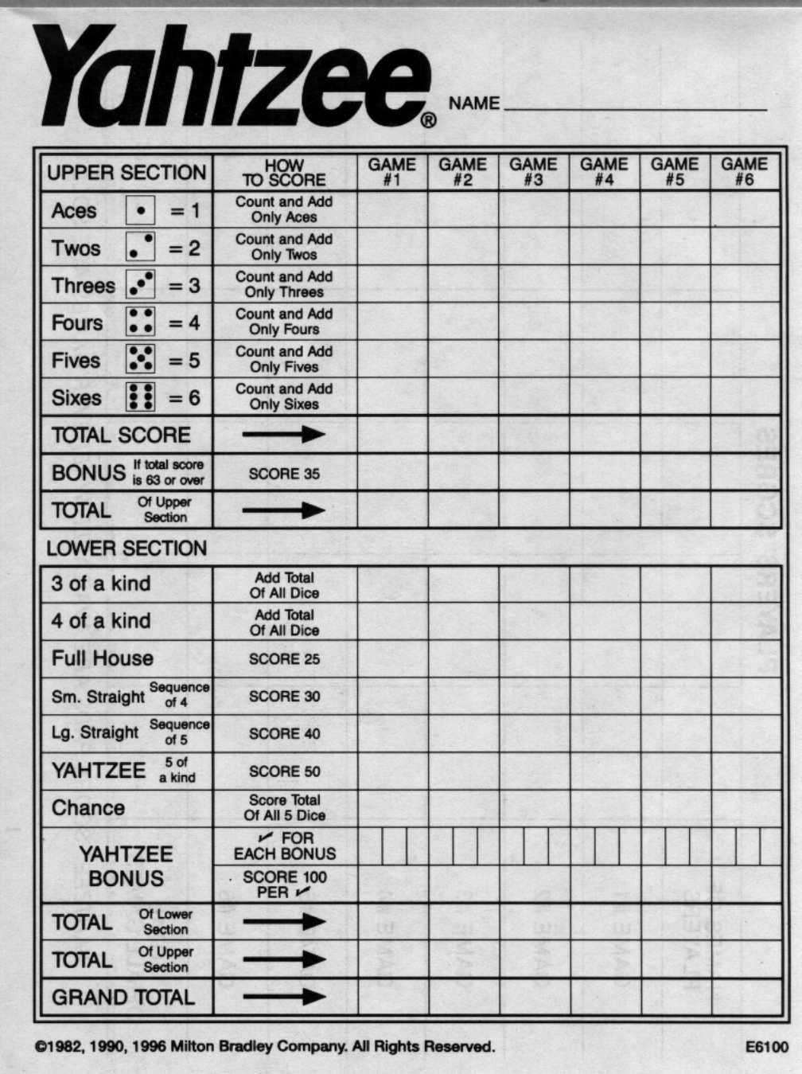
Our Problem
- Yahtzee!
- 3 rolls of 5 dice per round
- Choose a category at the end
of each round
- Game ends when all 13
categories are used
- Score range: 0-375

Slide 2
Problem Analysis
- Stochastic
- Large state space
- Number of rolls left in round
- Categories left to choose from
- Current dice roll
- [3][2^13][6^5] ~= Two hundred million!
- Fairly large number of actions
- Middle of the round: 2^5 = 32
- End of the round: 13 or less

Slide 3
Approach
- Featurization of states
- A combination of hard-coding and Monte-
Carlo Planning
- UCT
- Expectimax

Slide 4
Challenges and Shortcomings

Slide 5
Results
-Benchmarks
-Human Agent
-Averages
-Greedy Agent
-Averages
-Strategic Agent
-Averages
-Optimal
-Averages 255
-Our Planning Agent

