Slide 1
Deciding the Result of Chess Endgames as a Classification Problem
Mike Anderson Greg Gutshall

Slide 2
Our Problem
- Determine the result of a chess endgame position.
- Usually formulated as a search problem.
- Slow because tree grows exponentially.
- We wanted to use a classification approach.
- Found a UCI King-Rook vs. King dataset.

Slide 3
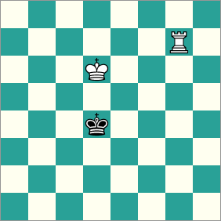
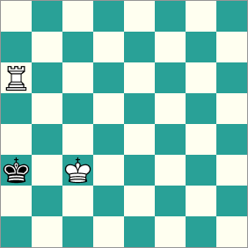
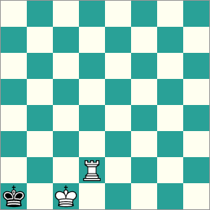
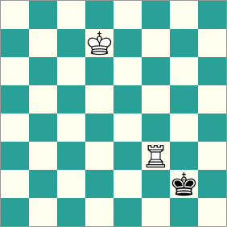

Slide 4
Methodology
- Decision tree
- Fast.
- Used successfully on a similar dataset.
- SVM
- Strong general-purpose algorithm.
- Redefined Error
- Difficult to distinguish between nearing classes.
- Normal loss metric non-informative.
- Use distance to correct class label.

Slide 5
Reparameterization
- Original parameterization with row and column locations of individual pieces uninformative.
- Reparameterized in terms of spatial relationships, just like real chess players do!
- Distance of black king to corner.
- Distance of black king to edge.
- Distance between black king and white king.
- Is position drawn?
- Is position checkmate?

Slide 6
Decision Tree Experiment
- Very fast.
- Split using maximum information gain at each node.
- Original parameterization massively overfits data.
- Reparameterization performs well using validation.
- Mean error: 1.07
- Std: 1.45

Slide 7
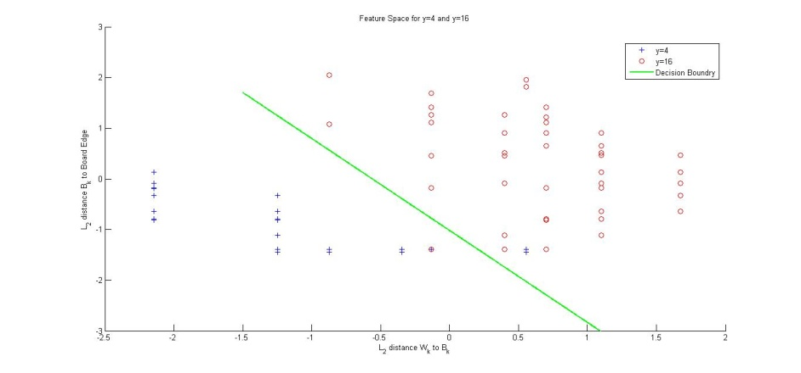
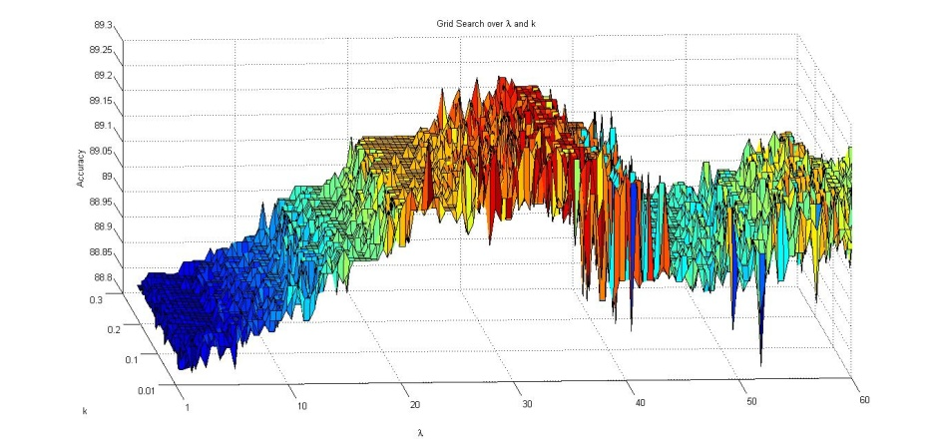
SVM
Pegasos
FAST, iterated sub-gradient projections.
Requires one-v-one Multi-Class method.
Non-linear Kernels are difficult to implement.
LIBSVM
Off-the-Shelf SVM package
Supports Kernels and Multi-Class
Method | μ error | σ error | Testing Accuracy (ε = 1)
Pegasos: Linear, One-v-One | 1.78 | 1.59 | 51.25%
LIBSVM: Linear | 1.29 | 1.42 | 68.28%
LIBSVM: Polynomial d-2 | 1.75 | 1.93 | 59.90%
LIBSVM: Polynomial d-3 | 1.32 | 1.42 | 66.70%
LIBSVM: Polynomial d-4 | 1.60 | 1.71 | 61.82%
LIBSVM: RBF (Gaussian) | 1.20 | 1.37 | 70.10%
LIBSVM: Sigmoid | 1.94 | 1.85 | 52.50%

Slide 8
Conclusions
- Reparameterizations using expert knowledge can be highly effective.
- A good definition of error is often domain-specific.
- Both decision tree and SVM were highly effective.
- Decision tree outperformed SVM
- Somewhat better in terms of accuracy.
- Much better in terms of speed.

