Slide 1

RSA encryption implemented in VHDL
Using Montgomery multiplicaiton

Slide 2
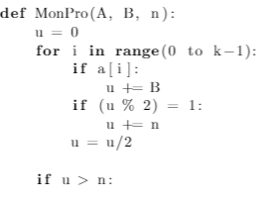

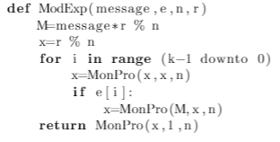
Solution overview
Using Montgomery modular multipliciation
«Montgomery plane»
Two functions
MonPro
ModExp
Can be improved

Slide 3


Improvements
r mod n(r_n) and r^2 mod (rr_n) are supplied
  Calculation of M is sped up
Parallellisation of MonPro
  Doubles speed (in theory)
Stop loop after the most
significant 1-bit.
  Speed increase when e < 128 bit
Pre-calculate whether n has to be added in MonPro
  By performing: u[0]⊕A[i]B[0]. Speeds up MonPro.

Slide 4
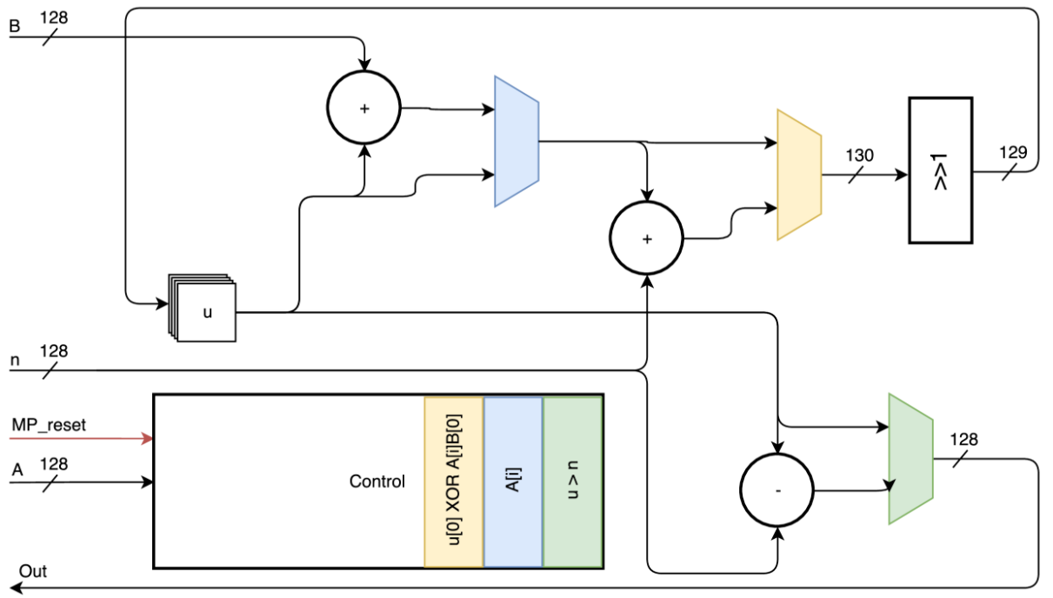
MonPro diagram

Slide 5
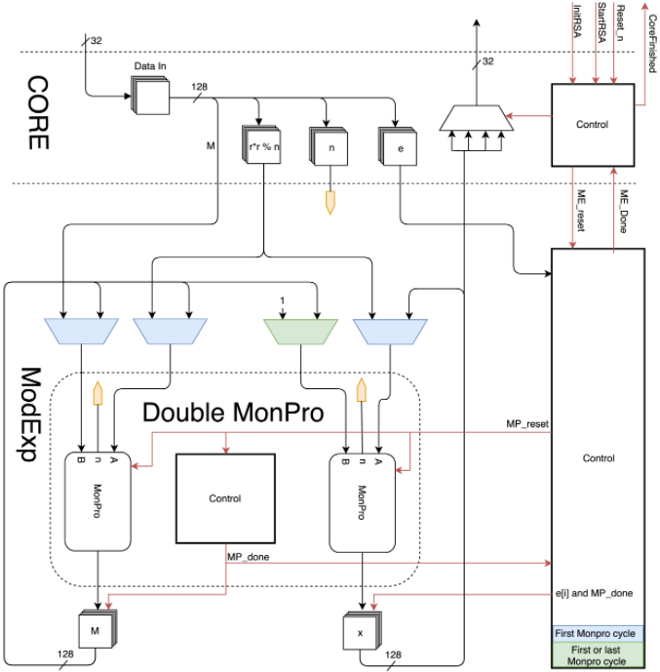
ModExp diagram

Slide 6
Verification
Wrote a Python script
  Using Montgomery multiplication
Started with the MonPro
Verified and tested that before continuing
Continued with ModExp
Verified and compared with Python

Slide 7
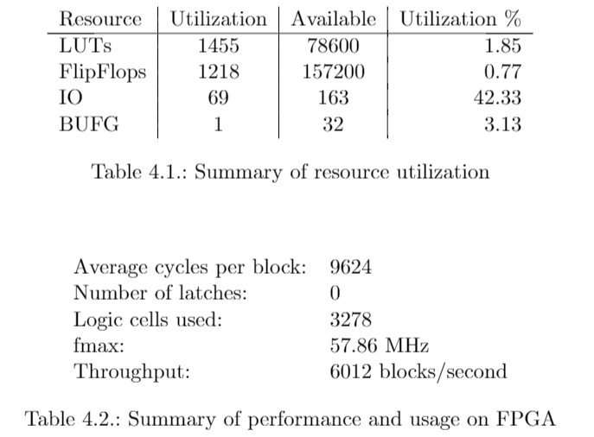
Results

