Slide 1

Improving Student Experience with A/B Testing
A Look at Montana State University’s Library
2023 Feb 29

Slide 2
Introduction to A/B testing
A/B Testing is a controlled experiment where two or more variations of a product or service is served to its users.
A/B Testing is a widely used methodology that allows researchers to make iterative user centered, data driven decisions for its products or services based on user feedback and response.

Slide 3
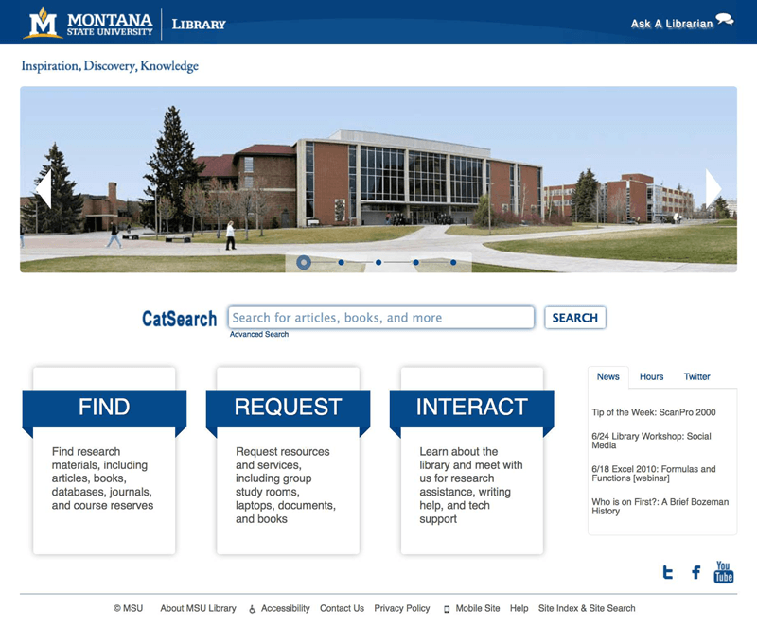
Research Question
Website analytics from MSU’s library website showed that the ”Interact” tile card was often neglected by users.
Sample period: Apr 3 – Apr 10, 2013. Included 10,819 visits.
”Interact” is where students can find information regarding hours, instructional services, staff directory, floor map and more.

Slide 4
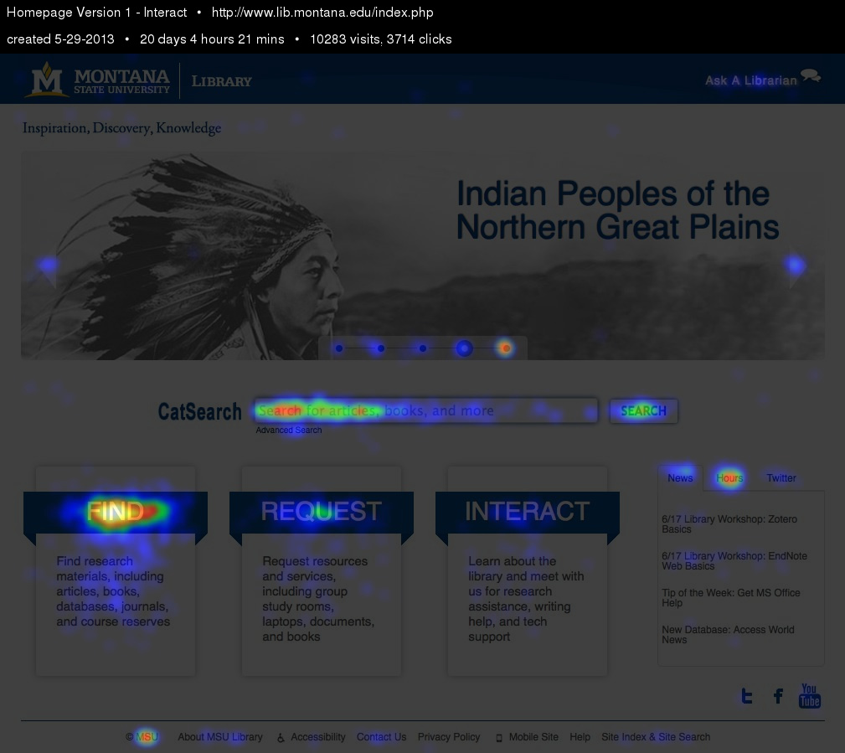
The resource website contains 3 primary Call to Actions (CTA):
35% engaged with “Find”
6% engaged with “Request”
2% engaged with “Interact”
via CrazyEgg

Slide 5
Student Survey
A qualitative student survey was conducted as a small-scale test to confirm variations in click through rates.
Three students were randomly recruited to ask:
Have you previously clicked on Interact?
What content do you expect to see after you click Interact?
Does Interact accurately describe the content you find after selecting it?
Which word best describes the category? Interact, Connect, Learn, Help or Services?

Slide 6
Key Excerpts
Junior student:
"I am not a native English speaker, so I look for strong words. I look for help, so Help is the best, then Services too."
Senior student:
"I've never felt the need to click on Interact. What am I interacting with? I guess the library?”
"Help makes sense. When I'm in the library, and I think I need help, it would at least get me to click there to find out what sort of help there is.”
In order of preferences of the choices, this student responded: Help, Services, Connect, Interact, Learn
Sophomore student:
"I didn't know that 'About' was under Interact.'"
"Connect is too vague and too close to Interact."
"Services is more accurate. Help is stronger.”
"Floor maps seem odd here.”
In order of preferences of the choices, this student responded: Help, Services, Interact, Connect, Learn

Slide 7
Study Design
Hypothesis: Help or Services will generate increased website engagement compared to Learn, Connect and Interact.
Data Collection: Google Analytics, CrazyEgg
Metrics: Click Through Rate (CTR), Bounce Rate, Exit Rate
CTR will indicate how users are responding to the new CTA language
Bounce rate indicates whether a user will leave the site after visiting a given page.
Exit rate indicates users who navigate away after visiting a single page, indicating students successfully finding the resources they are looking for.

Slide 8
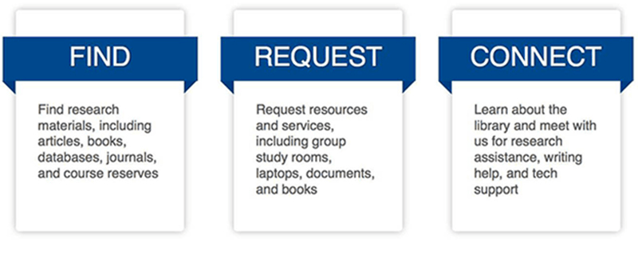
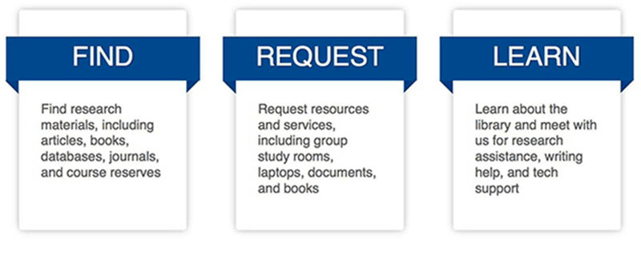
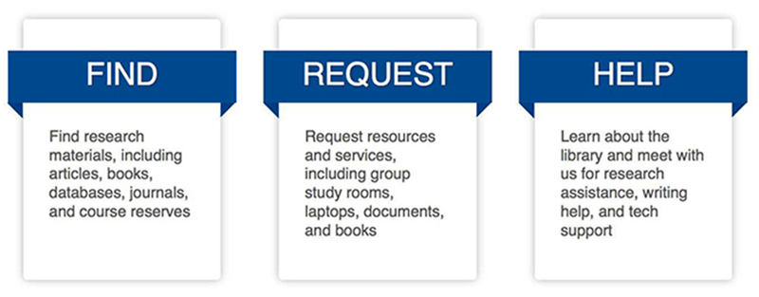
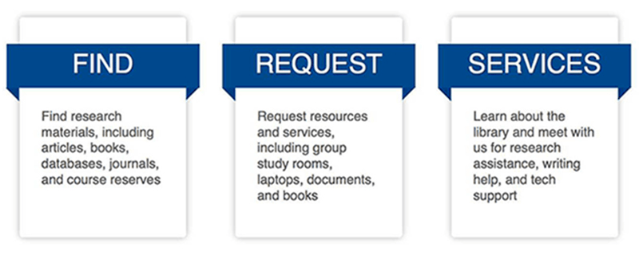
Test Setup
Five options were created for AB testing for the duration of 3 weeks:

Slide 9
Exploratory Analysis

Slide 10
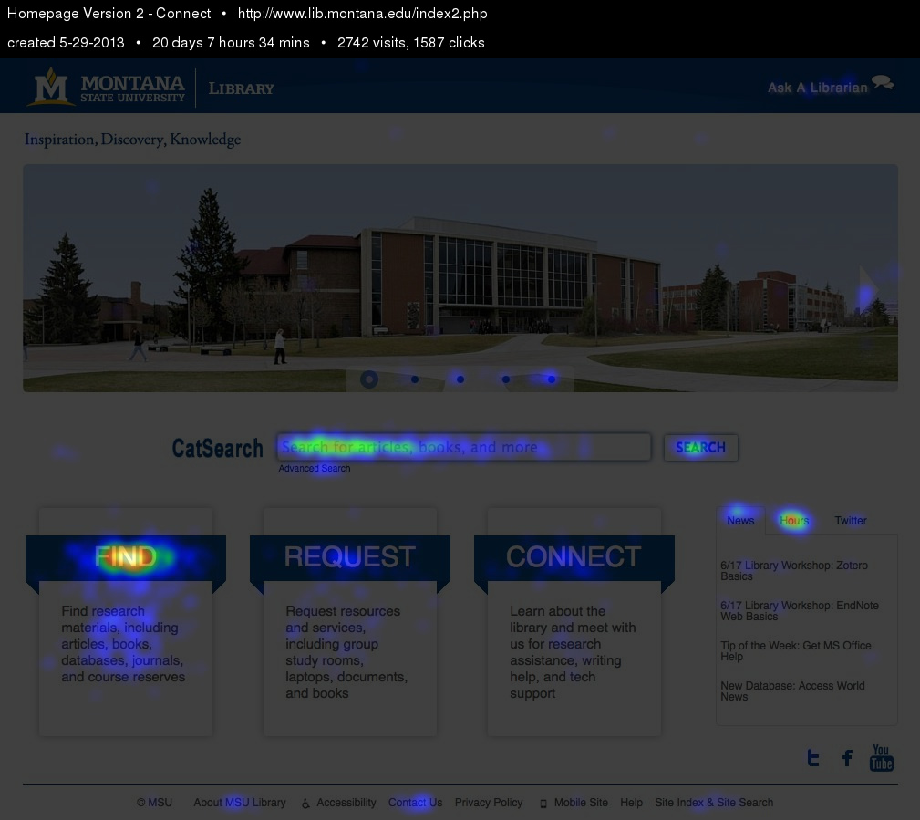
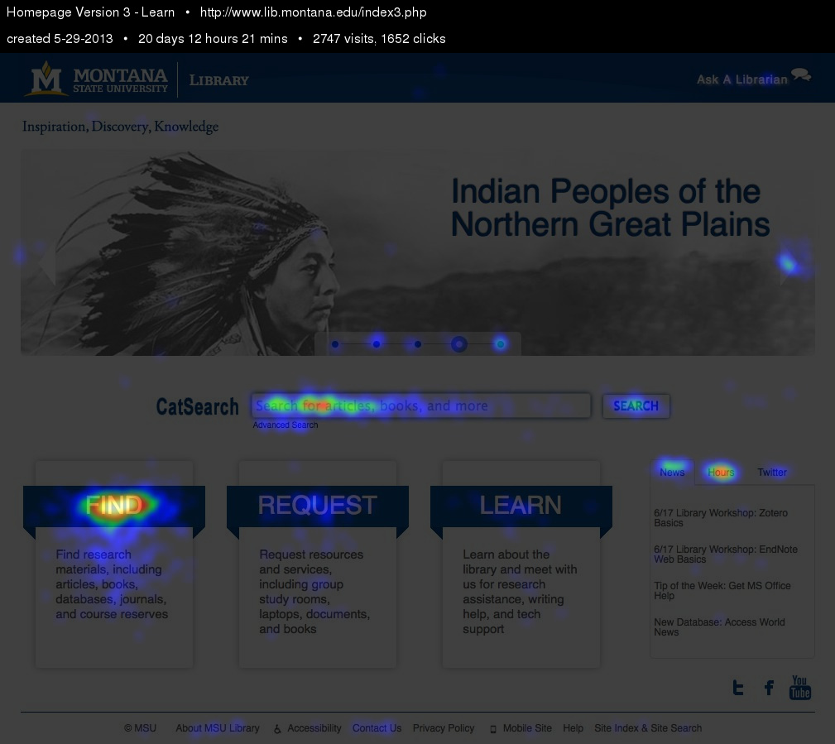
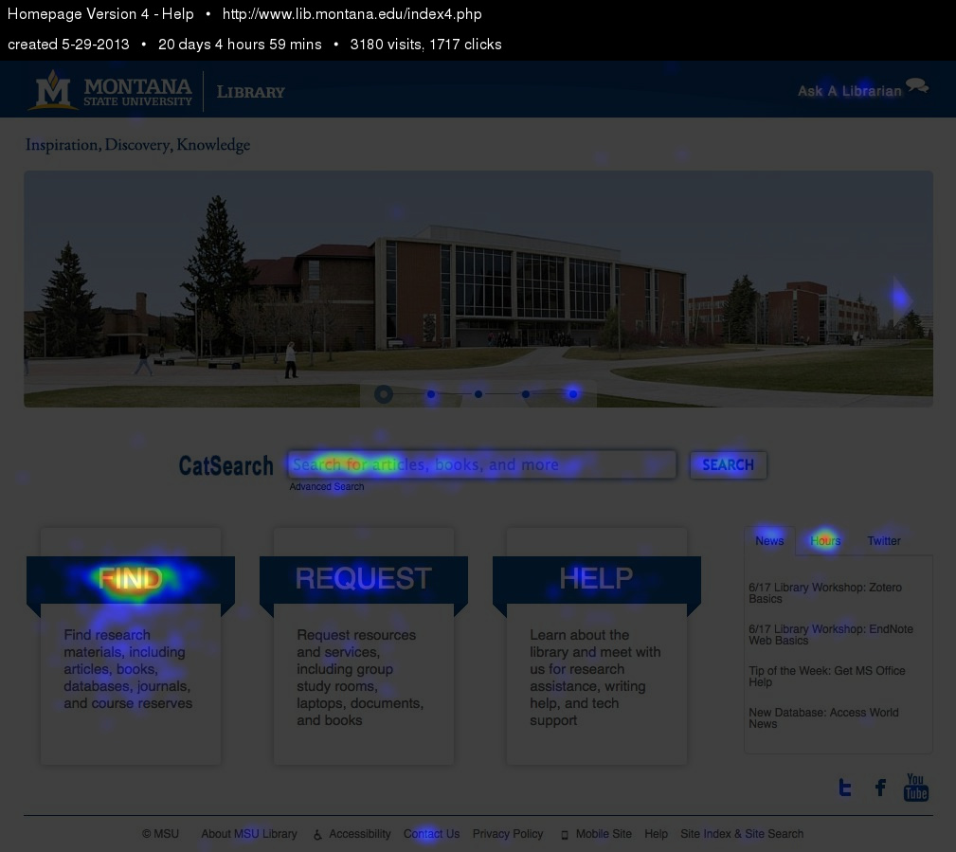
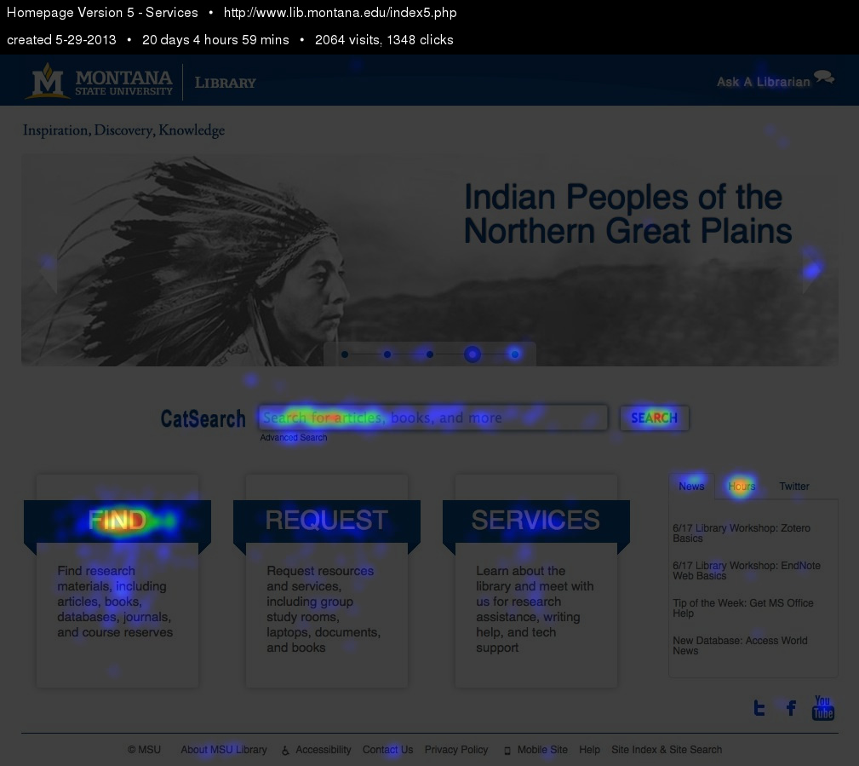
CrazyEgg Heatmap

Slide 11
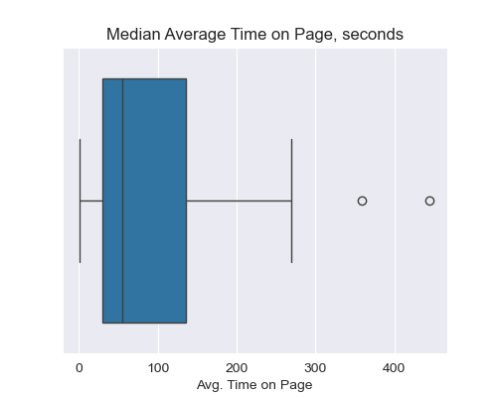
Exploratory Analysis
The Median Average Time Spent on each page is 55.67 seconds.
Average view per page is about 1519 views.
Two outliers were found in the dataset and did not impact study.

Slide 12
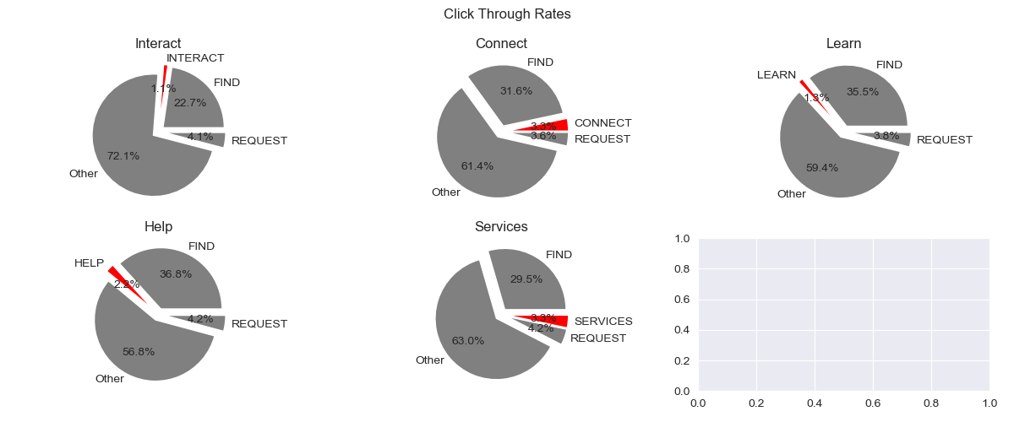
Click Through Rates (CTR)

Slide 13
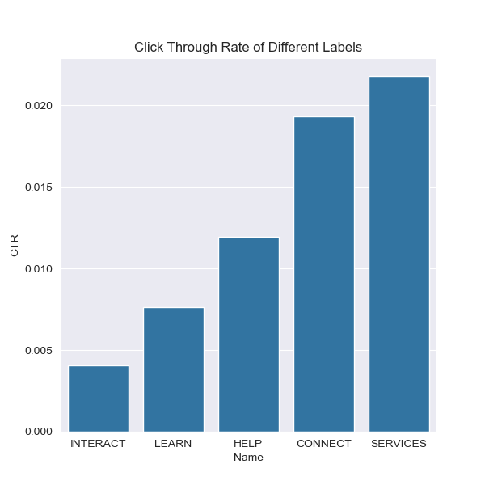
Exploratory Analysis
Changing CTA language from Interact to Services increased click through rate by 5-fold.
Changing CTA language from Interact to Help increased click through rate by 2-fold.

Slide 14
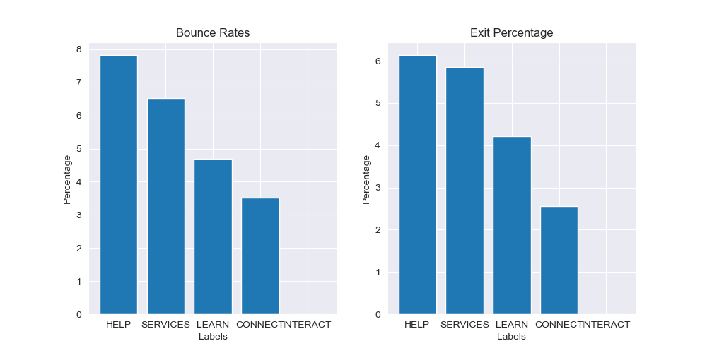
Exit Rates and Bounce Rates, normalized to Interact

Slide 15
Conclusion and Recommendations
Renaming the card from INTERACT to SERVICES improves click through rates by 5-fold, suggesting that the SERVICES is a better call to action for students accessing MSU's library resources.
HELP and SERVICES however experience a higher than typical bounce rate between 6% and 8%. This is reinforced with the higher exit percentage rates at about 6%, suggesting that users who click on SERVICES OR HELP finds the information they are looking for without further exploration of the website.
I recommend changing the title card to SERVICES, due to the stronger CTR compared to the other options. This is further supported by the higher Bounce and Exit percentages. Since this is a library meant to provide students with resources, having a higher bounce and exit percentage is more judicious, as it indicates that students are finding the resources they are looking for.

