Slide 1
Ependymoma Proteomics
Tumor Sample Set
17 x Samples EPN
Subgroup | ID
EPN_PFA | 7EP34
EPN_RELPOS | 4EP47
EPN_RELPOS | 9EP13
EPN_RELPOS | 3EP8
EPN_RELPOS | 3EP28
EPN_RELPOS | 3EP50
EPN_PFA | 4EP29
EPN_RELPOS | 4EP51
EPN_RELPOS | 7EP35
EPN_RELPOS | 3EP11
EPN_RELPOS | 4EP54
EPN_PFA | 9EP29
EPN_RELPOS | 3EP30
EPN_RELPOS | 4EP48
EPN_PFA | 4EP5
EPN_RELPOS | 3EP19
EPN_RELPOS | 4EP49
4 x Samples PFA
EPN_PFA | 7EP34
 | 4EP29
 | 9EP29
 | 4EP5
13 x Samples RELPOS
EPN_RELPOS | 3EP28
 | 3EP50
 | 4EP47
 | 4EP51
 | 7EP35
 | 3EP11
 | 4EP54
 | 9EP13
 | 3EP30
 | 4EP48
 | 3EP8
 | 3EP19
 | 4EP49
4 x PFA
13 x RELPOS

Slide 2

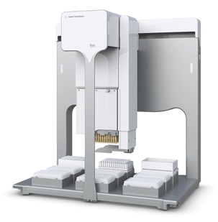
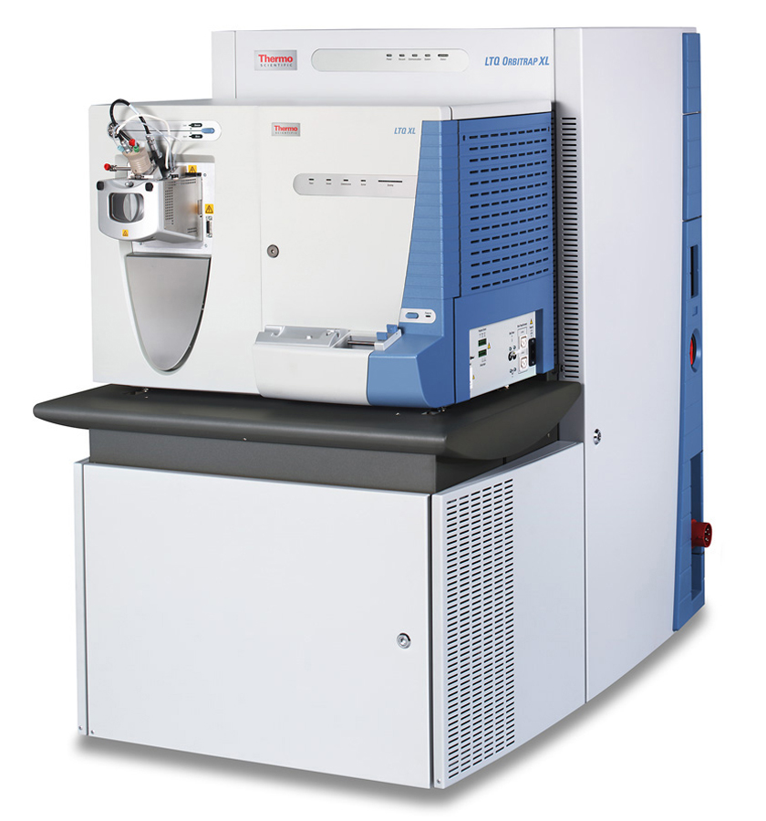
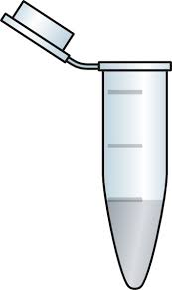
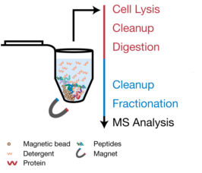
Prologue
In-Depth Proteomic Profiling; Concept to Implementation
SP3
Clinical Samples
Generic, streamlined workflow from sample to deep-proteome profile
Deep coverage (maximum # of IDs)
Quantitative
Scalable
Low-quantity samples (cells, tissues, fixed tissues..)
Fast & Cost-effective
Robust & Reproducible
Minimized hands-on time (automation)

Slide 3



Data Acquisition Strategy
Separation of Identification and Quantification
Gathering of Protein Identifications
Focusing on Quantification
gathering data points
Deep-Proteome Library
Single-shot Samples
34h
1h

Slide 4
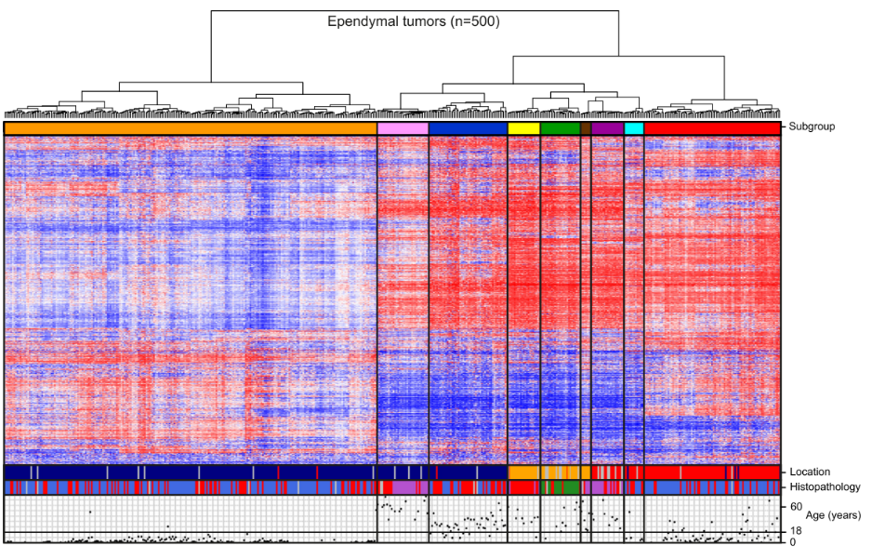
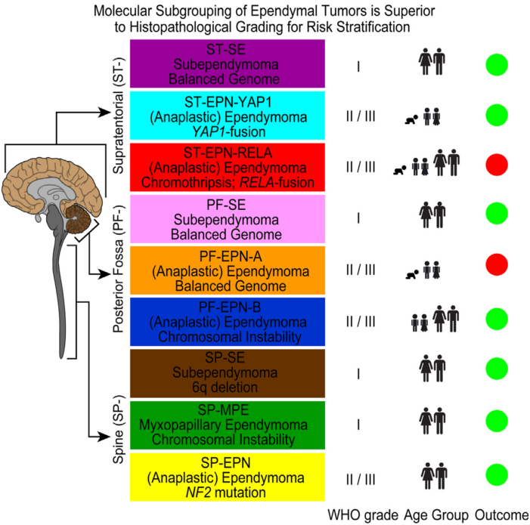
Proteomic Profiling of Clinical Tissue Samples
Application to Ependymoma; Concept to Implementation
10,000 probes
PFA
RELPOS
17 EPN Samples
Most distinct groups
Dismal prognosis
9 distinct subgroups
Pajtler, K. W. et al. Molecular Classification of Ependymal Tumors across All CNS Compartments, Histopathological Grades, and Age Groups. Cancer Cell 27, 728–743 (2015)
Notes:
DNA methylation patterns for improved molecular classification; -> demonstrates a stable, highly reliable classification strategy; Proteomic profiling for improved characterization & classification

Slide 5
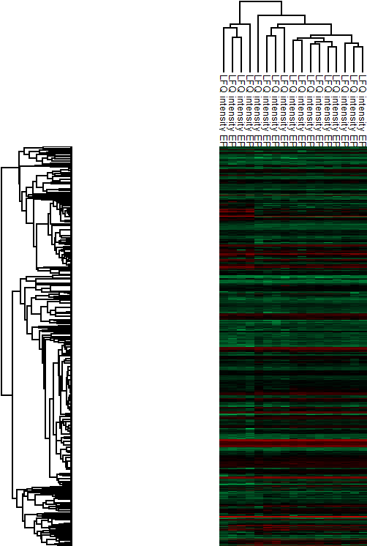
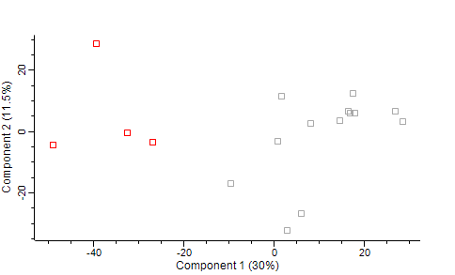

Application to two Ependymoma subgroups
1H Gradient, T2 method; Unsupervised Hierarchical Clustering & PCA
Patient Samples
2862 shared proteins groups across all 17 samples
still clustered in PFA and RELPOS
Subgroup
PFA
RELPOS
PFA
RELPOS
2862 protein-groups
40
PFA
RELPOS
|
|
|
|
30
Log2 LFQ intensities
25
20

Slide 6
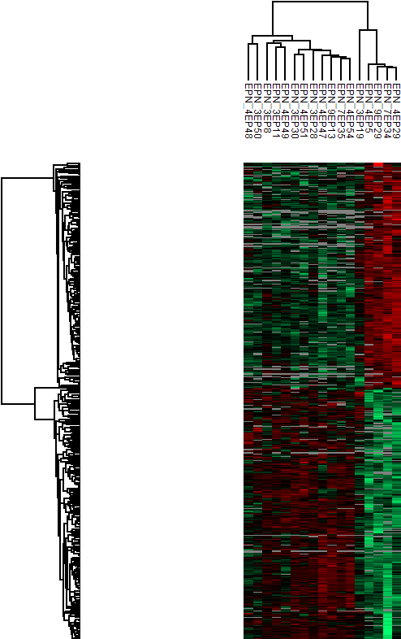
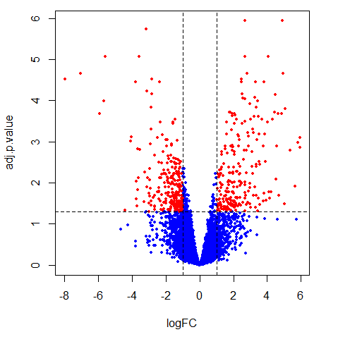

Application to two Ependymoma subgroups
1H Gradient; Limma Statistics (incl. all protein groups = 6739)
Patient Samples
Subgroup
RELPOS
PFA
-log₁₀(adj. p-value)
489 protein-groups
logFC (PFA/RELPOS)
|
2
BH adjusted p-value: 0.05 threshold
Fold change PFA/RELPOS >1 or <-1
|
0
Log2 LFQ intensities
|
-2

Slide 7
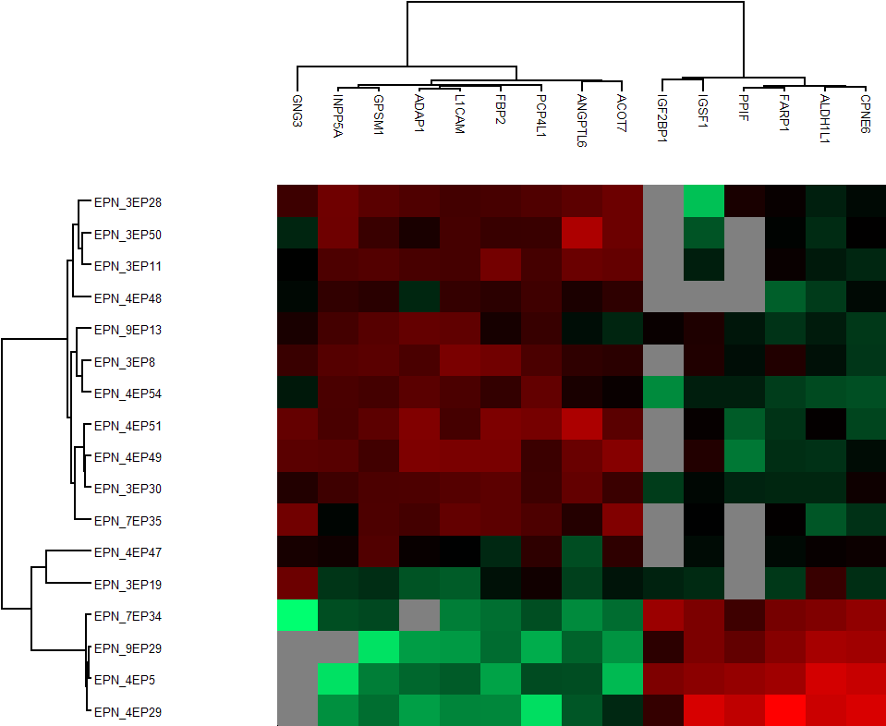
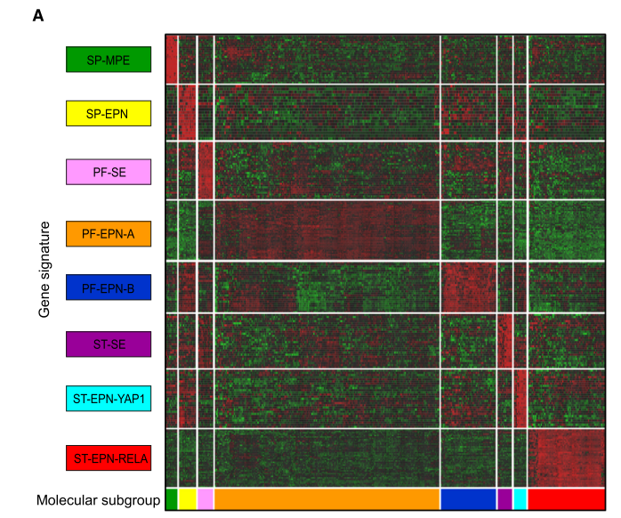

Gene expression data – subgroup associated signature genes
transcription profiles, supervised hierarchical clustering
Significant, subgroup-associated proteins
Signature Genes based on
Transcription Profile
RELPOS
-2
0
2
|
|
|
Log2 LFQ intensities
PFA
Pajtler, K. W. et al. Molecular Classification of Ependymal Tumors across All CNS Compartments, Histopathological Grades, and Age Groups. Cancer Cell 27, 728–743 (2015)
Notes:
EPHA2: Involved for instance in angiogenesis, in early hindbrain development, epithelial proliferation
L1Cam: Neural cell adhesion molecule involved in the dynamics of cell adhesion and in the generation of transmembrane signals at tyrosine kinase receptors. During brain development, critical in multiple processes, including neuronal migration, axonal growth and fasciculation, and synaptogenesis

Slide 8
Extending the current Set of Ependymoma Samples
Proteomic Profiling of 83 clinical tissue samples; 17 + new 66 samples
83 EPN Samples
9 distinct subgroups
Pajtler, K. W. et al. Molecular Classification of Ependymal Tumors across All CNS Compartments, Histopathological Grades, and Age Groups. Cancer Cell 27, 728–743 (2015)
Notes:
DNA methylation patterns for improved molecular classification; -> demonstrates a stable, highly reliable classification strategy; Proteomic profiling for improved characterization & classification

