Slide 2
box-1
box-2
VIP
Virtual Layer-2
vi0
internal
vxlan0
vxlan
vxlan0
vi0
bridge-0
bridge-0
bond-0
bond-0
eno-1
eno-2
eno-1
eno-2

Slide 3
VM-0
vm_port-0
192.168.1.1/24
bridge-0
box-1
box-2
Virtual Layer-2
br-int
192.168.1.2/24
vi0
internal
vxlan0
vxlan
vxlan0
vi0
br-prov
internal
192.168.1.1/24
br-phy1
local="172.16.227.141", remote="172.16.227.140"
192.168.1.1/24
eno-1
dpdk0/eno-1
eno-1
eno-2
br-tun
ovs-ofctl show br-tun

Slide 4
GENEVE
Generic Network Virtualization Encapsulation (GENEVE) -- that promises to address the perceived limitations of the earlier specifications and support all of the capabilities of VXLAN, NVGRE and STT. Many believe GENEVE could eventually replace these earlier formats entirely.
VMWare uses VXLAN to communicate with gateways to the non virtualized world
NVGRE is used mostly by Microsoft
VMWare uses STT as the tunneling mechanism between vSwitches

Slide 5
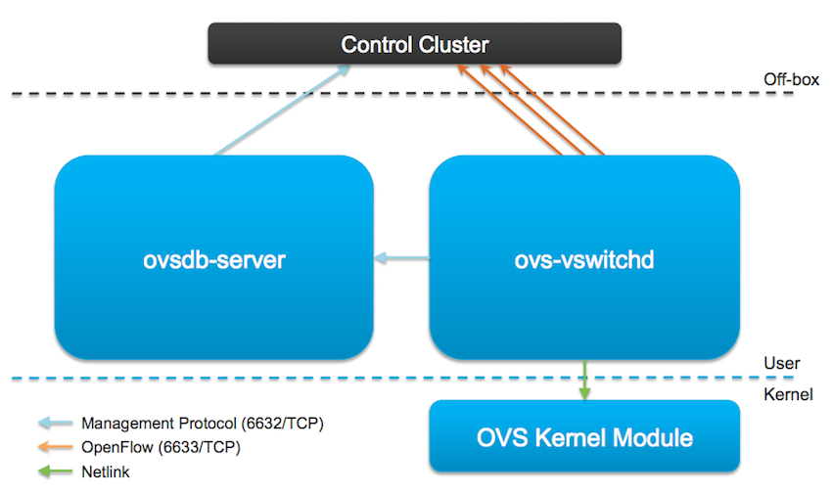
Open vSwitch
OpenFlows - User Space based
Datapath - kernel based, a kind of cached version of the OpenFlow ones.
ovs-ofctl - speak to OpenFlow module
ovs-dpctl - speak to Kernel module

Slide 6
Overlay tunneling
HOST-1
HOST-2
ovs-vsctl add-br br-tun
ovs-vsctl add-br br-int
ovs-vsctl add-port br-tun eth0
ifconfig eth0 0
ifconfig br-tun 192.168.1.10 netmask 255.255.255.0
route add default gw 192.168.1.1 br-tun
ifconfig br-int 10.1.2.10 netmask 255.255.255.0
ovs-vsctl add-br br-tun
ovs-vsctl add-br br-int
ovs-vsctl add-port br-tun eth0
ifconfig eth0 0
ifconfig br-tun 192.168.1.11 netmask 255.255.255.0
route add default gw 192.168.1.1 br-tun
ifconfig br-int 10.1.2.11 netmask 255.255.255.0
ovs-vsctl add-port br-int gre1 -- set interface gre1 type=gre options:remote_ip=192.168.1.11
ovs-vsctl add-port br-int gre1 -- set interface gre1 type=gre options:remote_ip=192.168.1.10
GRE
VXLAN
ovs-vsctl add-port br-int vx1 -- set interface vx1 type=vxlan options:remote_ip=192.168.1.11
ovs-vsctl add-port br-int vx1 -- set interface vx1 type=vxlan options:remote_ip=192.168.1.10
GENEVE
ovs-vsctl add-port br-int gen1 -- set interface gen1 type=geneve options:remote_ip=192.168.1.11
ovs-vsctl add-port br-int gen1 -- set interface gen1 type=geneve options:remote_ip=192.168.1.10

Slide 7
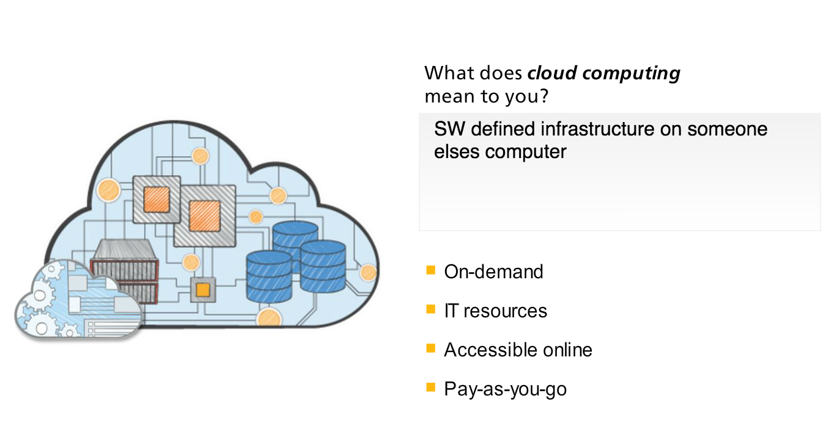

Slide 8
Network basics
Provider NW (layer 2, directly to phys infra in datacenter, NO floating&routing)
External NW ()
Network types (flat, local, vlan, vxlan, gre, geneve)

Slide 9


Private Cloud POC architecture
Compute-1
Compute-2
Compute-n
MULE
SOLR
MONGO
Nova Compute
Tenant x
Nova Compute
Nova Compute
NAGIOS
HADOOP
Kvm
VM-1
VM-n
Kvm
Tenant z
Kvm
br-int
br-int
br-tun
Tenant y
br-tun
VM-1
VM-n
br-int
br100
br102
br100
br102
br100
br102
eth0
eth2
eth0
eth2
eth0
eth2
VM-1
LXC-n
Data
Mgmt
ISCSI (block storage)
Controller-1
Network-1
keystone
Glance
Cinder
Neutron
Nova
Horizon
Swift
Internet
Neutron
RabbitMQ
MariaDB
br100
br101
br101
API
eth0
eth1
eth2
eth0
eth1
External NW
Notes:
Common architecture and framework
Python
Management network. Used for internal communication between OpenStack components. The IP addresses on this network should be reachable only within the data center.
Data network. Used for VM data communication within the cloud deployment. The IP addressing requirements of this network depend on the Quantum plugin in use.
External network. Used to provide VMs with Internet access in some deployment scenarios. The IP addresses on this network should be reachable by anyone on the Internet.
API network. Exposes all OpenStack APIs, including the Quantum API, to tenants. The IP addresses on this network should be reachable by anyone on the Internet. This may be the same network as the external network, as it is possible to create a quantum subnet for the external network that uses IP allocation ranges to use only less than the full range of IP addresses in an IP block.

Slide 10
LB
web-1
web-1
VM-0
vm_port-0
AZ-1
AZ-2
Virtual NW Layer-2
br-tun
vlan
controller
network
compute
br-int
vxlan
maria-db
rabbitmq
httpd
memcached
keystone
neutron-server
glance-api
glance-registry
nova-api
nova-cert
nova-conductor
nova-consoleauth
nova-novncproxy
nova-scheduler
dnsmasq
openVswitch
neutron-openvswitch-agent
neutron-metering-agent
neutron-metadata-agent
neutron-l3-agent
neutron-dhcp-agent
neutron-lbaasv2-agent
libvirt
qemu-kvm
openVswitch
neutron-openvswitch-agent
nova-compute
br-prov
terraform apply/destroy

