Slide 1
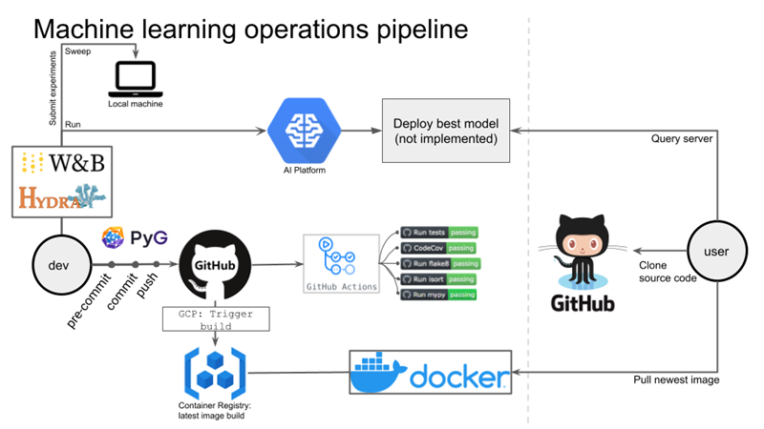


Slide 2
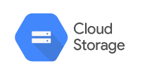

Deploy
train

Slide 3


Curl
Deploy
train

