Slide 1
How to write a spelling checker?
Detect errors
Show Suggests
In a simple way

Slide 2
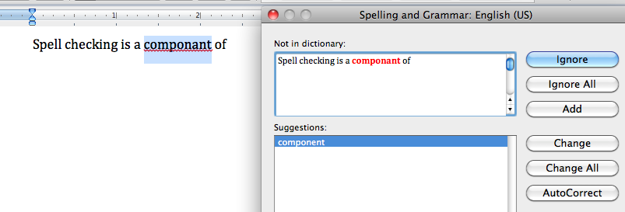
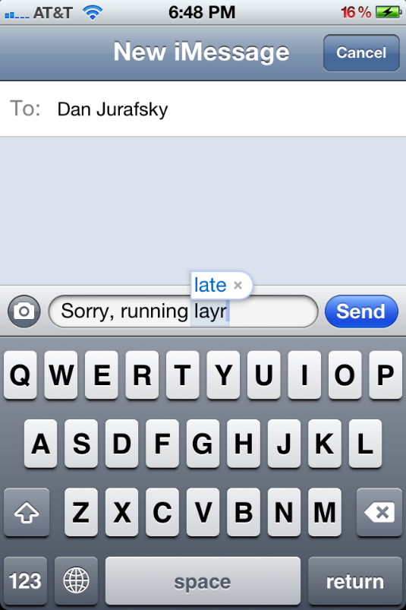


Common applications
Word processor
Phones
Web search

Slide 3
How to put an elephant into a fridge?
Open the fridge
Put in the elephant
Close the door

Slide 4
Spelling tasks
Detect spelling error
Generate candidate words
Show suggestions
Autocorrect: hte -> the
Suggest a correction
Suggest a list
Evaluate
Does it really word (enough) well?

Slide 5
Types of spelling errors
Non-word Errors
graffe -> giraffe
Real-word Errors
Typographical errors
three -> there
Cognitive errors (homophone)
piece -> peace
too -> two

Slide 6
Rates of spelling errors
Web queries: 26% (Wang et al. 2003)
Retyping, no backspace: 13% (Whitelaw et al.)
Retyping: 1-2% (Kane and Wobbrock 2007)

Slide 7
What we will develop is..
A non-word spell checker
Detect error
Generate candidates
Find best ones
Evaluate

Slide 8
Error detection
Any word not in a dictionary is an error
The larger the dictionary the better
Our task is to build a fairly large dictionary
From books
From web

Slide 9
Build a simple dictionary
import re, collections def words(text): return re.findall('[a-z]+', text.lower()) def train(features): model = collections.defaultdict(lambda: 1) for f in features: model[f] += 1 return model NWORDS = train(words(file('big.txt').read()))
the 1024
I 510
love 55
book 20
…

Slide 10
Candidates generation (1)
Essentially, we choose the similar words
Similar spelling
Similar pronunciation
caught -> cort
component -> componant

Slide 11
Candidates generation (2)
How to measure the similarity?
Damerau-Levenshtein edit distance
Insertion
Deletion
Substitution
Transposition of two adjacent letters

Slide 12
Candidates generation (3)
80% of errors are within edit distance 1
Almost all errors are within edit distance 2
Our task is actually to
find all words within edit distance 2 from the dictionary

Slide 13
Edit distance examples
Error | Candidate Correction | Correct Letter | Error Letter | Type (for correction)
acress | actress | t | - | deletion
acress | cress | - | a | insertion
acress | caress | ca | ac | transposition
acress | access | c | r | substitution
acress | across | o | e | substitution
acress | acres | - | s | insertion
acress | acres | - | s | insertion

Slide 14
Find all words within edit distance 2
alphabet = 'abcdefghijklmnopqrstuvwxyz' def edits1(word): s = [(word[:i], word[i:]) for i in range(len(word) + 1)] deletes = [a + b[1:] for a, b in s if b] transposes = [a + b[1] + b[0] + b[2:] for a, b in s if len(b)>1] replaces = [a + c + b[1:] for a, b in s for c in alphabet if b] inserts = [a + c + b for a, b in s for c in alphabet] return set(deletes + transposes + replaces + inserts) def known_edits2(word): return set(e2 for e1 in edits1(word) for e2 in edits1(e1) if e2 in NWORDS)

Slide 15
Now let’s find out the best ones
Noisy Channel Model
Language Model

Slide 16
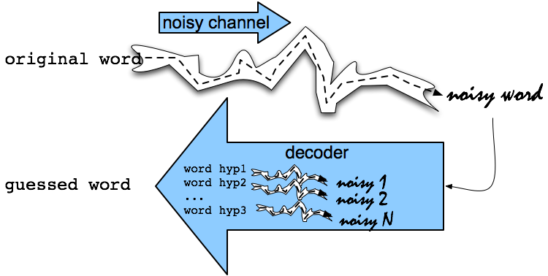
Noisy Channel Model Intuition
Speech Recognition

Slide 17
Noisy Channel Model
We saw an observation x of a misspelled word
Find the correct word w
Bayes’ theorem
Language model
Error model

Slide 18
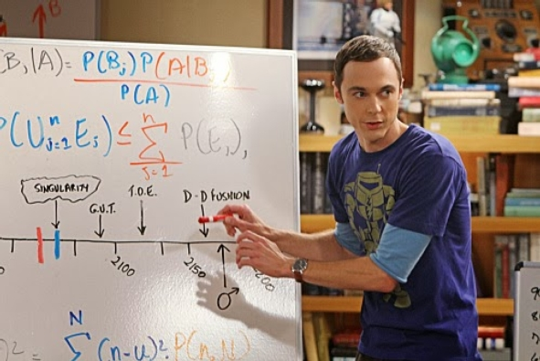
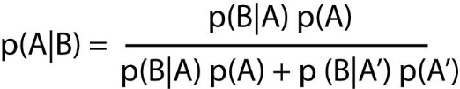
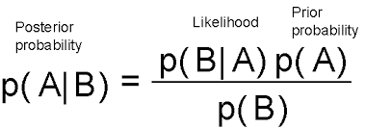
Bayes’ theorem
Describes the probability of an event,
based on conditions that might be related to the event.

Slide 19
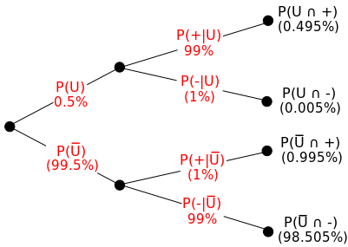

Bayes’ theorem example

Slide 20
Language Model
Assign a probability to a sentence/sequence
Unigram
Bigram
Trigram
N-gram
P(about fifteen minutes from) > P(about fifteen minuets from)

Slide 21
Unigram probability
Counts from 404,253,213 words in Corpus of Contemporary English (COCA)
word | Frequency of word | P(word)
actress | 9,321 | .0000230573
cress | 220 | .0000005442
caress | 686 | .0000016969
access | 37,038 | .0000916207
across | 120,844 | .0002989314
acres | 12,874 | .0000318463

Slide 22
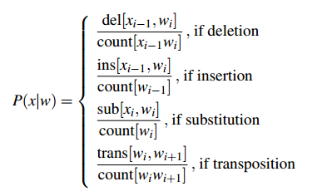
Error model(1)
Misspelled word x = x₁, x₂, x₃… x_{m}
Correct word w = w₁, w₂, w₃,…, w_{n}
P(x|w) = probability of the edit
(deletion/insertion/substitution/transposition)

Slide 23
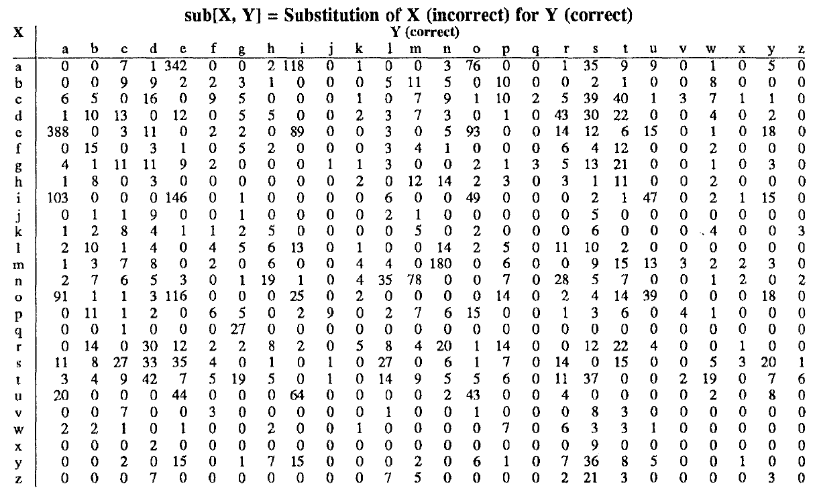
Error model(2)

Slide 24
Error model(3)
Candidate Correction | Correct Letter | Error Letter | x|w | P(x|word)
actress | t | - | c|ct | .000117
cress | - | a | a|# | .00000144
caress | ca | ac | ac|ca | .00000164
access | c | r | r|c | .000000209
across | o | e | e|o | .0000093
acres | - | s | es|e | .0000321
acres | - | s | ss|s | .0000342

Slide 25
Noisy channel probability for acress
Candidate Correction | Correct Letter | Error Letter | x|w | P(x|word) | P(word) | 10^{9 *}P(x|w)P(w)
actress | t | - | c|ct | .000117 | .0000231 | 2.7
cress | - | a | a|# | .00000144 | .000000544 | .00078
caress | ca | ac | ac|ca | .00000164 | .00000170 | .0028
access | c | r | r|c | .000000209 | .0000916 | .019
across | o | e | e|o | .0000093 | .000299 | 2.8
acres | - | s | es|e | .0000321 | .0000318 | 1.0
acres | - | s | ss|s | .0000342 | .0000318 | 1.0

Slide 26
Noisy channel probability for acress
Candidate Correction | Correct Letter | Error Letter | x|w | P(x|word) | P(word) | 10^{9 *}P(x|w)P(w)
actress | t | - | c|ct | .000117 | .0000231 | 2.7
cress | - | a | a|# | .00000144 | .000000544 | .00078
caress | ca | ac | ac|ca | .00000164 | .00000170 | .0028
access | c | r | r|c | .000000209 | .0000916 | .019
across | o | e | e|o | .0000093 | .000299 | 2.8
acres | - | s | es|e | .0000321 | .0000318 | 1.0
acres | - | s | ss|s | .0000342 | .0000318 | 1.0

Slide 27
The simplest spell checker in the history
def known(words): return set(w for w in words if w in NWORDS) def correct(word): candidates = known([word]) or known(edits1(word)) or known_edits2(word) or [word] return max(candidates, key=NWORDS.get)
>>> correct('speling') 'spelling' >>> correct('korrecter') 'corrector'

Slide 28
Evaluate(1)
Error dataset:
scold: schold, skold
adaptable: adabtable
caned: canned, cained
immature: imature
shouldn't: shoudln, shouldn’t
…
Split dataset
Train/dev
Test

Slide 29
Evaluate(2)
def spelltest(tests, bias=None, verbose=False): import time n, bad, unknown, start = 0, 0, 0, time.clock() if bias: for target in tests: NWORDS[target] += bias for target,wrongs in tests.items(): for wrong in wrongs.split(): n += 1 w = correct(wrong) if w!=target: bad += 1 unknown += (target not in NWORDS) if verbose: print 'correct(%r) => %r (%d); expected %r (%d)' % ( wrong, w, NWORDS[w], target, NWORDS[target]) return dict(bad=bad, n=n, bias=bias, pct=int(100. - 100.*bad/n), unknown=unknown, secs=int(time.clock()-start))
{'bad': 68, 'bias': None, 'unknown': 15, 'secs': 16, 'pct': 74, 'n': 270} {'bad': 130, 'bias': None, 'unknown': 43, 'secs': 26, 'pct': 67, 'n': 400}

Slide 30
Further improvements - context
“a stellar and versatile acress whose combination of sass and glamour…”
Unigram: across > actress
Bigram:
P(“versatile actress whose”) = .000021*.0010 = 210 x10⁻¹⁰
P(“versatile across whose”) = .000021*.000006 = 1 x10⁻¹⁰

Slide 31
Further reading
How to Write a Spelling Corrector
Natural Language Corpus Data (Chapter 14 of Beautiful Data)
Speech and Language Processing (Chapter 4, 6)
Edit distance
Bayes’ theorem
Language model
Noisy channel model

Slide 32
Thank youu ☺

