Slide 1
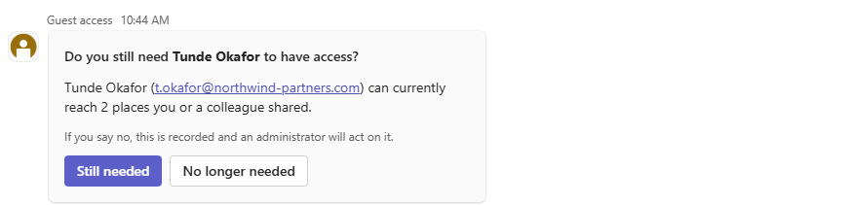
Governance for Microsoft 365
SHARING AND GUEST ACCESS · MICROSOFT 365
Every share in your tenant was a decision somebody made.
Now somebody is asked whether it still holds.
Nothing is locked down, nothing is blocked, and nobody is retrained. The people who made each sharing decision are asked, later and in Teams — and their answers become your record.
FIG. 01 The question, as it arrives in Teams. One click, and the answer is recorded.

Slide 2
01 · ACCESS OUTLIVES ITS REASON
Internal oversharing used to need somebody to go looking.
Now it only needs somebody to ask.
Sharing in Microsoft 365 takes one click. Remembering why, and asking later whether it still stands, takes something Microsoft 365 does not have. The gap opens in two directions, and most organisations have both.
A
40%
delayed their Copilot rollout by three months or more because of oversharing
B
64%
spent considerable time and resources on governance and security risk before they could deploy at all
C · A GUEST ACCOUNT, BY DEFAULT
No expiry. No inactivity alert. No cleanup.
A, B: Gartner survey of 132 IT leaders, June 2025. C: how the platform works.
The person who granted the access is the only one who knows it should end. Nothing ever asks them.

Slide 3
THE GAP OPENS IN TWO DIRECTIONS
It is rarely one folder — and it is rarely only inside.
Inside the company
Outside the organisation
A folder gets shared with everyone in the organisation, because that was the quickest way to unblock one colleague on one afternoon. The link is still there. So is the folder.
It is rarely one folder. “Everyone Except External Users” — the group that grants access to every employee you have — is the single largest source of it, and the default suggestion in several of SharePoint's own sharing dialogs.
An external user arrives the ordinary way: somebody shares a folder. From that moment, nothing records which internal person is responsible for them. The project ends. The person who shared moves on. The access doesn't.
Organisations collaborating externally for a couple of years hold hundreds to thousands of guest accounts — some who signed in and stopped, some who never signed in at all.
The person who granted the access is the only one who knows it should end. Nothing ever asks them.

Slide 4
02 · GOVERNANCE WITHOUT TAKING ANYTHING AWAY
You should not have to lock sharing down to get control of it.
Every answer to oversharing so far has been restriction. Tighten external sharing. Turn off Anyone links. Make people raise a ticket to collaborate. It works, and it costs you the goodwill of everybody who now has to ask permission to do their job.
This takes the other route. Nothing is locked down, nothing is blocked, and nobody is retrained. The people who made the sharing decisions are simply asked, later, whether they still stand — and their answers become your record.

Slide 5
03 · HOW IT WORKS
A named person, one question, a recorded answer.
Megan shares a folder with Lars at Fabrikam. The project ends in May. In November, somebody finally asks.
1 · WATCH
We monitor what happens across Microsoft 365. When somebody shares a folder, or an external account appears, a named internal person becomes answerable for that access.
2 · ASK
On a schedule you set, that person gets one question in Teams: is this still needed? It takes one click.
3 · RECORD
Not just the access change, but the decision — who made it and when. The evidence a compliance review asks for and nobody has.

Slide 6
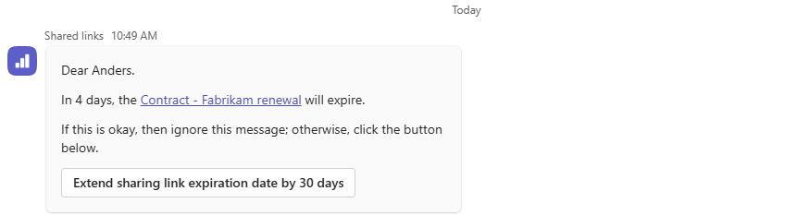
04 · SHARED LINKS
Every link, not only the external ones.
People set expiry dates on links and forget them. When a link expires, work stops — so the instinct is to set long expiries, or none at all.
A link shared with one colleague, with the whole company, or outside it: each was a decision with a reason, and each is watched the same way.
The existing link keeps working. There is nothing to re-send.
FIG. 03 Before a link expires, its owner is told. One button extends it — same URL, same permission.

Slide 7
05 · GUEST ACCESS
Who is answerable for every guest.
Every guest invited from the day you switch it on, in one list, with the thing that exists nowhere else: who is answerable for them, and what they can reach today.
On your schedule, that person is asked whether the guest is still needed. Say yes and the clock resets. Say no and the guest passes to the next person who invited them. Only when nobody is left does an administrator hear about it.
A “no” from one person is not a verdict on the guest. It is one person stepping back.

Slide 8
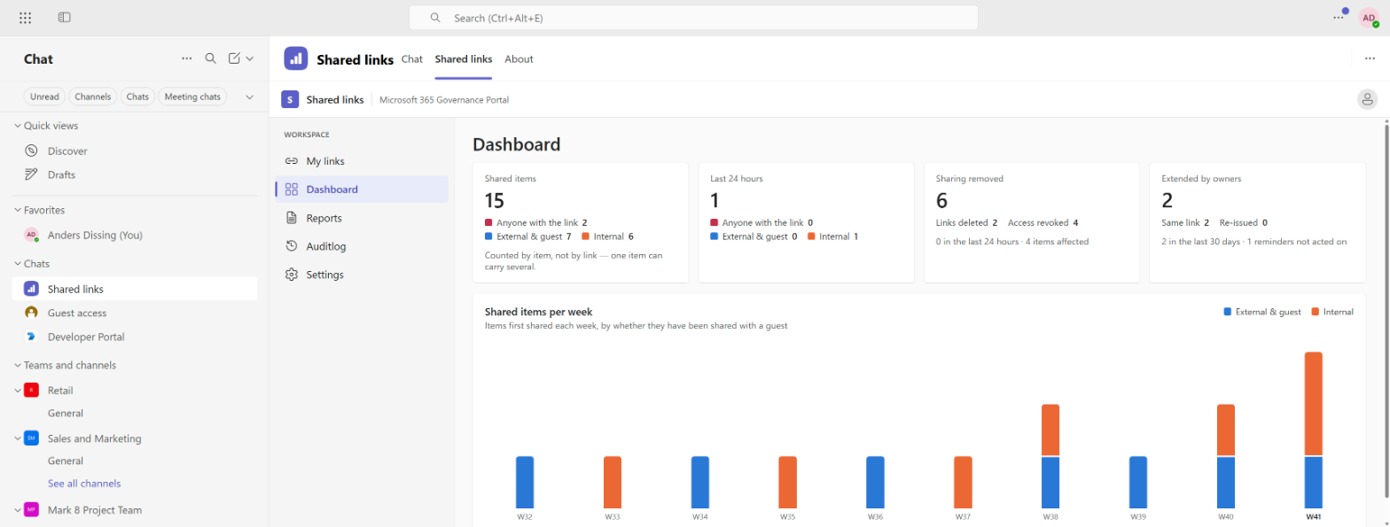
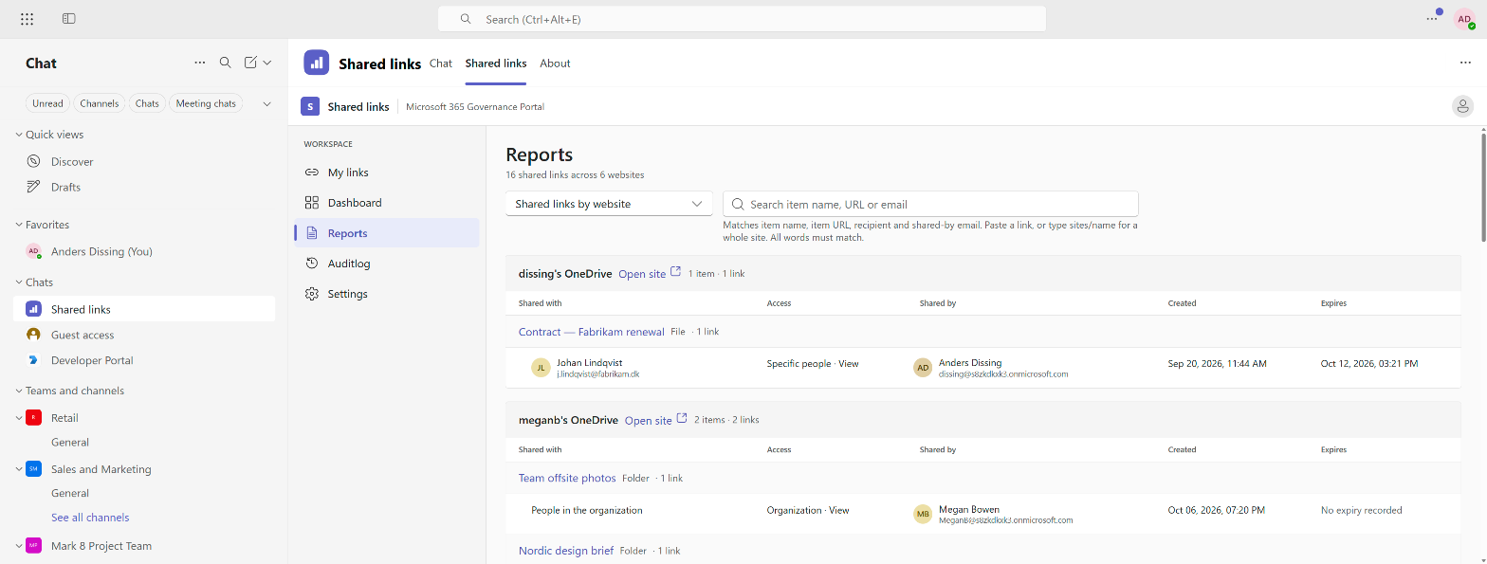
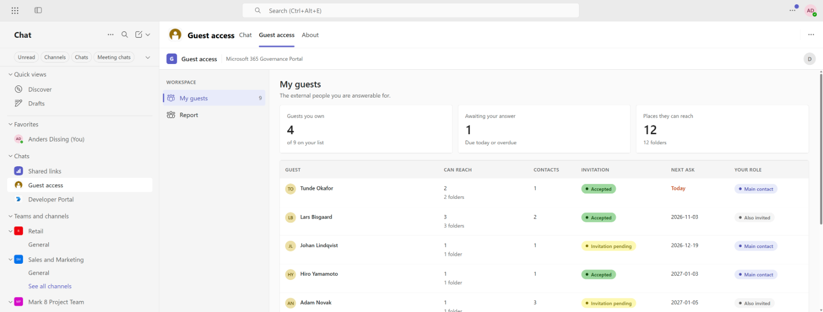
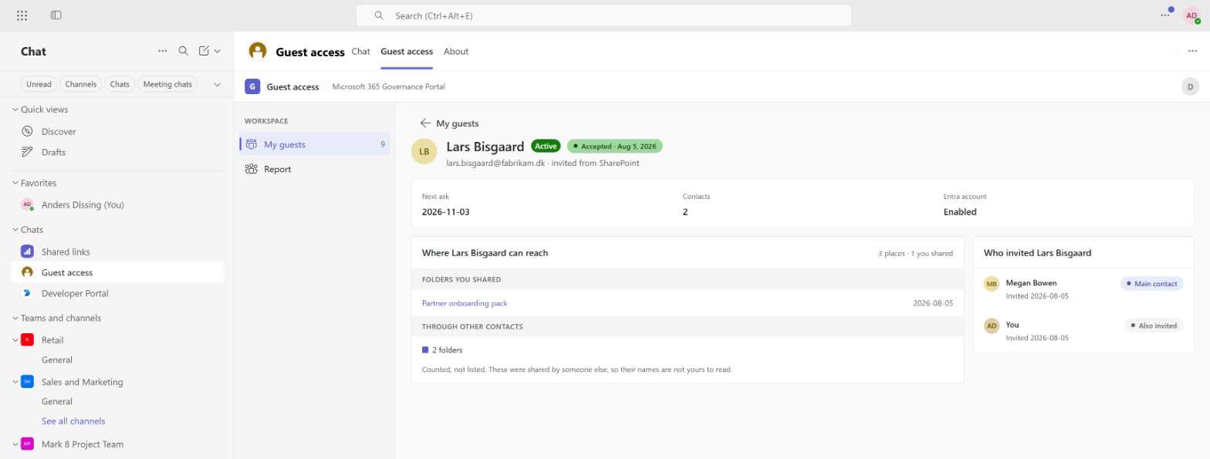
INSIDE TEAMS
The two apps, as people use them
SHARED LINKS · DASHBOARD
SHARED LINKS · REPORTS
GUEST ACCESS · MY GUESTS
GUEST ACCESS · GUEST DETAIL

Slide 9
06 · PEOPLE SEE ONLY WHAT THEY ARE ANSWERABLE FOR
“Counted, not listed. These were shared by someone else, so their names are not yours to read.”
Access is enforced in the database itself, not by hiding things in the interface. Somebody who opens a guest's page sees the folders they shared. Where that guest can also reach folders shared by colleagues, they get the number — but not the names.
Administrators see the whole tenant. Everybody else sees exactly their own responsibility.

Slide 10
07 · YOU DECIDE WHAT IT IS ALLOWED TO DO
It asks questions. What it does with the answers is yours to set.
The defaults are the cautious ones.
Links
Let people extend an expiry from the card, or keep it read-only and let the reminder stand on its own.
SHIPS WITH: EXTEND FROM THE CARD
Guests
A final “no longer needed” can be recorded for an administrator to act on, or act on the account directly.
SHIPS WITH: RECORDING ONLY
Timing
How long before an expiry people are reminded, how long before a guest is revisited, and what a “still needed” buys.
YOUR SCHEDULE
Until you turn something on, it holds no permission to do it.
That is not a policy setting. Where the product is set to record rather than act, it is not granted the access that would let it act at all.

Slide 11
08 · IT CONNECTS TO WHAT YOU ALREADY HAVE
The signals about sharing stop being Microsoft's and start being yours.
Everything the product observes is published as a standard event. Your own systems can subscribe to the same signals and build on them without touching anything here.
Service desk
Joiner-mover-leaver
SIEM
Your own reporting

Slide 12
Governance for Microsoft 365
Make every share someone's responsibility — starting with the next one.
Contact Anders Dissing
dissing@sharepointkonsulenterne.dk
Screenshots use demo data. External addresses are invented.

