Slide 1
Semester Seed
Register
Log in

Slide 2
Semester Seed
Logged in as: bob
Log Out
Add New Place

Slide 3
Semester Seed
Create New Place
Logged in as: bob
Log Out
City
Description
Street
Zip
Add New Place
Geo
image
Upload
Rating (1-5)
Weeknumber
Create Place

Slide 4
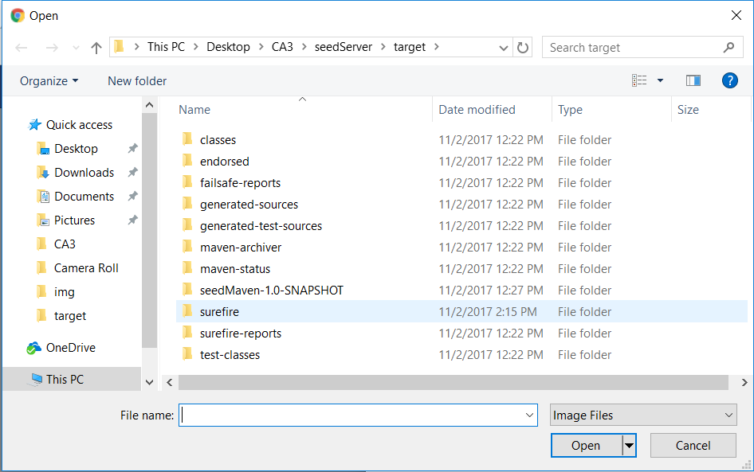
Semester Seed
Register
Log In
Choose

