Slide 1

DISLOCATION STRESS FIELDS
MATERIALS SCIENCE
&
ENGINEERING
Dislocation stress fields → infinite body
Dislocation stress fields → finite body
Image forces
Interaction between dislocations
Part of
A Learner’s Guide
AN INTRODUCTORY E-BOOK
Anandh Subramaniam & Kantesh Balani
Materials Science and Engineering (MSE)
Indian Institute of Technology, Kanpur- 208016
Email: anandh@iitk.ac.in, URL: home.iitk.ac.in/~anandh
http://home.iitk.ac.in/~anandh/E-book.htm
Advanced reading (comprehensive)
Theory of Dislocations
J. P. Hirth and J. Lothe
McGraw-Hill, New York (1968)

Slide 2
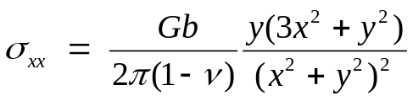
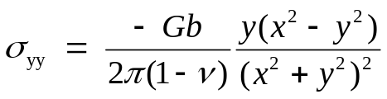
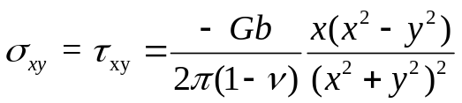
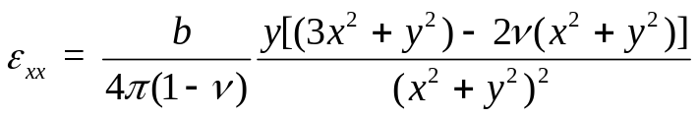
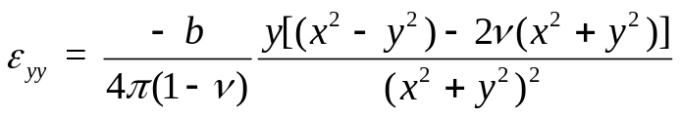
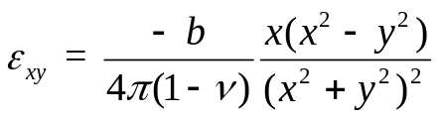
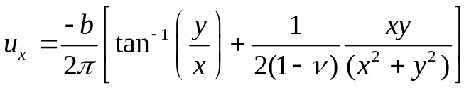
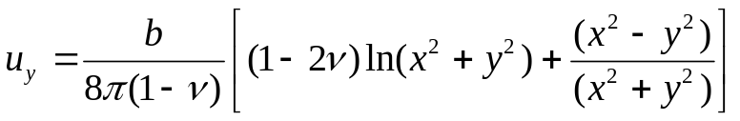
Stress fields of dislocations
Edge dislocation
We start with the dislocation elastic stress fields in an infinite body
The core region is ignored in these equations (which hence have a singularity at x = 0, y = 0)
(Core being the region where the linear theory of elasticity fails)
Obviously a real material cannot bear such ‘singular’ stresses
stress fields
The material is considered isotropic (two elastic constants only- E & ν or G & ν)
→ in reality crystals are anisotropic w.r.t to the elastic properties
Strain fields
Displacement fields
Plots in the coming slides

Slide 3
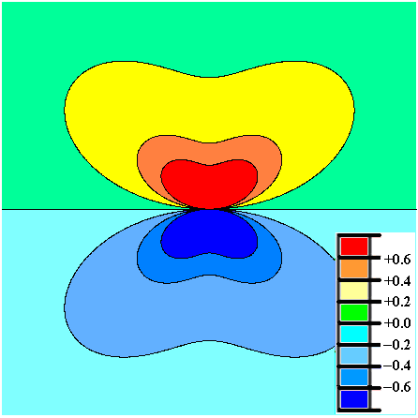
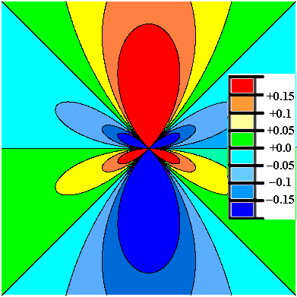
Note that the region near the dislocation has stresses of the order of GPa
Position of the Dislocation line → into the plane
More about this in the next slide
σ_{xx}
σ_{yy}
286 Å
Stress values in GPa
286 Å
➢ Material properties used in the plots are in the last slide

Slide 4
Left-right mirror symmetry
σ_{xx}
Tensile
Compressive
Up down ‘inversion’ symmetry
(i.e. compression goes to tension)

Slide 5
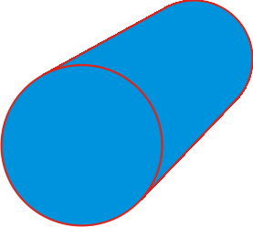
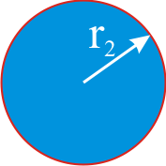
Stress fields in a finite cylindrical body
In an infinite body the σ_{xx} stresses in one half-space maintain a constant sign (remain tensile or compressive) → in a finite body this situation is altered.
We consider here stresses in a finite cylindrical body.
The core region is again ignored in the equations.
The material is considered isotropic (two elastic constants only).
Finite cylindrical body
The results of edge dislocation in infinite homogeneous media are obtained by letting r₂ → ∞
Plots in the coming slides

Slide 6
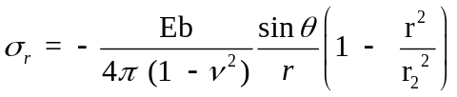
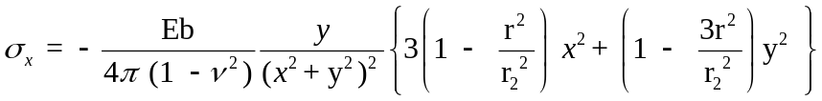
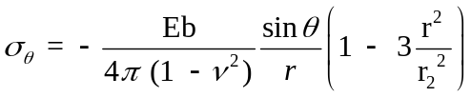
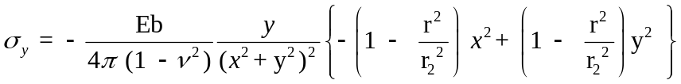
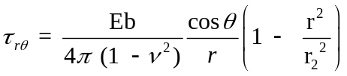
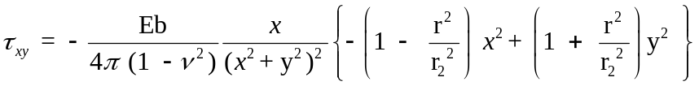
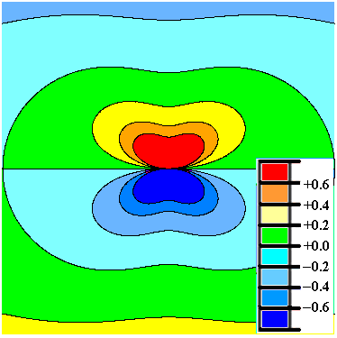
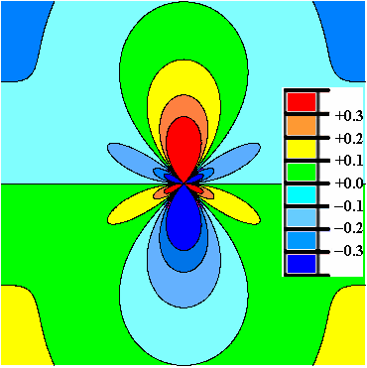
Polar coordinates
Cartesian coordinates
Stress fields in a finite cylindrical body
σ_{xx}
σ_{yy}
286 Å
Stress values in GPa
286 Å

Slide 7
Like the infinite body the symmetries are maintained.
But, half-space does not remain fully compressive or tensile
Compressive stress
Left-right mirror symmetry
Not fully tensile
σ_{xx}
Tensile stress
Up down ‘inversion’ symmetry
(i.e. compression goes to tension)

Slide 8
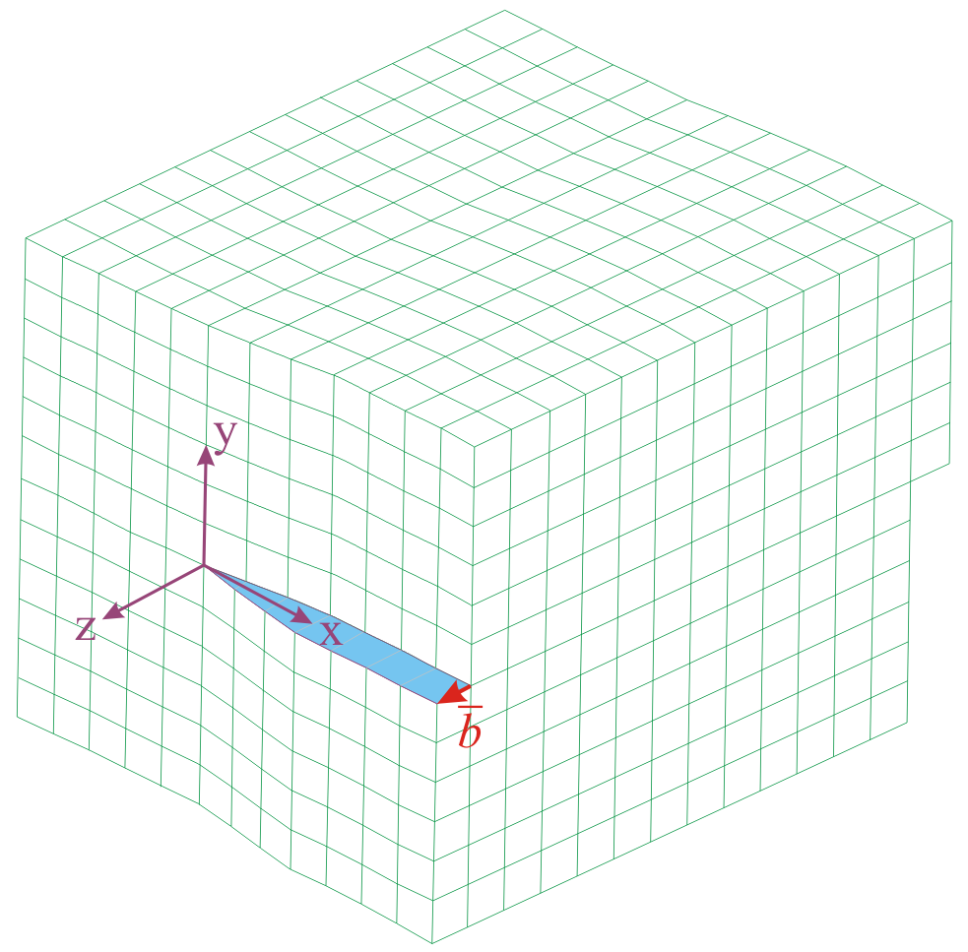

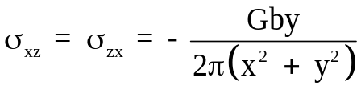
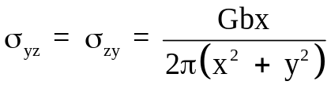


Stress fields of dislocations
Screw dislocation
The screw dislocation is associated with shear stresses only
Cartesian
coordinates
Polar
coordinates
Plots in the next slide

Slide 9
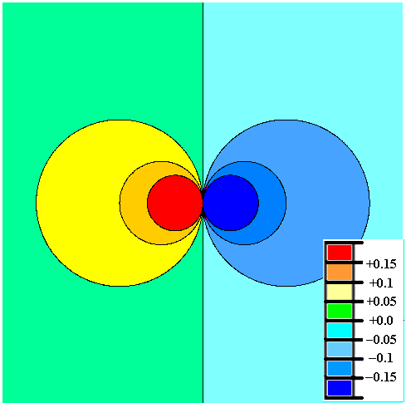
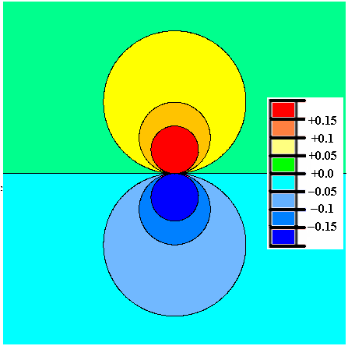
σ_{xz}
σ_{yz}
572 Å
Stress values in GPa
572 Å

Slide 10
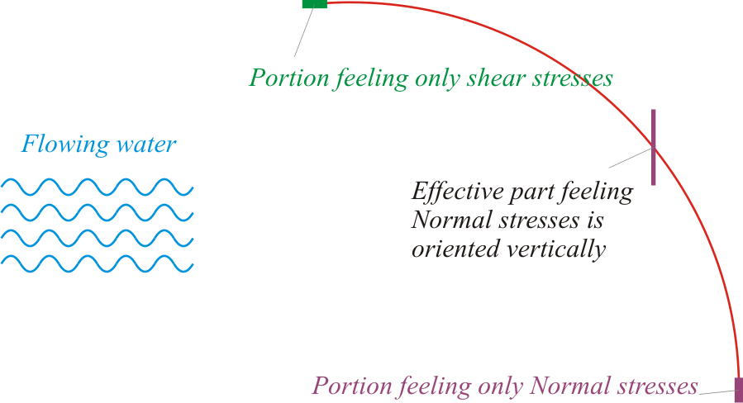
Understanding stress fields of mixed dislocations: an analogy
For a mixed dislocation how to draw an effective “fraction” of an ‘extra half-plane’?
For a mixed dislcation how to visualize the edge and screw component?
This is an important question as often the edge component is written as bCosθ →does this imply that the Burgers vector can be resolved (is it not a crystallographically determined constant?)

Slide 11
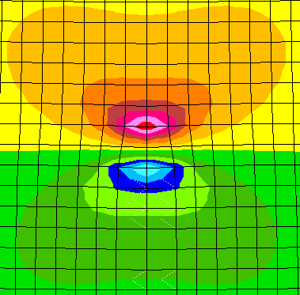
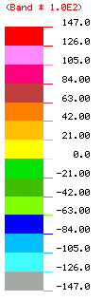
STRESS FIELD OF A EDGE DISLOCATION
σ_{X} – FEM SIMULATED CONTOURS
FILM
28 Å
SUBSTRATE
b
27 Å
(MPa)
(x & y original grid size = b/2 = 1.92 Å)

Slide 12
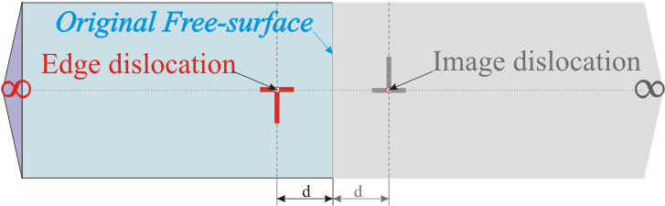
CONCEPT OF IMAGE FORCES & STRESS FIELDS IN THE PRESENCE OF A FREE SURFACE
A dislocation near a free surface (in a semi-infinite body) experiences a force towards the free surface, which is called the image force.
The force is called an ‘image force’ as the force can be calculated assuming an negative hypothetical dislocation on the other side of the surface (figure below).
A hypothetical negative dislocation is assumed to exist across the free-surface for the calculation of the force (attractive) experienced by the dislocation in the proximal presence of a free-surface

Slide 13
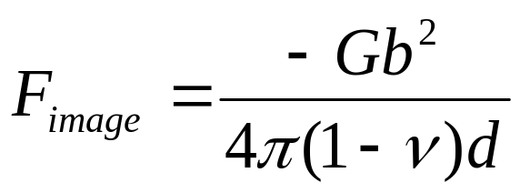
Image force can be thought of as a ‘configurational force’ → the force tending to take one configuration of a body to another configuration.
The origin of the force can be understood as follows:
◘ The surface is free of tractions and the dislocation can lower its energy by positioning itself closer to the surface.
◘ The slope of the energy of the system between two adjacent positions of the dislocation gives us the image force (F_{image} = ΔE_{position 1→2} /b)
In a finite crystal each surface will contribute to an ‘image dislocation’ and the net force experienced by the dislocation will be a superposition of these ‘image forces’.
An approximate formula derived using ‘image construction’
Importance of image stresses:
If the image stresses exceed the Peierls stress then the dislocation can spontaneously move in the absence of externally applied forces and can even become dislocation free!

Slide 14
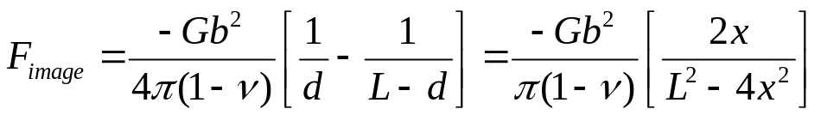
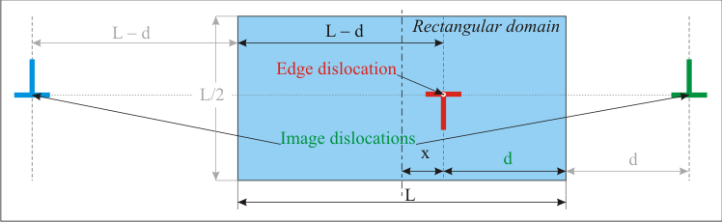
In a finite crystal each surface will contribute to an ‘image dislocation’ and the net force experienced by the dislocation will be a superposition of these ‘image forces’.
The image force shown below is the glide component of the image force (i.e. along the slip plane, originating from the vertical surfaces)
It must be clear that no image force is experienced by a dislocation which is positioned symmetrically in the domain.
Superposition of two images
Glide

Slide 15
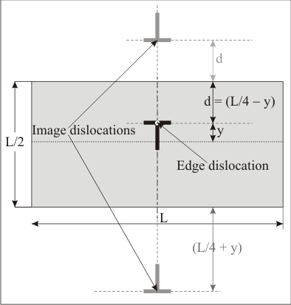
Similarly the climb component of the image force can be calculated (originating from the horizontal surfaces)
Superposition of two images
Climb

Slide 16
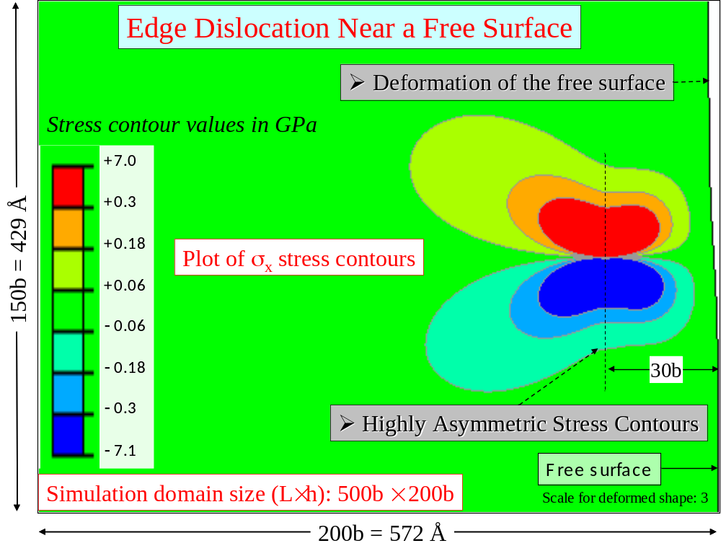
Stress fields in the presence of an edge dislocation
Deformation of the free surface in the proximity of a dislocation (edge here) leads to a breakdown of the formulae for image forces seen before!
Left-right mirror symmetry of the stress fields broken due to the presence of free surfaces

Slide 17
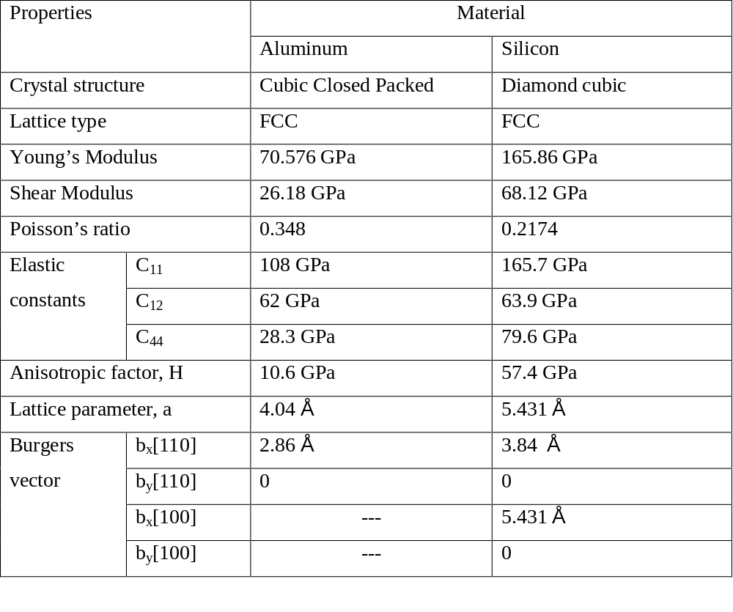
Material properties of Aluminium and Silicon used in the analysis

