Slide 1
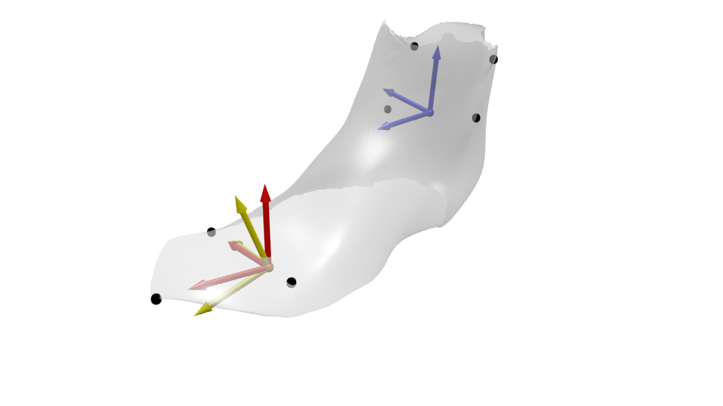
z_{ankle}
Lateral Shank
Medial Shank
y_{ankle}
Lateral Malleolus
Medial Malleolus
x_{ankle}
z_{origin,MTP}
5th Metatarsal Head
y_{origin,MTP}
x_{origin,MTP}
1st Metatarsal Head
2nd Toe

