Slide 1
Welcome to CS-1180!!
Acknowledgements: Slides created based off material provided by Dr. Travis Doom

Slide 2
Java
Object-oriented
Popular choice in industry
Portable
Execution without recompiling
Many libraries, IDEs, etc.
VSCode, IntelliJ, NetBeans, Eclipse, etc.

Slide 3
Vocabulary
Semantics
Meaning
Syntax
Grammar
Style
Conventions for readability
Compiler/IDE
Spellchecker

Slide 4
HelloWorld Example
Semantics
Classes
Containers for a portion of a design
Method (/function/subroutine) header
Containers for a specific task
main method
Method body
Statements implementing an algorithm

Slide 5
HelloWorld Example
Syntax
One class per java file
Name matches file name
One main method
Keywords
public, class, static, void, main, etc.
Identifiers
Your names for classes, methods, variables, etc
Literals
Unchanging constant value
Ex: 5, 'a', 7.5

Slide 6
HelloWorld Example
Style
White space usage
Descriptive names
Capital letters for class names; lower case for methods
Curly braces
Statements
Generally, end with a semicolon
Whitespace is ignored

Slide 7
Comments
Incredibly important
Three ways:
// one line comment
/*
Block comment
*/
/** @author Clarissa
Java doc comments have specific syntax to generate separate documentation
*/

Slide 8
Variables
Named location to hold information
Data type to describe the type of information
Ex: dataType variableName
Primitive data types
byte, short, int, long, float, double, boolean, char
Assignments
LHS: must be a variable
RHS: can be a literal, variable, method, equation, anything that results in a value
Ex: value = 5;
letter = 'a';

Slide 9
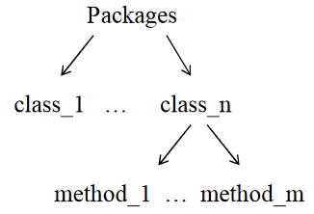
Java library Methods
java.lang (built-in)
System class performs system-level tasks
Ex: System.out.println("Hello World");
Math class includes useful math operations
Ex: Math.abs(-5);
String class features useful string operations
Ex: String.valueOf(-5);
java.util (must import)
Ex: import java.util.Scanner;

Slide 10
Understanding method calls
int notNegative = Math.abs(-5);

Slide 11


Understand Method Calls
Objects can also call methods
An object is an instance of a class
String randomLetters = “AbCdEfgHijK”;
randomLetters = randomLetters.toLowerCase();

Slide 12
Note on Identifying Methods
Generally, start with a lowercase letter
Often appear to the right of a period (when called from a class or object)
Always have parentheses () after them

Slide 13
Console I/o
Output
System.out.println("Hello!");
System.out.print("Hi");
System.out.printf("Pi starts with %.1f", 3.14159);
Input
Scanner input = new Scanner(System.in);
String answer = input.nextLine();
int answer = input.nextInt();

Slide 14
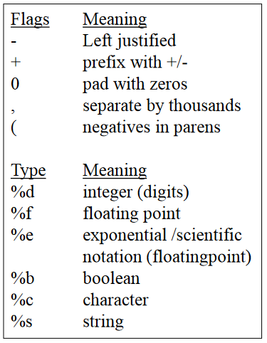
More on format
System.out.printf(format, v1, v2, ...vn);
String s = String.format(format, v1, ...);
For each variable:
%[flags][width][.precision][type]
Ex: System.out.printf("Pi starts with %.1f", 3.14159);
Output: Pi starts with 3.1
Ex: System.out.printf("%+0,20.5f", 123456789.987654321);
Output: +00123,456,789.98765

Slide 15
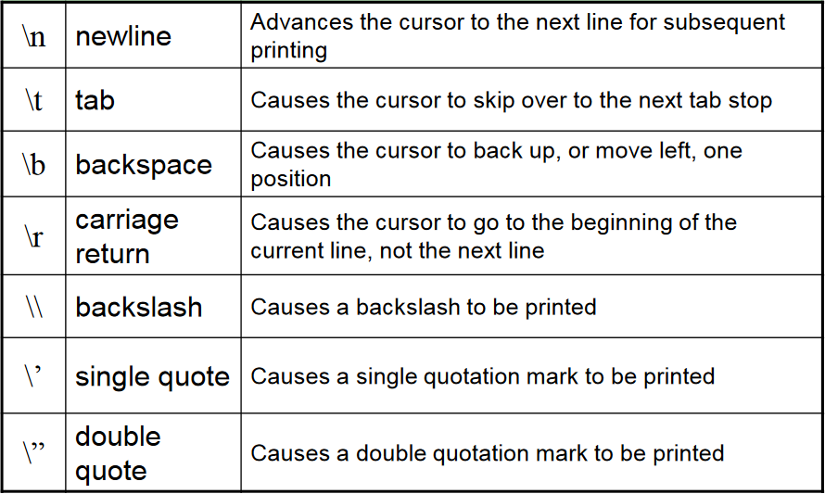
Escape Sequences

Slide 16
More on scanner
Must import: import java.util.Scanner;
Creation: Scanner input = new Scanner(System.in);
Useful methods:
next()
nextInt()
nextDouble()
nextLine()
Must import: import java.util.Scanner;
Creation: Scanner input = new Scanner(System.in);
Useful methods:
A returns the next token
B returns the next input as an integer
C returns the next input as a double
D returns the next line as a String

Slide 17
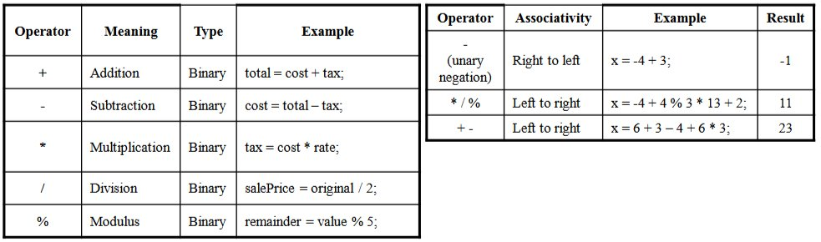
Operators
Used to manipulate variables
Java has 5 arithmetic operators

Slide 18
Java.lang.math
Provides mathematic operations beyond the standard operators
Rounding
floor(x), ceil(x), round(x)
Trig
sin(x), cos(x), tan(x), atan(x), asin(x), acos(x), log(x), exp(x)
Other Math operations
pow(x, y), sqrt(x), min(x, y), max(x, y)
Useful constants
PI, E

