Slide 1
Week Two
Acknowledgements: Slides created based off material provided by Dr. Travis Doom

Slide 2
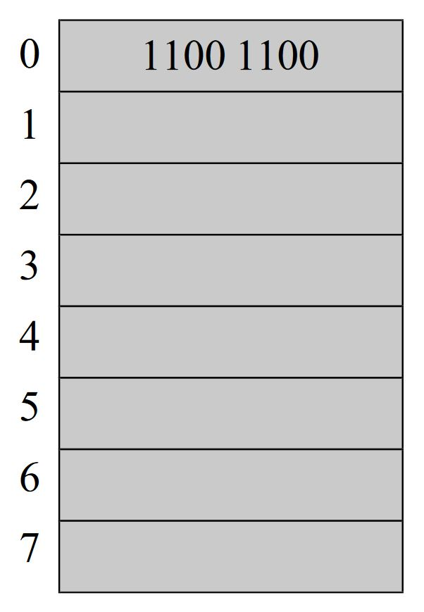

Memory and Data Representation
Computers are made up of many switches
Switches can either be on or off
Binary: 1 or 0
Bit: a single binary digit
Byte: 8 bits
Main memory
RAM: Random Access Memory
Contains running programs and their data
Divided into addresses
Address holds bits of information

Slide 3
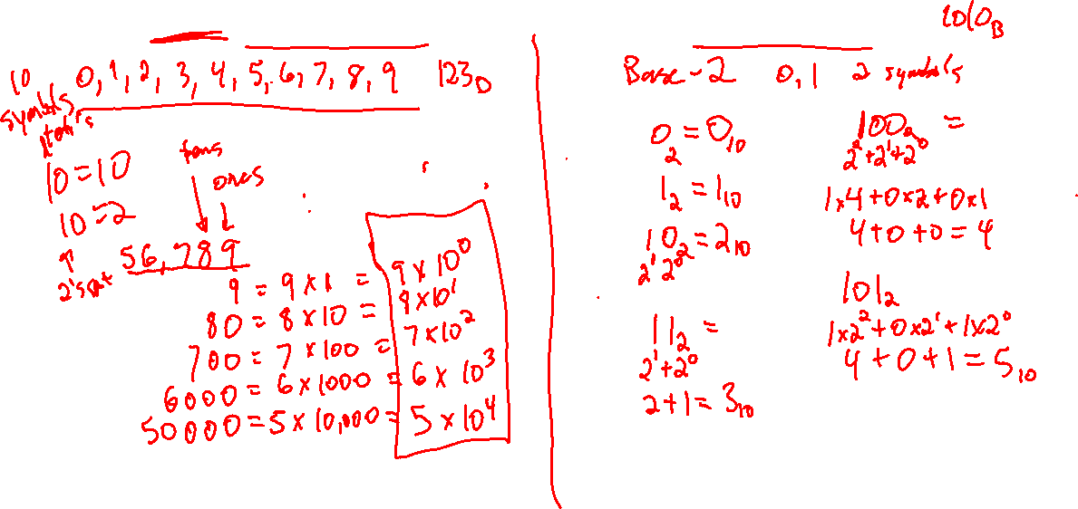
Base Ten Decimal System Vs Binary

Slide 4
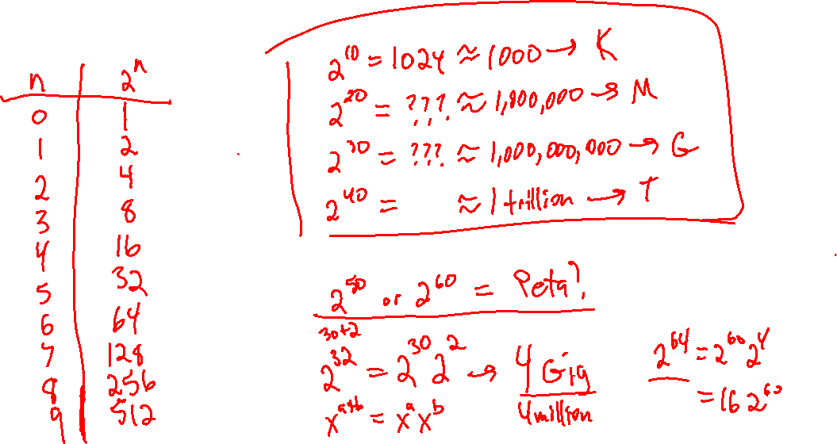

Powers of two

Slide 5
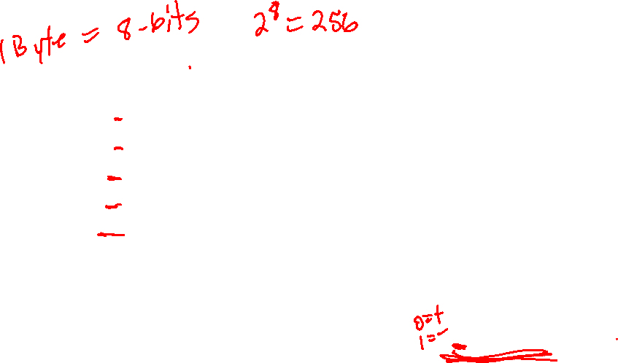
More on Binary
Base Ten | 1B-Binary | Base Ten | 1B-Binary
0 | 0000 0000 | 9 | 0000 1001
1 | 0000 0001 | 10 | 0000 1010
2 | 0000 0010 | 11 | 0000 1011
3 | 0000 0011 | 12 | 0000 1100
4 | 0000 0100 | 13 | 0000 1101
5 | 0000 0101 | 14 | 0000 1110
6 | 0000 0110 | 15 | 0000 1111
7 | 0000 0111 | 16 | 0001 0000
8 | 0000 1000 | 17 | 0001 0001

Slide 6
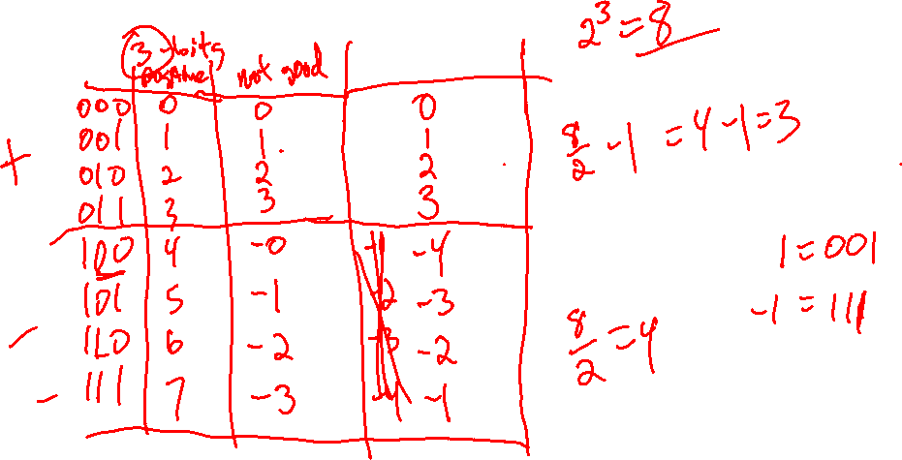
Positive vs. negative

Slide 7
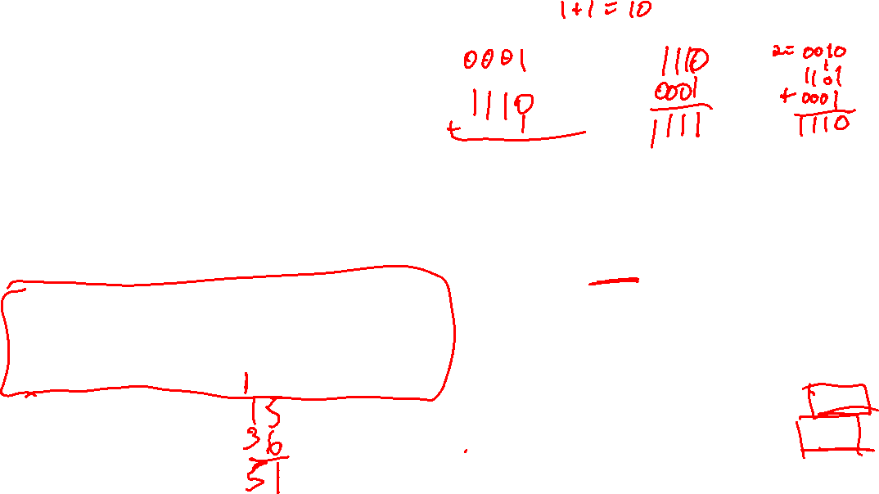
Negative Numbers
Two’s complement
Flip all the bits in the number
Add 1 to the result
OR
Starting at RIGHT, keep everything the same up until the first 1
Flip all the bits to the LEFT of the first 1 (first 1 remains 1)
Base Ten | 4b-Binary | Base Ten | 4b-Binary
+0 | 0000 | -8 | 1000
+1 | 0001 | -7 | 1001
+2 | 0010 | -6 | 1010
+3 | 0011 | -5 | 1011
+4 | 0100 | -4 | 1100
+5 | 0101 | -3 | 1101
+6 | 0110 | -2 | 1110
+7 | 0111 | -1 | 1111

Slide 8
2’s complement

Slide 9
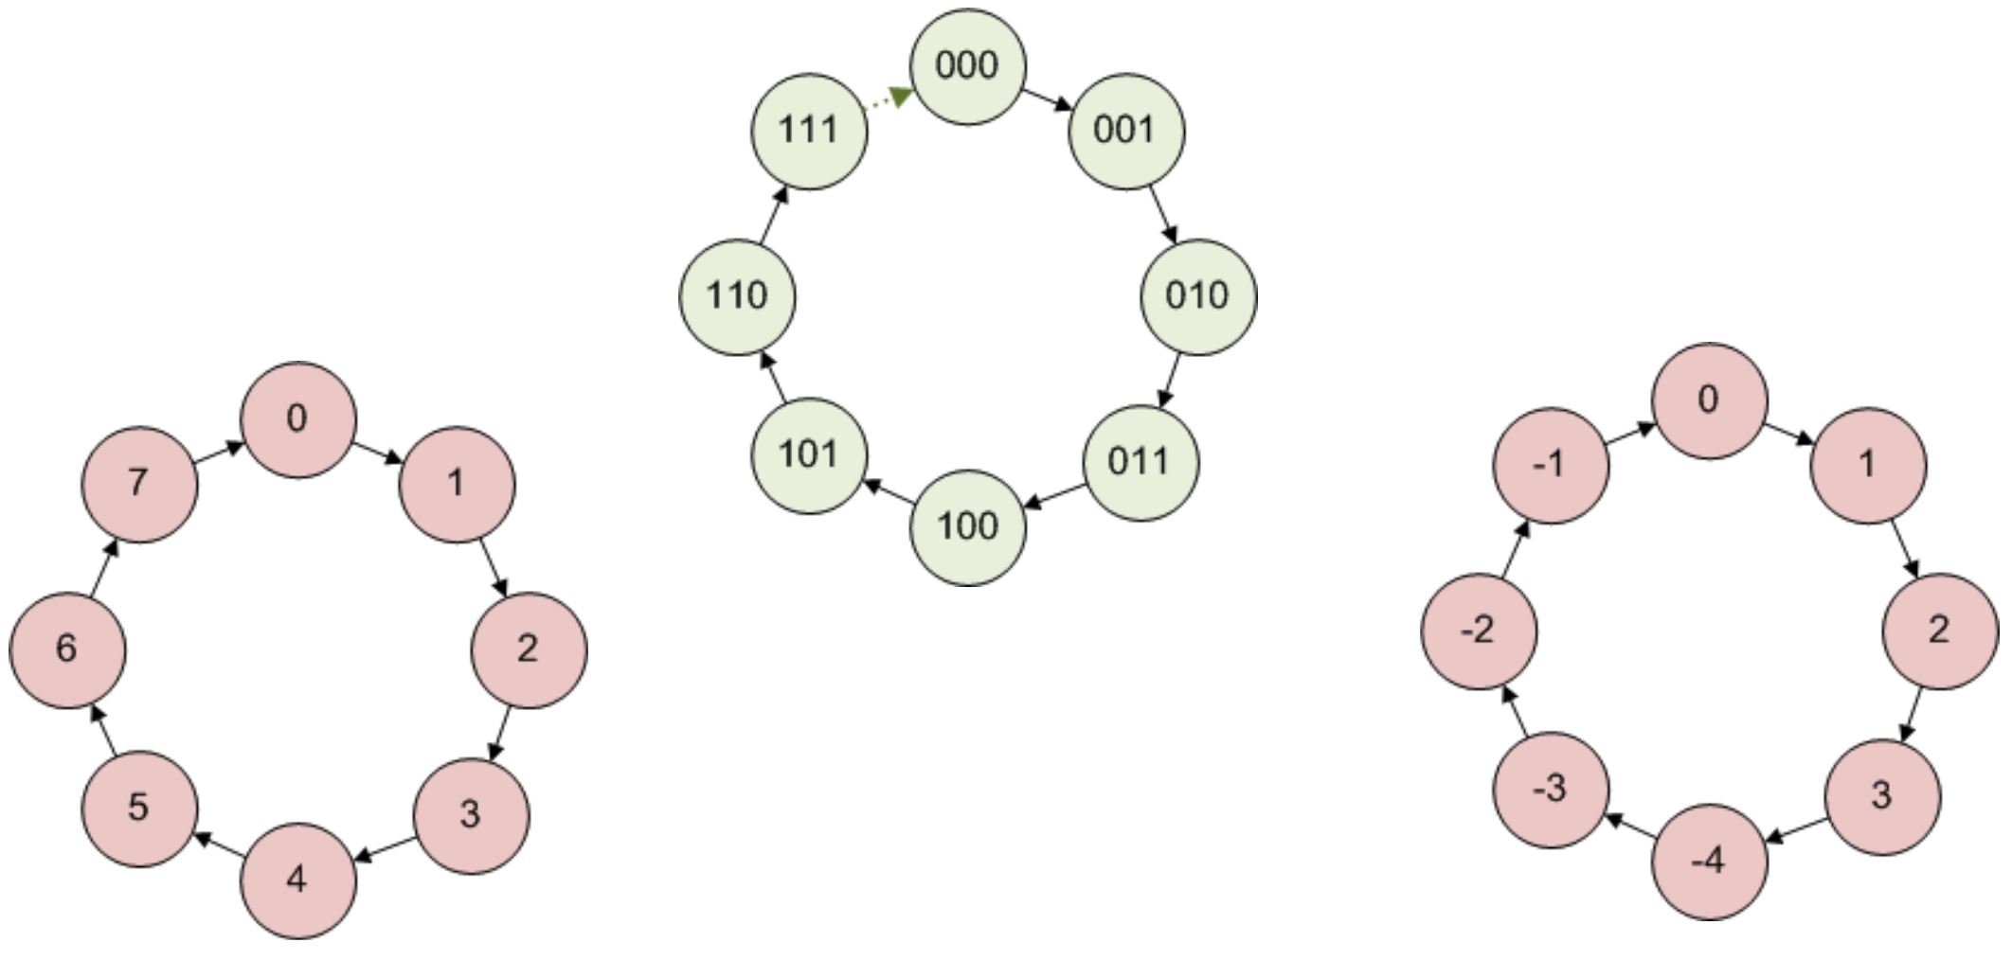
Different Binary Systems

Slide 10
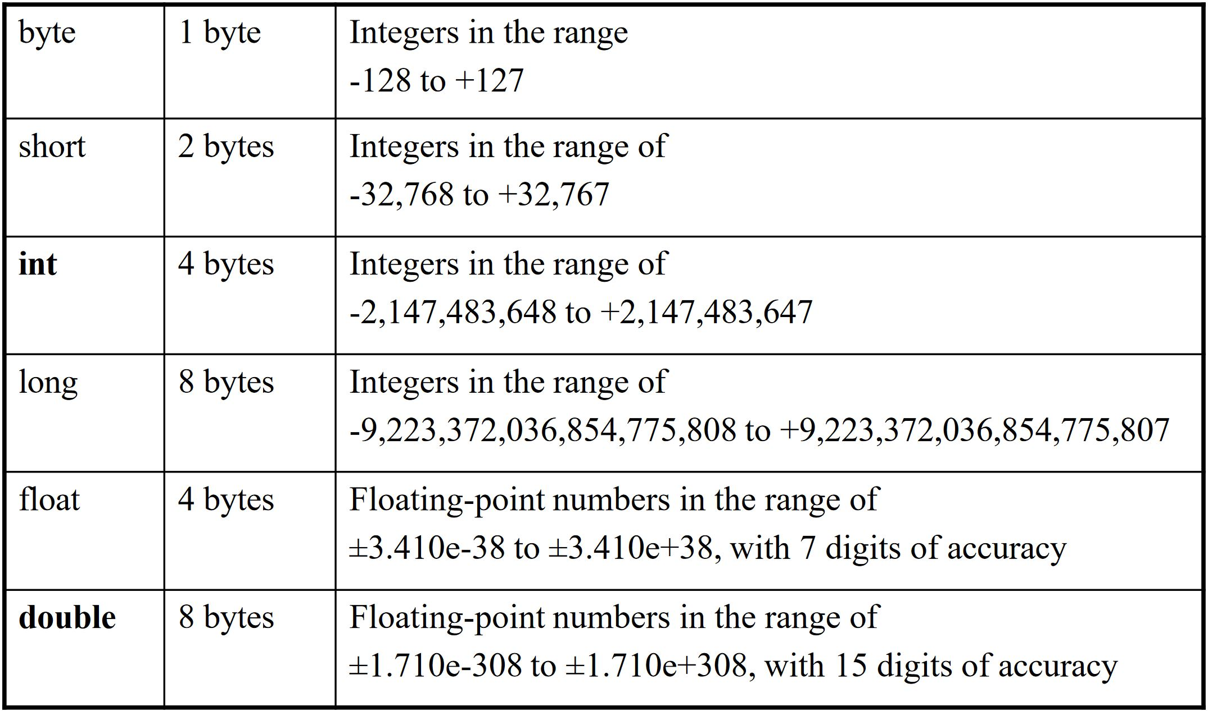
memory size for datatypes

Slide 11
BINARY addition

Slide 12
Overflow
There are real constraints on the size of number the memory can hold
What happens when we exceed those constraints?
In Java, overflow occurs
No errors
Every numeric datatype affected

Slide 13
Type-casting and Integer Division
What’s the result of the following?
double answer = 9 / 3;
answer = 9 / 2;
Must make our numbers into doubles
Add a .0 on either
Cast to a double
Casting allows us to change the type of a variable
answer = (double) 9 / 2;
Java will automatically cast types of lower precision to types of higher precision
We must use type-casting if we wish to go from higher precision to lower precision
int num = (int) 6.543;

Slide 14
Useful String Methods
char charAt​(int index)
boolean contains​(CharSequence s)
int indexOf​(int ch)
int lastIndexOf​(int ch)
boolean isEmpty()
int length()
String replace​(char oldChar, char newChar)
String substring​(int beginIndex, int endIndex)
String toLowerCase()
String toUpperCase()
String valueOf​(boolean b)

