Slide 1
CIT 4302
Customer Relation Management

Slide 2
Learning Goals
Explain the value of customer relationship management (CRM) to a small firm.
Discuss the importance of delivering exceptional customer service.
Understand how technology may be utilized to strengthen customer connections and how to build a customer database.

Slide 3
Learning Goals
Explain why understanding customer interactions requires knowing how customers make decisions.
Recognize specific psychological impacts on customer behavior.
Recognize the impact of sociocultural factors on customer behavior.

Slide 4
Atul Parvatiyar and Jagdish N. Sheth provide an excellent definition for customer relationship management in their work titled - 'Customer Relationship Management: Emerging Practice, Process, and Discipline' −
Customer Relationship Management is a comprehensive strategy and process of acquiring, retaining, and partnering with selective customers to create superior value for the company and the customer. It involves the integration of marketing, sales, customer service, and the supply-chain functions of the organization to achieve greater efficiencies and effectiveness in delivering customer value.

Slide 5
Defintion of CRM
Customer relationship management is a critical concept in modern marketing and the maintenance of the value chain in Operations Management.
Customer relationship management (CRM) is described as the total process of developing and sustaining profitable customer relationships via greater customer value and satisfaction.

Slide 6
Cont.
CRM - A company-wide business strategy that focuses on highly defined and exact consumer groups in order to maximize revenue and customer happiness.
Deals with all aspects of client acquisition, retention, and growth.
Superior client value and happiness are the keys to creating customer relationships.

Slide 7
Customer Relationship Evolution
Customers' relationships can change over time and progress through the following stages:
Exploration- entails researching or testing the supplier's capabilities and performance.
Awareness- Customer understanding of the supplier's or product's motivating values

Slide 8
Cont.
Expansion - the supplier gains the client's trust, and the customer becomes completely dependent on the source. There are more opportunities to do business with that specific consumer and increase business.
Commitment - entails changing company norms and goals in order to flourish.
Dissolution - the termination of a relationship.

Slide 9
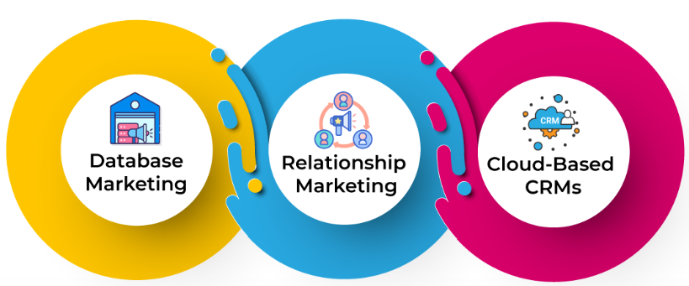
CRM Evolution
Image not mine
Source: https://www.apptivo.com/blog/crm-importance-in-business-a-comprehensive-overview/

Slide 10
CRM Software
CRM Software is the most commonly used to refer to a product or solution that assists organizations in tracking and managing interactions with customers and prospects. In general, it is a database that stores information such as first and last name, email address, firm, a log of interactions with your company, and so on.

Slide 11
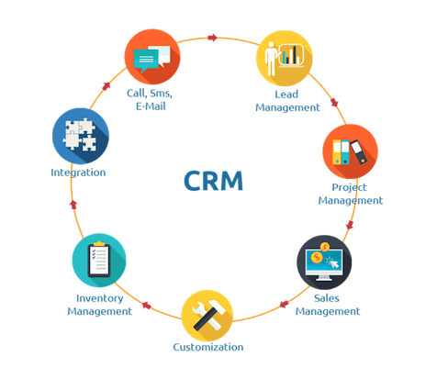
CRM Software
Image not mine
Source: https://www.wordstream.com/blog/ws/2020/11/09/crm-for-small-business

Slide 12
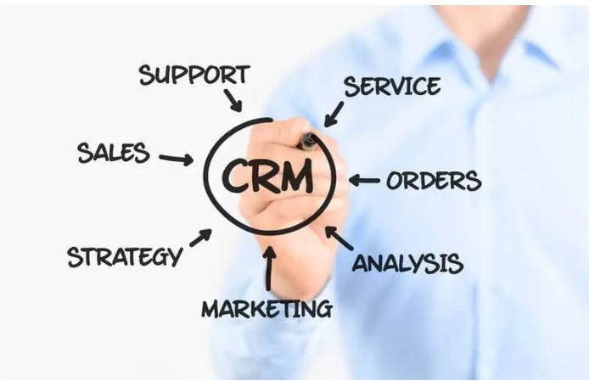
Benefits of CRM Software
Image not mine
Source: https://www.hashmicro.com/blog/what-is-crm-software/

Slide 13
Benefits of CRM
Improved Customer Relations- All comprehensive lead and client information is saved in a single repository so that you can quickly track it whenever needed. The precise information may help you better understand the demands of your leads and clients, allowing you to give the best service possible.

Slide 14
Benefits of CRM
Data Entry Reduction - CRM allows you to automate a range of time-consuming manual chores, such as entering lead or customer data in spreadsheets. It enables you to automatically generate new leads from sign-up forms and send them thank you or welcome emails.

Slide 15
Benefits of CRM
Increased Sales Force Efficiency - You can simply track the success of your sales staff using CRM software. You may learn about the status of each lead handled by each salesperson, their contacts with leads in the past, the steps they take to convert leads into customers, and much more.
Sales Pipeline Simplified - CRM helps you to have a better understanding of your sales funnel by creating phases and substages. This makes it simple for you to discover high-potential leads and prioritize your best transactions.

Slide 16
Benefits of CRM
Increased Participation - Personalization is one of the most powerful marketing strategies. CRM allows you to personalize advertising, mailings, and special offers to the preferences of each of your leads or customers.
Enhanced Team Collaboration - When each team works alone, it might be difficult for your firm to grow. CRM enables sales, marketing, and customer service teams to organize and exchange data through a single system.

Slide 17
Benefits of CRM
Growth in revenue - Because you always have a complete picture of your leads and customers, you can up-sell and cross-sell at the proper moment and with more success. You may also enhance income by providing better services and high-quality items that are targeted to your consumers' demands. Integrate CRM systems by utilizing a purchasing system to ensure effective procurement costs and automate the management of purchase requests across various branches.

Slide 18
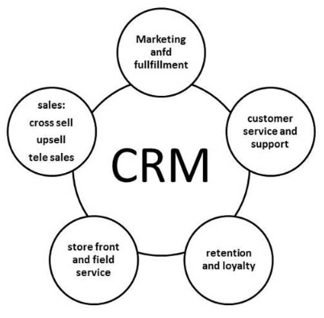
Scope of CRM.
Image not mine
Source: https://www.tutorialspoint.com/management_information_system/customer_relationship_management.htm

Slide 19
Focus of CRM
Customers are more important than things.
Process, system, and cultural changes
From the Internet to field sales, all channels and media are used in the marketing endeavor.

Slide 20
Advantages of CRM
CRM Advantages
Improves client service while increasing consumer income.
Finds new consumers.
More successfully cross-sells and up-sells items.
Allows salesperson to clinch transactions more quickly.
Increases the efficiency of call centers.
Processes for marketing and sales are simplified.

Slide 21
Disadvantages of CRM
CRM Disadvantages
Record loss may be a big issue at times.
Overhead expenses
Employee training is a challenge in small businesses.

Slide 22
Importance of customer relationship
Trust - confidence and security in any connection formed when both parties experience faultless and pleased motives.
Commitment: Mutual trust exists, and the two parties share the same ideals. In a committed connection, both the provider and the customer try to maintain the relationship and never want to leave, which results in the relationship becoming stronger and sharper.

Slide 23
CRM to Small Business*
The economic benefits of retaining ties with current consumers are as follows:
New client acquisition costs are substantial.
Long-term consumers spend more than new customers.
Customers who are satisfied suggest their friends and coworkers.
Established clients have cheaper order-processing expenses.
Customers are eager to spend extra for things they already own.

Slide 24
References:
CUSTOMER RELATIONSHIP MANAGEMENT - ppt download. (n.d.). Slideplayer.com. Retrieved August 2, 2022, from https://slideplayer.com/slide/5703523/
‌Customer Relationship Management. (n.d.). PowerShow. Retrieved August 2, 2022, from https://www.powershow.com/viewfl/421e18-ODFkM/Customer_Relationship_Management_powerpoint_ppt_presentation
‌Customer relationship management systems Lecture ppt download. (n.d.). Slideplayer.com. Retrieved August 2, 2022, from https://slideplayer.com/slide/5739167/
MIS - Customer Relationship Management - Tutorialspoint. (n.d.). Www.tutorialspoint.com. https://www.tutorialspoint.com/management_information_system/customer_relationship_management.htm
(n.d.). Https://Www.wordstream.com/Blog/Ws/2020/11/09/Crm-For-Small-Business.
Team, C. (2021, June 14). CRM Importance In Business - A Comprehensive Overview. Apptivo. https://www.apptivo.com/blog/crm-importance-in-business-a-comprehensive-overview/
Kanya. (2022, March 17). A Comprehensive Overview of CRM Software. BusinessTech. https://www.hashmicro.com/blog/what-is-crm-software/

Slide 25


